Slide 1
OBJECT DETECTION
FACE RECOGNITION
AND HUMAN EYE TRACKING
FACE DETECTION SYSTEM USING A BOOSTED CASCADE OF SIMPLE FEATURES

Slide 2
Acknowledgement
We would like to express our special thanks and gratitude to our teacher Megha P. and Shruthi G. who gave us the golden opportunity to do the project on the topic “Object Detection”, which helped us not only in our research but also paved path to know and learn so many new things.

Slide 3
INTRODUCTION
What is object detection?
Object detection using Haar feature-based cascade classifiers is an effective object detection method. Object detection is a computer vision technique for identifying objects in images or videos. Object detection is a key output of deep learning and machine learning algorithms. When humans look at a photograph or watch a video, we can readily spot people, objects, scenes, and visual details.
The goal is to teach a computer to do what comes naturally to humans: to gain a level of understanding of what an image contains.
It is also useful in a variety of applications such as disease identification in bioimaging, industrial inspection, and robotic vision.

Slide 4
PROBLEM FORMULATION
PROBLEM?
The loaded input image essentially depicts that our face is near a square. And over that, the shape of an eye is somewhat ovular and that of pupils a near circle. Classifiers and detectors can be used to sense the eye movement and their state of closure which can be further studied and analysed to depict the state of person awareness.
So what can the system do to ensure this happens inevitably?
SOLUTION
We are creating a deep convolution neural network such that it identifies the face in the loaded images in grayscale mode, quickly and accurately. Once the faces are found, we create a ROI for the face and apply eye detection on the ROI (since eyes are always on the face).

Slide 5
LITERATURE SURVEY
1) Face detection and tracking: Using OpenCV (ISSN :17433111)
2) Real time Human Face detection (ISSN :14198370)
3) Real time Eye detection and tracking
4) Face detection in color images (ISSN :7265319)

Slide 6
DRAWBACKS
Image detection is not fast enough for practical implementation.
Expensive technology.
Equipmental dependency (weather).
Calibrating the equipments takes time.

Slide 7
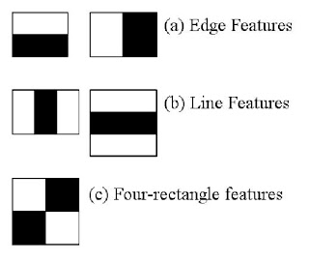
IMPLEMENTATION
Step 1: Training the classifier
Algorithm needs a lot of positive images (images of faces) and negative
images (images without faces) to train
the classifier.
Then we need to extract features from it.
For this, haar features shown are used.

Slide 8
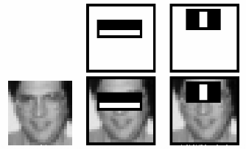
IMPLEMENTATION
Step 2: Implementation of the classifier on the loaded image

Slide 9
IMPLEMENTATION
Step 3: Face and Eye Detectors are then used to find face in the loaded input image
In the image, most of the image region is non-face region. So it’s better to have a simple method to check if a window is not a face. If it is not, discard it in a single shot. Don’t process it again.

Slide 10
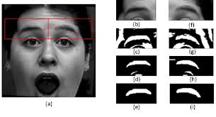
IMPLEMENTATION
Step 4: Creation of a ROI for the face and apply eye detection on this ROI

Slide 11
SOFTWARE REQUIREMENTS
Anaconda (python platform)
Packages: numpy , Scipy, Matplotlib, TensorFlow, Keras, OpenCV, Pillow, H5py
Haar Cascade Classifiers

Slide 12
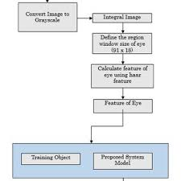
Flow Chart

Slide 13
ALGORITHM
import numpy as np
import cv2
face_cascade = cv2.CascadeClassifier('haarcascade_frontalface_default.xml')
eye_cascade = cv2.CascadeClassifier('haarcascade_eye.xml')
img = cv2.imread('sachin.jpg')
gray = cv2.cvtColor(img, cv2.COLOR_BGR2GRAY)
faces = face_cascade.detectMultiScale(gray, 1.3, 5)
for (x,y,w,h) in faces:
cv2.rectangle(img,(x,y),(x+w,y+h),(255,0,0),2)
roi_gray = gray[y:y+h, x:x+w]
roi_color = img[y:y+h, x:x+w]
eyes = eye_cascade.detectMultiScale(roi_gray)
for (ex,ey,ew,eh) in eyes:
cv2.rectangle(roi_color,(ex,ey),(ex+ew,ey+eh),(0,255,0),2)
cv2.imshow('img',img)
cv2.waitKey(0)
cv2.destroyAllWindows()

Slide 14
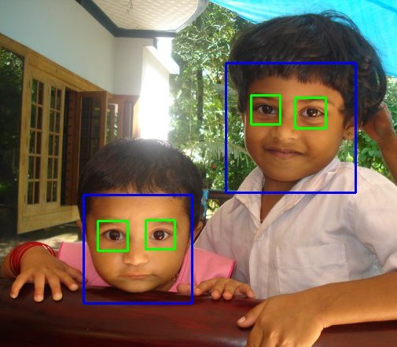
RESULT

Slide 15
CONCLUSION
Over the years there is a trend to go more deeper, to solve more complex tasks and to also increase/improve the classification and recognition accuracy. But, as we go deeper; the training of neural network and classifier and machine learning models becomes difficult and the accuracy starts saturating, at first and then degrades. Residual Learning tries to solve both these problems.

Slide 16
BIBLIOGRAPHY
https://docs.opencv.org/3.3.0/d7/d8b/tutorial_py_face_detection.html
https://www.analyticsvidhya.com/blog/2018/06/understanding-building-object-detection-model-python/
https://www.youtube.com/watch?v=88HdqNDQsEk
Face detection and precise eye location (INSPEC Accession Number: 6912398

Slide 17
Presented BY
Rishabh Agarwal : 1MS16IS071
Rakesh M : 1MS16IS066

