Slide 1

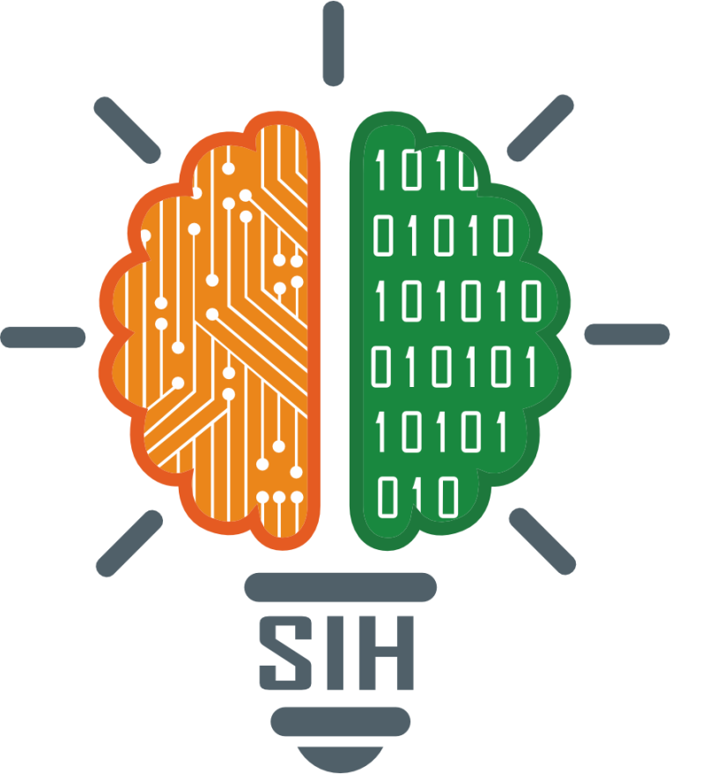
SMART INDIA HACKATHON 2024
Problem Statement ID – 1591
Problem Statement Title- Student inovation
Theme- Travel and Tourism
PS Category- Software
Team ID-
Team Name : Hack Harmonics

Slide 2

TravConnect | Your journey Your connections
Proposed Solution:
Our solution is a travel platform that provides solo travelers and groups with a Travel Companion Finder, Crowd Density Monitoring, AI-Powered Personalized Recommendations, 360-Degree Destination Previews, and Government-Backed Travel Campaign Finder.
The platform connects travelers with verified companions, promotes underexplored regions through campaigns, and allows users to avoid overcrowded places with real-time data.
How it Addresses the Problem:
It ensures safety by offering verified companions. Promotes rural and eco-tourism, supporting government initiatives.
Improves the travel experience by allowing users to choose destinations based on crowd density and preferences.
Innovation and Uniqueness:
Combines verified companion finding with AI-powered suggestions and government-certified travel campaigns. Integrates real-time crowd monitoring and 360-degree virtual tours to enhance travel decisions.

Slide 3
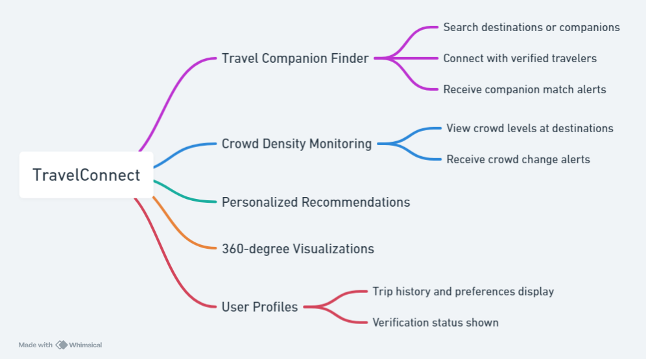
TECHNICAL APPROACH
Technologies to be Used:
Frontend: React.js (for interactive and responsive UI)
Backend: Node.js and Express.js (for real-time data management)
Database: MySQL/MongoDB (for user data and destination tracking)
AI: Machine learning models for personalized recommendations API Integration: For crowd density monitoring and government data
Cloud Platform: AWS or Google Cloud for scalable, real-time data processing

Slide 4
FEASIBILITY AND VIABILITY
Feasibility Analysis:
Technology:
Feasible using widely available tech stacks (React.js, Node.js, AI, APIs). Market: Large potential user base among solo travelers and small groups looking for safe, connected travel.
Partnerships:
Can partner with government tourism boards and local operators for campaign and guide verification.
Challenges:
User Trust: Ensuring users trust companions.
Data Accuracy: Real-time crowd monitoring data must be reliable.
Government Collaboration: Coordinating with tourism boards and agencies.
Mitigation Strategies:
User Reviews and Ratings for companions
Collaboration with trusted API providers for crowd data.

Slide 5
IMPACT AND BENEFITS
Potential Impact:
Encourages tourists to explore lesser-known destinations, reducing crowding at popular site.
Boosts local economies through rural tourism.
Promotes sustainable travel practices by recommending eco-friendly destinations and companions.
Benifits
Social Benefits:
Creates a safer travel environment, especially for solo travelers.
Strengthens community-based tourism by promoting cultural exchanges.
Economic Benefits:
Supports regional economies through government-endorsed travel campaigns.
Encourages travel in off-peak seasons, balancing tourist influx.

Slide 6
RESEARCH AND REFERENCES
Academic and Industry Research
Journals: "Journal of Travel Research", "Tourism Management“
Books: "Tourism Management" by Page, "Mobile App Development with React Native" by Holmes
2. Technical Resources APIs: Google Maps API, CrowdTangle API Frameworks: React.js, Tailwind CSS
3. Market Analysis Reports: WTTC Annual Report, India Tourism Statistics Competitors: TripAdvisor, MakeMyTrip
4. Government and Policy Resources Policies: National Tourism Policy (India) Regulations: GDPR, IT Act (India)
5. User Research Surveys: SurveyMonkey, Google Forms Focus Groups: User feedback reports
6. Technical and Development Tools SDKs: Android SDK, iOS SDK Cloud Services: AWS, Google Cloud
7. Consultations and Expert Opinions Interviews: Tourism and app development experts Advisory Panels: Industry consultants
8. Cultural and Regional Information Guides: Lonely Planet, Rough Guides Experts: Local cultural organizations
9. Ethical and Legal References Ethics: EU AI Ethics Guidelines Legal: GDPR, IT Act (India)

