Slide 1



SMART INDIA HACKATHON 2024
Problem Statement ID – 1591
Problem Statement Title – Student Innovation
Theme- Travel and Tourism
PS Category- Software
Team ID-
Team Name : Hack Harmonics

Slide 2
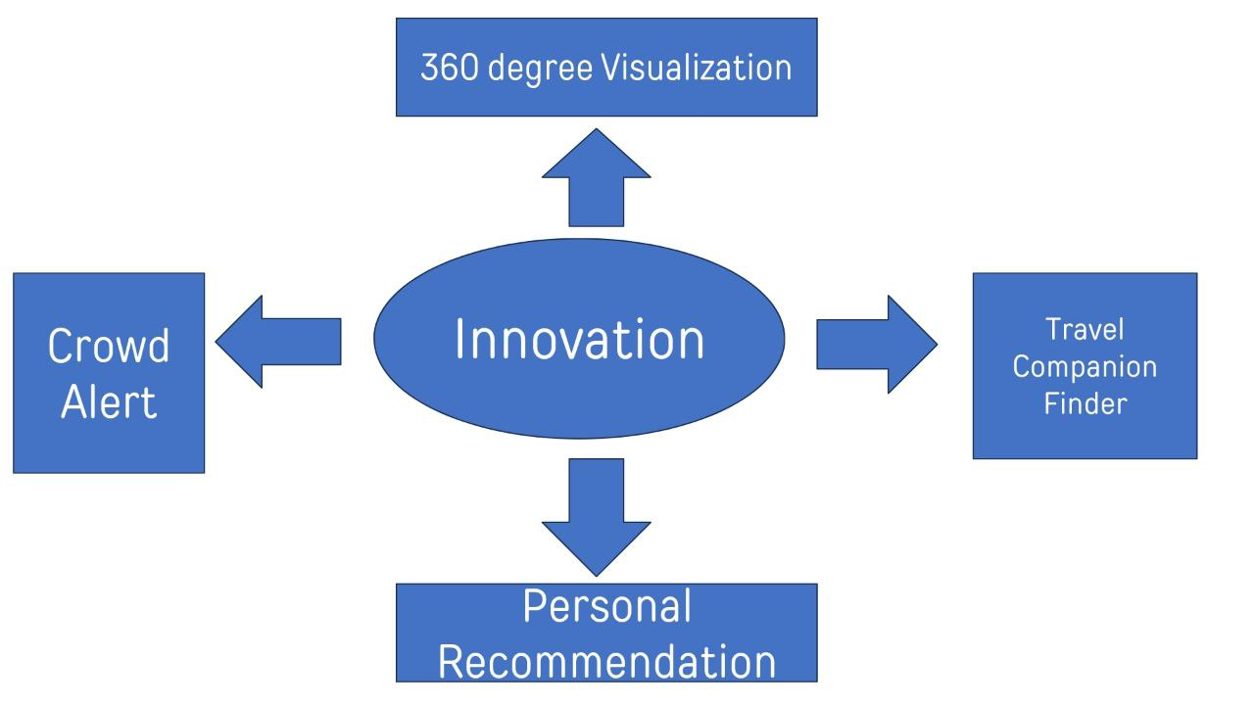
TravConnect | Your journey Your connections
Proposed Solution:
Travel Companion Finder
Crowd Density Monitoring
Personal Recommendations
360-Degree Previews
Travel Campaigns
How it Solves:
Verified companions for safety
Promotes rural and eco-tourism Real-time crowd data for better travel

Slide 3

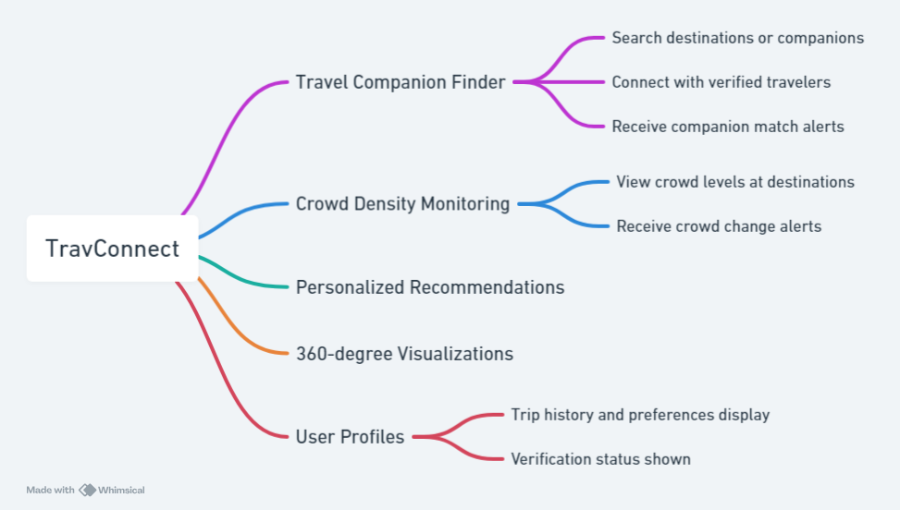







TECHNICAL APPROACH
Technologies Used:

Slide 4
FEASIBILITY AND VIABILITY
Feasibility Analysis:
Technology: Feasible with React.js, Node.js, AI, APIs.
Market: solo travelers, small groups.
Partnerships:
Collaboration with government tourism boards and local operators.
Challenges:
User trust in companions.
Reliable real-time crowd data.
Coordinating with tourism boards.
Mitigation:
Companion reviews/ratings.
Trusted APIs for crowd data..

Slide 5
IMPACT AND BENEFITS
Potential Impact:
Encourages tourists to explore lesser-known destinations, reducing crowding at popular site.
Boosts local economies through rural tourism.
Promotes sustainable travel practices by recommending eco-friendly destinations and companions.
Benefits
Social Benefits:
Creates a safer travel environment, especially for solo travelers.
Strengthens community-based tourism by promoting cultural exchanges.
Economic Benefits:
Supports regional economies through government-endorsed travel campaigns.
Encourages travel in off-peak seasons, balancing tourist influx.

Slide 6
RESEARCH AND REFERENCES
Academic & Industry Research:
Sources: Google Scholar, Meta AI, ChatGPT
Journals: Journal of Travel Research, Tourism Management
Technical Resources:
APIs: Google Maps, CrowdTangle
Frameworks: React.js, Tailwind CSS
Market Analysis:
Reports: WTTC, India Tourism Statistics
Competitors: TripAdvisor, MakeMyTrip
Government & Policy:
Regulations: GDPR, IT Act (India)

