Slide 1

RDBMS IA-1 Data Analysis by Web Scraping using Python
Made BY :
Rishabh KOTHARI-1911110-SY COMPS B3 Batch

Slide 2
Abstract of the Paper
The standard information investigation are built on the root and impact relationship, shaped an example minuscule examination, subjective and quantitative examination, the rationality approach of creating extrapolation examination.
The Web Scraper’s various techniques and procedures are juxtaposed, it explains about the working of how the scraper is premeditated.
The technique of it is allocated into three fragments: the web scraper draws the desired links from web, and then the data is extracted to get the data from the source links and finally stowing that data into a csv file.
The Python language is implemented for the carrying out.,by doing so, linking all these with the moral knowledge of libraries and working know-how, we can have an adequate Scraper in our hand to produce the desired result.
Due to an enormous community and library resources for Python and the exquisiteness of coding chic of python language, it is most appropriate one for Scraping desired data from the desired website.

Slide 3
I. Introduction to Key terms

Slide 4

1. Data Analysis
Data analysis is the method of extracting solutions to the problems via interrogation and interpretation of data. The analysis process comprises of discovering problems, resolve the accessibility of suitable data, determining which method can help in finding the solution to the interesting problem and convey the result.
For the purpose of analysis, the data has to segregate into various steps further on such as starting with its specification assembling, organizing, cleaning, re-analyzing, applying models and algorithms and the final result.

Slide 5
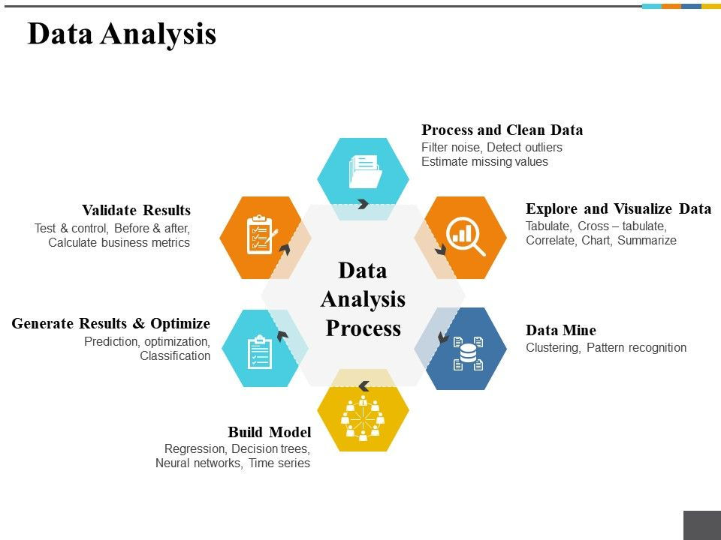

Slide 6
2. Web Scraping
The dictionary meaning of word ‘Scrapping’ implies getting something from the web.
Here two questions arise: What we can get from the web and How to get that. The answer to the first question is ‘data’.
Data is indispensable for any programmer and the basic requirement of every programming project is the large amount of useful data.
The answer to the second question is a bit tricky, because there are lots of ways to get data.
In general, we may get data from a database or data file and other sources. But what if we need large amount of data that is available online? One way to get such kind of data is to manually search (clicking away in a web browser) and save (copy-pasting into a spreadsheet or file) the required data. This method is quite tedious and time consuming.
Another way to get such data is using web scraping. Web scraping, also called web data mining or web harvesting, is the process of constructing an agent which can extract, parse, download and organize useful information from the web automatically. In other words, we can say that instead of manually saving the data from websites, the web scraping software will automatically load and extract data from multiple websites as per our requirement.

Slide 7
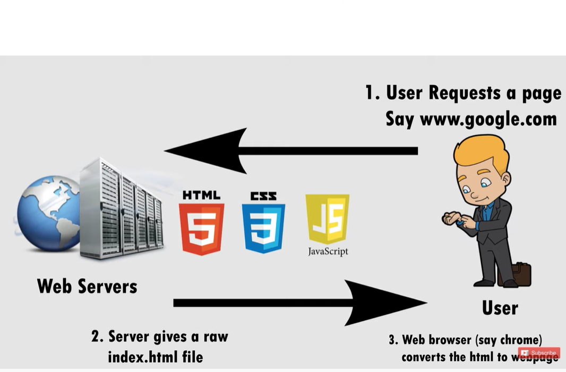
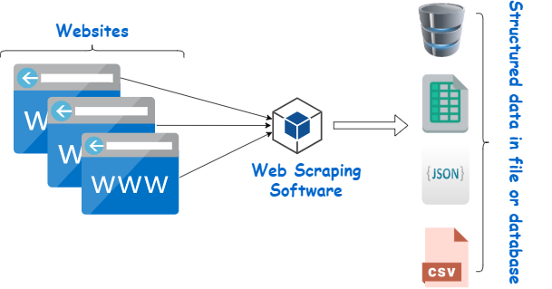
Overview of How Web Scraping Works
By and large, web scraping is notable for a "Screen Scraping", "Web Data Extraction".
The web scrubber programming is planned for exhaustive for all noteworthy data from different online stores and mining, and collecting it into the new website.
The scraper tool for the web is utilized for derived information from the web host, and as a portion of uses used for web orders, web mining and data mining, online esteem change observing and value correlation, element survey scratching (to watch the challenge), gathering land postings, atmosphere data checking, webpage change area, inspect, following on the web closeness and reputation, web mashup and, web data joining. [
Pages are manufactured utilizing content-based increase dialects (HTML and XHTML), and much of the time contain a profusion of cooperative info in the content structure.

Slide 8
Benefits of Web Scraping
E-commerce Websites: Web scrapers can collect the data specially related to the price of a specific product from various e-commerce websites for their comparison.
Content Aggregators: Web scraping is used widely by content aggregators like news aggregators and job aggregators for providing updated data to their users.
Marketing and Sales Campaigns: Web scrapers can be used to get the data like emails, phone number etc. for sales and marketing campaigns.
Search Engine Optimization (SEO): Web scraping is widely used by SEO tools like SEMRush, Majestic etc. to tell business how they rank for search keywords that matter to them.
Data for Machine Learning Projects: Retrieval of data for machine learning projects depends upon web scraping.
Data for Research: Researchers can collect useful data for the purpose of their research work by saving their time by this automated process.

Slide 9
II. Key Objectives of The Paper
The point of the paper is to remove the information from different sources with the assistance of programming known as the web crawler Scrapy utilizing the programming language Python adaptation 3.6.(Now, updated to 3.9 Latest version)
Understanding Working of frameworks like BeautifulSoup & To Scrape data from Reddit using PRAW.
[Web scraping software’s such as Scrapy is available for whenever ease of access needed by the user and also it’s an open-source web-crawling framework for the collection of any data as per user’s needs.
The software is used to extract data using an application programming interface or as a general-purpose web crawler required by the desired customer.
We are also able to scrape the data of E-commerce sites such as Flipkart, Amazon, etc. so as to find out the product details which aren’t available with the application interface and to analyze the variation, comments, ratings or anything else with innumerable options.

Slide 10
III. Literature Review of The Paper
To know how the data extraction process has evolved has so much one must understand the techniques involved in this method of web scraping is important scraping has been around nearly as long as the web.
The impact behind business web scraping has dependably been to pick up a simple business advantage and incorporate things like undermining a contender's special valuing, taking leads, commandeering promoting efforts, diverting APIs, and the inside and out robbery of and information.
The primary aggregators and examination motors seemed hot on the impact points of the web based business blast and worked generally unchallenged until the legitimate difficulties of the mid-2000s.
Early scraping apparatuses were really fundamental - physically reordering anything unmistakable from the site.
When software engineers got included, scraping graduated to the Unix grep order or customary articulation coordinating procedures posting remote HTTP demands utilizing attachment programming, and parsing site utilizing information programming and parsing site utilizing information inquiry dialects.

Slide 11
Today, in any case, it's an altogether different story: web scraping is huge business with powerful devices and administrations to coordinate.
Extraction and Analysis of information are generally utilized by the Digital distributers and catalogs, Travel, Real home, and E-trade.
Then again, examination and figuring come path back with the advances in accumulation components and the innovation of Real Databases: The data had been seen and dealt with as data to be set up for data examination.
The pivotal turning point was the nearness of RDB (Relational Database) amid the 1980s which empowered customers to create Sequel (SQL) to recoup data from the database.
For customers, the advantage of RDB and SQL is to have the ability to separate their data on intrigue. It made the methodology to get data basic and spread database use. Information Warehouse: The distinction from regular social databases is that information stockrooms are generally streamlined for reaction time to inquiries.

Slide 12
IV. Feasibility and Application
As we know to find out the logic behind the purpose of data, data extraction and analysis is a must.
The need for extraction is required in order to consistently promotion authentically acquire the information according to before the interpretative stage, not as to foresee the significance of information as a substitute for extraction.
We need extraction with respect to the articles are in various configurations and utilize distinctive styles of announcing.
The need to feature the principle information components of intrigue and to give institutionalization.
Also to aid pattern recognition and analysis. As for data analysis is essential for awareness of data resources by focusing on the applicable issues. It throws a light on by providing with the surveys, planning for statistical graphs designing and redesigning etc.

Slide 13
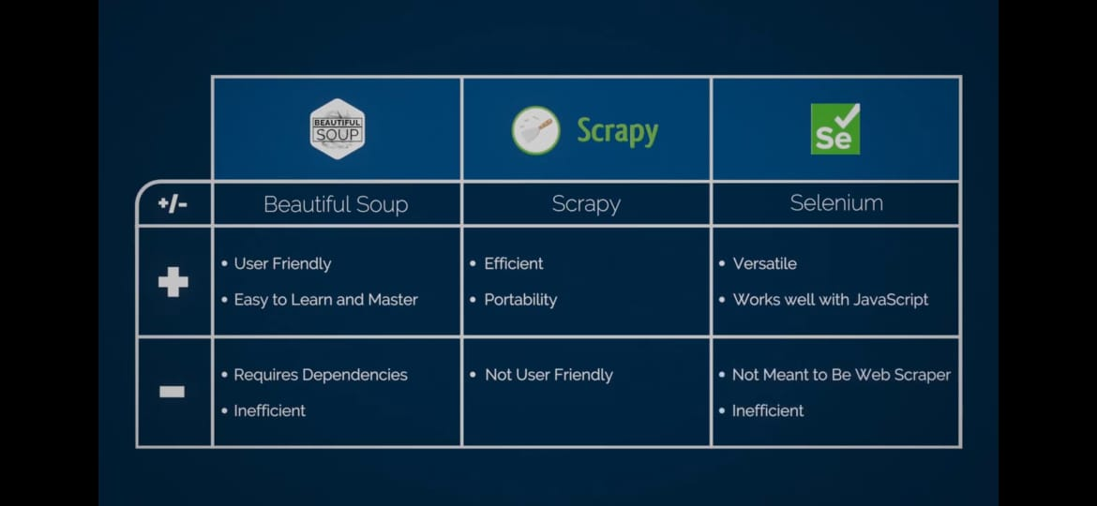
Comparison between Top 3 Python Frameworks for Web Scraping

Slide 14
Understanding Scrapy
Scrapy is an open source web scraping framework in Python used to build web scrapers. It gives you all the tools you need to efficiently extract data from websites, process them as you want, and store them in your preferred structure and format.
The web crawler, scrapy is an application system for gliding the sites and removing organized information which can be utilized for a wide scope of priority applications, similar to fact quarrying, data concocting or recording the data.
Scrapy was initially intended with the end goal of web scraping data from source, it can likewise be utilized to remove the data exploiting APIs or as a broadly useful web scraper. The fundamental points of interest of scrapy are that demands are booked and handled non concurrently, which implies that scrapy doesn't have to trust that a solicitation will be done and prepared, it can send another solicitation or do different things meanwhile, implying that different solicitations can prop up regardless of whether a few solicitations fizzle or a blunder occurs while doing the emphasis.

Slide 15

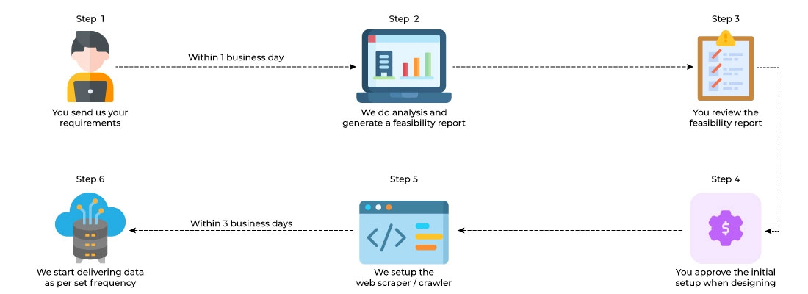
Flowchart & Block Diagram

Slide 16
V. Implementations(Python & its libs)
Python 3.6 is scheduled to be the last major version in the 2x series before it moves into an extended maintenance period.(We are going to use updated Version of Python 3.8 or 3.9 for implementation)
It contains a large number of the highlights that were discharged in python 3.6.
This ad libbed form incorporates the accompanying highlights, for example, an arranged word reference type, new unit highlights including test skipping, new state strategies, and attest techniques, and test disclosure, a match quicker to the module, programmed numbering of fields in the str. group() technique.
Buoy up upgrades back ported from 3.x, tile support for T kinter. A dark port of the memory see object from 3.x, set literals set and word reference understandings, lexicon sees, new sentence structure for settled with proclamations and the sys config module.

Slide 17
Use of Scrapy
Scrapy is an application framework for crawling locales and expelling composed data which can be used for a wide extent of supportive applications, like data mining, information taking care of or real reported.
Despite the way that Scrapy was at first expected for web scraping, it can in like manner be used to evacuate data using APIs, (for instance, Amazon AWS) or as an all-around valuable web crawler.
Sketchy is written in Python. Let’s take an example on Wiki related to one such issue “A simple online photo gallery may offer three options to users, as specified through HTTP GET parameters in the URL.
If there exist four ways to sort images, three choices of thumbnail size, two file formats, and an option to disable user provided contents, then the same set of content can be accessed with 48 different URLs, all of which may be linked on the site.
This carefully worked-out combination creates a problem for crawlers, as they must sort through endless combinations of relatively minor scripted changes in order to recover unique content.”

Slide 18
VI. Methodology
The methodology used for the project is to gather all the data extracted from various sources by using the vivid features of the web crawler scrapy using the scripts written in python language and further analyze it as per the requirements of the customer where the data is stored in the company's database.
The web crawler scrapy which is python based also may help us retrieve the desired result as we analysis process by specific code and give the desired url for the iteration to perform for scrapping the data from the source url.
Coding:
The basic web crawling script used for the project which shows the data
crawled and stored in the database of the products from a social network site,
in this case, Reddit by using Beautiful Soup & PRAW API (Html Parsing)
method involved to find the details of each element of the Frequent Searches.

Slide 19
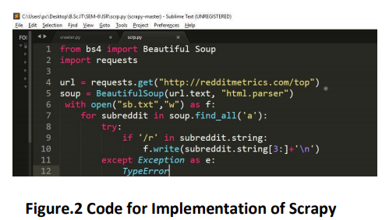
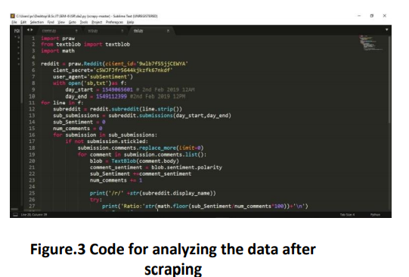
Testing :
The project was tested by using the various components as defined earlier and made to run on the browser. The extraction done turns out to be completely relevant and the analysis made is estimated.
Results:
The overall results of the project turn out to be helpful to understand. The Web scrapy extracted the data and made into csv file format.
The script which was written to extract the data turned out to be both of finding each of these sources provided with great ease.

Slide 20
VII. Conclusion
As the Internet has grown astronomically and businesses have become increasingly dependent on data, it is now a compulsion to have access to the latest data on every given subject.
Data has become the basis of all decision-making processes whether it’s a business or a non-profit organization. Therefore, web scraping has found its applications in every endeavour of note in contemporary times.
It is also becoming increasingly clear that those who will make creative and advanced use of web scraping tool will race ahead of others and gain a competitive advantage.
So we must leverage web scraping and boost prospects in our chosen area of endeavour! .
The main outcomes of this project were user friendly search interface, indexing, query processing, and effective data extraction technique based on web structure, form submission analysis and new submission plan.

Slide 21
VIII. Future Scope
With the addition of more and more data in the world of the internet, the importance of web scraping is increasing.
Many companies are now offering customized web scraping tools to their clients in which they gather data from all over the world of the internet and arrange them into useful and easily understandable data.
It reduces the precious man-power to manually visit each website and collect the data.
Web Scrapers are designed and code for each and individual website and crawlers do broad scraping.
If the website has a complicated structure, more coding is required to scrap its data as compared to a simple one.
The Future of web scraping is indeed bright and it will become more and more essential for every business with the passage of time.

Slide 22
IX. References Used
1.”Renita Crystal Pereira, Vanitha T. “Web Scraping of Social Networks.” International Journal of Innovative Research in Computer and Communication Engineering, vol. 3, pp.237-239, Oct. 7, 2018”
2.”Ghazvinian, Holbert, Viswanathan. “Simple WebScraping.”Internet:https://seanholbert.wor dpress.com/2011/07/15/scrappy-simple-webscraping/, Jun. 2015”
3.”Bellarosey.“Crowdsourcing-Definition.” Internet:http://crowdsourcing.typepad.com/cs/ 2006/06/crowdsourcing_a.html, Jun. 02, 2006”
4.“Naveen Ashish and Craig Knoblock. ”Wrapper Generation for semi-structured Internet Sources. In Proc” ACM SIGMOD Workshop on Management of Semi Structured Data, Tucson, Arizona, May 1997.”
5. “Datahen."3 Advantages of web scraping for yourenterprise"Internet:https://www.datahen.c om/3-advantages-web-scrapingenterprise/,May.17,2017””

Slide 23
6. https://en.wikipedia.org/wiki/Web_scraping
7. https://www.webharvy.com/articles/whatis-web-scraping.html
8. http://resources.distilnetworks.com/h/i/538 22104-is-webscraping- illegal-depends-on-whatthe-meaning-of-theword-is-is/181642
9.”https://www.quora.com/What-is-thelegality-of-web-scraping”
10. https://en.wikipedia.org/wiki/Web_crawler
11.”Kolari, Pand Joshi A. ,“Web mining : research and practice , Computing in Science & Engineering”, IEEE Transactions on Knowledge and Data Engineering, vol. 6, no. 2,Vol. 6 , No. 4 , 2004”
12.“Pythonversion3.6,http://www.python.org.”
13.”Kengtel,W:Wagner,M.Proteins1999,37,334- 345.”
14. “BrightPLanet.com Deep web White Paper. http://www.completeplanet.com/Tutorials/Dee pWeb/index.asp.”

Slide 24
Strategy for Implementation
The Paper made use of Python 3.6, but for its implementation we would be using its upgraded version Python 3.8 as it would have the latest libraries in the frameworks which we are supposed to use for web scraping.
We would also make an account on Reddit first and Register an App to get all the credentials required to get started with Web Scraping using PRAW.
We would be making use of PRAW (Python Reddit API Wrapper).It is a Python module that provides a simple access to Reddit's API. PRAW is easy to use and follows all of Reddit's API rules ,it enables us to scrape data from subreddits, create a bot and much more.
We would be making use of Beautiful Soup to parse the response object and scraping the Images from posts in a particular subreddit(The research paper accounts for only data scraping).
I would also try to get the community to know a little bit more about the general idea of accessing an API in general and Interpreting the results using things like Requests in python.
In addition I would also to try to implement a Spam Detection Bot for a subreddit.
Finally , would even use Try to implement Scrapy framework & show how we can extract data from a given url in Scrapy shell.

Slide 25
Credits to Writers of the Paper
i)MR David Mathew Thomas
ii)MR Sandeep Mathur
Amity Institute of Information Technology Amity University (AUUP), Sec-125, Noida

Slide 26
Thank You!

