Slide 1

Welcome to serviceGo
Your gateway to variety of services

Slide 2
INTRODUCTION
serviceGo is a platform designed to connect service providers with customers seeking various services.
Service Go can enhance market efficiency and reduce the time spent on searching for services.
A user-friendly interface can significantly improve customer satisfaction, encouraging repeat use and fostering loyalty.

Slide 3
SERVICES OFFERED
Rental system services.
Electronic services for domestic purposes.
Books purchasing.
Clothing.
Online Ticket-booking.

Slide 4
HOW IT WORKS ?
User-Friendly Process:
Step 1: Browse Services
Step 2: Choose a Provider
Step 3: Book & Confirm
Step 4: Enjoy Your Service

Slide 5
Benefits of Using serviceGo
Wide selection of services
Verified service providers
Easy booking system
Customer support

Slide 6
TESTIMONIALS
Testimonials will be determined after the feedback given by the customers.
On the basis of feedback, the website will be promoted.

Slide 7
PRICING STRUCTURE
Various subscription plans will be given to customers.
Special discount will be given on various festivals.
Special offers will be given for specific purchases on services.

Slide 8
USER ENGAGEMENT
Call to Action:
Sign up for exclusive offers
Join our community
Follow us on social media

Slide 9
CONCLUSION
To address these challenges, we propose an all-in-one service website designed specifically for businesses seeking to enhance the online visibility and customer interaction.

Slide 10
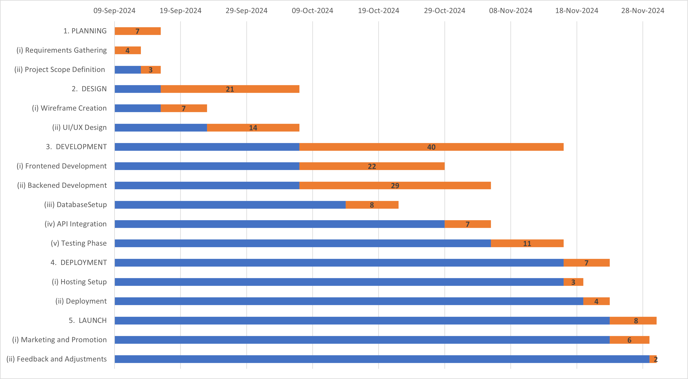
Gantt Chart

Slide 11
THANK YOU!
We look forward to encourage the users to visit the serviceGo website.
NOTE: serviceGo website is under maintenance.

