Slide 1

UI5 vs UI5 WebComponents vs Fiori Fundamentals
Rishabh Gour, EvoraIT solutions
July 4, 2019

Slide 2




About me
A web development enthusiast.
Started my career with SAP Labs (July ‘16 – Sept ‘18).
Currently working as a UI5 consultant for Evora IT solutions.
Have 3 years of experience working with SAP UI5.

Slide 3
Agenda
Building up the foundation
Explaining some fundamental terminologies
Fiori
UI5
Web components
UI5 web components
Fiori fundamentals
Why UI5 web components and Fiori fundamentals
UI5 vs UI5 web components vs Fiori fundamentals
Ease of development
Flexibility
Performance
Maturity
Demo
Where do I go from here?

Slide 4
Building up the foundation

Slide 5


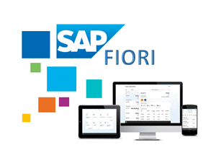
UI5 vs Fiori
Fiori is a set of design guidelines.
UI5 is a technology used to build web apps.
SAP UI5
Similar
Angular
Material Design
SAP Fiori
Similar

Slide 6



Web Components is a suite of different technologies allowing you to create reusable custom
elements — with their functionality encapsulated away from the rest of your code —
and utilize them in your web apps.
Add some HTML, CSS and JavaScript
<button> + some HTML, CSS and JavaScript
<RefreshButton>

Slide 7

SAP Fiori Fundamentals is a light-weight presentation layer using HTML and CSS.
<link rel='stylesheet' type='text/css' href='https://unpkg.com/fiori-fundamentals@1.5.8/dist/fiori-fundamentals.min.css'>
<button class="fd-button--emphasized sap-icon--refresh">Refresh</button>
Doesn’t follow Fiori design
Follows Fiori design

Slide 8
Why use Web components and Fiori fundamentals?

Slide 9
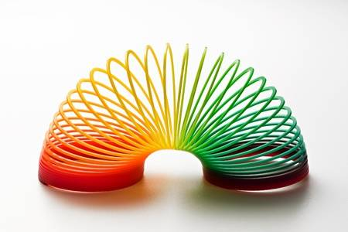






This is why :
You get more flexibility as a developer.
You can use the framework of your choice.
Significant improvement in app’s performance.
You get to use all the latest things.
etc…

Slide 10
UI5 vs UI5 web components vs Fiori fundamentals

Slide 11

Ease of Development
Easy
Hard

Slide 12
Flexibility
More
Less

Slide 13
Performance
Fast
Slow

Slide 14
Maturity of technology
While UI5 itself is quite mature, UI5 web components and Fiori fundamentals are not.
There are some noticeable design inconsistencies compared to UI5.
Latter 2 have less number of UI controls compared to UI5.

Slide 15
Demo

Slide 16
Where do I go from here?

Slide 17
Some useful links
Web components
https://www.webcomponents.org/
https://developer.mozilla.org/en-US/docs/Web/Web_Components
https://sap.github.io/ui5-webcomponents/
Fiori fundamentals
https://sap.github.io/fundamental/
Demo apps and examples
https://github.com/rishabh62/UI5con

Slide 18
Thank you ☺
Contact information:
Rishabh Gour
UI5 consultant
rishabhgour62@gmail.com

