Slide 1

UI5 vs UI5 WebComponents vs Fiori Fundamentals
Rishabh Gour, EvoraIT solutions
July 4, 2019

Slide 2




About me
Web enthusiast
Started with SAP Labs
UI5 consultant @ Evora
3 years of exp. with UI5

Slide 3
Agenda
Building up the foundation
Why UI5 web components and Fiori fundamentals
UI5 vs UI5 web components vs Fiori fundamentals
When should I use what?
Demo
Where do I go from here?

Slide 4
Building up the foundation

Slide 5




UI5 vs Fiori
Fiori is a set of design guidelines.
UI5 is a technology used to build web apps.
Similar
Similar

Slide 6


Web Components
Web Components is a suite of different technologies allowing you to create reusable custom
elements — with their functionality encapsulated away from the rest of your code —
and utilize them in your web apps.
- Mozilla Developer Network
Add some HTML, CSS and JavaScript
<button> + some HTML, CSS and JavaScript
<RefreshButton>

Slide 7
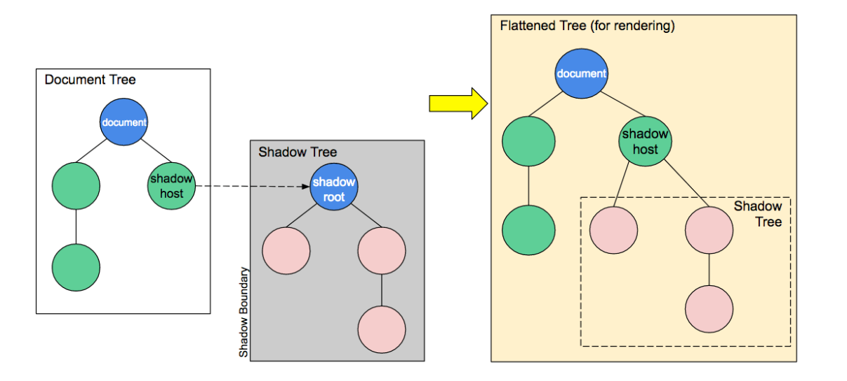
Shadow DOM

Slide 8
SAP Fiori Fundamentals
SAP Fiori Fundamentals is a light-weight presentation layer using HTML and CSS.
<link rel='stylesheet' type='text/css' href='https://unpkg.com/fiori- fundamentals@1.5.8/dist/fiori-fundamentals.min.css’>
<button class="fd-button--emphasized sap-icon--refresh">Refresh</button>
Doesn’t follow Fiori design
Follows Fiori design

Slide 9
Why use Web components and Fiori fundamentals?

Slide 10







This is why:
More flexibility
Framework of choice
Better performance
Use latest stuff.

Slide 11
UI5 vs UI5 web components vs Fiori fundamentals

Slide 12
 | Ease of Development | Flexibility | Performance | Number of UI Controls
UI5
UI5 Webcomponent
Fiori Fundamentals

Slide 13
When should I use what?

Slide 14
Note: UI5 web components and Fiori fundamentals are not meant to replace UI5, they just bring the UI5/Fiori look and feel to your applications.
UI5 | When you want faster development, OData integration, Complex UI controls
UI5 Web components | Simple Fiori apps with framework of choice
Fiori Fundamentals | More flexibility and Simple UI, or to Fiorify existing web apps

Slide 15
Demo

Slide 16
Where do I go from here?

Slide 17
Some useful links
Web components
https://www.webcomponents.org/
https://developer.mozilla.org/en-US/docs/Web/Web_Components
https://sap.github.io/ui5-webcomponents/
Fiori fundamentals
https://sap.github.io/fundamental/
Demo apps and examples
https://github.com/rishabh62/UI5con

Slide 18
Thank you ☺
Contact information:
Rishabh Gour
UI5 consultant
rishabhgour62@gmail.com

