Slide 1
Binomial Heaps
Sachin Tripathi
IIT(ISM), Dhanbad
Slides from Prof. Jim Anderson, California State University, Northridge

Slide 2
Binomial Heaps
A way to implement mergeable heaps.
    Useful in scheduling algorithms and graph algorithms.
Operations:
    Make-Heap().
    Insert(H, x), where x is a node H.
    Minimum(H).
    Extract-Min(H).
    Union(H₁, H₂): merge H₁ and H₂, creating a new heap.
    Decrease-Key(H, x, k): decrease x.key (x is a node in H) to k. (It’s assumed that k ≤ x.key.)

Slide 3
Definitions
Binomial Heap: Collection of binomial trees (satisfying some properties).
Binomial Trees
Definition is inductive.
These are ordered trees, i.e., order of children is important.
1
Different Trees
1
2
3
3
2
4
5
4
5
Base Case: B₀ = single node is a binomial tree.
Inductive Step:
B_{k} = is a binomial tree.
B_{k-1}
B_{k-1}

Slide 4
Definitions
Binomial Heap: Collection of binomial trees (satisfying some properties).
Binomial Trees
Definition is inductive.
Base Case: B₀ = single node is a binomial tree.
Inductive Step:
B_{k} = is a binomial tree.
B_{k-1}
B_{k-1}

Slide 5
Examples
B₀
B₁
B₂
B₃
depth # nodes
0 1
1 4
2 6
3 4
4 1
B₄

Slide 6
Another Way to Look at B_{k}
☹
B₀
B₁
B₂
B_{k-2}
B_{k-1}
B_{k}

Slide 7

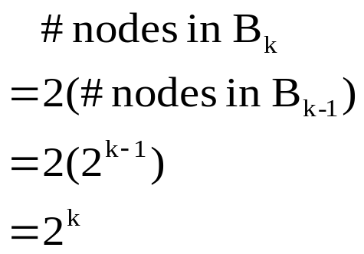
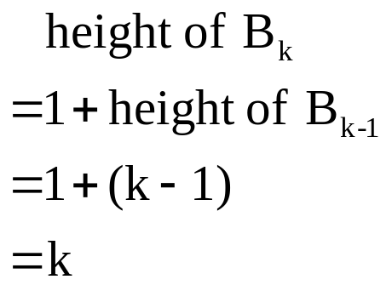
Properties of Binomial Trees
Lemma: For the binomial tree B_{k},
1. There are 2^{k} nodes.
2. Tree height is k.
3. nodes at depth i, i = 0, 1, …, k [binomial coefficients].
4. Root has degree k, other nodes have smaller degree. i^{th}
child of root is root of subtree B_{i}, where i = k–1, k–2, …,
0 [k–1 is LM, 0 is RM].
Proof:
1. Induction on k.
2. Induction on k.

Slide 8
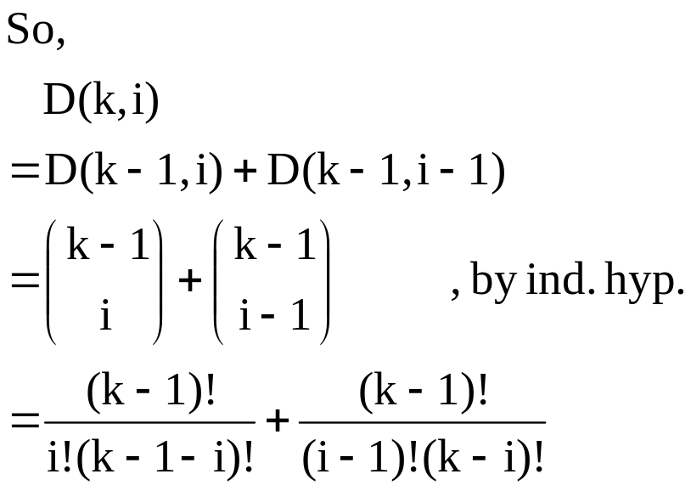
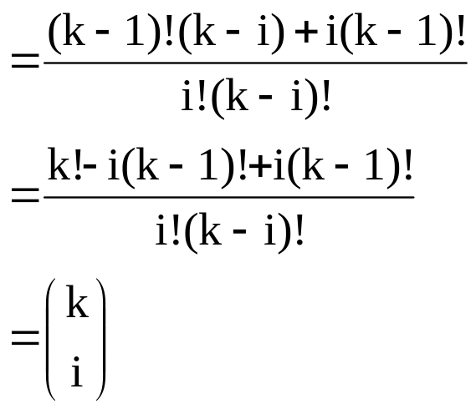
Proof (Continued)
3. Let D(k,i) = # nodes at depth i in B_{k}. Want to show D(k,i) = .
depth i in this B_{k-1}
B_{k}
B_{k-1}
B_{k-1}
depth i in B_{k}
depth i–1 in this B_{k-1}

Slide 9
Proof (Continued)
4. Root degree of B_{k} = 1 + root degree of B_{k-1}
= 1 + k–1 , induction hypothesis
= k
The maximum degree in an n-node binomial tree is lg n.

Slide 10
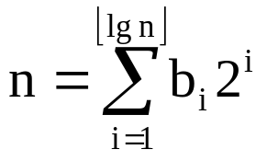
Binomial Heaps
Set of binomial trees satisfying binomial-heap properties:
  Heap ordered: In each binomial tree, key of a node is at least parent’s key.
      Implies root of a binomial tree has the smallest key in that tree.
  Set includes at most one binomial tree whose root is a given degree.
      Implies B.H. with n nodes has at most ⎣lg n⎦ + 1 B.T.’s.
      Think of n in binary: ⟨b_{⎣lg n⎦}, …, b₀⟩, i.e.,
      B.H contains B_{i} iff b_{i} is 1.

Slide 11
Binomial Heaps
Set of binomial trees satisfying binomial-heap properties:
  Heap ordered:
      Implies root of a binomial tree has the smallest key in that tree.
  Set includes at most one binomial tree whose root is a given degree.
      Implies B.H. with n nodes has at most ⎣lg n⎦ + 1 B.T.’s.
      Think of n in binary: ⟨b_{⎣lg n⎦}, …, b₀⟩, i.e.,
      B.H contains B_{i} iff b_{i} is 1.

Slide 12
Representing Binomial Heaps
called the root list
10
1
6
12
25
8
14
29
18
11
17
38
27
Each node is
represented by a
structure like this
parent
key
degree
child
sibling
10
1
6
12
25
8
14
29
18
11
17
38
27

Slide 13
Binomial Heap: Implementation
Implementation.
  Represent trees using left-child, right sibling pointers.
    three links per node (parent, left, right)
  Roots of trees connected with singly linked list.
    degrees of trees strictly decreasing from left to right
heap
6
3
18
6
3
18
Parent
29
10
44
37
29
37
Left
Right
48
31
17
48
10
50
50
31
17
44
Binomial Heap
Leftist Power-of-2 Heap

Slide 14
Binomial Heap: Implementation
Implementation.
  Represent trees using left-child, right sibling pointers.
    three links per node (parent, left, right)
  Roots of trees connected with singly linked list.
    degrees of trees strictly decreasing from left to right
heap
6
3
18
6
3
18
Parent
29
10
44
37
29
37
Left
Right
48
31
17
48
10
50
50
31
17
44
Binomial Heap

Slide 15
Operations on Binomial Heaps
Minimum(H)
y := NIL;
x := head[H];
min := ∞;
while x ≠ NIL do
if key[x] < min then
min := key[x];
y := x
fi;
x := sibling[x]
od;
return y
Time is O(lg n).

Slide 16
Linking Two Binomial Heaps
Link(y,z)
p[y] := z;
sibling[y] := child[z];
child[z] := y;
degree[z] := degree[z] + 1
y
z
z
y
B_{k-1}
B_{k-1}
B_{k-1}
Link
B_{k-1}

Slide 17
Union
H₁, H₂
Union
H₁ ∪ H₂
H₁ =
H₂ =
First, simply merge the two root lists by root degree (like merge sort).
Remaining Problem: Can have two trees with the same root degree.

Slide 18
Binomial Heap: Union
Create heap H that is union of heaps H' and H''.
  "Mergeable heaps."
  Easy if H' and H'' are each order k binomial trees.
    connect roots of H' and H''
    choose smaller key to be root of H
6
8
29
10
44
30
23
22
48
31
17
45
32
24
50
55
H'
H''

Slide 19
Binomial Heap: Union
6
3
18
8
29
10
44
37
30
23
22
48
31
17
15
7
12
45
32
24
50
+
55
28
33
25
41
1
1
1
1
0
0
1
1
19 + 7 = 26
+
0
0
1
1
1
1
1
0
1
0

Slide 20
Binomial Heap: Union
6
3
18
8
29
10
44
37
30
23
22
48
31
17
15
7
12
45
32
24
50
+
55
28
33
25
41

Slide 21
Binomial Heap: Union
12
18
6
3
18
8
29
10
44
37
30
23
22
48
31
17
15
7
12
45
32
24
50
+
55
28
33
25
41

Slide 22
3
12
7
37
18
25
6
3
18
8
29
10
44
37
30
23
22
48
31
17
15
7
12
45
32
24
50
+
55
28
33
25
41
12
18

Slide 23
3
3
12
15
7
37
7
37
18
28
33
25
25
41
6
3
18
8
29
10
44
37
30
23
22
48
31
17
15
7
12
45
32
24
50
+
55
28
33
25
41
12
18

Slide 24
3
3
12
15
7
37
7
37
18
28
33
25
25
41
6
3
18
8
29
10
44
37
30
23
22
48
31
17
15
7
12
45
32
24
50
+
55
28
33
25
41
3
12
15
7
37
18
28
33
25
41

Slide 25
3
3
12
15
7
37
7
37
18
28
33
25
25
41
6
3
18
8
29
10
44
37
30
23
22
48
31
17
15
7
12
45
32
24
50
+
55
28
33
25
41
6
3
12
8
29
10
44
15
7
37
18
30
23
22
48
31
17
28
33
25
45
32
24
50
41
55

Slide 26
Union (Continued)
Union traverses the new root list like this:
prev-x
x
next-x
Depending on what x, next-x, and sibling[next-x] point to, Union
links trees with the same root degree.
Note: We may temporarily create three trees with the same root
degree.

Slide 27
Analogy
head[H₁]
12
7
15
head[H₂]
18
3
6
25
28
33
37
8
29
10
44
41
23
22
48
31
17
30
45
32
24
50
Union
55
prev-x
x
Like binary addition:
1 1 1 (carries)
0 0 1 1 1
1 0 0 1 1
1 1 0 1 0
temporarily have three
trees of this degree
head[H]
12
3
6
18
15
7
37
29
10
44
8
28
33
25
22
48
31
17
30
23
41
32
24
50
45
55

Slide 28
Cases
prev-x
x
next-x
sibling[next-x]
Case 1
prev-x
x
next-x
a
b
c
d
a
b
c
d
B_{k}
B_{l}
B_{k}
B_{l}
prev-x
x
next-x
sibling[next-x]
Case 2
prev-x
x
next-x
a
b
c
d
a
b
c
d
B_{k}
B_{k}
B_{k}
B_{k}
B_{k}
B_{k}
prev-x
x
next-x
sibling[next-x]
Case 3
prev-x
x
next-x
a
b
c
d
a
b
d
c
B_{k}
B_{k}
B_{l}
B_{k}
B_{l}
key[x] ≤ key[next[x]]
B_{k}
B_{k+1}
prev-x
x
next-x
sibling[next-x]
Case 4
prev-x
x
next-x
a
b
c
d
a
c
d
b
B_{k}
B_{k}
B_{l}
B_{k}
B_{l}
key[x] > key[next[x]]
B_{k}
B_{k+1}

Slide 29
Code for Union
Union(H₁, H₂)
H := new heap;
head[H] := merge(H₁, H₂); /* simple merge of root lists */
if head[H] = NIL then return H fi;
prev-x := NIL;
x := head[H];
next-x := sibling[x];
while next-x ≠ NIL do
if (degree[x] ≠ degree[next-x]) or
(sibling[next-x] ≠ NIL and degree[sibling[next-x]] = degree[x]) then
prev-x := x;
x := next-x;
else
if key[x] ≤ key[next-x] then
sibling[x] := sibling[next-x];
Link(next-x, x)
else
if prev-x = NIL then head[H] := next-x else sibling[prev-x] := next-x fi
Link(x, next-x);
x := next-x
fi
fi;
next-x := sibling[x]
od;
return H
Cases 1,2
Case 3
Case 4

Slide 30
Union Example
head[H₁]
12
7
15
head[H₂]
18
3
6
25
28
33
37
8
29
10
44
41
23
22
48
31
17
30
45
32
24
50
55
Merge
x
next-x
head[H]
12
18
7
3
15
6
25
37
28
33
29
10
44
8
41
22
48
31
17
30
23
45
32
24
50
55

Slide 31
Union Example (Continued)
x
next-x
head[H]
12
18
7
3
15
6
25
37
28
33
29
10
44
8
41
22
48
31
17
30
23
45
32
24
50
55
Case 3
x
next-x
head[H]
12
7
3
15
6
18
25
37
28
33
29
10
44
8
41
22
48
31
17
30
23
45
32
24
50
55

Slide 32
Union Example (Continued)
x
next-x
head[H]
12
7
3
15
6
18
25
37
28
33
29
10
44
8
41
22
48
31
17
30
23
45
32
24
50
Case 2
55
prev-x
x
next-x
head[H]
12
7
3
15
6
18
25
37
28
33
29
10
44
8
41
22
48
31
17
30
23
45
32
24
50
55

Slide 33
Union Example (Continued)
prev-x
x
next-x
head[H]
12
7
3
15
6
18
25
37
28
33
29
10
44
8
41
22
48
31
17
30
23
45
32
24
50
Case 4
55
prev-x
x
next-x
head[H]
12
3
15
6
18
7
37
28
33
29
10
44
8
25
41
22
48
31
17
30
23
45
32
24
50
55

Slide 34
Union Example (Continued)
prev-x
x
next-x
head[H]
12
3
15
6
18
7
37
28
33
29
10
44
8
25
41
22
48
31
17
30
23
45
32
24
50
Case 3
55
prev-x
x
next-x
head[H]
12
3
6
18
15
7
37
29
10
44
8
28
33
25
22
48
31
17
30
23
41
32
24
50
45
55

Slide 35
Union Example (Continued)
prev-x
x
next-x
head[H]
12
3
6
18
15
7
37
29
10
44
8
28
33
25
22
48
31
17
30
23
41
32
24
50
45
Case 1
55
prev-x
x
next-x = NIL
⇒ terminates
head[H]
12
3
6
18
15
7
37
29
10
44
8
28
33
25
22
48
31
17
30
23
41
24
50
Note: Union is
O(lg n).
45
32
55

Slide 36
Union Example (Continued)
prev-x
x
next-x
head[H]
12
3
6
18
15
7
37
29
10
44
8
28
33
25
22
48
31
17
30
23
41
32
24
50
45
Case 1
55
prev-x
x
next-x = NIL
⇒ terminates
head[H]
12
3
6
18
15
7
37
29
10
44
8
28
33
25
22
48
31
17
30
23
41
32
24
50
45
55

Slide 37
Insert and Extract-Min
Insert(H, x)
H′ := Make-B-H();
p[x] := NIL;
child[x] := NIL;
sibling[x] := NIL;
degree[x] := 0;
head(H′) := x;
H := Union(H, H′)
Extract-Min(H)
remove minimum key root x from
H’s root list;
H′ := Make-B-H();
root list of H′ = x’s children in
reverse order;
H := Union(H, H′);
return x
Both are O(lg n).

Slide 38
Extract-Min
head[H]
37
10
1
41
28
13
16
12
25
6
77
29
26
23
18
8
14
11
17
38
42
27
x
head[H]
37
10
1
41
28
13
16
12
25
6
77
29
26
23
18
8
14
11
17
38
42
27

Slide 39
Extract-Min (Continued)
head[H]
37
10
head[H′]
25
12
16
6
41
28
13
18
26
23
8
14
29
77
42
11
17
38
27
head[H]
25
12
6
37
18
8
14
29
10
41
13
11
17
38
16
28
26
23
77
27
42

Slide 40
Insert and Extract-Min
Insert(H, x)
H′ := Make-B-H();
p[x] := NIL;
child[x] := NIL;
sibling[x] := NIL;
degree[x] := 0;
head(H′) := x;
H := Union(H, H′)
Extract-Min(H)
remove minimum key root x from
H’s root list;
H′ := Make-B-H();
root list of H′ = x’s children in
reverse order;
H := Union(H, H′);
return x

Slide 41
Decrease-Key Example
head[H]
25
12
6
37
18
8
14
29
10
41
13
11
17
38
16
28
26
23
77
27
42
Decrease key 26 to 7
head[H]
25
12
6
37
18
8
14
29
10
41
z
13
11
17
38
16
28
y
7
23
77
27
42

Slide 42
Decrease-Key Example (Continue)
head[H]
25
12
6
37
18
z
14
29
10
8
41
y
13
11
17
38
7
28
16
23
77
27
42
z
head[H]
25
12
6
37
18
y
7
8
14
29
41
13
11
17
38
10
28
16
23
77
27
42

Slide 43
Decrease-Key
Decrease-Key(H, x, k)
if k > key[x] then “error” fi;
key[x] := k;
y := x;
z := p[y];
while z ≠ NIL and key[y] < key[z] do
exchange key[y] and key[z];
y := z;
z := p[y]
od
O(lg n)

Slide 44
Decrease-Key
Decrease-Key(H, x, k)
if k > key[x] then “error” fi;
key[x] := k;
y := x;
z := p[y];
while z ≠ NIL and key[y] < key[z] do
exchange key[y] and key[z];
y := z;
z := p[y]
od

Slide 45
Delete
Delete(H, x)
Decrease-Key(H, x, −∞);
Extract-Min(H)
Time is O(lg n)

Slide 46
Delete
Delete(H, x)
Decrease-Key(H, x, −∞);
Extract-Min(H)

Slide 47
Thank you

