Slide 1
String Matching

Slide 2
String Matching
Given a pattern P[1..m] and a text T[1..n], find all occurrences of P in T. Both P and T belong to ∑*.
P occurs with shift s (beginning at s+1): P[1]=T[s+1], P[2]=T[s+2],…,P[m]=T[s+m].
If so, call s is a valid shift, otherwise, an invalid shift.
Note: one occurrence begins within another one: P=abab, T=abcabababbc, P occurs at s=3 and s=5.

Slide 3
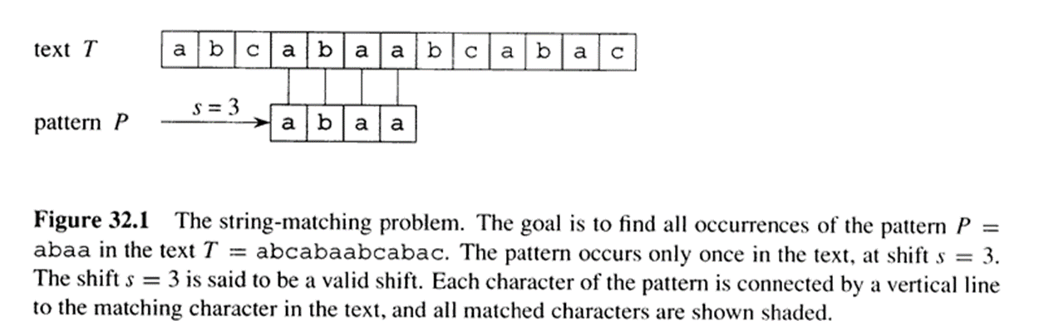
An example of string matching

Slide 4
Notation and terminology
w is a prefix of x, if x=wy for some y∈∑*. Denoted as w⇒x.
w is a suffix of x, if x=yw for some y∈∑*. Denoted as w⇐x.

Slide 5
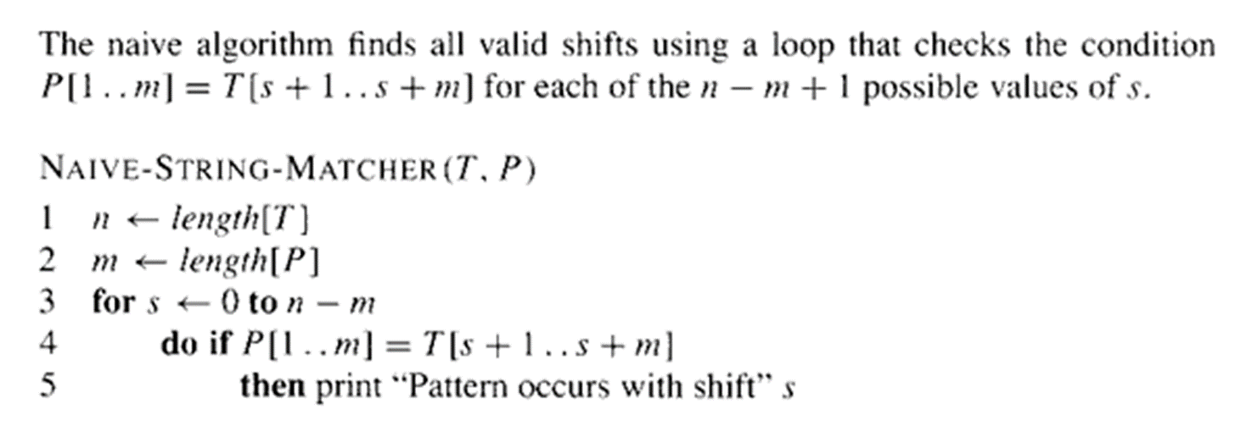
Naïve string matching
Running time: O((n-m+1)m).

Slide 6
Problem with naïve algorithm
Problem with Naïve algorithm:
  Suppose p=ababc, T=cabababcd.
T: c a b a b a b c d
P: a …
P: a b a b c
P: a…
P: a b a b c
Whenever a character mismatch occurs after matching of several characters, the comparison begins by going back in T from the character which follows the last beginning character.
Can we do better: not go back in T?

Slide 7
Rabin Karp
Rabin and Karp have proposed a string-matching algorithm that performs well in practice and that also generalizes to other algorithms for related problems, such as two-dimensional pattern matching. The worst-case running time of the Rabin-Karp algorithm is O((n - m + 1)m), but it has a good average-case running time

Slide 8
For expository purposes, let us assume that = {0, 1, 2, . . . , 9}, so that each character is a decimal digit. (In the general case, we can assume that each character is a digit in radix-d notation)
We can then view a string of k consecutive characters as representing a length-k decimal number. The character string 31415 thus corresponds to the decimal number 31,415.

Slide 9
Given a pattern P[1 . . m], we let p denote its corresponding decimal value. In a similar manner, given a text T[1 . . n], we let ts denote the decimal value of the length-m substring T[s + 1 . . s + m], for s = 0, 1, . . . , n - m. Certainly,
ts = p if and only if T[s + 1 . . s + m] = P[1 . . m];
thus, s is a valid shift if and only if ts = p.

Slide 10
If we could compute p in time O(m) and all of the ti values in a total of O(n) time, then we could determine all valid shifts s in time O(n) by comparing p with each of the ts's.
Note: p and the ts's might be very large numbers.

Slide 11
We can compute p in time O(m) using Horner's rule :
p = P[m] + 10 (P[m - 1] + 10(P[m - 2] + . . . + 10(P[2] + 10P[1]) . . . )).
The value t0 can be similarly computed from T[1 . . m] in time O(m).

Slide 12
To compute the remaining values t1, t2, . . . , tn-m in time O(n - m), it suffices to observe that ts + 1 can be computed from ts in constant time, since
t_{s} + 1 = 10(t_{s} - 10^{m} - 1T[s + 1]) + T[s + m + 1].

Slide 13
For example, if m= 5 and ts = 31415, then we wish to remove the high-order digit T[s + 1] = 3 and bring in the new low-order digit (suppose it is T[s + 5 + 1] = 2) to obtain
ts+1 = 10(31415 - 10000.3) + 2 = 14152 .

Slide 14
Subtracting 10m-1 T[s+1] removes the high-order digit from ts, multiplying the result by 10 shifts the number left one position, and adding T[s + m + 1] brings in the appropriate low-order digit.

Slide 15
The only difficulty with this procedure is that p and ts may be too large to work with conveniently.
If P contains m characters, then assuming that each arithmetic operation on p (which is m digits long) takes "constant time" is unreasonable.
Fortunately, there is a simple cure for this problem, as shown in Figure 34.4 : compute p and the ts's modulo a suitable modulus q.
Since the computation of p, t0, and the recurrence (34.1) can all be performed modulo q, we see that p and all the ts's can be computed modulo q in time O(n + m).

Slide 16
The modulus q is typically chosen as a prime such that 10q just fits within one computer word, which allows all of the necessary computations to be performed with single-precision arithmetic.

Slide 17
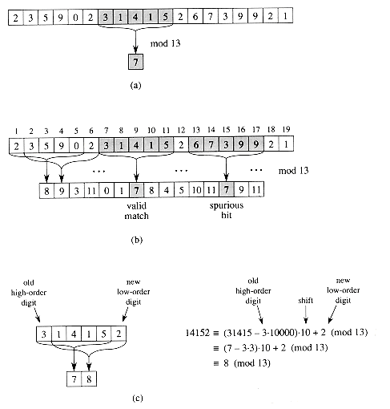
Example

Slide 19
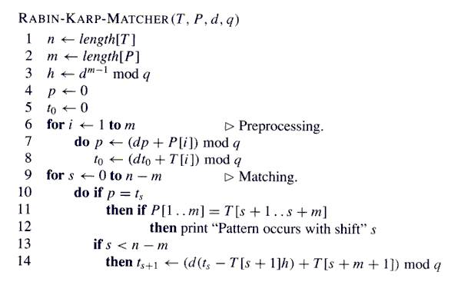
Horner’s method

Slide 20
Finite Automaton Review
A finite automaton M is a 5-tuple (Q, q₀, A, Σ, δ), where
  Q is a finite set of states.
  q₀ ∈ Q is the start state.
  A ⊆ Q is a distinguished set of accepting states.
  Σ is a finite input alphabet.
  δ is a function from Q × Σ into Q called the transition function of M.
If M reads input character a when in state q, then it changes to state δ(q, a).
If its currents state q is in A, then M is said to accept the string read so far.
M induces a function ϕ: Σ* → Q, called the final-state function, such that ϕ(w) is the state of M after reading the string w. ϕ can be defined recursively as follows:
ϕ(ε) = q₀
ϕ(wa) = δ(ϕ(w), a)
Therefore, M accepts w if and only if ϕ(w) ∈ A.

Slide 21
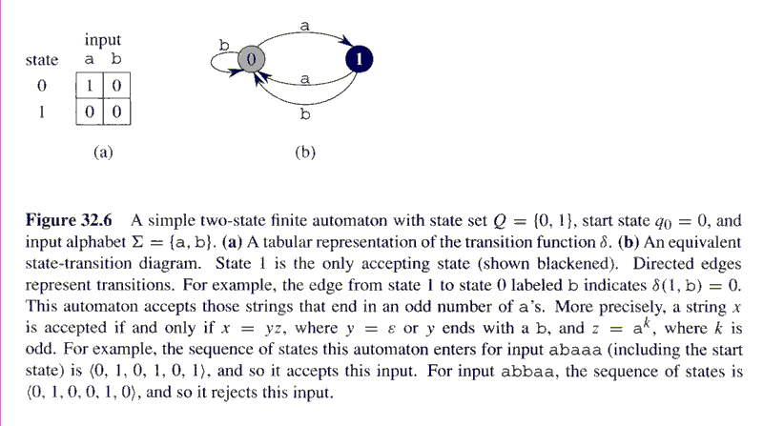

Slide 22
String Matching with Finite Automata
Strategy: Design a finite automaton that reads the text string character by character, going to an accept state only if the pattern P has just been seen. In other word, the automaton accepts strings with suffix P.
E.g., if the text is “abbbabcca” and the pattern “ab” we want the automaton to consume a, b, b , b, a, b, c, c, a and entering into an accept state only at the red b’s.
Exercise: Design an automaton as required by the strategy for the particular example above.

Slide 23
Implementing the Strategy
For a pattern P[1..m] define a function σ: Σ* → {0, 1, …, m}, called the suffix function for P, such that σ(x) is the length of the longest prefix of P that is a suffix of x. I.e.,
σ(x) = max{k: P_{k} ↑ x}
Example: If the pattern is P = aba, then σ(ε) = 0, σ(abab) = 2, σ(abbaba) = 3. How about σ(ababb) and σ(bbba)?
For a pattern P[1..m] of length m, σ(x) = m if and only if P ↑ x, i.e., if and only if the pattern is at the end of x.
This leads to defining the string-matching automaton M corresponding to P[1..m] as follows:
  State set Q = {0, 1, …, m}.
  Start state q₀ is 0.
  The only accepting state is m.
  The transition function is defined by δ(q, a) = σ(P_{q}a).
Intuition: As M reads the string T =T[1]T[2]…T[n] character by character, it goes to state σ(T[1]T[2]…T[i]) after reading T[i] (Why? To be proved!). Therefore, if it is in the accepting state m after reading T[i], then the pattern P has just been seen.

Slide 24
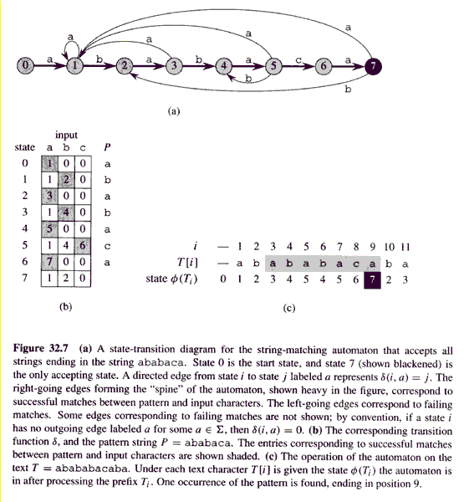
Pattern P = ababaca

Slide 25
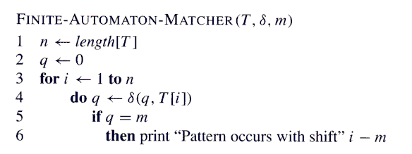
Matching time (excluding preprocessing time to compute δ): Θ(n)

Slide 26
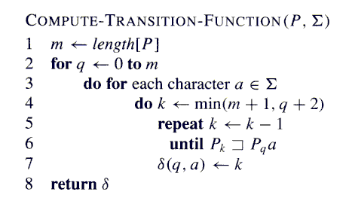
// O(m) time
// O(|Σ|) time
// O(m) time
// test O(m) time
Running time = preprocessing time for the
FA-matcher: O(m³|Σ|)
(this can be improved to O(m|Σ|))

Slide 27
Running time (excluding preprocessing time to compute δ): Θ(n)

Slide 28
Knuth-Morris-Pratt Algorithm
Strategy: Improve on the string-matching automaton by avoiding the time consuming computation of the transition function δ.
Instead, pre-compute in Θ(m) time an auxiliary function
π that contains information about how the pattern P matches against shifts of itself.
Precisely, given pattern P[1..m], the prefix function for P is the function π: {1, 2, …, m} → {0, 1, …, m-1} such that
π(q) = max{k: k < q and P_{k} ↑ P_{q}}
I.e., π(q) is the length of the longest prefix of P that is a proper suffix of P_{q}.
Q: What is the relation between the suffix fn. σ(P_{q}) and π(q)?

Slide 29
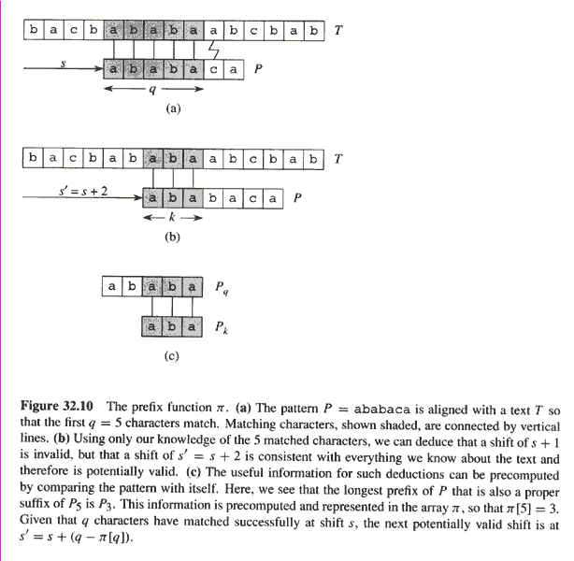
π(5) = 3 indicates that a shift of
+1 to the right cannot be valid;
however, +2 is potentially valid.

Slide 30
Facts about the Prefix Function
Given a pattern P[1..m], we’ll show that all the prefixes of P that are proper suffixes of a given prefix P_{q} can be listed by iterating the prefix function π.
Let
π*(q) = {π(q), π⁽²⁾(q), π⁽³⁾(q), …, π^{(t)}(q) = 0},
where π⁽²⁾(q) = π(π(q)), π⁽³⁾(q) = π (π(π(q))), etc.
I.e., π*(q) is the list of all possible values obtained by repeatedly applying the prefix function π to q.
Lemma 32.5 (Prefix-function Iteration Lemma)
Let P be a pattern of length m with prefix function π. Then, for
q = 1, 2, …, m, we have π*(q) = {k : k < q and P_{k} ↑ P_{q}}.
Proof: Induction on q†…
^{†Text does a different} ^{induction, but induction} ^{on q seems simplest.}

Slide 31
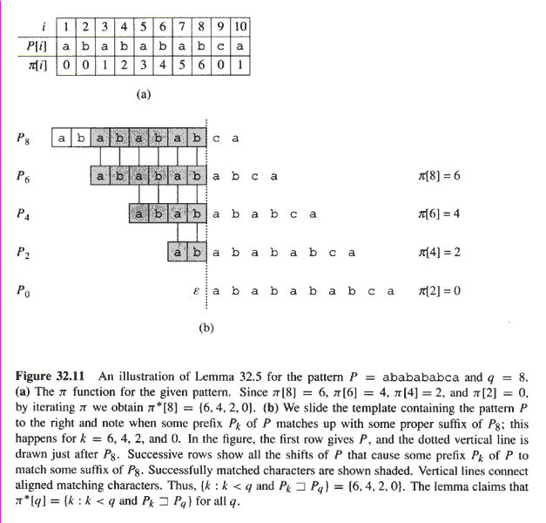

Slide 32
Lemma 32.6:
Let P be a pattern of length m, and let π be the prefix function
for P. For q = 1, 2, …, m, if π(q) > 0, then π(q) – 1 ∈ π*(q – 1).
Proof: If π(q) = r > 0, then r < q and P_{r} ↑ P_{q}. Therefore, r – 1 < q – 1 and
P_{r-1} ↑ P_{q-1}. By previous lemma, π(q) – 1 = r – 1 ∈ π*(q – 1).
For q = 2, 3, .., m, define the subset E_{q–1} ⊆ π*(q – 1) by
E_{q–1} = {k ∈ π*(q – 1) : P(k+1) = P(q)}
I.e., E_{q–1} consists of those values k < q – 1 for which P_{k} ↑ P_{q–1}
and for which P_{k+1} ↑ P_{q} because P(k+1) = P(q). Equivalently, E_{q–1}
consists of those values k ∈ π*(q – 1) such that we can extend P_{k}
to P_{k+1} and get a proper suffix of P_{q}.
Corollary 32.7:
Let P be a pattern of length m, and let π be the prefix function for
P. For q = 2, 3, .., m,
π(q) = 0 if E_{q–1} = ∅.
1 + max{k ∈ E_{q–1}} if E_{q–1} ≠ ∅.
Proof: Straightforward use of above lemma…

Slide 33
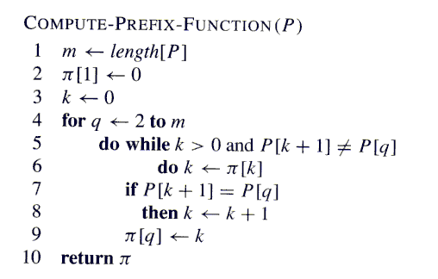
Correctness follows from Cor. 32.7.
Running time = preprocessing time for KMP-matcher: Θ(m)
(by amortized analysis!)

Slide 34
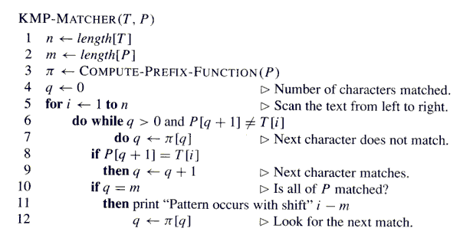
equivalent
Correctness follows from the fact that the KMP-MATCHER simulates
the FINITE-AUTOMATON-MATCHER.
Running time: Θ(n) (again by amortized analysis)

Slide 35
Problems
Ex. 32.1-1
Ex. 32.1-3
Ex. 32.2-1
Ex. 32.2-2
Ex. 32.2-3
Ex. 32.3-1
Ex. 32.3-2
Ex. 32.3-3
Ex. 32.3-4
Ex. 32.4-1
Ex. 32.4-2
Ex. 32.4-4
Prob. 32-1

