Slide 1
Lecture 6
Evaluation

Slide 2
How do you evaluate a search engine / algorithm [say for e-commerce]
Sec. 8.6
How fast does it index?
  Number of documents/hour
  Incremental indexing – site adds 10K products/day
How fast does it search?
  Latency and CPU needs for site’s 5 million products
Does it recommend related products?
This is all good, but it says nothing about the quality of search
  You want the users to be happy with the search experience

Slide 3
How do you tell if users are happy?
Search returns products relevant to users
  How do you assess this at scale?
Search results get clicked a lot
  Misleading titles/summaries can cause users to click
Users buy after using the search engine
  Or, users spend a lot of $ after using the search engine
Repeat visitors/buyers
  Do users leave soon after searching?
  Do they come back within a week/month/… ?

Slide 4

Happiness: elusive to measure
Sec. 8.1
Most common proxy: relevance of search results
  But how do you measure relevance?
Pioneered by Cyril Cleverdon in the Cranfield Experiments

Slide 5
Measuring relevance
Sec. 8.1
Three elements:
  A benchmark document collection
  A benchmark suite of queries
  An assessment of either Relevant or Nonrelevant for each query and each document

Slide 6
So you want to measure the quality of a new search algorithm
Benchmark documents – the products
Benchmark query suite – more on this
Judgments of document relevance for each query
5 million products
Relevance
judgement
50000
sample
queries

Slide 7
Relevance judgments
Binary (relevant vs. non-relevant) in the simplest case, more nuanced (0, 1, 2, 3 …) in others
What are some issues already?
5 million times 50K takes us into the range of a quarter trillion judgments
  If each judgment took a human 2.5 seconds, we’d still need 10¹¹ seconds, or nearly $300 million if you pay people $10 per hour to assess
  10K new products per day

Slide 8
Crowd source relevance judgments?
Present query-document pairs to low-cost labor on online crowd-sourcing platforms
  Hope that this is cheaper than hiring qualified assessors
Lots of literature on using crowd-sourcing for such tasks
Main takeaway – you get some signal, but the variance in the resulting judgments is very high

Slide 9
What else?
Sec. 8.5
Still need test queries
  Must be germane to docs available
  Must be representative of actual user needs
  Random query terms from the documents generally not a good idea
  Sample from query logs if available
Classically (non-Web)
  Low query rates – not enough query logs
  Experts hand-craft “user needs”

Slide 10
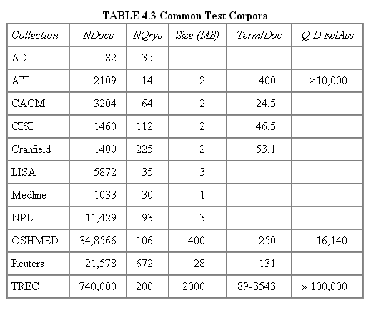
Some public test Collections
Sec. 8.5
Typical TREC

Slide 11
Now we have the basics of a benchmark
Let’s review some evaluation measures
  Precision
  Recall
  DCG
  …

Slide 12
Evaluating an IR system
Sec. 8.1
Note: user need is translated into a query
Relevance is assessed relative to the user need, not the query
E.g., Information need: My swimming pool bottom is becoming black and needs to be cleaned.
Query: pool cleaner
Assess whether the doc addresses the underlying need, not whether it has these words

Slide 13
Unranked retrieval evaluation:
Precision and Recall
Sec. 8.3
Binary assessments
Precision: fraction of retrieved docs that are relevant = P(relevant|retrieved)
Recall: fraction of relevant docs that are retrieved
= P(retrieved|relevant)
Precision P = tp/(tp + fp)
Recall R = tp/(tp + fn)
 | Relevant | Nonrelevant
Retrieved | tp | fp
Not Retrieved | fn | tn

Slide 14
Rank-Based Measures
Binary relevance
  Precision@K (P@K)
  Mean Average Precision (MAP)
  Mean Reciprocal Rank (MRR)
Multiple levels of relevance
  Normalized Discounted Cumulative Gain (NDCG)

Slide 15

Precision@K
Set a rank threshold K
Compute % relevant in top K
Ignores documents ranked lower than K
Ex:
  Prec@3 of 2/3
  Prec@4 of 2/4
  Prec@5 of 3/5
In similar fashion we have Recall@K

Slide 16

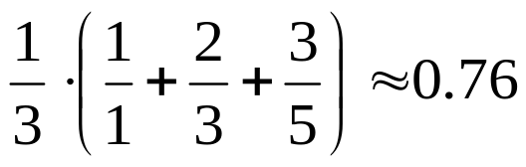
Mean Average Precision
Consider rank position of each relevant doc
  K₁, K₂, … K_{R}
Compute Precision@K for each K= K₁, K₂, … K_{R}
Average precision = average of P@K
Ex: has AvgPrec of
MAP is Average Precision across multiple queries/rankings

Slide 17
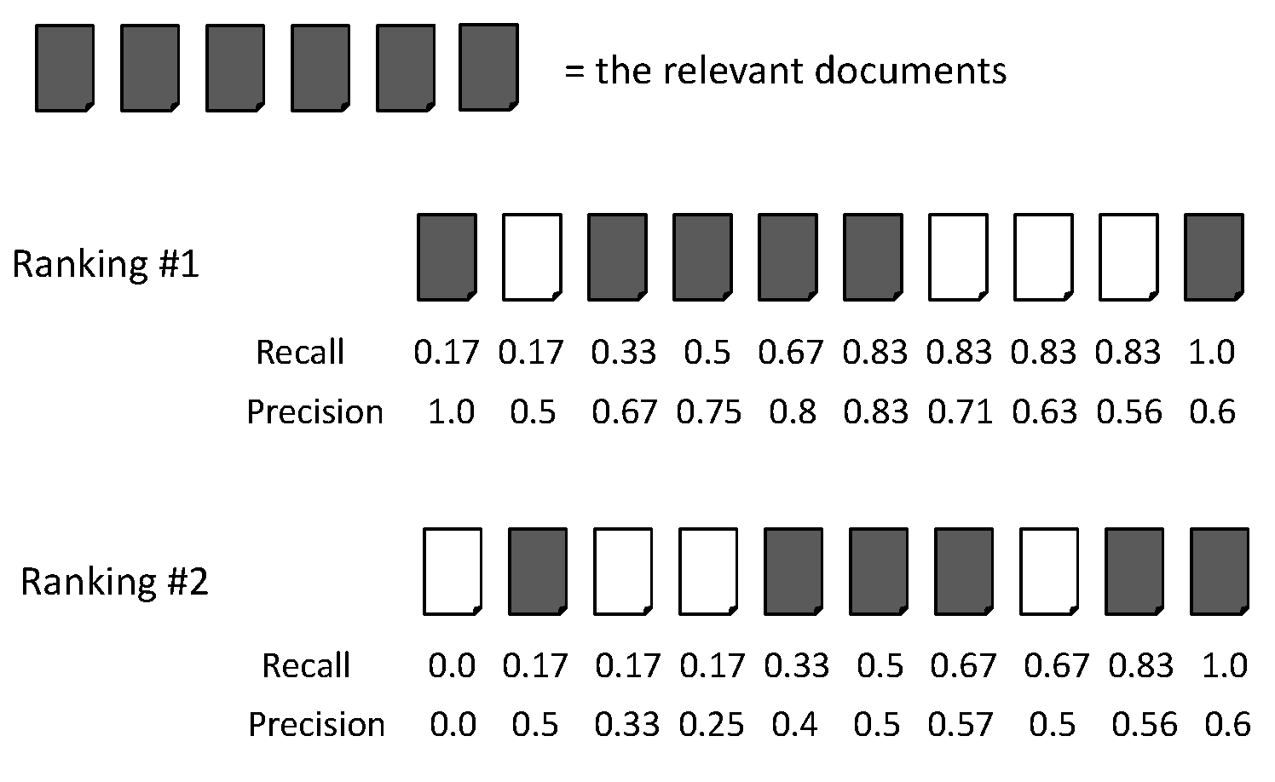
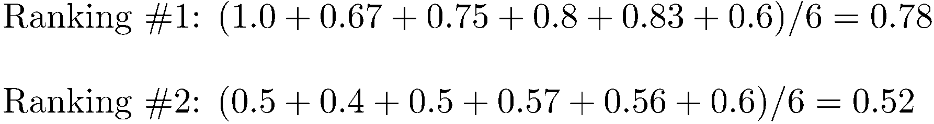
Average Precision

Slide 18
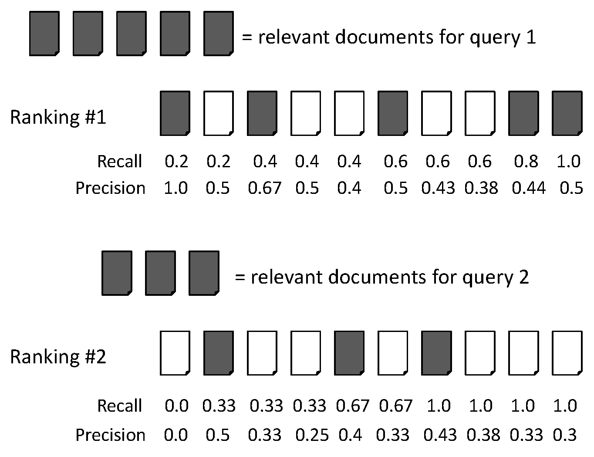
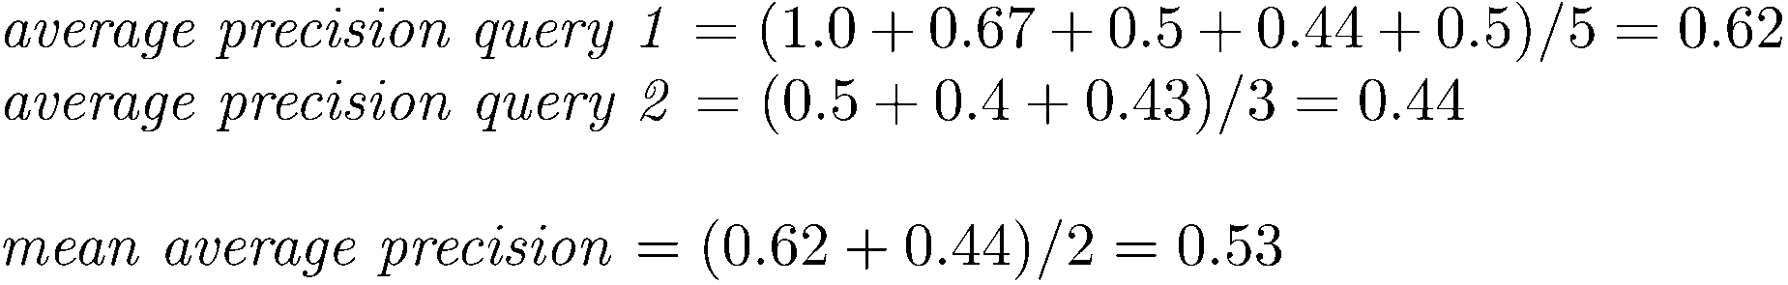
MAP

Slide 19
Mean average precision
  If a relevant document never gets retrieved, we assume the precision corresponding to that relevant doc to be zero
  MAP is macro-averaging: each query counts equally
  Now perhaps most commonly used measure in research papers
  Good for web search?
  MAP assumes user is interested in finding many relevant documents for each query
  MAP requires many relevance judgments in text collection

Slide 20
What if the results are not in a list?
Suppose there’s only one Relevant Document
Scenarios:
  known-item search
  navigational queries
  looking for a fact
Search duration ~ Rank of the answer
  measures a user’s effort

Slide 21
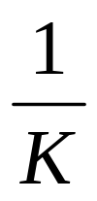
Mean Reciprocal Rank
Consider rank position, K, of first relevant doc
  Could be – only clicked doc
Reciprocal Rank score =
MRR is the mean RR across multiple queries

Slide 22
Beyond binary relevance

Slide 23
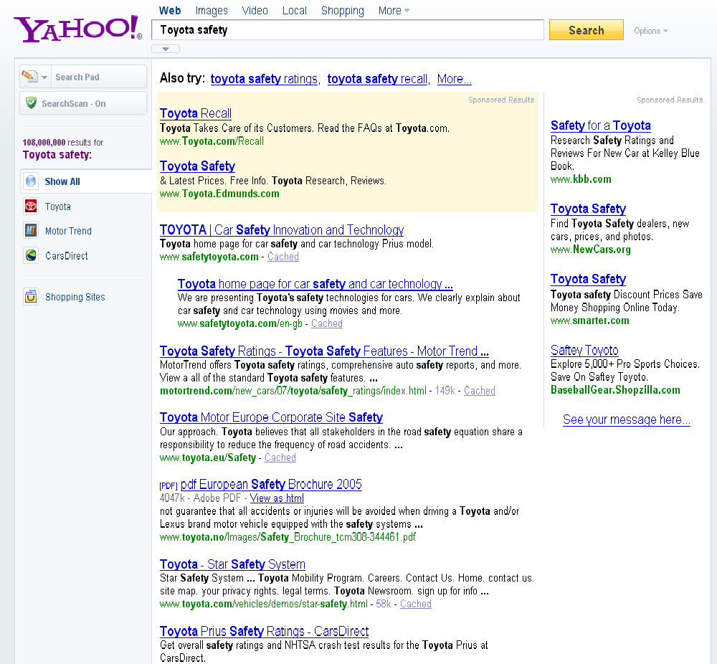
fair
fair
Good

Slide 24
Discounted Cumulative Gain
Popular measure for evaluating web search and related tasks
Two assumptions:
  Highly relevant documents are more useful than marginally relevant documents
  The lower the ranked position of a relevant document, the less useful it is for the user, since it is less likely to be examined

Slide 25
Discounted Cumulative Gain
Uses graded relevance as a measure of usefulness, or gain, from examining a document
Gain is accumulated starting at the top of the ranking and may be reduced, or discounted, at lower ranks
Typical discount is 1/log (rank)
  With base 2, the discount at rank 4 is 1/2, and at rank 8 it is 1/3
  Intuition: if a good document is retrieved at rank 4, system gets only half the credit that it would have got if the doc were to be retrieved at rank 1

Slide 26
Summarize a Ranking: DCG
What if relevance judgments are in a scale of [0,r]? r>2
Cumulative Gain (CG) at rank n
  Let the ratings of the n documents be r₁, r₂, …r_{n} (in ranked order)
  CG = r₁+r₂+…r_{n}
Discounted Cumulative Gain (DCG) at rank n
  DCG = r₁ + r₂/log₂2 + r₃/log₂3 + … r_{n}/log₂n
    We may use any base for the logarithm
Notes:
For rank positions above b, do not discount

Slide 27
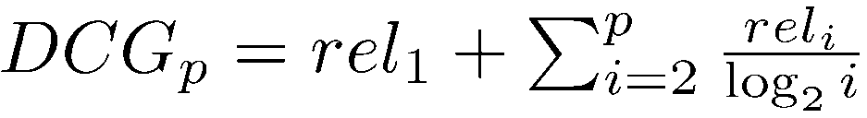
Discounted Cumulative Gain
DCG is the total gain accumulated at a particular rank p:
  used by some web search companies
  emphasis on retrieving highly relevant documents

Slide 28
DCG Example
10 ranked documents judged on 0-3 relevance scale:
  3, 2, 3, 0, 0, 1, 2, 2, 3, 0
Discounted gain:
  3, 2/1, 3/1.59, 0, 0, 1/2.59, 2/2.81, 2/3, 3/3.17, 0
  = 3, 2, 1.89, 0, 0, 0.39, 0.71, 0.67, 0.95, 0
DCG:
  3, 5, 6.89, 6.89, 6.89, 7.28, 7.99, 8.66, 9.61, 9.61
A problem: how to compare DCG for queries having different number of relevant docs?
Notes:
Normalized DCG:
DCG values are often normalized by comparing the DCG at each rank with the DCG value for the perfect ranking
makes averaging easier for queries with different numbers of relevant documents

Slide 29
Summarize a Ranking: NDCG
Normalized Discounted Cumulative Gain (NDCG) at rank n
  Normalize DCG at rank n by the DCG value at rank n of the ideal ranking
  The ideal ranking would first return the documents with the highest relevance level, then the next highest relevance level, etc
Normalization useful for contrasting queries with varying numbers of relevant results
NDCG is now quite popular in evaluating Web search
Notes:
Perfect ranking:
3, 3, 3, 2, 2, 2, 1, 0, 0, 0
ideal DCG values:
3, 6, 7.89, 8.89, 9.75, 10.52, 10.88, 10.88, 10.88, 10
Actual DCG:
3, 5, 6.89, 6.89, 6.89, 7.28, 7.99, 8.66, 9.61, 9.61
NDCG values (divide actual by ideal):
1, 0.83, 0.87, 0.76, 0.71, 0.69, 0.73, 0.8, 0.88, 0.88
NDCG ≤ 1 at any rank position

Slide 30
NDCG for the same example
10 ranked documents judged on 0-3 relevance scale:
  3, 2, 3, 0, 0, 1, 2, 2, 3, 0
Perfect ranking: 3, 3, 3, 2, 2, 2, 1, 0, 0, 0
Ideal DCG values:
  3, 6, 7.89, 8.89, 9.75, 10.52, 10.88, 10.88, 10.88, 10
Actual DCG (from two slides back):
  3, 5, 6.89, 6.89, 6.89, 7.28, 7.99, 8.66, 9.61, 9.61
NDCG values (divide actual by ideal):
  1, 0.83, 0.87, 0.76, 0.71, 0.69, 0.73, 0.8, 0.88, 0.88
  NDCG ≤ 1 at any rank position
Notes:
Normalized DCG:
DCG values are often normalized by comparing the DCG at each rank with the DCG value for the perfect ranking
makes averaging easier for queries with different numbers of relevant documents

Slide 31
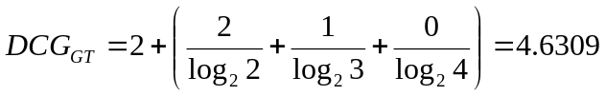
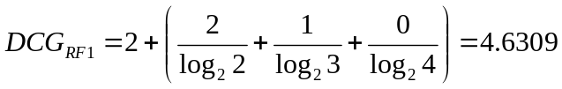
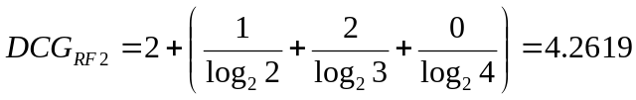

NDCG – Another Example
4 documents: d₁, d₂, d₃, d₄
i | Ground Truth |  | Ranking Function₁ |  | Ranking Function₂
 | Document Order | r_{i} | Document Order | r_{i} | Document Order | r_{i}
1 | d4 | 2 | d3 | 2 | d3 | 2
2 | d3 | 2 | d4 | 2 | d2 | 1
3 | d2 | 1 | d2 | 1 | d4 | 2
4 | d1 | 0 | d1 | 0 | d1 | 0
 | NDCG_{GT}=1.00 |  | NDCG_{RF1}=1.00 |  | NDCG_{RF2}=0.9203

