Slide 1
Lecture 8: Index Construction

Slide 2
Index construction
Ch. 4
How do we construct an index?
What strategies can we use with limited main memory?

Slide 3
Hardware basics
Sec. 4.1
Many design decisions in information retrieval are based on the characteristics of hardware
We begin by reviewing hardware basics

Slide 4
Hardware basics
Sec. 4.1
Access to data in memory is much faster than access to data on disk.
Disk seeks:
  No data is transferred from disk while the disk head is being positioned. → takes a while for the disk head to move to the part of the disk where data is located.
  Therefore: Transferring one large chunk of data from disk to memory is faster than transferring many small chunks.
Disk I/O is block-based: Reading and writing of entire blocks (as opposed to smaller chunks): 8 to 256 KB.

Slide 5
Hardware basics
Sec. 4.1
Servers used in IR systems now typically have several GB of main memory, sometimes tens of GB.
Available disk space is several (2–3) orders of magnitude larger.

Slide 6
Hardware assumptions for this lecture
Sec. 4.1
symbol statistic value
s average seek time 5 ms = 5 x 10⁻³ s
b transfer time per byte 0.02 μs = 2 x 10⁻⁸ s
processor’s clock rate 10⁹ s⁻¹
p low-level operation 0.01 μs = 10⁻⁸ s
  (e.g., compare & swap a word)
size of main memory several GB
size of disk space 1 TB or more

Slide 7
RCV1: Our collection for this lecture
Sec. 4.2
Shakespeare’s collected works definitely aren’t large enough for demonstrating many of the points in this course.
The collection we’ll use isn’t really large enough either, but its publicly available and is at least a more plausible example.
As an example for applying scalable index construction algorithms, we will use the Reuters RCV1 collection.
This is one year of Reuters newswire (part of 1995 and 1996)

Slide 8

A Reuters RCV1 document
Sec. 4.2

Slide 9
Reuters RCV1 statistics
Sec. 4.2
symbol statistic value
N documents 800,000
M terms (= word types) 400,000
non-positional postings 100,000,000 (100 Million)

Slide 10
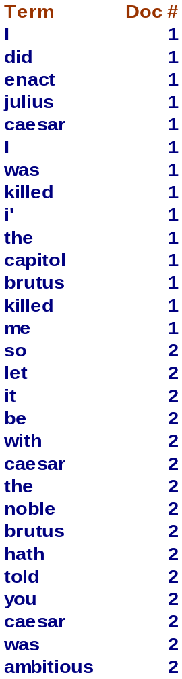
Recap: Lec 1 index construction
Sec. 4.2
Documents are parsed to extract words and these are saved with the Document ID.
Doc 1
Doc 2
I did enact Julius
Caesar I was killed
i' the Capitol;
Brutus killed me.
So let it be with
Caesar. The noble
Brutus hath told you
Caesar was ambitious

Slide 11
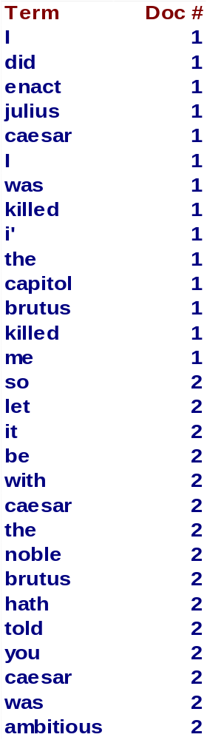
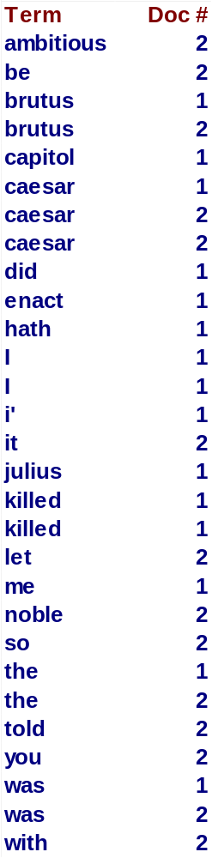
Key step
Sec. 4.2
After all documents have been parsed, the inverted file is sorted by terms.
We focus on this sort step.
We have 100M items to sort.

Slide 12
Scaling index construction
Sec. 4.2
In-memory index construction does not scale
  Can’t stuff entire collection into memory, sort, then write back
How can we construct an index for very large collections?
Taking into account the hardware constraints we just learned about . . . Memory, disk, speed, etc.

Slide 13
Sort-based index construction
Sec. 4.2
As we build the index, we parse docs one at a time.
  While building the index, we cannot easily exploit compression tricks (you can, but much more complex)
The final postings for any term are incomplete until the end.
At 12 bytes per non-positional postings entry (term, doc, freq), demands a lot of space for large collections.
T = 100,000,000 in the case of RCV1
  So … we can do this in memory in 2009, but typical collections are much larger. E.g., the New York Times provides an index of >150 years of newswire
Thus: We need to store intermediate results on disk.

Slide 14
Sort using disk as “memory”?
Sec. 4.2
Can we use the same index construction algorithm for larger collections, but by using disk instead of memory?
No: Sorting T = 100,000,000 records on disk is too slow – too many disk seeks.
We need an external sorting algorithm.

Slide 15
Bottleneck
Sec. 4.2
Parse and build postings entries one doc at a time
Now sort postings entries by term (then by doc within each term)
Doing this with random disk seeks would be too slow – must sort T=100M records
If every comparison took 2 disk seeks, and N items could be
sorted with N log₂N comparisons, how long would this take?

Slide 16
BSBI: Blocked sort-based Indexing (Sorting with fewer disk seeks)
Sec. 4.2
12-byte (4+4+4) records (term, doc, freq).
These are generated as we parse docs.
Must now sort 100M such 12-byte records by term.
Define a Block ~ 10M such records
  Can easily fit a couple into memory.
  Will have 10 such blocks to start with.
Basic idea of algorithm:
  Accumulate postings for each block, sort, write to disk.
  Then merge the blocks into one long sorted order.

Slide 17
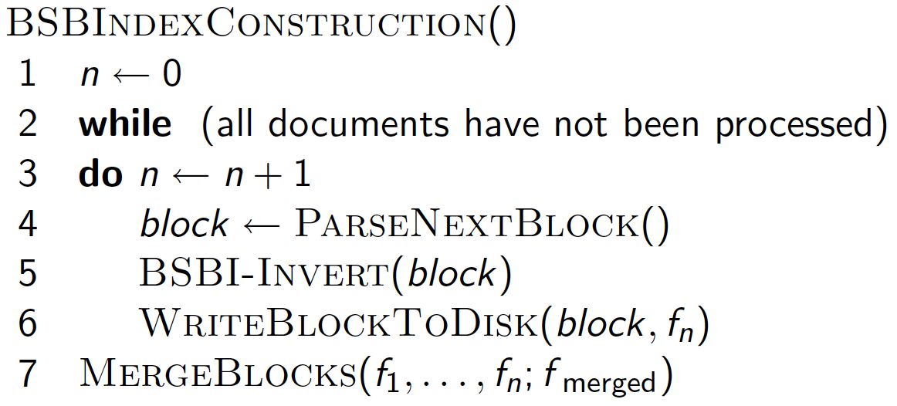
Sec. 4.2
Inversion involves 2 steps:
sort the termID-docID pairs
collect all termID–docID pairs with the same termID into a postings list

Slide 18
Sorting 10 blocks of 10M records
Sec. 4.2
First, read each block and sort within:
  Quicksort takes 2N ln N expected steps
  In our case 2 x (10M ln 10M) steps
Exercise: estimate total time to read each block from disk and and quicksort it.
10 times this estimate – gives us 10 sorted runs of 10M records each.

Slide 19
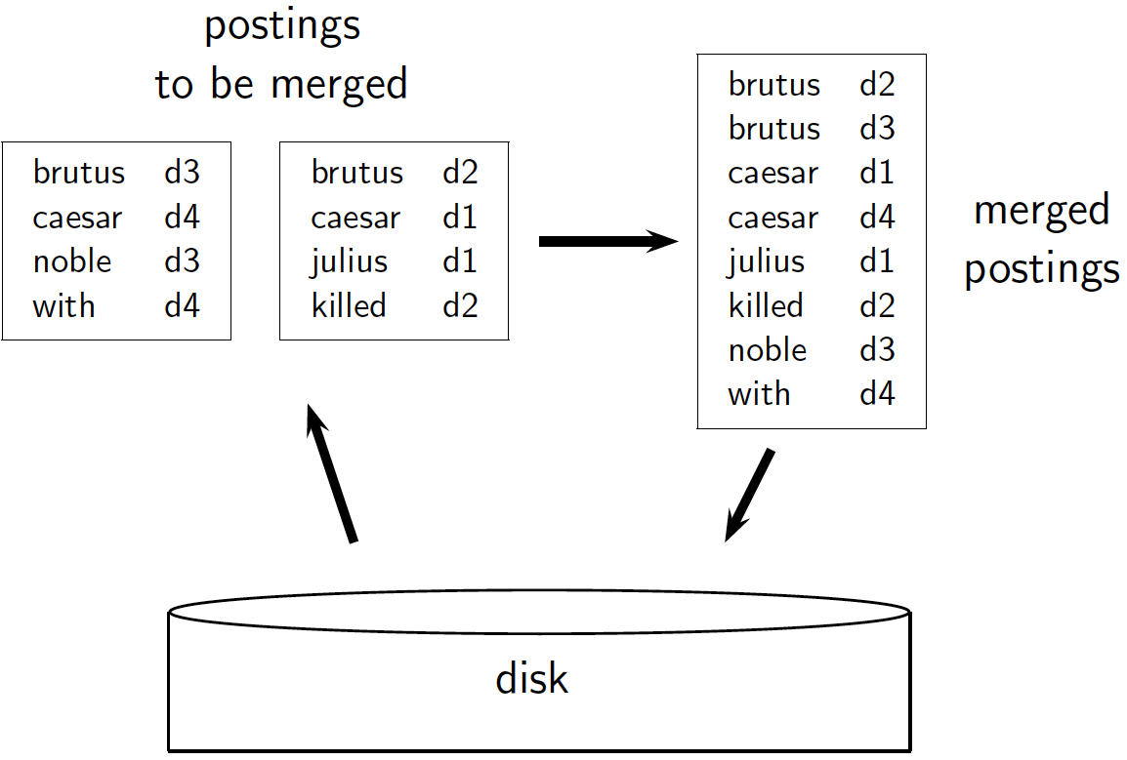
Sec. 4.2

Slide 20
How to merge the sorted runs?
Sec. 4.2
Can do binary merges, with a merge tree of log₂10 = 4 layers.
During each layer, read into memory runs in blocks of 10M, merge, write back.
1
1
2
2
Merged run.
3
4
3
4
Runs being
merged.
Disk

Slide 21
How to merge the sorted runs?
Sec. 4.2
But it is more efficient to do a multi-way merge, where you are reading from all blocks simultaneously
Providing you read decent-sized chunks of each block into memory and then write out a decent-sized output chunk, then you’re not killed by disk seeks
Notes:
What is the overall complexity of

Slide 22
Remaining problem with sort-based algorithm
Sec. 4.3
Our assumption was: we can keep the dictionary in memory.
We need the dictionary (which grows dynamically) in order to implement a term to termID mapping.
Actually, we could work with term,docID postings instead of termID,docID postings . . .
. . . but then intermediate files become very large. (We would end up with a scalable, but very slow index construction method.)

Slide 23
Terms represented as termIDs?
To make index construction more efficient, we can represent terms as termIDs
Each termID is a unique serial number
How to build the mapping from terms to termIDs?
  On the fly while we are processing the collection; or,
  A two-pass approach: compile the vocabulary in the first pass and construct the inverted index in the second pass
Some indexing algorithms use termIDs, others directly use the term
  Hybrid approaches possible: map frequently occurring terms to termIDs, rare terms directly handled

Slide 24
SPIMI:
Single-pass in-memory indexing
Sec. 4.3
Key idea 1: Generate separate dictionaries for each block – no need to maintain term-termID mapping across blocks.
Key idea 2: Don’t sort. Accumulate postings in postings lists as they occur.
With these two ideas we can generate a complete inverted index for each block.
These separate indexes can then be merged into one big index.

Slide 25
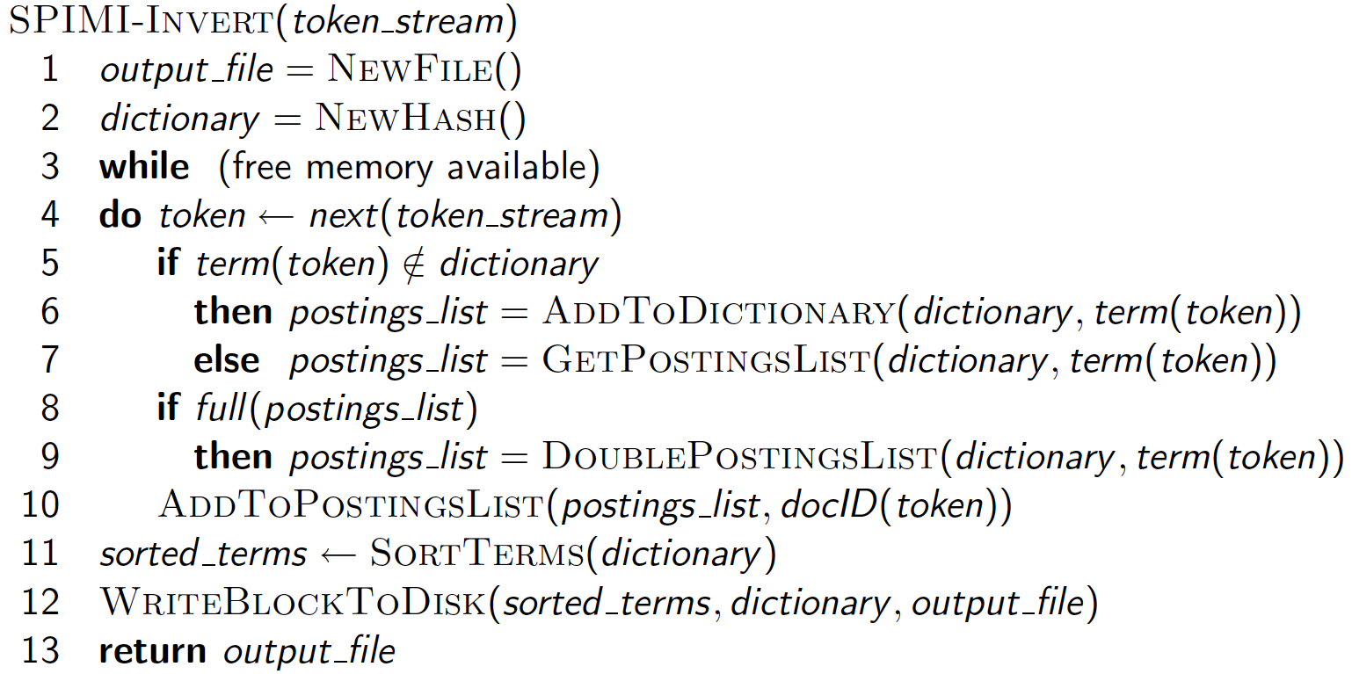
SPIMI-Invert
Sec. 4.3
Merging of blocks is analogous to BSBI.

Slide 26
SPIMI-Invert: explanation
Instead of first collecting all termID–docID pairs and then sorting them (as we did in BSBI), SPIMI adds a posting directly to its postings list (line 10)
We do not know how large the postings list of a term will be when we first encounter it, hence
  allocate space for a short postings list initially,
  double the space each time it is full (lines 8–9)

Slide 27
SPIMI-Invert: explanation
When memory exhausted, write the index of the block (which consists of the dictionary and the postings lists) to disk (line 12)
Sort the terms (line 11) before writing to disk since we want to write postings lists in lexicographic order to facilitate the final merging step.

Slide 28
Till now
Sort-based indexing
  Naïve in-memory or in-disk inversion
  Blocked Sort-Based Indexing (BSBI)
    Merge sort is effective for disk-based sorting (avoid seeks!)
Single-Pass In-Memory Indexing (SPIMI)
  No global dictionary
    Generate separate dictionary for each block
  Don’t sort postings
    Accumulate postings in postings lists as they occur
Next
  Distributed indexing using MapReduce
  Dynamic indexing: Multiple indices, logarithmic merge

Slide 29
Distributed indexing
Sec. 4.4
For web-scale indexing:
  must use a distributed computing cluster
Individual machines are fault-prone
  Can unpredictably slow down or fail
How do we exploit such a pool of machines?

Slide 30
Web search engine data centers
Sec. 4.4
Web search data centers (Google, Bing, Baidu) mainly contain commodity machines.
Data centers are distributed around the world.
Estimate: Google ~1 million servers, 3 million processors/cores (Gartner 2007)

Slide 31
Distributed indexing
Sec. 4.4
MapReduce: a general architecture for distributed computing
Maintain a master node (machine) directing the indexing job – considered “safe”.
Many worker nodes, each of which can fail
Break up indexing into sets of (parallel) tasks.
Master assigns each task to an idle worker from a pool

Slide 32
Distributed Indexing
In general, MapReduce breaks a large computing problem into smaller parts by recasting it in terms of manipulation of key-value pairs
For the task of indexing, a key-value pair has the form (termID,docID)

Slide 33
Parallel tasks
Sec. 4.4
We will use two sets of parallel tasks
  Parsers
  Inverters
Break the input document collection into splits
Each split is a subset of documents (corresponding to blocks in BSBI/SPIMI)
Map phase: map splits of the input data to key-value pairs - done by parser machines
Reduce phase: Collect all values (here: docIDs) for a given key (here: termID) – done by inverter machines

Slide 34
Data flow
Sec. 4.4
assign
Master
assign
Postings
Parser
a-f
g-p
q-z
Inverter
a-f
Parser
a-f
g-p
q-z
Inverter
g-p
splits
Inverter
q-z
Parser
a-f
g-p
q-z
Map
phase
Reduce
phase
Segment files

Slide 35
Parsers (Map phase)
Sec. 4.4
Master assigns a split to an idle parser machine
Parser reads a document at a time and emits (term, doc) pairs
Parser writes pairs into j partitions
Each partition is for a range of terms’ first letters (called term-partition)
  (e.g., a-f, g-p, q-z) – here j = 3.
Now to complete the index inversion

Slide 36
Inverters (Reduce phase)
Sec. 4.4
An inverter collects all (term,doc) pairs (= postings) for one term-partition.
Sorts and writes to postings lists
  Finally, the list of values is sorted for each key and written to the final sorted postings list (“postings” in the figure).
Note:
  Parsers and inverters are not separate sets of machines.
  The same machine can be a parser in the map phase and an inverter in the reduce phase.

Slide 37
Schema for index construction in MapReduce
Sec. 4.4
Schema of map and reduce functions
map: input → list(k, v) reduce: (k,list(v)) → output
Instantiation of the schema for index construction
map: collection → list(termID, docID)
reduce: (<termID1, list(docID)>, <termID2, list(docID)>, …) → (postings list1, postings list2, …)

Slide 38
Example for index construction
Map:
d1 : C came, C c’ed.
d2 : C died. →
<C,d1>, <came,d1>, <C,d1>, <c’ed, d1>, <C, d2>, <died,d2>
Reduce:
(<C,(d1,d2,d1)>, <died,(d2)>, <came,(d1)>, <c’ed,(d1)>) → (<C,(d1:2,d2:1)>, <died,(d2:1)>, <came,(d1:1)>, <c’ed,(d1:1)>)

Slide 39
Dynamic indexing
Sec. 4.5
Up to now, we have assumed that collections are static.
They rarely are:
  Documents come in over time and need to be inserted.
  Documents are deleted and modified.
This means that the dictionary and postings lists have to be modified:
  Postings updates for terms already in dictionary
  New terms added to dictionary

Slide 40
Simplest approach
Sec. 4.5
Maintain “big” main index
New docs go into “small” auxiliary index
Search across both, merge results
Deletions
  Invalidation bit-vector for deleted docs
  Filter docs output on a search result by this invalidation bit-vector
Periodically, re-index into one main index

Slide 41
Issues with main and auxiliary indexes
Sec. 4.5
Problem of frequent merges – you touch stuff a lot
Poor performance during merge
Actually:
  Merging of the auxiliary index into the main index is efficient if we keep a separate file for each postings list.
  Merge is the same as a simple append.
  But then we would need a lot of files – inefficient for OS.
Assumption for the rest of the lecture: The index is one big file.
In reality: Use a scheme somewhere in between (e.g., split very large postings lists, collect postings lists of length 1 in one file etc.)

Slide 42
Logarithmic merge
Sec. 4.5
Maintain a series of indexes, each twice as large as the previous one
  At any time, some of these powers of 2 are instantiated
Keep smallest (Z₀) in memory
Larger ones (I₀, I₁, …) on disk
If Z₀ gets too big (> n), write to disk as I₀
or merge with I₀ (if I₀ already exists) as Z₁
Either write merge Z₁ to disk as I₁ (if no I₁)
Or merge with I₁ to form Z₂

Slide 43
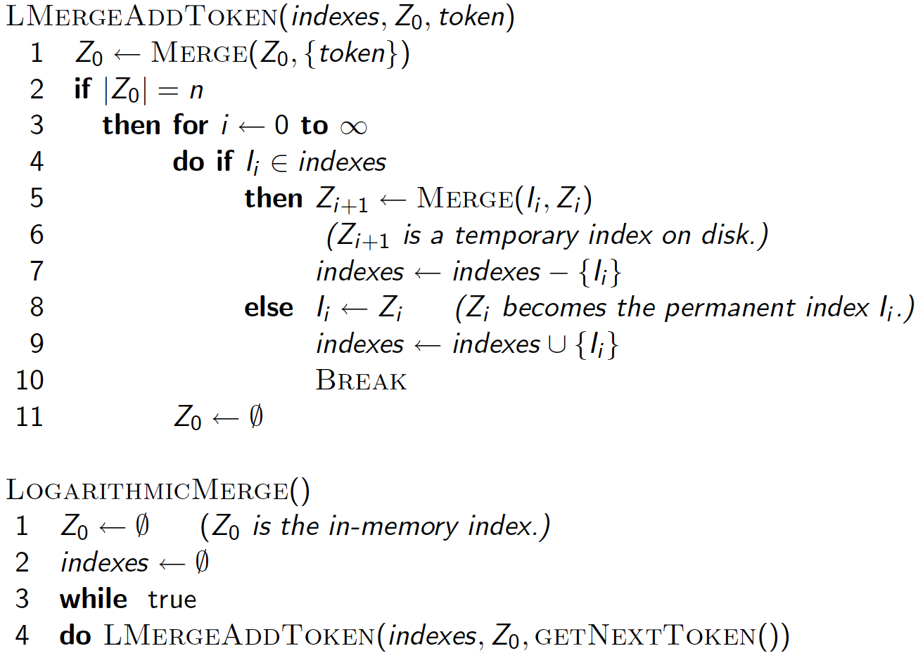
Sec. 4.5

Slide 44
Further issues with multiple indexes
Sec. 4.5
Collection-wide statistics are hard to maintain
E.g., when we spoke of spell-correction: which of several corrected alternatives do we present to the user?
  We said, pick the one with the most hits
How do we maintain the top ones with multiple indexes and invalidation bit vectors?
  One possibility: ignore everything but the main index for such ordering

Slide 45
Dynamic indexing at search engines
Sec. 4.5
All the large search engines now do dynamic indexing
Their indices have frequent incremental changes
  News items, blogs, new topical web pages
But (sometimes/typically) they also periodically reconstruct the index from scratch
  Need more hardware resources
  Query processing is then switched to the new index, and the old index is deleted

Slide 46
Other sorts of indexes
Sec. 4.5
Positional indexes
  Same sort of sorting problem … just larger
Building character n-gram indexes:
  As text is parsed, enumerate n-grams.
  For each n-gram, need pointers to all dictionary terms containing it – the “postings”.
  Note that the same “postings entry” will arise repeatedly in parsing the docs – need efficient hashing to keep track of this.
    E.g., that the trigram uou occurs in the term deciduous will be discovered on each text occurrence of deciduous
    Only need to process each term once

