Slide 1


Bayesian Classification

Slide 2
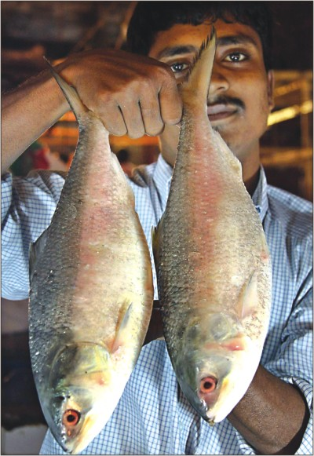
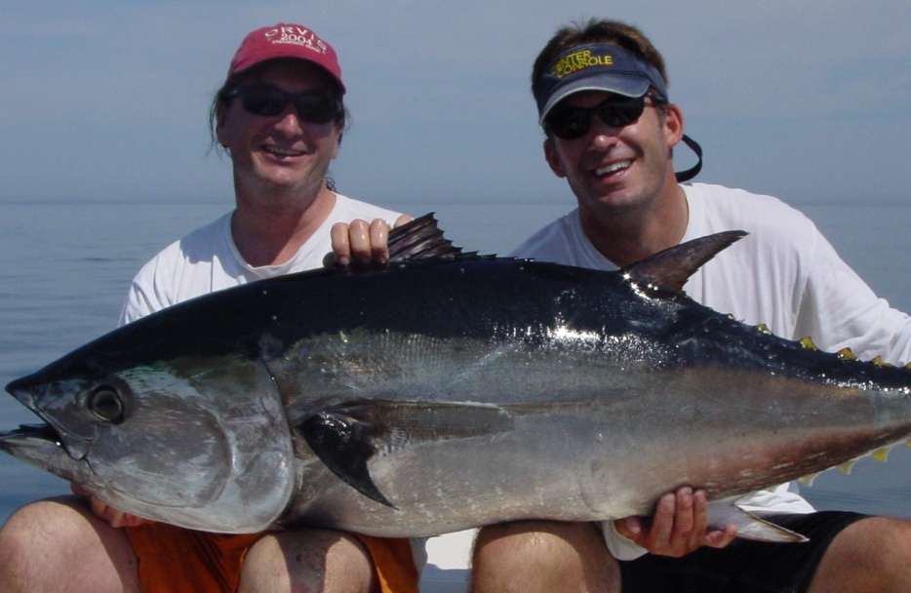
A Simple Species Classification Problem
Measure the length of a fish, and decide its class
  Hilsa or Tuna

Slide 3
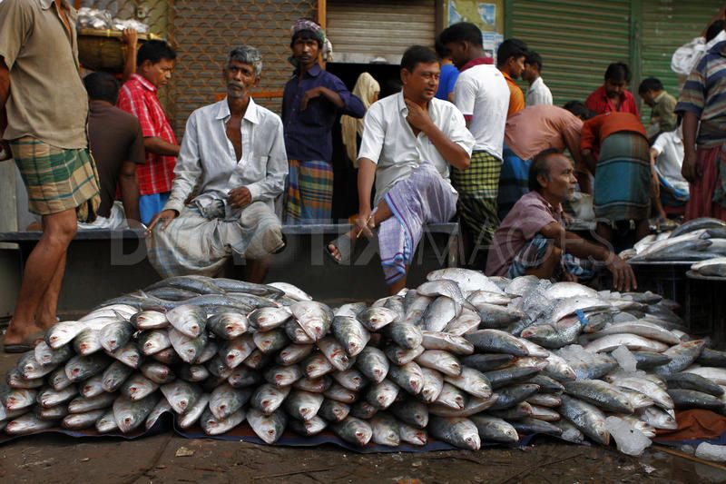
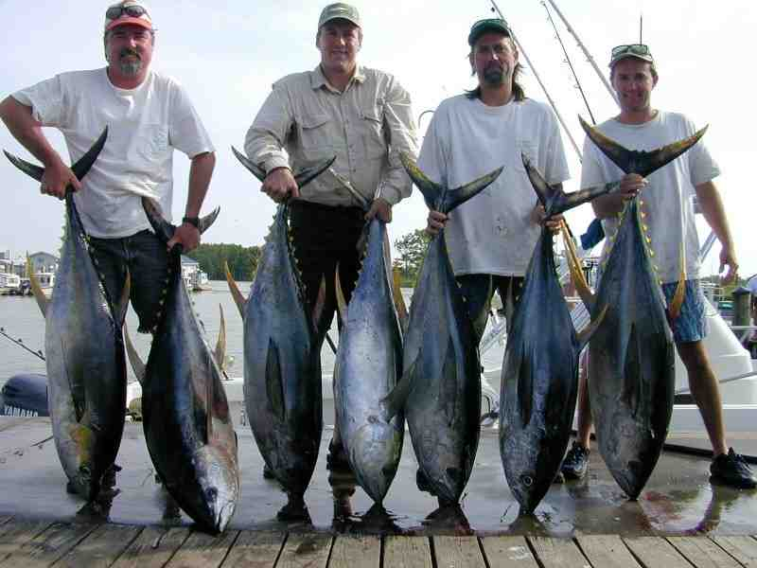
Collect Statistics …
Population for Class Hilsa
Population for Class Tuna

Slide 4
Distribution of “Fish Length”
Class Conditional Distributions
P ( L = 1.75 ft | HILSA )
P ( L = 4.25 ft | TUNA )
HILSA
Count/probability
length in feet
1ft
TUNA
Count/probability
Histograms
length in feet
4ft

Slide 5
Decision Rule
If length L ≤ B
  HILSA
ELSE
  TUNA
What should be the value of B (“boundary” length) ?
  Based on population statistics

Slide 6
Error of Decision Rule
P( L | TUNA)
P( L | HILSA)
L
B
Errors: Type 1 + Type 2,
Type 1: Actually Tuna, Classified as Hilsa (area under pink curve to the left of a B)
Type 2: Actually Hilsa, Classified as Tuna (area under blue curve to the right of a B)

Slide 7
Optimal Decision Rule
P( L | TUNA)
P( L | HILSA)
L
B*
B*: Optimal Value of B, (Optimal Decision Boundary)
Minimum Possible Error
P ( B* | HILSA ) = P ( B* | TUNA )
If Type 1 and Type 2 errors have different costs : optimal boundary shifts

Slide 8
Species Identification Problem
Measure lengths of a (sizeable) population of Hilsa and Tuna fishes
Estimate Class Conditional Distributions for Hilsa and Tuna classes respectively
Find Optimal Decision Boundary B* from the distributions
Apply Decision Rule to classify a newly caught (and measured) fish as either Hilsa or Tuna
  (with minimum error probability)

Slide 9
Location/Time of Experiment
Calcutta in Monsoon
  More Hilsa few Tuna
California in Winter
  More Tuna less Hilsa
Even a 2ft fish is likely to be Hilsa in Calcutta (2000 Rs/Kilo!),
a 1.5ft fish may be Tuna in California

Slide 10
Apriori Probability
Without measuring length what can we guess about the class of a fish
  Depends on location/time of experiment
    Calcutta : Hilsa, California: Tuna
Apriori probability: P(HILSA), P(TUNA)
  Property of the frequency of classes during experiment
    Not a property of length of the fish
  Calcutta: P(Hilsa) = 0.90, P(Tuna) = 0.10
  California: P(Tuna) = 0.95, P(Hilsa) = 0.05
  London: P(Tuna) = 0.50, P(Hilsa) = 0.50
Also a determining factor in class decision along with class conditional probability

Slide 11
Classification Decision
We consider the product of Apriori and Class conditional probability factors
Posteriori probability (Bayes rule)
  P(HILSA | L = 2ft) = P(HILSA) x P(L=2ft | HILSA) / P(L=2ft)
  Posteriori ≈ Apriori x Class conditional
  denominator is constant for all classes
Apriori: Without any measurement - based on just location/time – what can we guess about class membership (estimated frm size of class populations)
Class conditional: Given the fish belongs to a particular class what is the probability that its length is L=2ft (estimated from population)
Posteriori: Given the measurement that the length of the fish is L=2ft what is the probability that the fish belongs to a particular class (obtained using Bayes rule from above two probabilities).
  Useful in decision making using evidences/measurements.

Slide 12
Bayes Classification Rule (Bayes Classifier)
Posteriori Distributions
P( TUNA | L)
P( HILSA | L)
L
B*
B*: Optimal Value of B, (Bayes Decision Boundary)
P ( HILSA| L= B* ) = P ( TUNA | L = B*)
Minimum error probability: Bayes error

Slide 13
MAP Representation of Bayes Classifier
Posteriori Distributions
P( TUNA | L)
P( HILSA | L)
L
Hilsa has higher posteriori probability than Tuna for this length
Instead of finding decision boundary B*, state classification rule as:
Classify an object in to the class for which it has the highest posteriori prob.
(MAP: Maximum Aposteriori Probability)

Slide 14
MAP Multiclass Classifier
Posteriori Distributions
P( TUNA | L)
P( SHARK | L)
P( HILSA | L)
L
Hilsa has highest posteriori probability among all classes for this length
Classify an object in to the class for which it has the highest posteriori prob.
(MAP: Maximum Aposteriori Probability)

Slide 15
Multivariate Bayes Classifier
Decision Boundary
TUNA
Weight
HILSA
Length
Feature or Attribute Space
Class Seperability

Slide 16
Decision Boundary: Normal Distribution
Two spherical classes having different means, but same variance (diagonal covariance matrix with same variances)
Weight
TUNA
HILSA
Length
Decision Boundary: Perpendicular bisector of the mean vectors

Slide 17
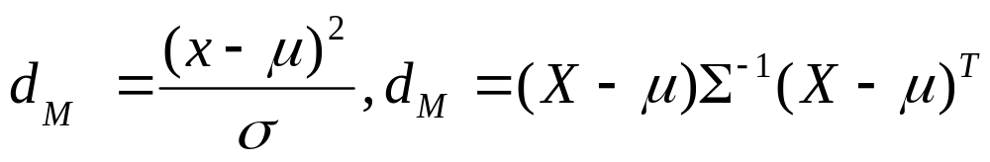
Distances
Two vectors: Euclidean, Minkowski etc
A vector and a distribution: Mahalanobis, Bhattacharya
Between two distributions: Kullback-Liebler Divergence
Which distribution is closer to x?
x
μ
σ₂
σ₁

Slide 18
Decision Boundary: Normal Distribution
Two spherical classes having different means and variances (diagonal covariance matrix with different variances)
TUNA
Weight
HILSA
Length
Boundary: Locus of equi-Mahalanobis distance points from the class distributions.
(still a straight line)

Slide 19
Decision Boundary: Normal Distribution
Two elliptical classes having different means and variances (general covariance matrix with different variances)
TUNA
Weight
HILSA
Length
Class Boundary: Parabolic

Slide 20
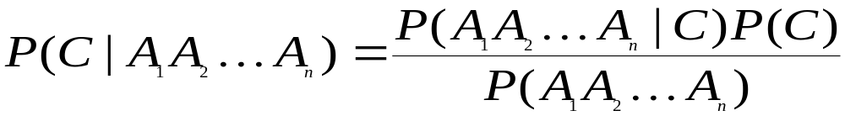
Bayesian Classifiers
Approach:
  compute the posterior probability P(C | A₁, A₂, …, A_{n}) for all values of C using the Bayes theorem
  Choose value of C that maximizes
  P(C | A₁, A₂, …, A_{n})
  Equivalent to choosing value of C that maximizes
  P(A₁, A₂, …, A_{n}|C) P(C)
How to estimate P(A₁, A₂, …, A_{n} | C )?

Slide 21
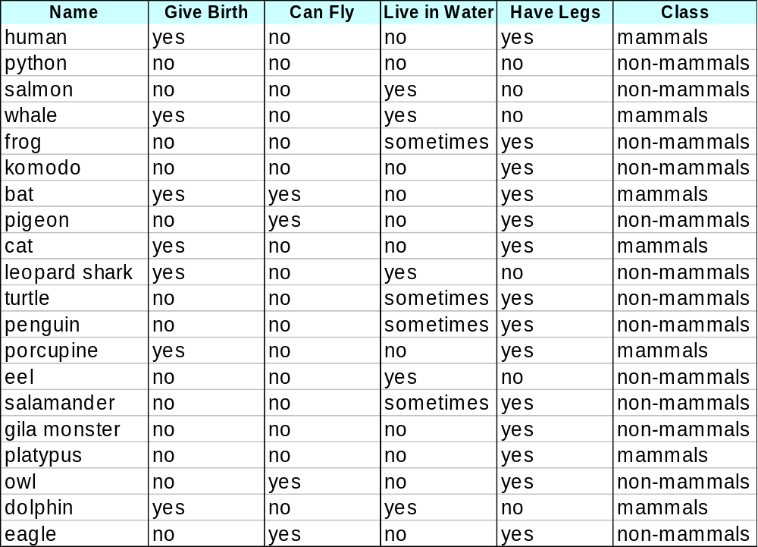
Example of Bayes Classifier
A: attributes
M: mammals
N: non-mammals
P(A|M)P(M) > P(A|N)P(N)
=> Mammals

Slide 22
Estimating Multivariate Class Distributions
Sample size requirement
  In a small sample: difficult to find a Hilsa fish whose length is 1.5ft and weight is 2 kilos, as compared to that of just finding a fish whose length is 1.5ft
  P(L=1.5, W=2 | Hilsa), P(L=1.5 | Hilsa)
  Curse of dimensionality
Independence Assumption
  Assume length and weight are independent
  P(L=1.5, W=2 | Hilsa) = P(L=1.5 | Hilsa) x P(W=2| Hilsa)
  Joint distribution = product of marginal distributions
  Marginals are easier to estimate from a small sample

Slide 23
Naïve Bayes Classifier
Assume independence among attributes A_{i} when class is given:
  P(A₁, A₂, …, A_{n} |C) = P(A₁| C_{j}) P(A₂| C_{j})… P(A_{n}| C_{j})
  Can estimate P(A_{i}| C_{j}) for all A_{i} and C_{j}.
  New point is classified to C_{j} if P(C_{j}) Π P(A_{i}| C_{j}) is maximal.

Slide 24
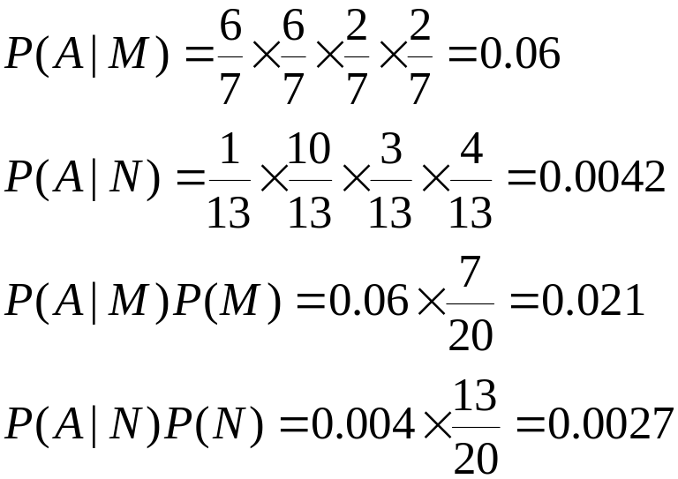
Example of Naïve Bayes Classifier
A: attributes
M: mammals
N: non-mammals
P(A|M)P(M) > P(A|N)P(N)
=> Mammals

Slide 25
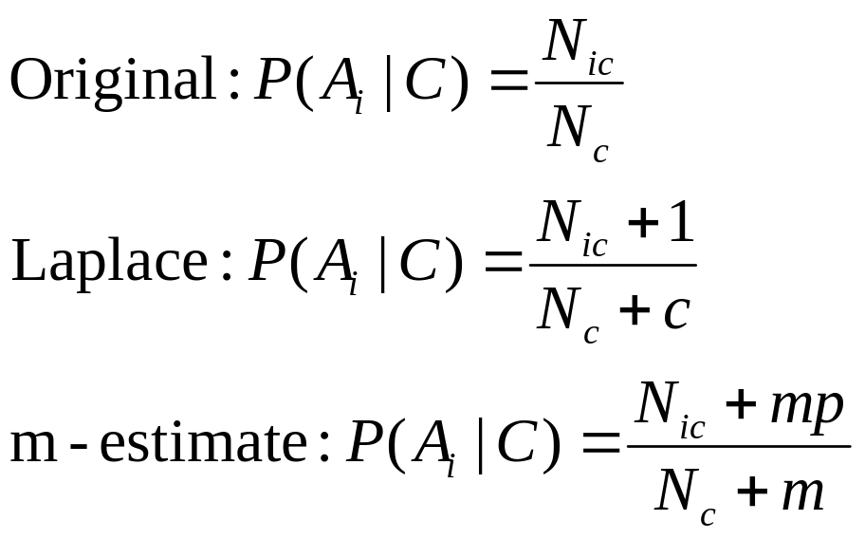
Naïve Bayes Classifier
If one of the conditional probability is zero, then the entire expression becomes zero
Probability estimation:
c: number of classes
p: prior probability
m: parameter

Slide 26
Bayes Classifier (Summary)
Robust to isolated noise points
Handle missing values by ignoring the instance during probability estimate calculations
Robust to irrelevant attributes
Independence assumption may not hold for some attributes
  Length and weight of a fish are not independent

Slide 27
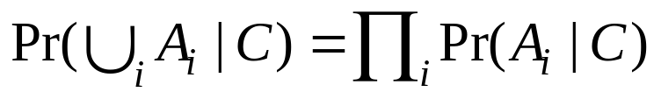
Conditional Independence
Event A and B are conditionally independent given C in case
Pr(AB|C)=Pr(A|C)Pr(B|C)
A set of events {A_{i}} is conditionally independent given C in case

Slide 28
CI: Conditional Independence
RV are rarely independent but we can still leverage local structural properties like CI.
X ⊥ Y | Z if once Z is observed, knowing the value of Y does not change our belief about X
  The following should hold for all x,y,z
  P(X=x | Z=z, Y=y) = P(X=x | Z=z)
  P(Y=y | Z=z, X=x) = P(Y=y | Z=z)
  P(X=x, Y=y | Z=z) = P(X=x| Z=z) P(Y=y| Z=z)
We call these factors : very useful concept !!

Slide 29
Example
Let the two events be the probabilities of persons A and B getting home in time for dinner, and the third event is the fact that a snow storm hit the city. While both A and B have a lower probability of getting home in time for dinner, the lower probabilities will still be independent of each other. That is, the knowledge that A is late does not tell you whether B will be late. (They may be living in different neighborhoods, traveling different distances, and using different modes of transportation.) However, if you have information that they live in the same neighborhood, use the same transportation, and work at the same place, then the two events are NOT conditionally independent.

Slide 30
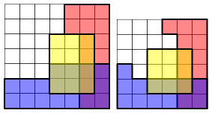
Conditional Independence
Each cell represents a possible outcome.
The events R, B and Y are represented by the areas
The probabilities of these events are shaded areas with respect to the total area.
In both examples R and B are conditionally independent given Y]
but not conditionally independent given not Y

Slide 31
Exercise: Conditional independence
p(smart ∧ study ∧ prep) | smart |  | ¬smart
 | study | ¬study | study | ¬study
prepared | .432 | .16 | .084 | .008
¬prepared | .048 | .16 | .036 | .072
Queries:
  Is smart conditionally independent of prepared, given study?
  Is study conditionally independent of prepared, given smart?

Slide 32
DAGS: Markov Assumption
Ancestor
We now make this independence assumption more precise for directed acyclic graphs (DAGs)
Each random variable X, is independent of its non-descendents, given its parents Pa(X)
Formally,
I (X, NonDesc(X) | Pa(X))
Parent
Y₁
Y₂
X
Non-descendent
Non-descendent
Descendent

