Slide 1
Machine Learning

Slide 2
What is Machine Learning?
Optimize a performance criterion using example data or past experience.
Role of Statistics: inference from a sample
Role of Computer science: efficient algorithms to
  Solve an optimization problem
  Represent and evaluate the model for inference
Learning is used when:
  Human expertise does not exist (navigating on Mars),
  Humans are unable to explain their expertise (speech recognition)
  Solution changes with time (routing on a computer network)
  Solution needs to be adapted to particular cases (user biometrics)
There is no need to “learn” to calculate payroll

Slide 3
What We Talk About When We Talk About “Learning”
Learning general models from a data of particular examples
Data is cheap and abundant (data warehouses, data marts); knowledge is expensive and scarce.
Example in retail: Customer transactions to consumer behavior:
  People who bought “Da Vinci Code” also bought “The Five People You Meet in Heaven” (www.amazon.com)
Build a model that is a good and useful approximation to the data.

Slide 4
Types of Learning Tasks
Association
Supervised learning
  Learn to predict output when given an input vector
Reinforcement learning
  Learn action to maximize payoff
    Payoff is often delayed
    Exploration vs. exploitation
    Online setting
Unsupervised learning
  Create an internal representation of the input e.g. form clusters; extract features
    How do we know if a representation is good?
  Big datasets do not come with labels.

Slide 5
Learning Associations
Basket analysis:
P (Y | X ) probability that somebody who buys X also buys Y where X and Y are products/services.
Example: P ( chips | beer ) = 0.7

Slide 6
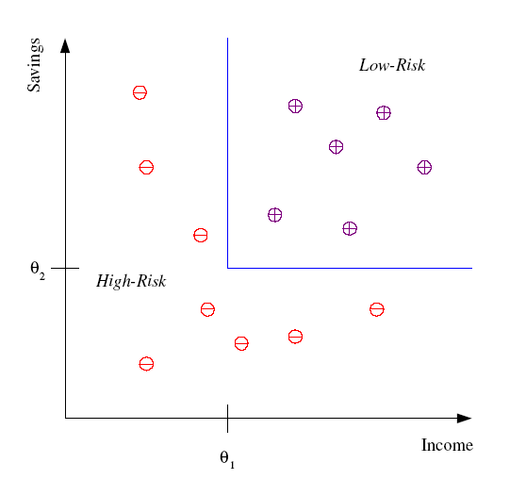
Classification
Example: Credit scoring
Differentiating between low-risk and high-risk customers from their income and savings
Discriminant: IF income > θ₁ AND savings > θ₂
THEN low-risk ELSE high-risk

Slide 7
Classification: Applications
Aka Pattern recognition
Face recognition: Pose, lighting, occlusion (glasses, beard), make-up, hair style
Character recognition: Different handwriting styles.
Speech recognition: Temporal dependency.
  Use of a dictionary or the syntax of the language.
  Sensor fusion: Combine multiple modalities; eg, visual (lip image) and acoustic for speech
Medical diagnosis: From symptoms to illnesses
...

Slide 8








Face Recognition
Training examples of a person
Test images

Slide 9
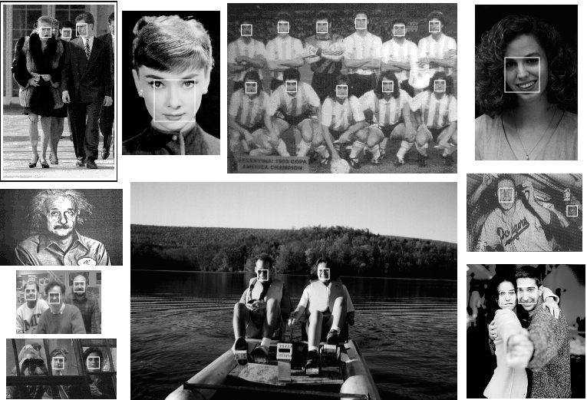
The Role of Learning

Slide 10
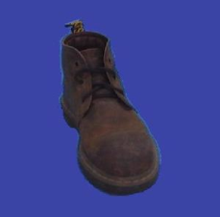

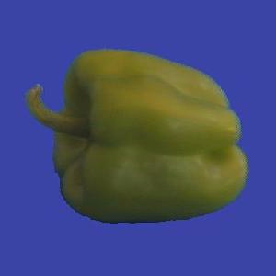
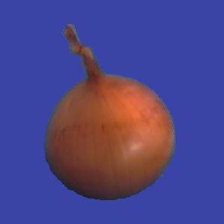
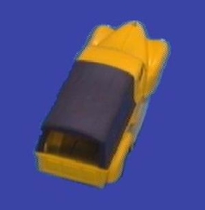
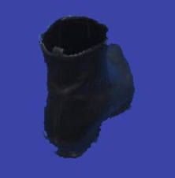



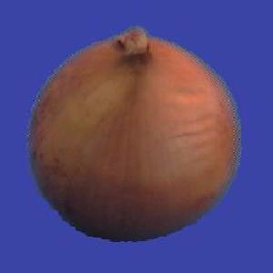
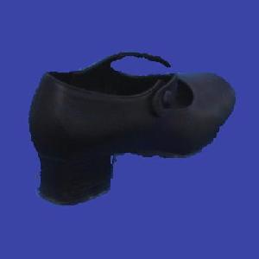
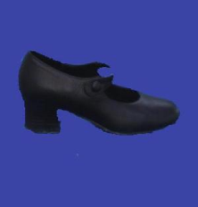


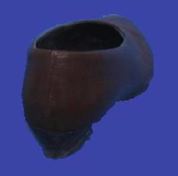

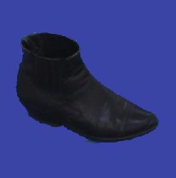




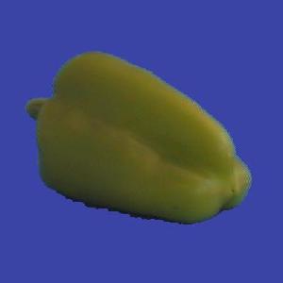




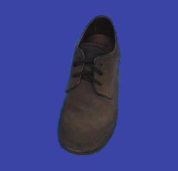
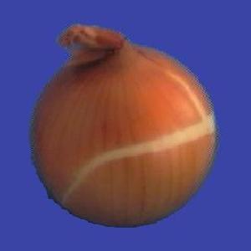


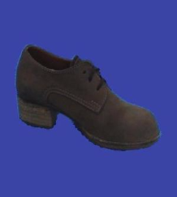
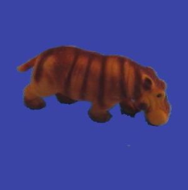
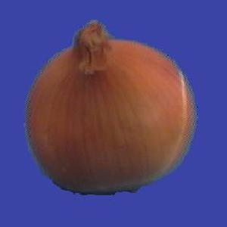
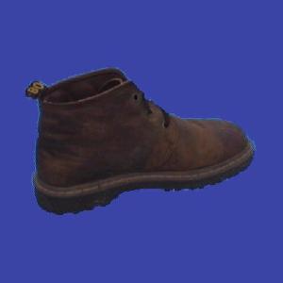
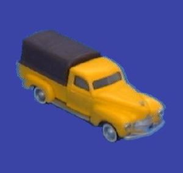
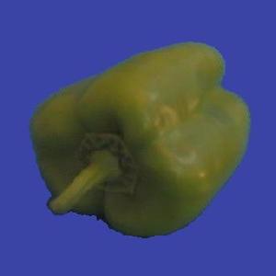
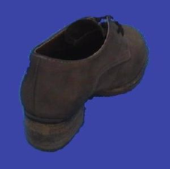
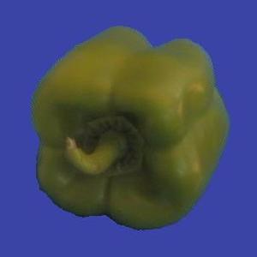
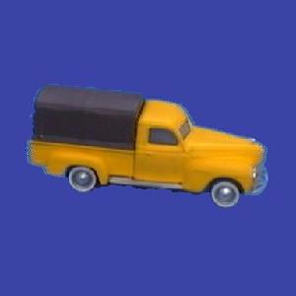



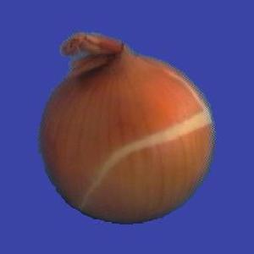
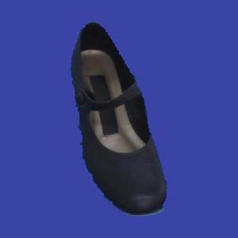
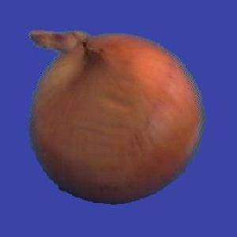
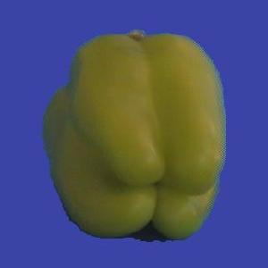
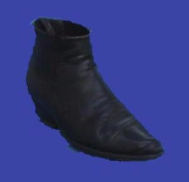



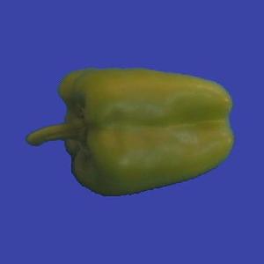

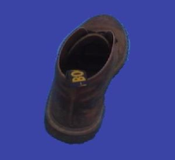
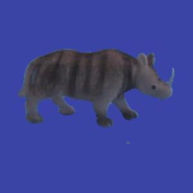

Slide 11
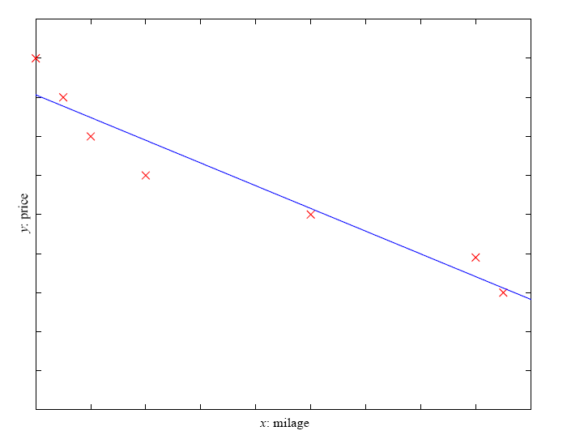
Regression
Example: Price of a used car
x : car attributes
y : price
y = g (x, θ )
g ( ) model,
θ parameters
y = wx+w₀

Slide 12
Supervised Learning: Uses
Prediction of future cases: Use the rule to predict the output for future inputs
Knowledge extraction: The rule is easy to understand
Compression: The rule is simpler than the data it explains
Outlier detection: Exceptions that are not covered by the rule, e.g., fraud

Slide 13
Unsupervised Learning
Learning “what normally happens”
Clustering: Grouping similar instances
Example applications
  Customer segmentation in CRM (customer relationship management)
  Image compression: Color quantization
  Bioinformatics: Learning motifs

Slide 14
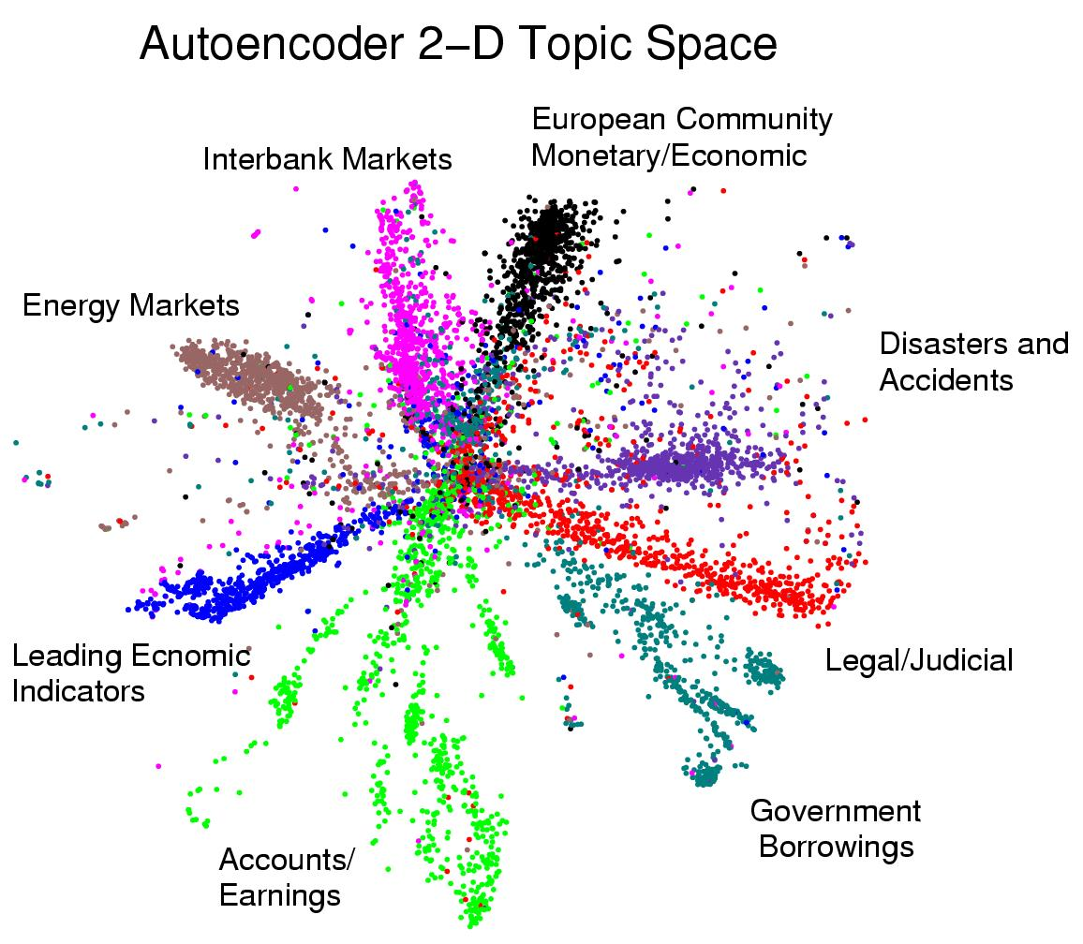
Displaying the structure of a set of documents

Slide 15
Example: Netflix
Application: automatic product recommendation
Importance: this is the modern/future shopping.
Prediction goal: Based on past preferences, predict which movies you might want to watch
Data: Past movies you have watched
Target: Like or don’t-like
Features: ?

Slide 16
Example: Zipcodes
Application: automatic zipcode recognition
Importance: this is modern/future delivery of small goods.
Goal: Based on your handwritten digits, predict what they are and use them to route mail
Data: Black-and-white pixel values
Target: Which digit
Features: ?

Slide 17
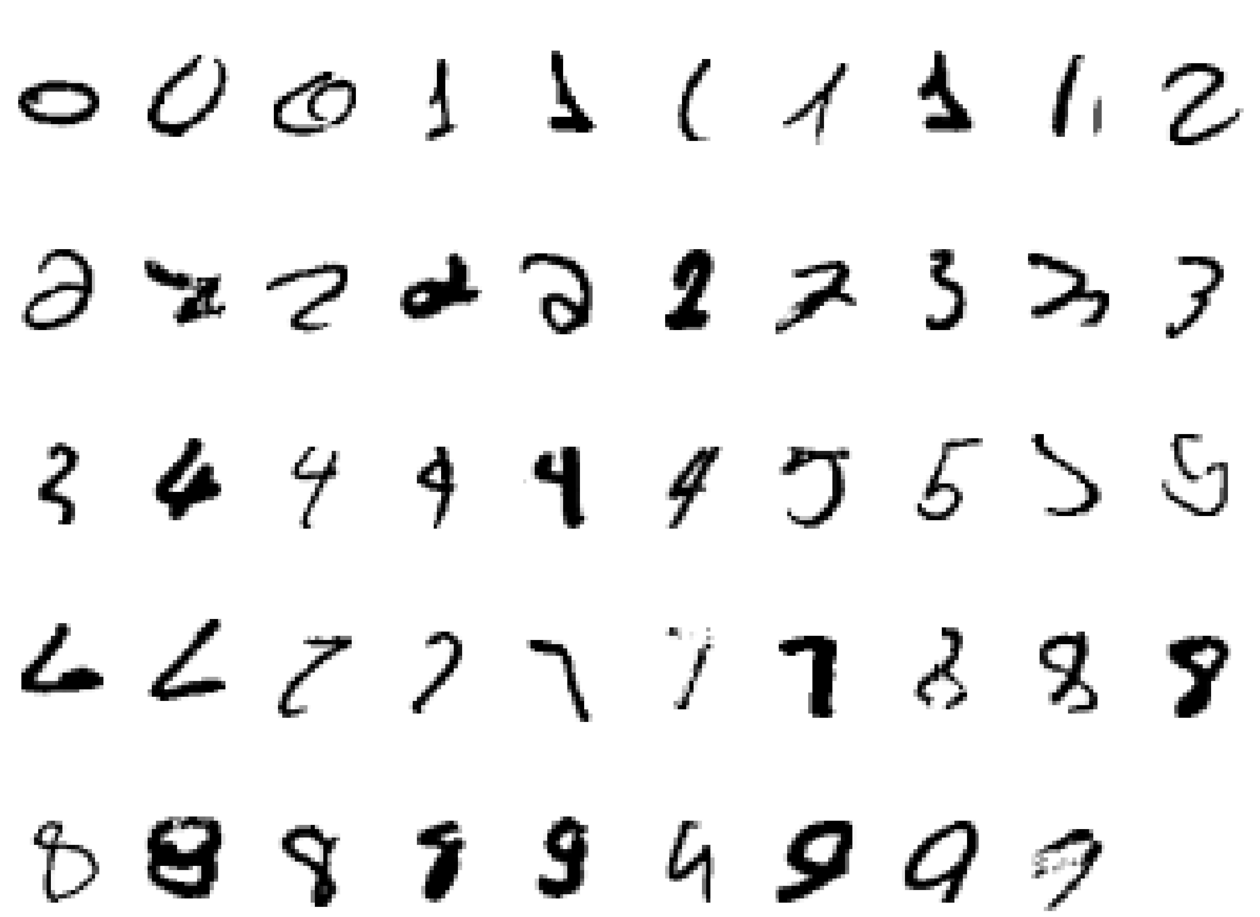
What makes a 2?

Slide 18
Example: Google
Application: automatic ad selection
Importance: this is modern/future advertising.
Prediction goal: Based on your search query, predict which ads you might be interested in
Data: Past queries
Target: Whether the ad was clicked
Features: ?

Slide 19
Example: Call Centers
Application: automatic call routing
Importance: this is modern/future customer service.
Prediction goal: Based on your speech recording, predict which words you said
Data: Past recordings of various people
Target: Which word was intended
Features: ?

Slide 20
Example: Stock Market
Application: automatic program trading
Importance: this is modern/future finance.
Prediction goal: Based on past patterns, predict whether the stock will go up
Data: Past stock prices
Target: Up or down
Features: ?

Slide 21
Web-based examples of machine learning
The web contains a lot of data. Tasks with very big datasets often use machine learning
  especially if the data is noisy or non-stationary.
Spam filtering, fraud detection:
  The enemy adapts so we must adapt too.
Recommendation systems:
  Lots of noisy data. Million dollar prize!
Information retrieval:
  Find documents or images with similar content.

Slide 22
What is a Learning Problem?
Learning involves performance improving
  at some task T
  with experience E
  evaluated in terms of performance measure P
Example: learn to play checkers
  Task T: playing checkers
  Experience E: playing against itself
  Performance P: percent of games won
What exactly should be learned?
  How might this be represented?
  What specific algorithm should be used?
Develop methods, techniques and tools for building intelligent learning machines, that can solve the problem in combination with an available data set of training examples.
When a learning machine improves its performance at a given task over time, without reprogramming, it can be said to have learned something.

Slide 23
Learning Example
Example from Machine/Computer Vision field:
  learn to recognise objects from a visual scene or an image
  T: identify all objects
  P: accuracy (e.g. a number of objects correctly recognized)
  E: a database of objects recorded

Slide 24
Components of a Learning Problem
Task: the behavior or task that’s being improved, e.g. classification, object recognition, acting in an environment.
Data: the experiences that are being used to improve performance in the task.
Measure of improvements: How can the improvement be measured? Examples:
  Provide more accurate solutions (e.g. increasing the accuracy in prediction)
  Cover a wider range of problems
  Obtain answers more economically (e.g. improved speed)
  Simplify codified knowledge
  New skills that were not presented initially

Slide 25
Learning = Generalization
H. Simon:
Learning denotes changes in the system that are adaptive in the sense that they enable the system to do the task or tasks drawn from the same population more efficiently and more effectively the next time.”
The ability to perform a task in a situation which has never been encountered before

Slide 26
Hypothesis Space
One way to think about a supervised learning machine is as a device that explores a “hypothesis space”.
  Each setting of the parameters in the machine is a different hypothesis about the function that maps input vectors to output vectors.
  If the data is noise-free, each training example rules out a region of hypothesis space.
  If the data is noisy, each training example scales the posterior probability of each point in the hypothesis space in proportion to how likely the training example is given that hypothesis.
The art of supervised machine learning is in:
  Deciding how to represent the inputs and outputs
  Selecting a hypothesis space that is powerful enough to represent the relationship between inputs and outputs but simple enough to be searched.

Slide 27
Generalization
The real aim of supervised learning is to do well on test data that is not known during learning.
Choosing the values for the parameters that minimize the loss function on the training data is not necessarily the best policy.
We want the learning machine to model the true regularities in the data and to ignore the noise in the data.
  But the learning machine does not know which regularities are real and which are accidental quirks of the particular set of training examples we happen to pick.
So how can we be sure that the machine will generalize correctly to new data?

Slide 28
Goodness of Fit vs. Model Complexity
It is intuitively obvious that you can only expect a model to generalize well if it explains the data surprisingly well given the complexity of the model.
If the model has as many degrees of freedom as the data, it can fit the data perfectly but so what?
There is a lot of theory about how to measure the model complexity and how to control it to optimize generalization.

Slide 29
A Sampling Assumption
Assume that the training examples are drawn independently from the set of all possible examples.
Assume that each time a training example is drawn, it comes from an identical distribution (i.i.d)
Assume that the test examples are drawn in exactly the same way – i.i.d. and from the same distribution as the training data.
These assumptions make it very unlikely that a strong regularity in the training data will be absent in the test data.

Slide 30
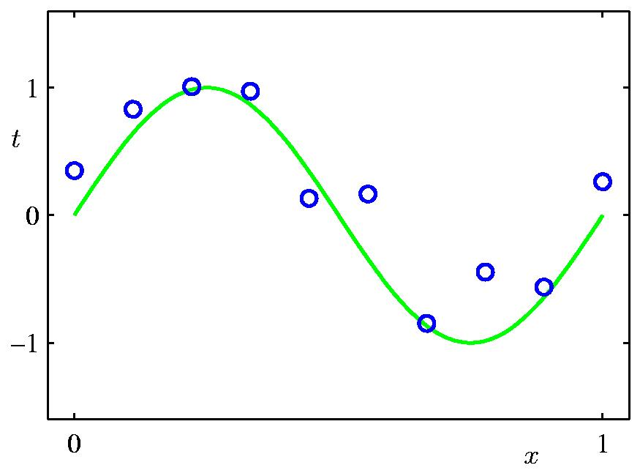
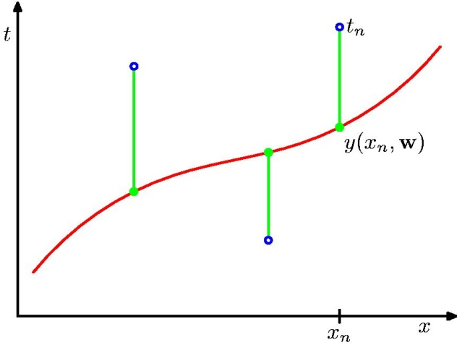
A Simple Example: Fitting a Polynomial
from Bishop
The green curve is the true function (which is not a polynomial)
The data points are uniform in x but have noise in y.
We will use a loss function that measures the squared error in the prediction of y(x) from x. The loss for the red polynomial is the sum of the squared vertical errors.

Slide 31
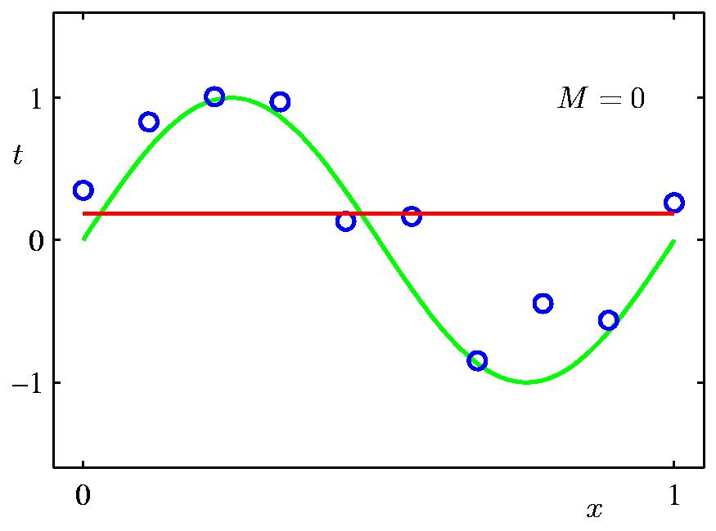
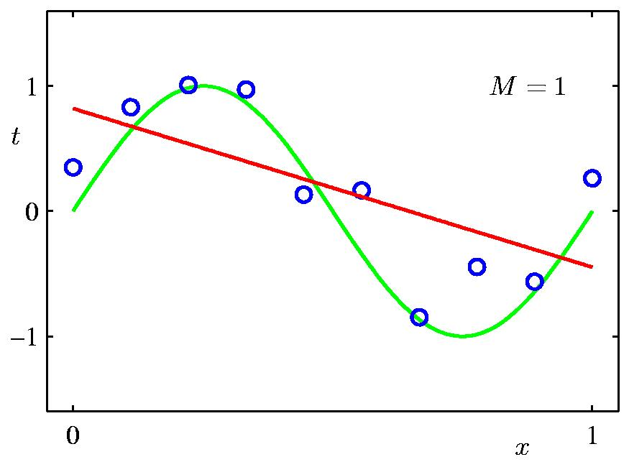
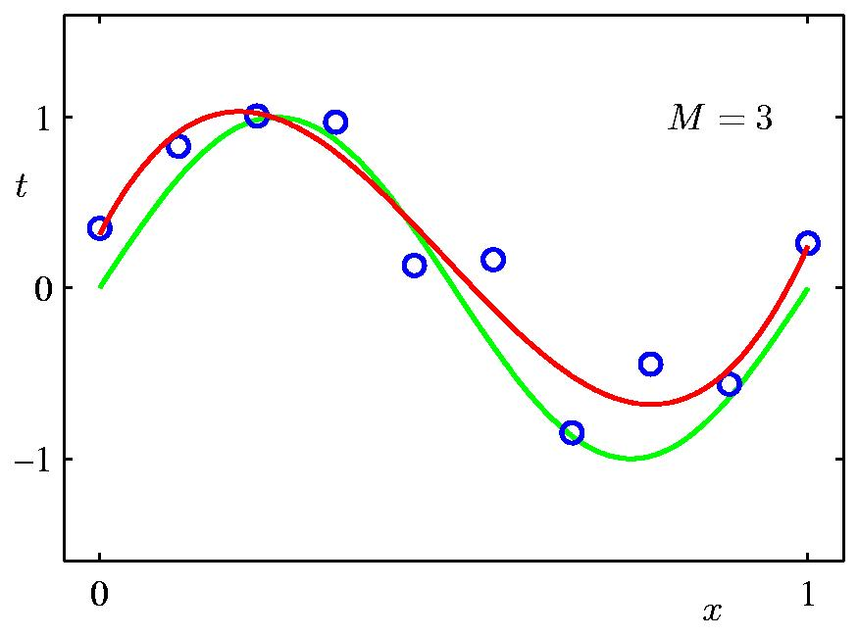
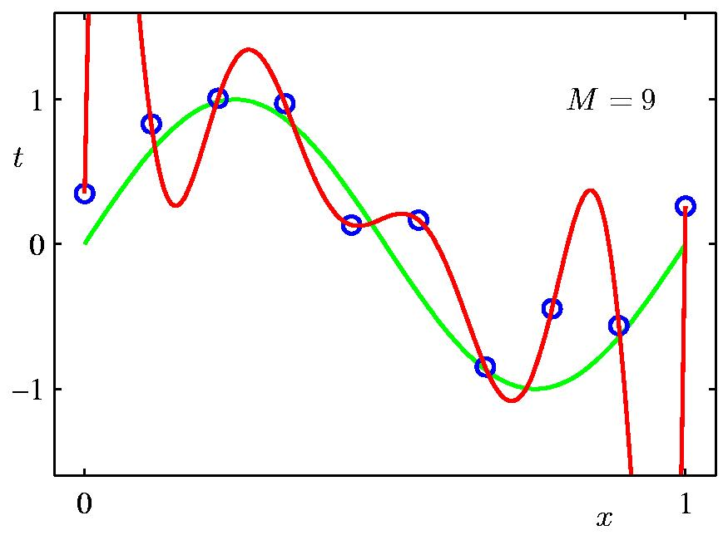
Some fits to the data: which is best?
from Bishop

Slide 32
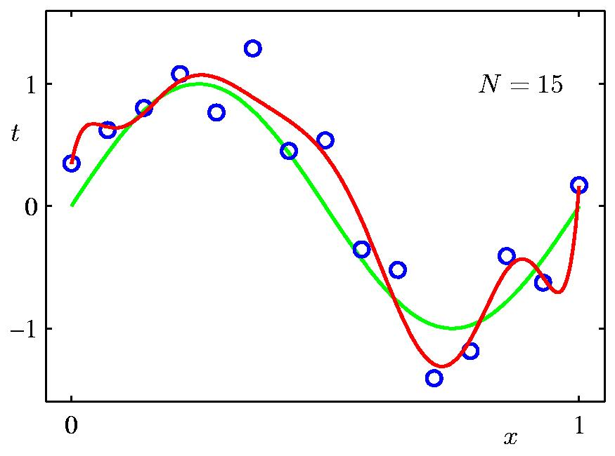
A simple way to reduce model complexity
If we penalize polynomials that have a high number of coefficients, we will get less wiggly solutions:
from Bishop
Ockham’s Razor

Slide 33
What Experience E to Use?
Direct or indirect?
  Direct: feedback on individual moves
  Indirect: feedback on a sequence of moves
    e.g., whether win or not
Teacher or not?
  Teacher selects board states
    Tailored learning
    Can be more efficient
  Learner selects board states
    No teacher
Questions
  Is training experience representative of performance goal?
  Does training experience represent distribution of outcomes in world?

Slide 34
What Exactly Should be Learned?
Playing checkers:
  Alternating moves with well-defined rules
  Choose moves using some function
  Call this function the Target Function
Target function (TF): function to be learned during a learning process
  ChooseMove: Board → Move
  ChooseMove is difficult to learn, e.g., with indirect training examples
A key to successful learning is to choose appropriate target function:
Strategy: reduce learning to search for TF
Alternative TF for checkers:
  V : Board → R
  Measure “quality” of the board state
  Generate all moves
    choose move with largest value

Slide 35
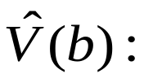
A Possible Target Function V For Checkers
In checkers, know all legal moves
  From these, choose best move in any situation
Possible V function for checkers:
  if b is a final board state that is win, then V(b) = 100
  if b is a final board state that is loss, then V(b) = −100
  if b is a final board state that is draw, then V(b) = 0
  if b is a not a final state in the game, then V(b) = V(b′), where b′ is the best final board state that can be achieved starting from b and playing optimally until the end of the game
This gives correct values, but is not operational
  So may have to find good approximation to V
  Call this approximation V
⌃

Slide 36
How Might Target Function be Represented?
Many possibilities (subject of course)
  As collection of rules ?
  As neural network ?
  As polynomial function of board features ?
Example of linear function of board features:
  w₀+ w₁bp(b) + w₂rp(b) + w₃bk(b)+w₄rk(b)+w₅bt(b)+w₆rt(b)
    bp(b) : number of black pieces on board b
    rp(b) : number of red pieces on b
    bk(b) : number of black kings on b
    rk(b) : number of red kings on b
    bt(b) : number of red pieces threatened by black (i.e., which can be taken on black's next turn)
    rt(b) : number of black pieces threatened by red
Generally, the more expressive the representation, the more difficult it is to estimate

Slide 37
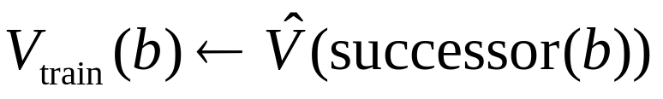
Obtaining Training Examples
  With learned function
  Search over space of weights: estimate w_{i}
  Training values that are needed V_{train}(b)
    Some from prior experience; some generated
    Example of training examples: (⟨3,0,1,0,0,0⟩, +100)
One rule for estimating training value
  successor(b) is for which it is program’s turn to move
  Used for intermediate values
  good in practice
Issue now of how to estimate weights w_{i}

Slide 38
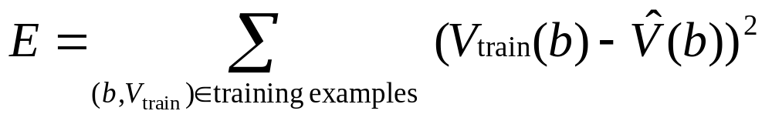
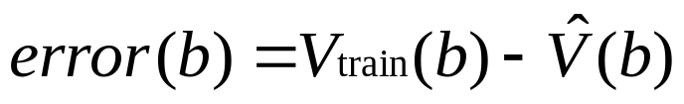
Example of LMS Weight Update Rule
Choose weights to minimize squared error
Do repeatedly:
  Select a training example b at random
1. Compute
2. for each board feature x_{i}, update weight w_{i}
3. If error > 0, w_{i} increases and vice versa
w
←
w
+
c.
x
.error
(
b
)
i
i
i
Gradient descent

Slide 39
Some Issues in Machine Learning
What algorithms can approximate functions well (and when)?
How does number of training examples influence accuracy?
How does complexity of hypothesis representation impact learning?
How does noisy data influence accuracy?
What are the theoretical limits of learnability?
How can prior knowledge of learner help?
What clues can we get from biological learning systems?
How can systems alter their own representations?

Slide 40
Learning Feedback
Learning feedback can be provided by the system environment or the agents themselves.
  Supervised learning: specifies the desired activities/objectives of learning – feedback from a teacher
  Unsupervised learning: no explicit feedback is provided and the objective is to find out useful and desired activities on the basis of trial-and-error and self-organization processes – a passive observer
  Reinforcement learning: specifies the utility of the actual activity of the learner and the objectives is to maximize this utility – feedback from a critic

Slide 41
Ways of Learning
Rote learning, i.e. learning from memory; in a mechanical way
Learning from examples and by practice
Learning from instructions/advice/explanations
Learning by analogy
Learning by discovery
…

Slide 42
Inductive and Deductive Learning
Inductive Learning: Reasoning from a set of examples to produce a general rules. The rules should be applicable to new examples, but there is no guarantee that the result will be correct.
Deductive Learning: Reasoning from a set of known facts and rules to produce additional rules that are guaranteed to be true.

Slide 43
Assessment of Learning Algorithms
The most common criteria for learning algorithms assessments are:
  Accuracy (e.g. percentages of correctly classified +’s and –’s)
  Efficiency (e.g. examples needed, computational tractability)
  Robustness (e.g. against noise, against incompleteness)
  Special requirements (e.g. incrementality, concept drift)
  Concept complexity (e.g. representational issues – examples & bookkeeping)
  Transparency (e.g. comprehensibility for the human user)

Slide 44
Some Theoretical Settings
Inductive Logic Programming (ILP)
Probably Approximately Correct (PAC) Learning
Learning as Optimization (Reinforcement Learning)
Bayesian Learning
…

Slide 45
Key Aspects of Learning
Learner: who or what is doing the learning, e.g. an algorithm, a computer program.
Domain: what is being learned, e.g. a function, a concept.
Goal: why the learning is done.
Representation: the way the objects to be learned are represented.
Algorithmic Technology: the algorithmic framework to be used, e.g. decision trees, lazy learning, artificial neural networks, support vector machines

Slide 46
An Owed to the Spelling Checker
I have a spelling checker.
It came with my PC
It plane lee marks four my revue
Miss steaks aye can knot sea.
Eye ran this poem threw it.
your sure reel glad two no.
Its vary polished in it's weigh
My checker tolled me sew.
……..

Slide 47
The Role of Learning
Learning is at the core of
  Understanding High Level Cognition
  Performing knowledge intensive inferences
  Building adaptive, intelligent systems
  Dealing with messy, real world data
Learning has multiple purposes
  Knowledge Acquisition
  integration of various knowledge sources to ensure robust behavior
  Adaptation (human, systems)

