Slide 1
Independent Component Analysis (ICA)

Slide 2
Motivation
A Method: find underlying factors or components form multi-dimensional statistical data
Distinguishes : looks for components that are both statistically independent and non-gaussian data

Slide 3




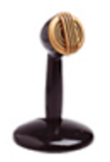
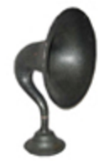
1. ORIGINAL SOUND SOURCES
2. SAMPLES AT THE COCKTAIL PARTY
3. FOUND SOUND SOURCES
Apply ICA to separate the samples sound sources
http://research.ics.aalto.fi/ica/cocktail/cocktail_en.cgi

Slide 4
PCA and ICA
Multi-dimensional statistical
– PCA and ICA: reduce dimensions
Difference:
PCA: with a Gaussian model
ICA: with non-Gaussian model
PCA: Vector are orthogonal
ICA: Vector are not orthogonal

Slide 5
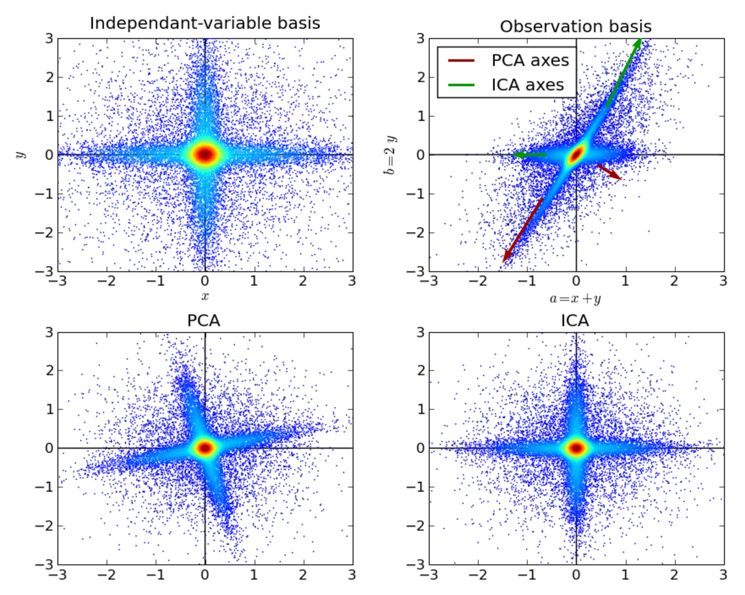
PCA and ICA
http://gael-varoquaux.info/science/ica_vs_pca.html

Slide 6
ICA mathematical approach
x_{i} = a_{i1}s₁ + a_{i2}s₂ + … + a_{in}s_{n}, for all i = 1,…, n
Giving:
observation “x”
Find:
Original independent components “s”
and Associated linear combination “a_{ij}”

Slide 7
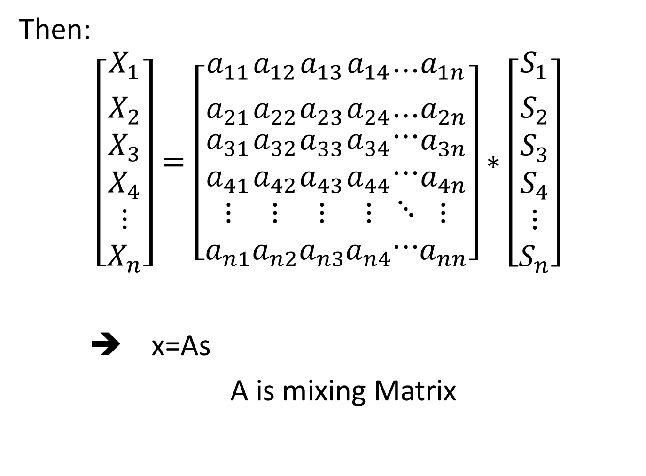

Slide 8

Also written as
Independent components are latent variables meaning they cannot be directly observed
The mixing matrix is assumed to be unknown.
All observe is the random vector x, and must estimate both A and s by using it.
This must be done under as general assumption as possible.

Slide 9
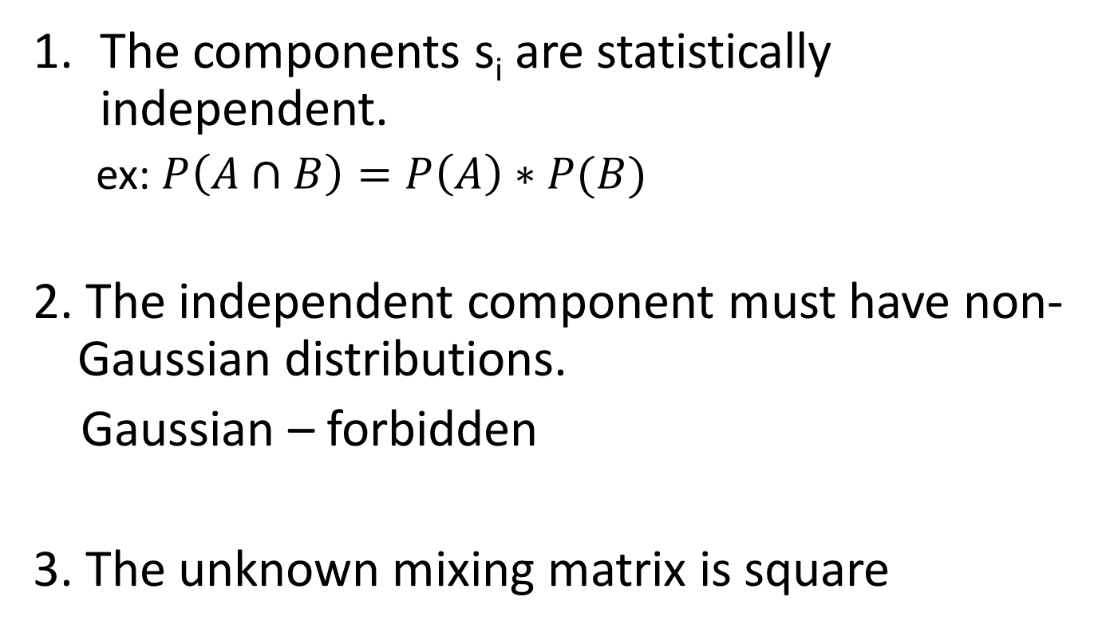
Assumptions of ICA

Slide 10
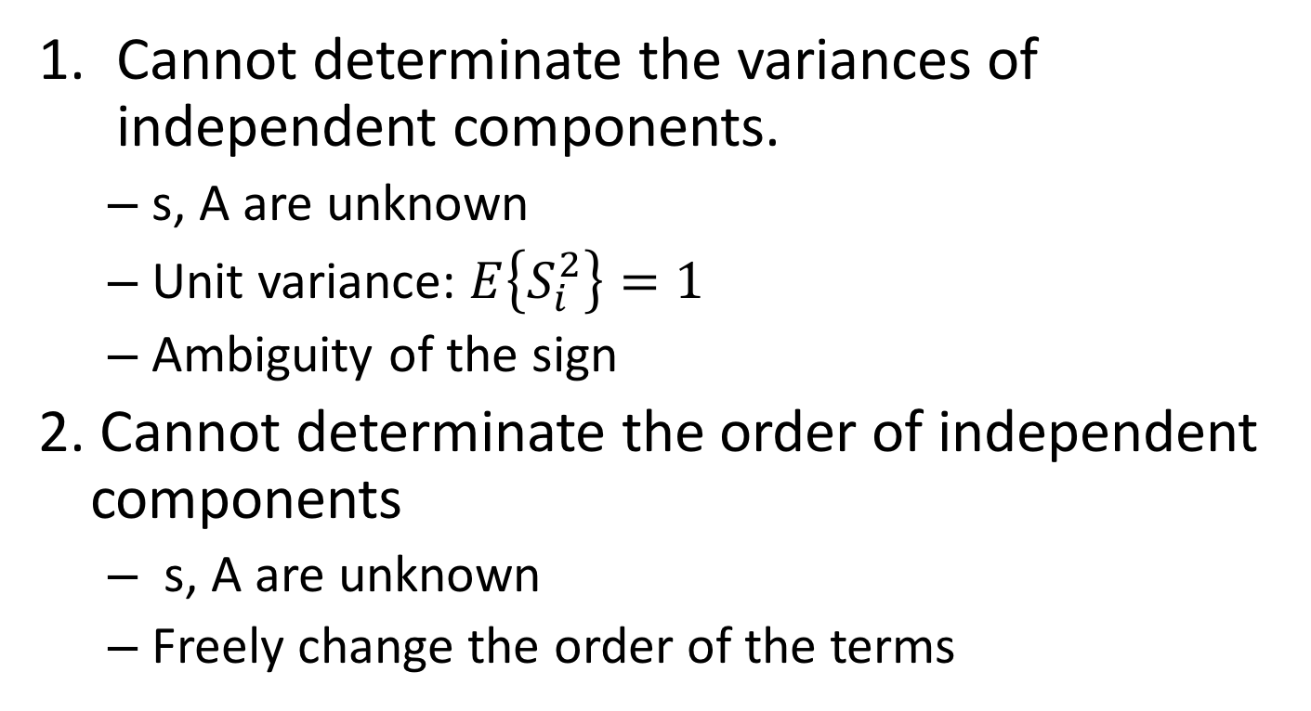
Limitation of ICA

Slide 11
ICA processes
1. centering data (remove mean)
2. whitening process (sphere data)
2.1 Uncorrelate variables
2.2 Scale variables so that their variance =1
Whitening + non-gaussianity ➔ independent

