Slide 1
Pattern Recognition
By
Dr. Rajendra Pamula

Slide 2
What is a Pattern?
A set of instances that
- share some regularities and similarities
- is repeatable
- is observable, sometimes partially, using sensors
- May have noise and distortion

Slide 3
What is Pattern Recognition?
Pattern recognition (PR) is the scientific discipline that concerns the description and classification (recognition) of patterns (objects)

Slide 4
What is Pattern Recognition?
Depending on the application, these objects can be images or signal waveforms or any type of measurements that need to be classified.
All these objects are referred using the generic term patterns.

Slide 5
What is Pattern Recognition?
Pattern recognition is an integral part in most machine intelligence systems built for decision making.
PR techniques are an important component of intelligent systems and are used for many application domains
- Decision making
- Object and pattern classification

Slide 6
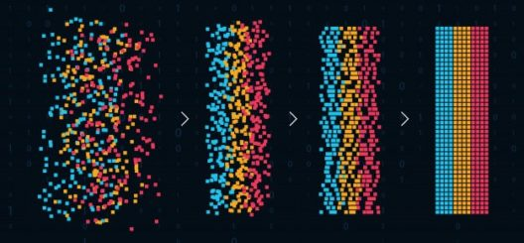
Pattern Recognition

Slide 7
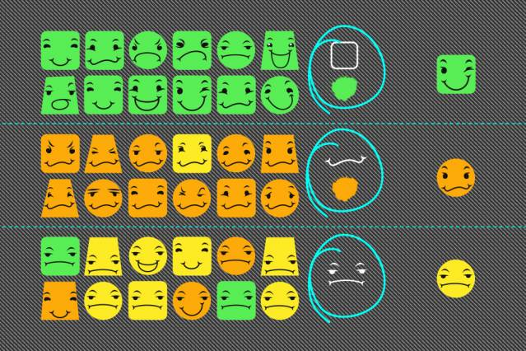
Pattern Recognition

Slide 8
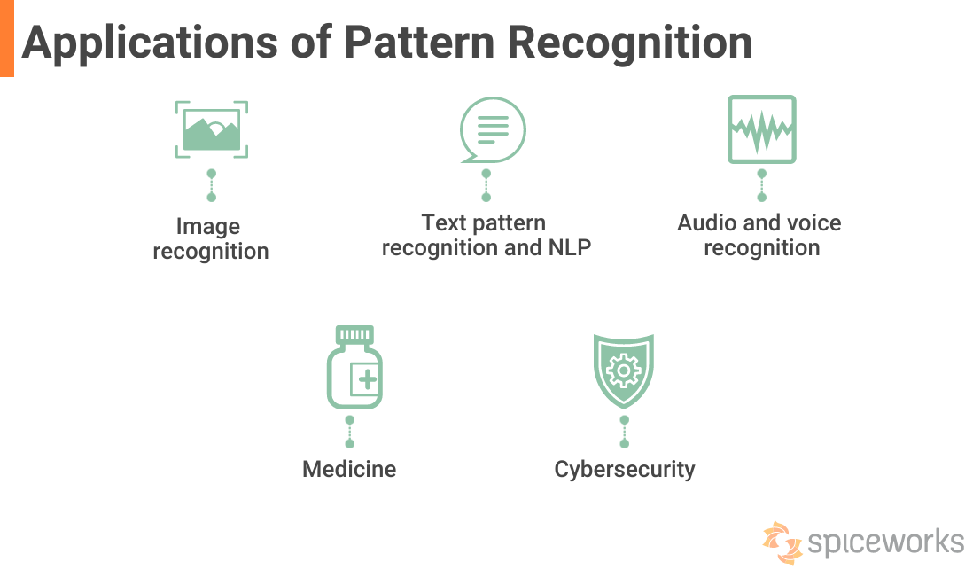

Slide 9
Human Perception
Humans have developed highly sophisticated skills
for sensing their environment and taking actions according to what they observe
e.g.,
recognizing a face,
understanding spoken words,
reading handwriting,
distinguishing fresh food from its smell.
We would like to give similar capabilities to machines

Slide 10
Machine Perception
Build a machine that can recognize patterns:
Speech recognition
Fingerprint identification
OCR (Optical Character Recognition)
DNA sequence identification

Slide 11
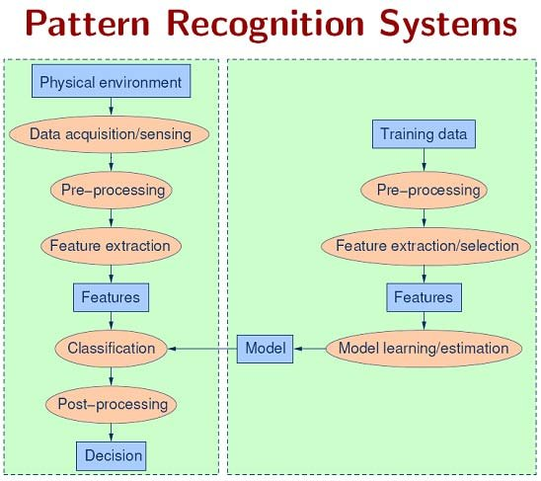

Slide 12
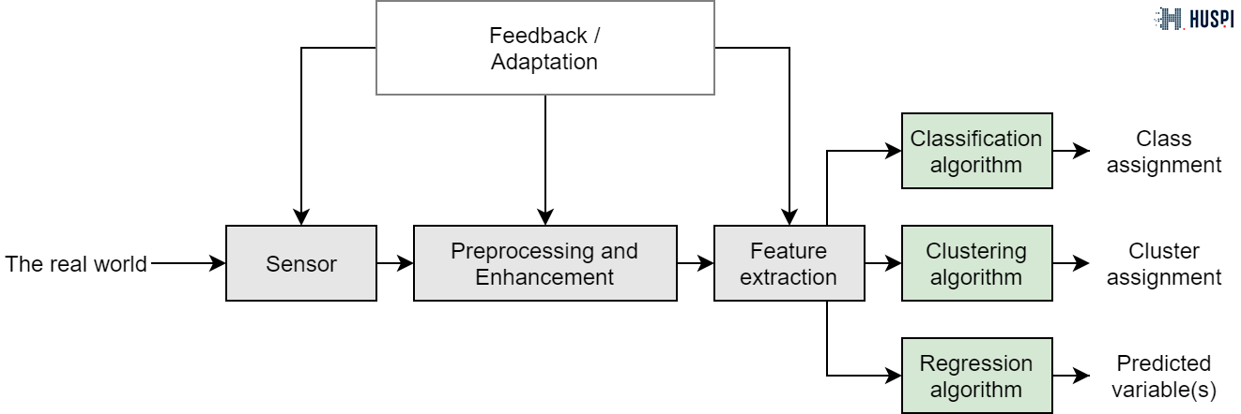
Pattern Recognition

Slide 13
Data Transformation
Data are transformed or consolidated into forms appropriate for pattern extraction
Smoothing: remove noise from the data. Such techniques include
binning, regression, and clustering.
Normalization, where the attribute data are scaled so as to fall within a small specified range, such as -1.0 to 1.0, or 0.0 to 1.0.

Slide 14
Binning
Binning, bucketing is a data pre-processing method used to minimize the effects of small observation errors.
The original data values are divided into small intervals known as bins and then they are replaced by a general value calculated for that bin. This has a smoothing effect on the input data and may also reduce the chances of overfitting in the case of small datasets.

Slide 15
Binning
There are 2 methods of dividing data into bins:
Equal Frequency Binning: bins have an equal frequency.
Equal Width Binning : bins have equal width with a range of each bin are defined as [min + w], [min + 2w] …. [min + nw] where w = (max – min) / (no of bins).

Slide 16
Binning
Equal frequency:
Input:[5, 10, 11, 13, 15, 35, 50, 55, 72, 92, 204, 215]
Output:
[5, 10, 11, 13]
[15, 35, 50, 55]
[72, 92, 204, 215]

Slide 17
Binning
Equal Width:
Input: [5, 10, 11, 13, 15, 35, 50, 55, 72, 92, 204, 215]
Output:
[5, 10, 11, 13, 15, 35, 50, 55, 72]
[92]
[204, 215]

Slide 18
Binning
Equal frequency: Smoothing by bin means
Input:[5, 10, 11, 13, 15, 35, 50, 55, 72, 92, 204, 215]
Output:
[5, 10, 11, 13] = [10, 10, 10, 10]
[15, 35, 50, 55] = [39, 39, 39, 39]
[72, 92, 204, 215] = [146, 146, 146, 146]

Slide 19
Binning
Equal frequency: Smoothing by bin boundaries
Input:[5, 10, 11, 13, 15, 35, 50, 55, 72, 92, 204, 215]
Output:
[5, 10, 11, 13] = [5, 13, 13, 13]
[15, 35, 50, 55] = [15, 15, 55, 55]
[72, 92, 204, 215] = [72, 72, 215, 215]

Slide 20
Normalization
Min-max normalization: to [new_min_{A}, new_max_{A}]
Ex. Let income range $12,000 to $98,000 normalized to [0.0, 1.0]. Then $73,600 is mapped to
Z-score normalization (μ: mean, σ: standard deviation):
Ex. Let μ = 54,000, σ = 16,000. Then
Normalization by decimal scaling
Where j is the smallest integer such that Max(|ν’|) < 1

Slide 21
Normalization
Normalization by decimal scaling
Where j is the smallest integer such that Max(|ν’|) < 1
Let the input data is: -10, 201, 301, -401, 501, 601, 701
To normalize the above data,
Step 1: Maximum absolute value in given data(m): 701
Step 2: Divide the given data by 1000 (i.e j=3)
Result: The normalized data is: -0.01, 0.201, 0.301, -0.401, 0.501, 0.601, 0.701

Slide 22
Correlated variables
Two variables are correlated if changes in one variable, correspond to changes in the other
Correlation in general refers to the statistical association between two variables
This statistical association allows us to make estimates for the one variable based on the value of the other
While we usually examine linear relationships, between variables, non-linear might exist too

Slide 23
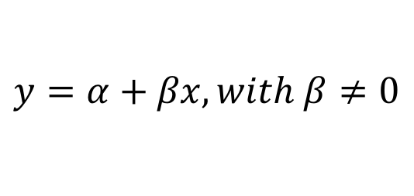
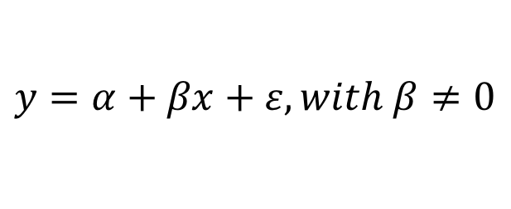
Linear correlation
Two variables x and y are said to be linearly correlated if their relationship can be described by the following equation:
This relationship will not be exact
There will be an error associated with it, and hence, in reality:
ε is the error term for the relationship

Slide 24
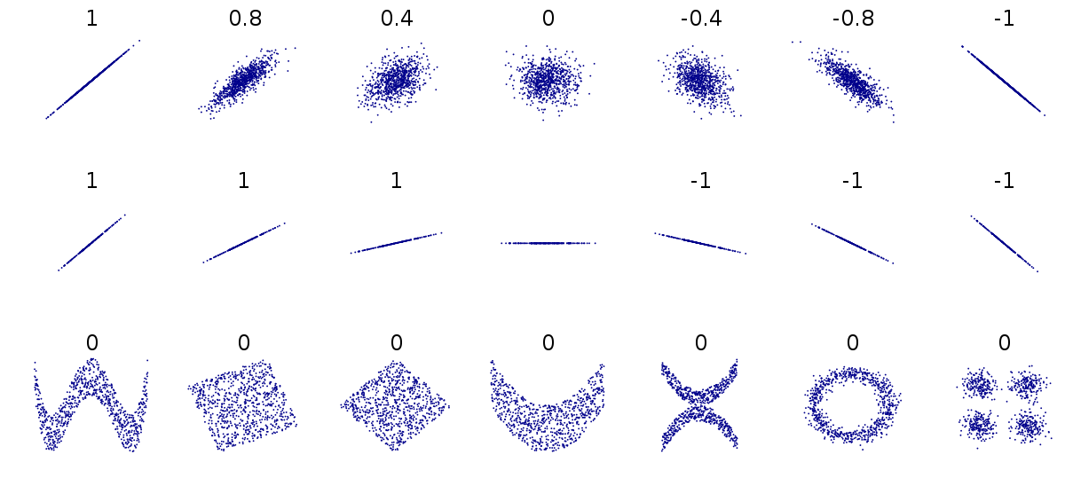
Perfect linear relationship – no error
Strong linear relationship – small error
Weak linear relationship – large error
No linear relationship

Slide 25
Explanatory Variable and Response Variable
Correlation describes linear relationships between quantitative variables
X is the quantitative explanatory variable
Y is the quantitative response variable
Example: The correlation between per capita gross domestic product (X) and life expectancy (Y) will be explored

Slide 26
Data (data file = gdp_life.sav)
Country | Per Capita GDP (X) | Life Expectancy (Y)
Austria | 21.4 | 77.48
Belgium | 23.2 | 77.53
Finland | 20.0 | 77.32
France | 22.7 | 78.63
Germany | 20.8 | 77.17
Ireland | 18.6 | 76.39
Italy | 21.5 | 78.51
Netherlands | 22.0 | 78.15
Switzerland | 23.8 | 78.99
United Kingdom | 21.2 | 77.37

Slide 27
Scatterplot: Bivariate points (x_{i}, y_{i})
This is the data point for Switzerland (23.8, 78.99)

Slide 28
Interpreting Scatterplots
Form: Can relationship be described by straight line (linear)? ..by a curved line? etc.
Outliers?: Any deviations from overall pattern?
Direction of the relationship either:
Positive association (upward slope)
Negative association (downward slope)
No association (flat)
Strength: Extent to which points adhere to imaginary trend line

Slide 29
Example: Interpretation
Here is the scatterplot we saw earlier:
This is the data point for Switzerland (23.8, 78.99)
Interpretation:
Form: linear (straight)
Outliers: none
Direction: positive
Strength: difficult to judge by eye

Slide 30
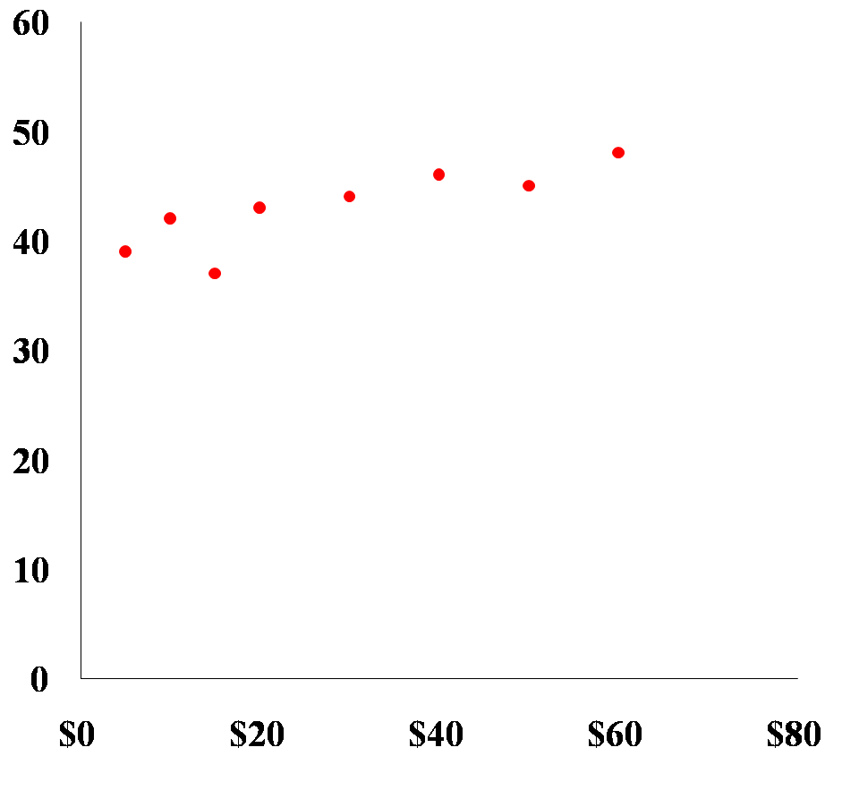
Example 2
Interpretation
Form: linear
Outliers: none
Direction: positive
Strength: difficult to judge by eye (looks strong)
Notes:
Wednesday, January 17, 2024
30

Slide 31
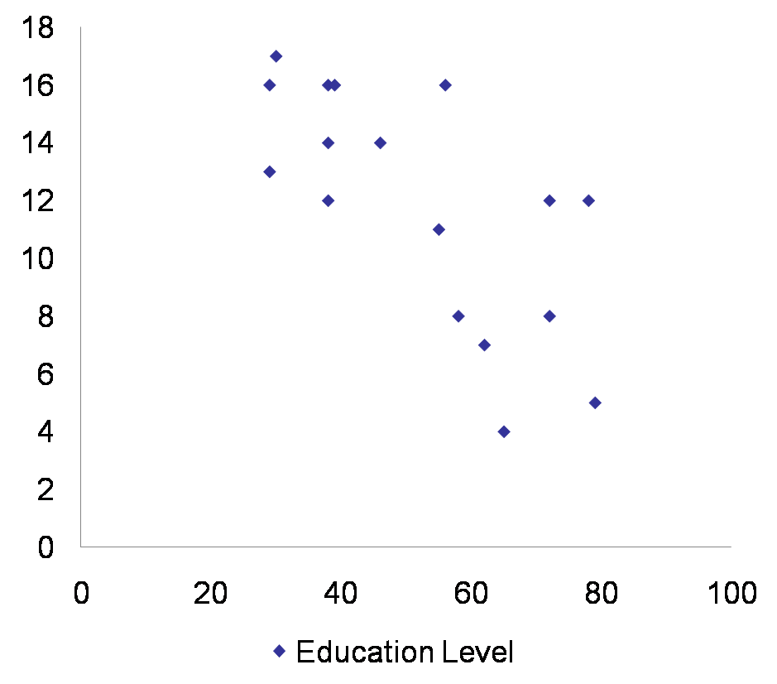
Example 3
Form: linear
Outliers: none
Direction: negative
Strength: difficult to judge by eye (looks moderate)
Notes:
Wednesday, January 17, 2024
31

Slide 32
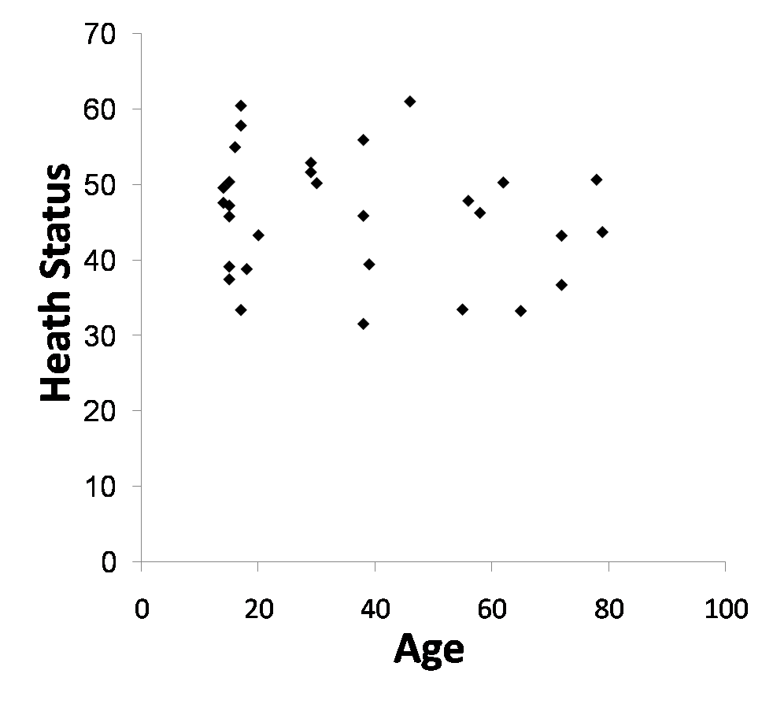
Example 4
Form: linear(?)
Outliers: none
Direction: negative
Strength: difficult to judge by eye (looks weak)
Notes:
Wednesday, January 17, 2024
32

Slide 33
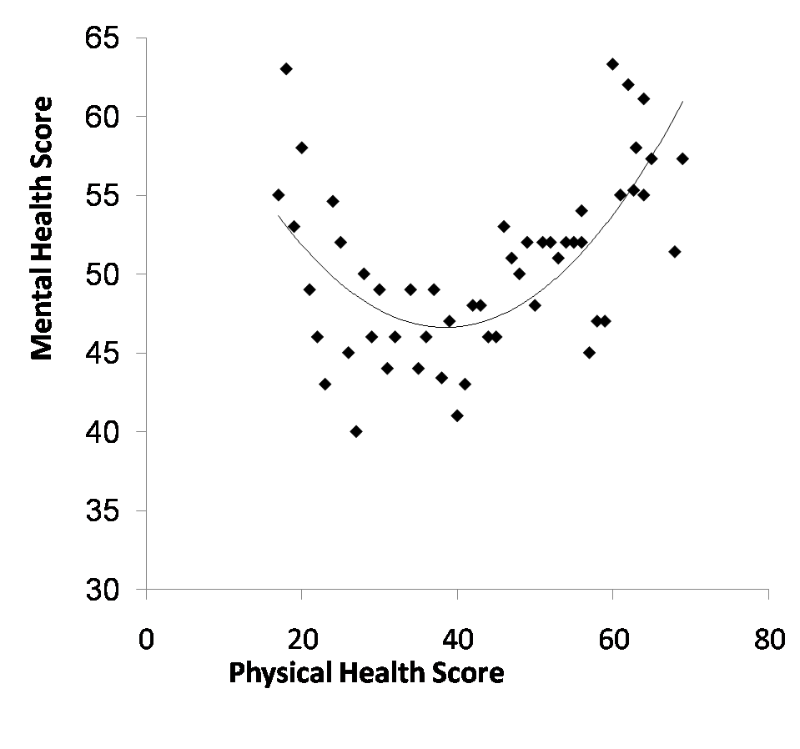
Interpreting Scatterplots
Form: curved
Outliers: none
Direction: U-shaped
Strength: difficult to judge by eye (looks moderate)
Notes:
Wednesday, January 17, 2024
33

Slide 34
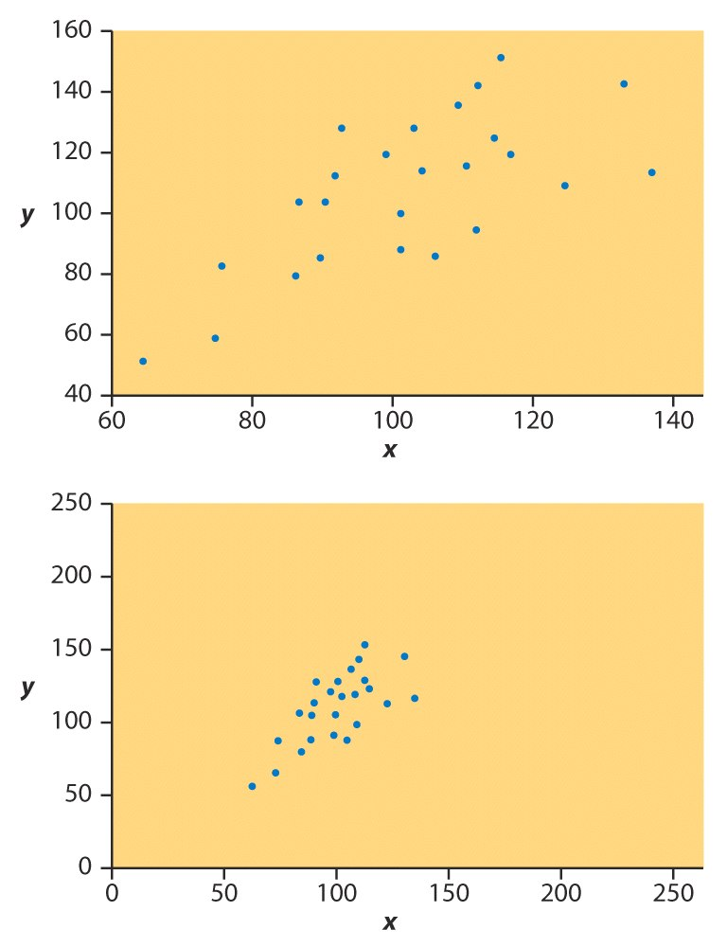
Correlational Strength
It is difficult to judge correlational strength by eye alone
Here are identical data plotted on differently axes
First relationship seems weaker than second
This is an artifact of the axis scaling
We use a statistical called the correlation coefficient to judge strength objectively

Slide 35
Pearson correlation coefficient
In statistics, the Pearson correlation coefficient (PCC)is a correlation coefficient that measures linear correlation between two sets of data.
It is the ratio between the covariance of two variables and the product of their standard deviations; thus,
It is essentially a normalized measurement of the covariance, such that the result always has a value between −1 and 1.

Slide 36

Pearson correlation coefficient
In order to test the linear association between two variables x and y we can use the Pearson correlation coefficient r_{xy}
The correlation coefficient takes values between -1 to 1
1: perfect/strong and positive linear correlation
-1: perfect/strong and negative linear correlation
0: no linear correlation

Slide 37

Pearson correlation coefficient
It is very crucial to understand that this correlation coefficient can only examine linear associations between two variables
1
0.8
0.4
0
-0.4
-0.8
-1
What is the correlation here?

Slide 38
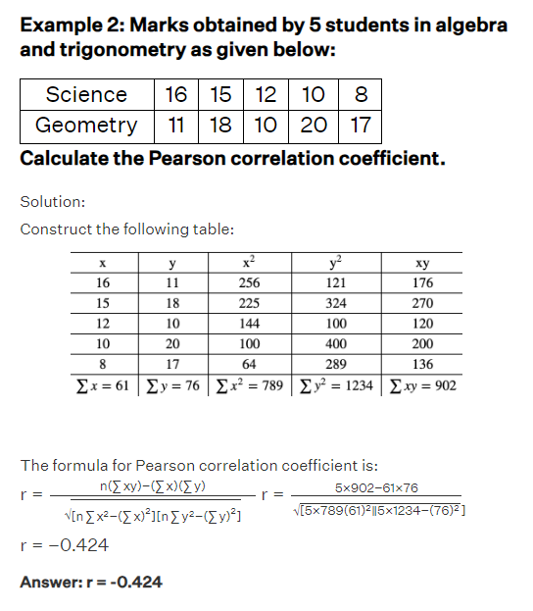

Slide 39
Spearman's rank correlation coefficient
In statistics, Spearman's rank correlation coefficient or Spearman's ρ, named after Charles Spearman and often denoted by the Greek letter ρ (rho) or as r_{s}
It is a nonparametric measure of rank correlation (statistical dependence between the rankings of two variables)
The Spearman correlation between two variables is equal to the Pearson correlation between the rank values of those two variables;
while Pearson's correlation assesses linear relationships, Spearman's correlation assesses monotonic relationships (whether linear or not). If there are no repeated data values, a perfect Spearman correlation of +1 or −1 occurs when each of the variables is a perfect monotone function of the other.

Slide 40
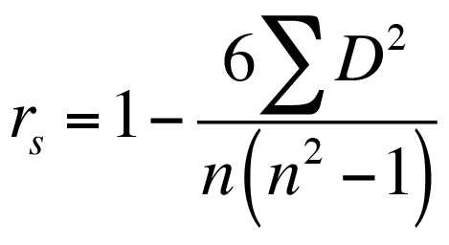
Spearman's rank correlation coefficient

Slide 41
