Slide 1

SMART INDIA HACKATHON 2026
3D ULPIN
Problem Statement ID –SIH26011
Problem Statement Title-3D ULPIN Generation and Vertical Property Mapping System
Theme- Smart Automation
PS Category-Software
Team ID-
Team Name (Registered on portal)

Slide 2
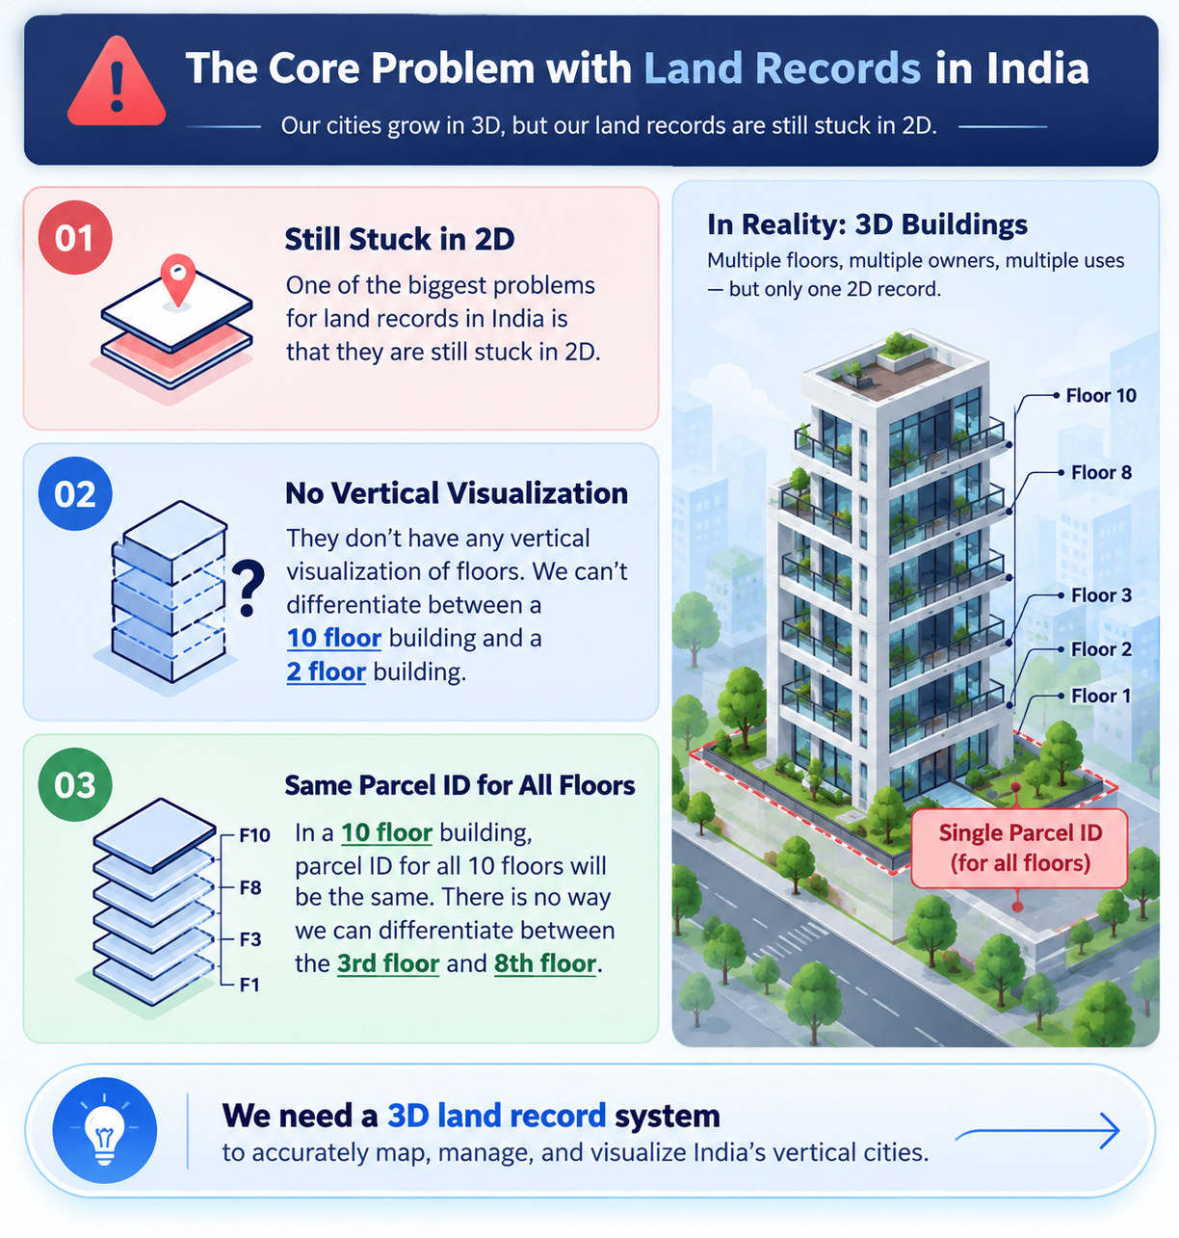
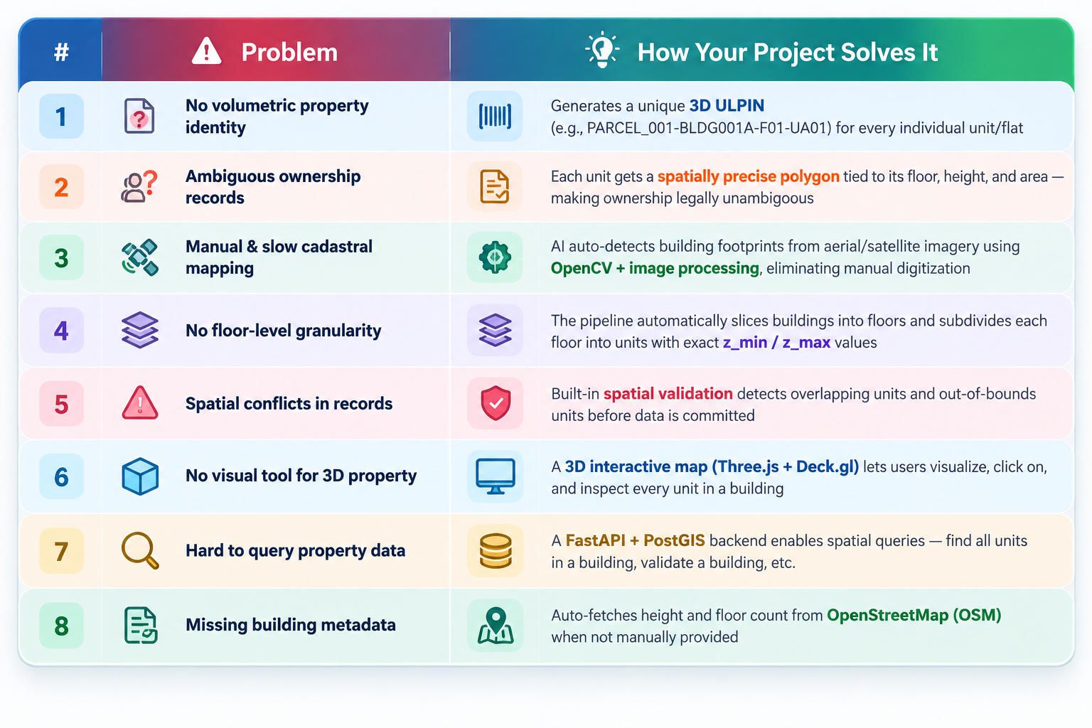
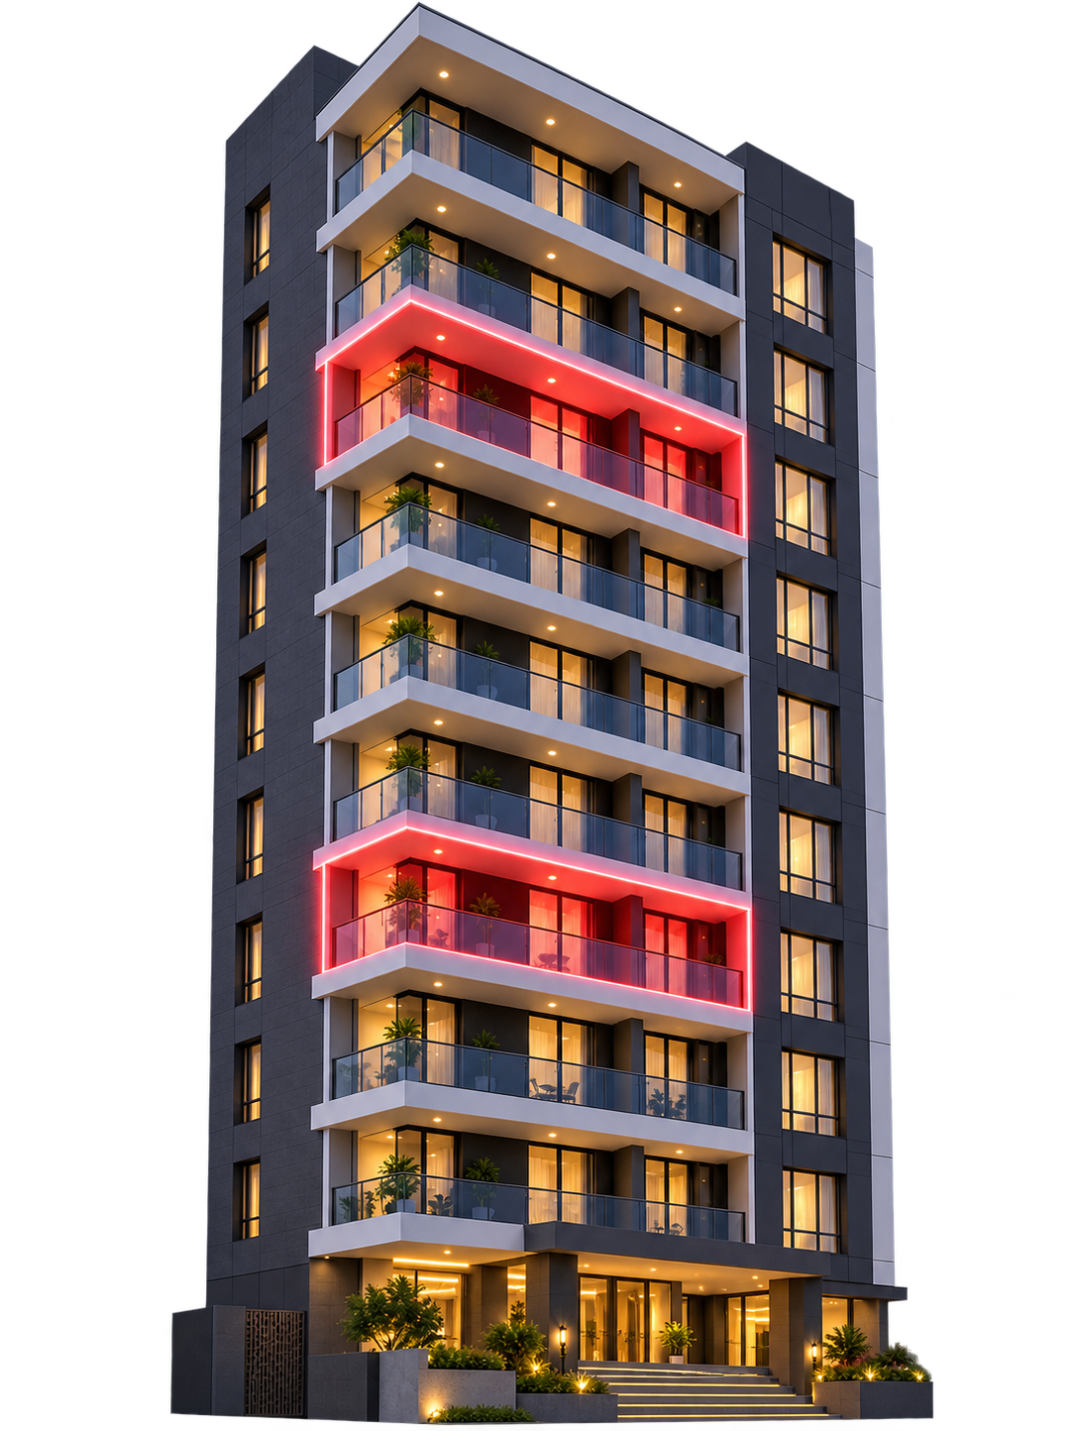
3D ULPIN GENERATOR
Your Team Name
Parcel Id for this
Building will be same for all same even thought it can be owned by different individuals

Slide 3
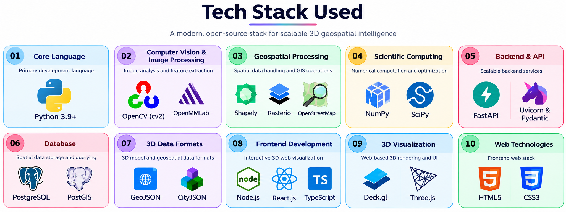
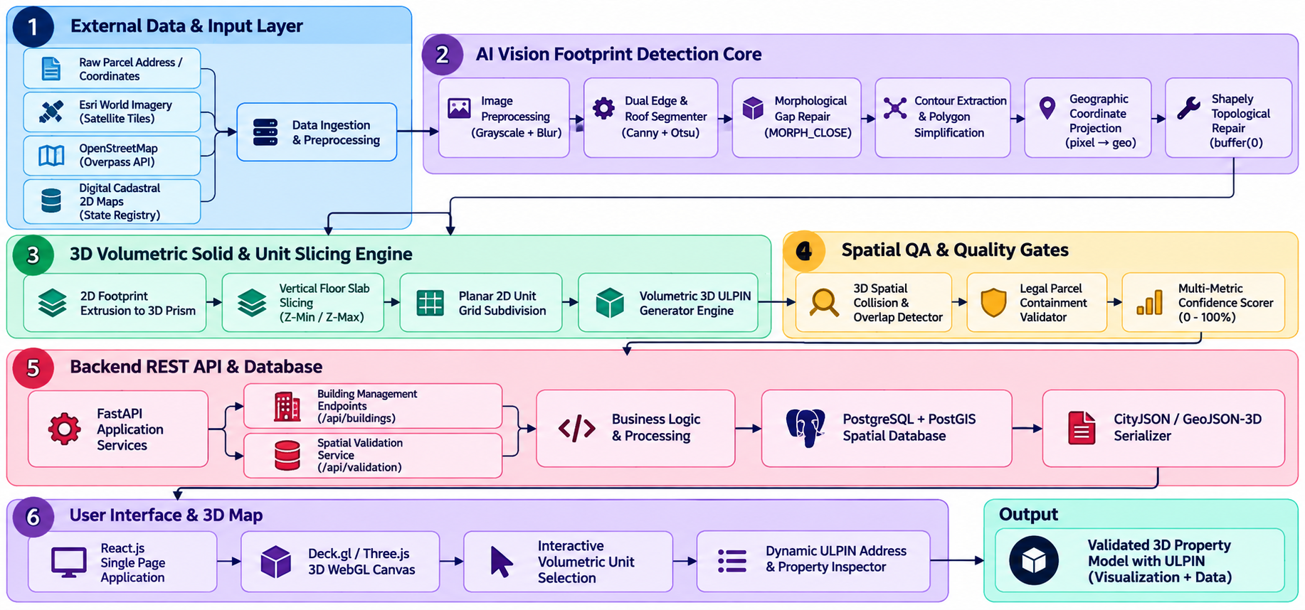
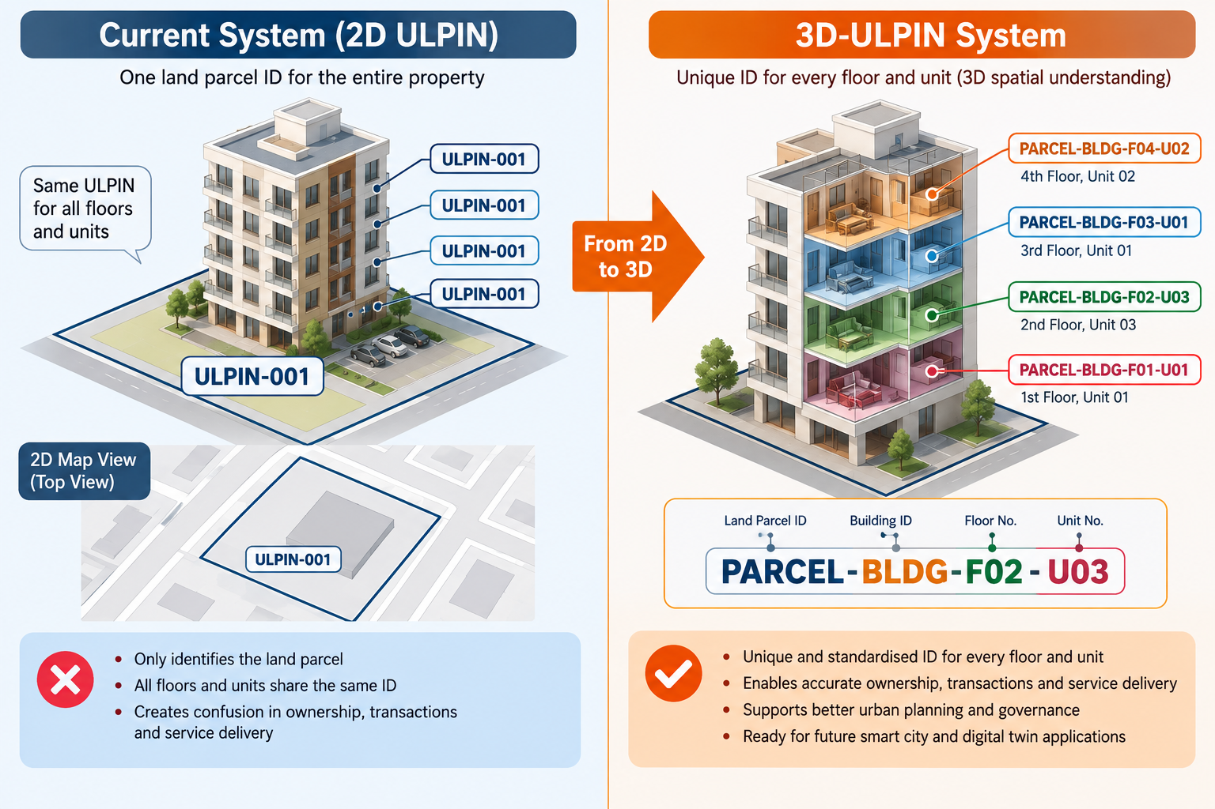
TECHNICAL APPROACH
Your Team Name
Workflow

Slide 4
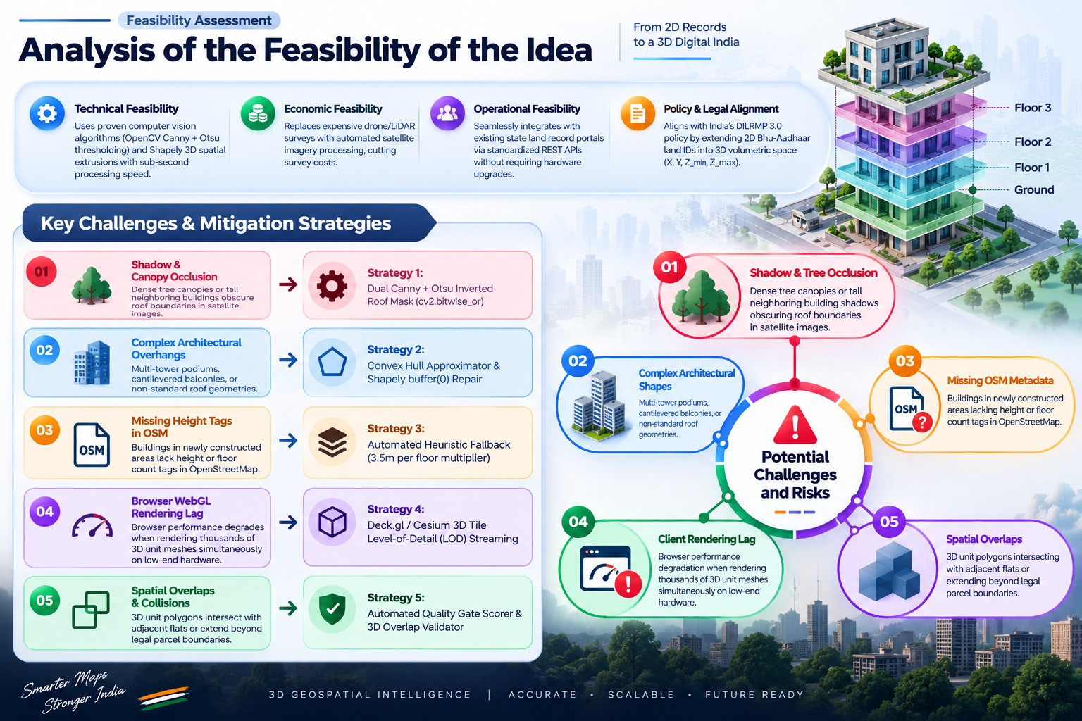
FEASIBILITY AND VIABILITY
Your Team Name

Slide 5
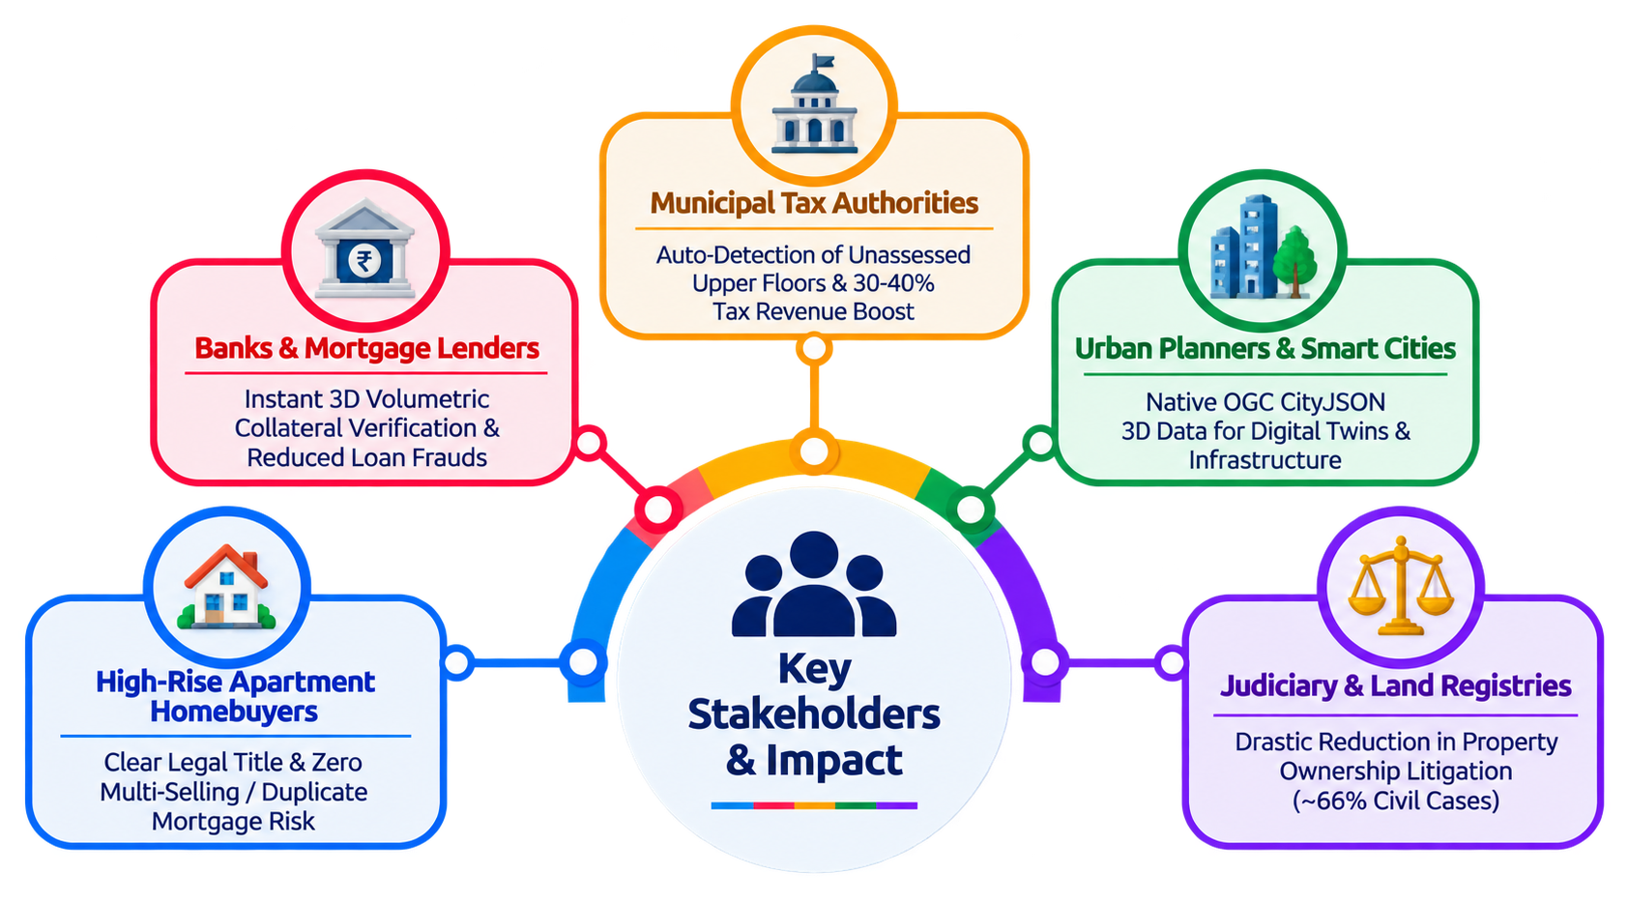
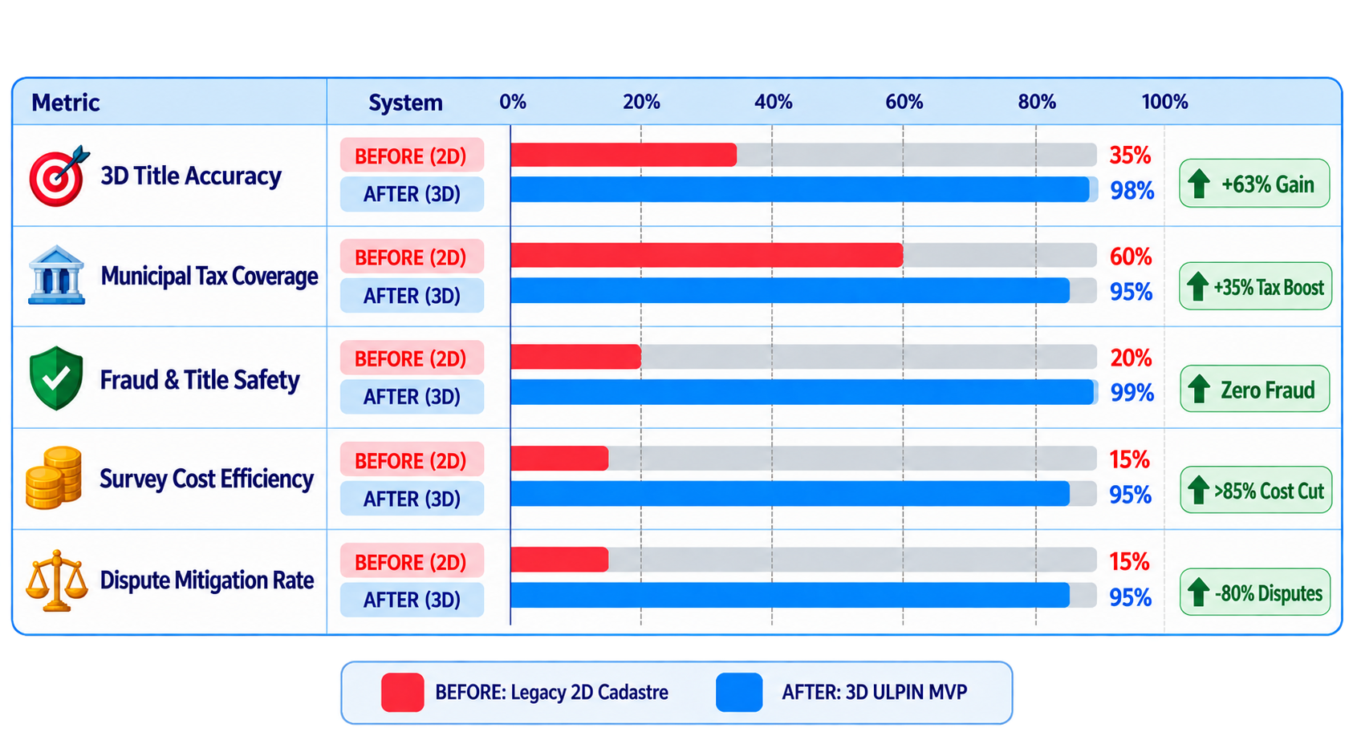
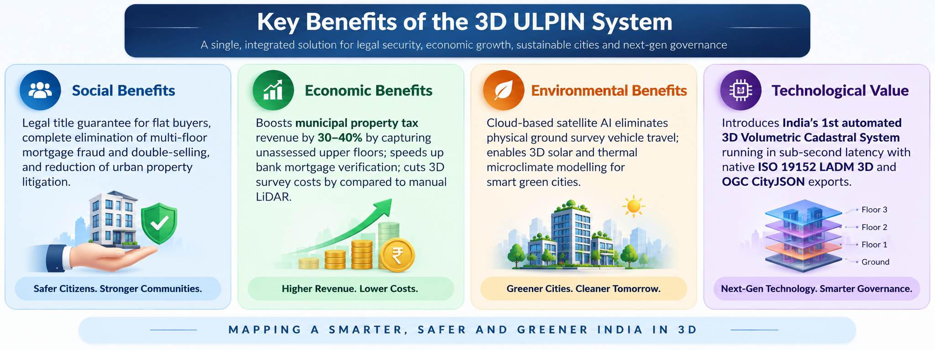
IMPACT AND BENEFITS
Your Team Name
Benifits

Slide 6
RESEARCH AND REFERENCES
Your Team Name

