Slide 1

J.A.R.V.I.S
Evaluation
Presentation By:
Rishabh Singh Manhas
(2020a1r082)
DEPARTMENT OF COMPUTER SCIENCE AND ENGINEERING
MIET(Autonomous), JAMMU

Slide 2
Contents:
Problem Statement
Problem statement is based on?
Tech Stack
Features
Workflow
Demonstration

Slide 3

What my Internship was based on?
Python: it’s applications and uses.

Slide 4
Problem Statement:
A voice assistant called J.A.R.V.I.S.
Main Objective:
This model is a virtual voice assistant, just like the Google assistant or Siri. This model is named after Jarvis, the one that was introduced in the first iron man movie.

Slide 5
So, what is J.A.R.V.I.S based on?
It is a virtual voice assistant using Python.
This project is aiming for improving the ease of access for the users.
This is in an early stage of development, so it just runs on the terminal..
This project uses various modules like, pyttsx3, speech recognition, wikipedia, smtplib, etc. for performing various functions like converting text to speech, searching on wikipedia, and sending and receiving emails.

Slide 6
We all know how a voice assistant works, but here’s a summary of what this project is and how it’ll be used:
JARVIS (Just a rather very intelligent system) is a digital assistant that uses voice recognition, language processing algorithms, and voice synthesis to listen to specific voice commands and return relevant information or perform specific functions as requested by the user.
Based on specific commands, sometimes called intents, spoken by the user, it can return relevant information by listening for specific keywords and filtering out the ambient noise.

Slide 7
Tech Stack:
This is a project solely built using Python, but other technologies involved are:
Operating System: Windows 11
Back-End: - PYTHON
Automatic speech recognition (ASR)
Natural Language generation (NLG)
Speech synthesis
Artificial Intelligence (AI)

Slide 8
Features:
J.A.R.V.I.S can perform any simple operations like a simple voice assistant, some of its key features are:
It can send emails on your behalf
It can play music for you.
It can do wikipedia searches for you.
It is capable of opening websites like Google, YouTube etc. in a web browser.
It is capable of opening code editor IDE with a single voice command on your device.

Slide 9
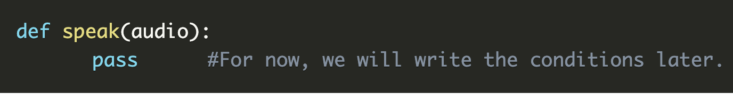
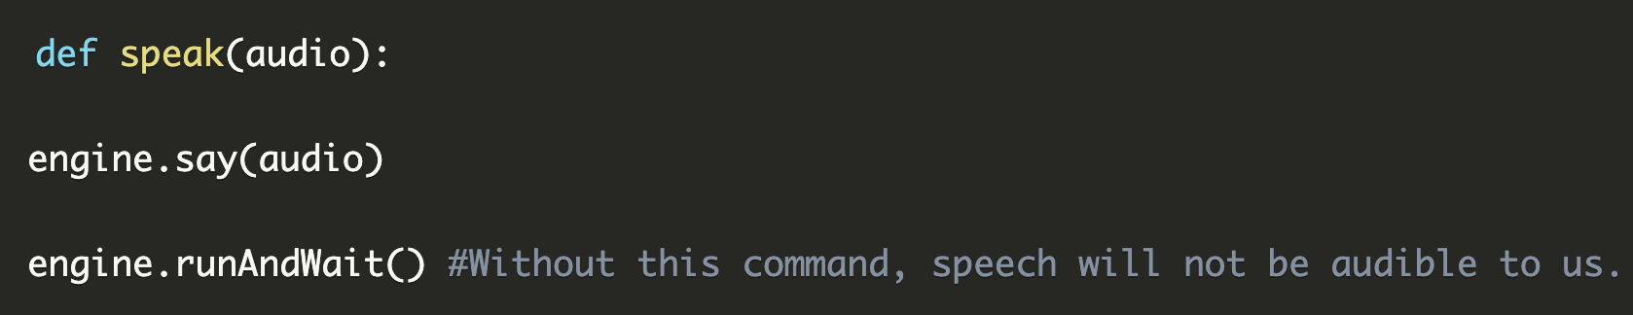
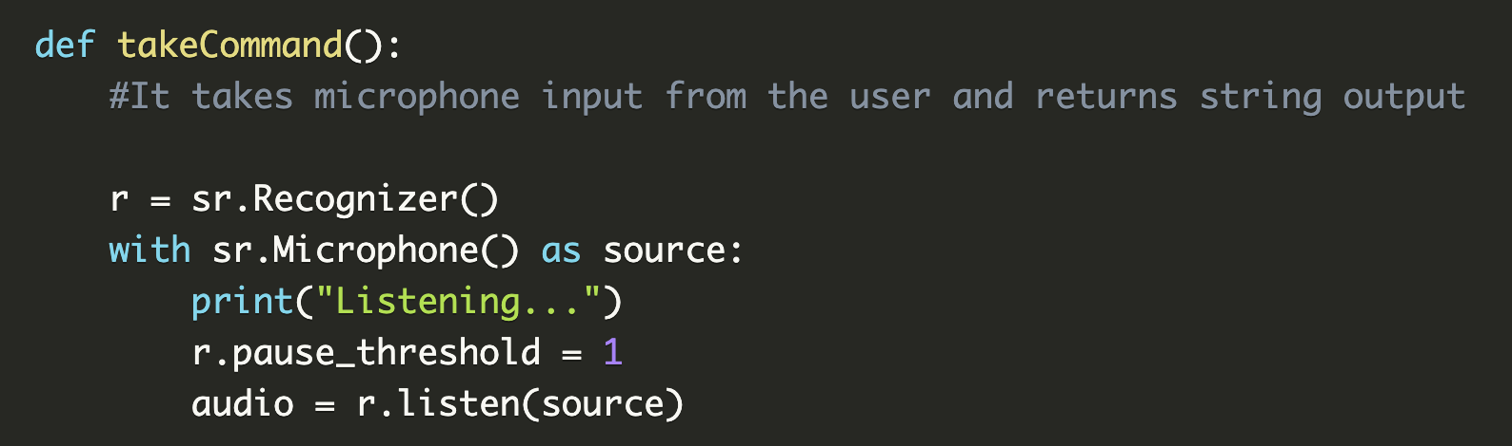
The code defined :-

Slide 10
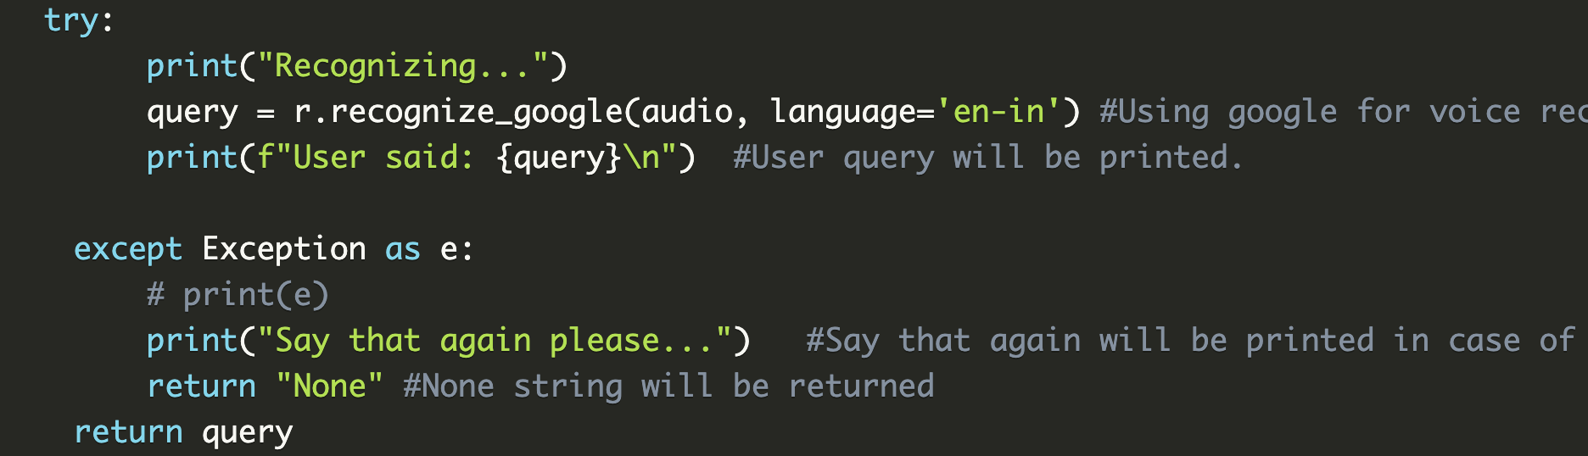
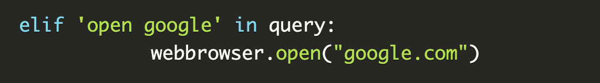
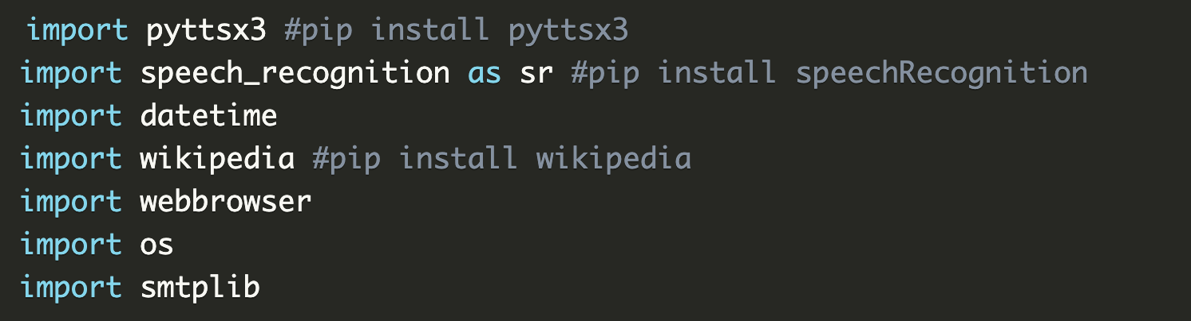
The code defined :

Slide 11
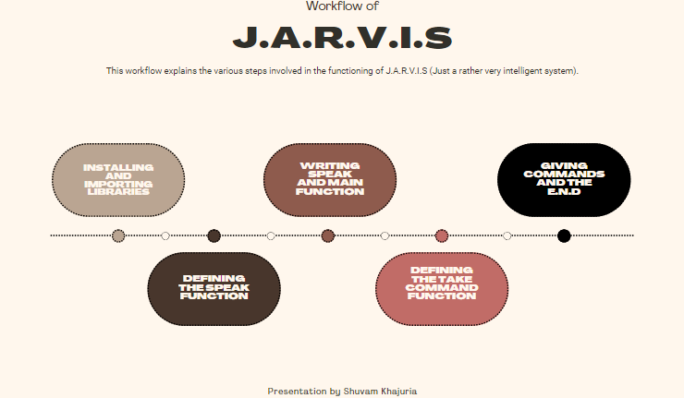
Workflow:

Slide 12
DEMONSTRATION:

Slide 13


