Slide 1
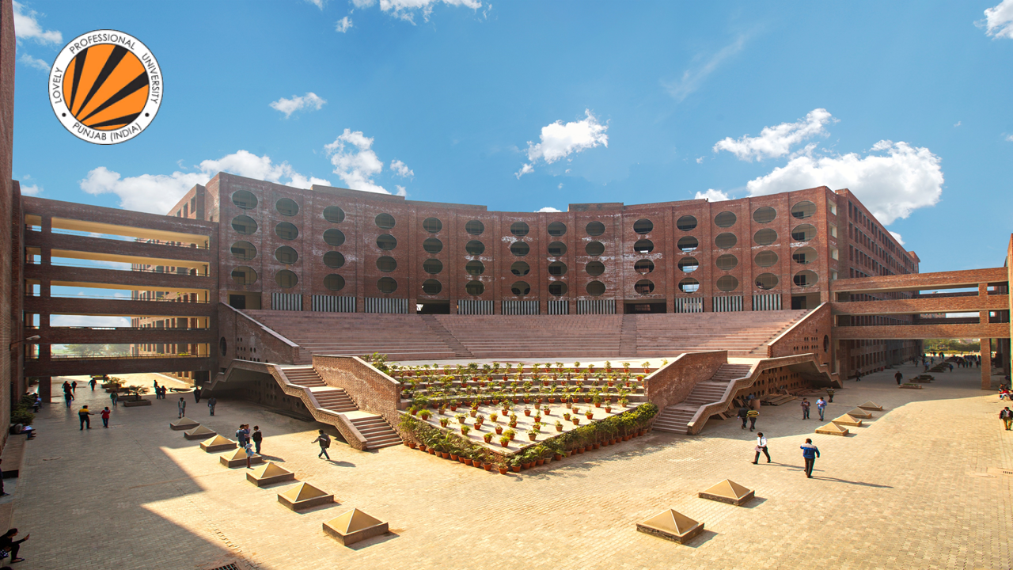
PATHWAY AREAS
School of Computer Science and Engineering

Slide 2

HOW?
Using PC – UMS
Using Mobile – LPUTouch App

Slide 3

Pathway Area
A set of courses that allow students to develop specific skill and value package for a chosen career.
Career pathways provide a set of courses required to achieve desired goal after graduation.
Service Based
Product Based
Higher Studies
Government Jobs
(Public Sector Jobs)

Slide 4
Pathways and Courses
SERVICE BASED
HIGHER STUDIES/GOVT JOBS
PRODUCT BASED
TERM 5
PEA305/PEA307 - ANALYTICAL SKILLS-I
PEA305/PEA307 - ANALYTICAL SKILLS-I
CSE329 – PRELUDE TO COMPETITIVE CODING
TERM 5
CSE333 - COMBINATORIAL STUDIES-I
CSE330 - COMPETITIVE CODING APPROACHES-TECHNIQUES
PEV107/PEV110 – VERBAL ABILITY-II
TERM 6
PES319 – SOFT SKILLS-II
CSE334 - COMBINATORIAL STUDIES-II
PES319 – SOFT SKILLS-II
TERM 6
PEA306/PEA308 - ANALYTICAL SKILLS-II
CSE335 - COMBINATORIAL STUDIES-III
CSE331 – CODING PEARLS

Slide 5
Program wise Pathway Elective Areas offered
PROGRAM CODE AND NAME | Career Pathway | Pathway Area
P102-NB-Dual Programme Diploma (Engg.) - B.Tech. (Computer Science & Engineering) P103-NB-Dual Programme Diploma (Engg.) - B.Tech. (Information Technology) P132-B.Tech. (Computer Science & Engineering) P132-H-B.Tech. (Computer Science & Engineering) (Hons.) P132-L-B.Tech. (Computer Science & Engineering) [Lateral Entry] P132-ND-Dual Degree B.Tech. - M.Tech. (Computer Science & Engineering) P132-NE-Dual Degree B.Tech. (Computer Science & Engineering)-MBA P133-B.Tech. (Information Technology) P133-L-B.Tech. (Information Technology) [Lateral Entry] | CORPORATE JOBS | SERVICE BASED
 |  | PRODUCT BASED
 | HIGHER STUDIES | HIGHER STUDIES
 | GOVERNMENT JOBS | GOVERNMENT JOBS
P192-ND-Integrated B.Tech. - M.Tech. (Computer Science & Engineering) P192-NE-Integrated B.Tech. (Computer Science & Engineering) - MBA | CORPORATE JOBS | SERVICE BASED
 |  | PRODUCT BASED

Slide 6
Service Based
This pathway prepare students for analytical, reasoning and soft skills.
Outcome
Preparedness for job in industries.
Provide better ingredients for success in career planning and placement drives.
Equipped the students for entry-level jobs that require analytical, reasoning and soft skills in addition to technical skills.

Slide 7
Description of Courses – Service Based
PEA305 - ANALYTICAL SKILLS-I
This course focuses on improving quantitative and reasoning skills of learners, which helps them crack various exams held in placement drives for engineering students. It also provides a base to prepare for advanced level aptitude exams.
Course Outcome:
Reproduce the concepts learned to solve various questions of quantitative and reasoning aptitude
Observe the data given and interpret it from the given problem
Apply the Concepts to solve Company Specific Aptitude tests
Analyze the problems and use logic to interpret and handle different situations
Select the appropriate approach to initiate the given problem
Solve quantitative and reasoning aptitude in competitive examinations

Slide 8
Description of Courses – Service Based
PEV107 - VERBAL ABILITY-II
This course is completely placement oriented. Topics are identified from various placement papers.
Course Outcome:
Associate learnings of sentence correction in written language usage scenarios
Demonstrate awareness of sound inventory in overall oral competence
Determine following components from a written passage: main idea, compare and contrast ideas, draw conclusions, and paraphrase information
Develop critical thinking abilities for resolution of reasoned arguments
Integrate awareness of grammatical components in oral language scenarios
Express professional writing abilities adapting changing workplace expectations.
Construct a coherent written passage(s) observing mechanics of writing.

Slide 9
Description of Courses – Service Based
PES319 - SOFT SKILLS-II
The course helps the students to build impactful personality through personal grooming. The students are trained to communicate with influence. Students are trained on group discussions and interview skills to help them in respective career pathways.
Course Outcome:
Prepare powerful brand for career progression
Articulate fluently with confidence
Demonstrate critical thinking while generating ideas
Apply successful answering techniques during an interview
Develop positive mindset while handling tasks that require decision making ability

Slide 10
Description of Courses – Service Based
PEA306 - ANALYTICAL SKILLS-II
This course focuses on improving quantitative and reasoning skills of learners, which helps them crack various exams held in placement drives for engineering students. It also provides a base to prepare for advanced level aptitude exams.
Course Outcome:
Reproduce the concepts learned to solve various questions of quantitative and reasoning aptitude
Observe the data given and interpret it from the given problem
Apply the Concepts to solve Company Specific Aptitude tests
Analyze the problems and use logic to interpret and handle different situations
Select the appropriate approach to initiate the given problem
Solve quantitative and reasoning aptitude in competitive examinations

Slide 11

What are the interfaces through which the student can participate in giving choice of Pathway area?
Only through UMS
Only through LPU Touch
Both through UMS and LPU Touch
Through any mobile browser

Slide 12
Higher Studies/Government Jobs
This pathway provides necessary inputs and guidance to prepare them for competitive exams like GATE/NET and other agency exams that forms the basis for public section jobs or higher studies.
Outcome
Preparedness to get admission to top-notch M.Tech/ME/MS institutes.
Opportunity to learn in a highly competitive environment and thus, develops and broadens your intellectual thought process.
Preparation for many public sector undertakings (PSUs) such as Power Grid, IOCL etc.

Slide 13
Description of Courses – Higher Studies/Govt Jobs
PEA305 - ANALYTICAL SKILLS-I
This course focuses on improving quantitative and reasoning skills of learners, which helps them crack various exams held in placement drives for engineering students. It also provides a base to prepare for advanced level aptitude exams.
Course Outcome:
Reproduce the concepts learned to solve various questions of quantitative and reasoning aptitude
Observe the data given and interpret it from the given problem
Apply the Concepts to solve Company Specific Aptitude tests
Analyze the problems and use logic to interpret and handle different situations
Select the appropriate approach to initiate the given problem
Solve quantitative and reasoning aptitude in competitive examinations

Slide 14
Description of Courses – Higher Studies/Govt Jobs
CSE333 - COMBINATORIAL STUDIES-I
This is an exclusively designed course for IES, GATE, SSC - Prelims and Mains. This course shows the importance of mathematics in an engineering career by demonstrating how simple engineering problems can be described and methodically analyzed.
Course Outcome:
Practice all the mathematical theories and concepts important for a computer science engineer.
Identify the utility of mathematics in higher studies.
Score good marks in higher studies related competitive exam like GATE.
Evaluate different mathematical theories related to Discrete Mathematics, Linear Algebra, Calculus, and Probability.

Slide 15
Description of Courses – Higher Studies/Govt Jobs
CSE334 - COMBINATORIAL STUDIES-II
Course provides insight into major Information Technology subjects that constitute higher denomination in GATE, IES, PSU, SSC and provide students in depth knowledge to clear the fundamental concepts of CSE-IT domain.
Course Outcome:
Assess their conceptual knowledge of all major algorithms of searching and sorting.
Analyze various data structures used for storage.
Measure their technical knowledge and understanding in the field of theory of computation.
Examine lexical analyzer and parser generator tools working.
Solve critical technical problems related to operating systems.
Formulate problem solutions and understand deep concepts of C language.

Slide 16
Description of Courses – Higher Studies/Govt Jobs
CSE335 - COMBINATORIAL STUDIES-III
Course provides insight into major Information Technology subjects that constitute higher denomination in GATE, IES, PSU, SSC and provide students in depth knowledge to clear the fundamental concepts of CSE-IT domain.
Course Outcome:
Practice critical technical problems related to combinational and sequential circuits in digital logic
Understand various addressing modes, concept of memory hierarchy and I/O interface in computer architecture
Practice critical problems related to computer networks and security
Formulate problem solutions and understand deep concepts related to RDBMS and Structured Query Language (SQL)

Slide 17
Special Requirements
Mathematics would be part of the pathway and students must have good understanding of it.
Must have done Engineering Mathematics.

Slide 18
Higher Studies/Government Jobs pathway expects that a student
Must have 8.0 or higher CGPA
Must appear in scrutiny test
a student must have good understanding of mathematics concepts
Must be doing integrated programme

Slide 19
Product Based
This pathway covers data structures & algorithms deeply with problem solving. Applications have the requirement to write code that results in time and space efficiency.
Outcome
Code formulation by designing optimal code
Comparison of two different solutions on the basis of time and space complexity

Slide 20
Description of Courses – Product Based
CSE329 - PRELUDE TO COMPETITIVE CODING
Course provides an introduction to competitive programming by introducing the students to the programming constructs data structures and algorithmic paradigms. The main focus of the course is to build intuition for problem solving in current computing environment.
Course Outcome:
Relate the theoretical knowledge and insights gained to formulate working code
Revise time and space efficient algorithms to solve abundant ubiquitous problems
Identify the intricacies present in the design of a solution to devise an optimal solution
Deduce the appropriate and efficient algorithms and data structures for optimal solution to the problems at hand
Extend and utilize the knowledge base of various algorithmic paradigms to build optimized solutions to real world problems
Validate the logic building and code formulation by designing optimal code capable of passing various test cases

Slide 21
Description of Courses – Product Based
CSE330 - COMPETITIVE CODING APPROACHES-TECHNIQUES
Course emphasize on best programming practices which leads to complexity control using advance coding approach with effective and logical techniques. Student will learn to reframe and optimize the problem solutions.
Course Outcome:
Analyze the time and memory complexity of an algorithm or a structure
Test primality efficiently
Use nlogn sorting techniques and recursion in effective way
Apply Tabulation and Memorization in standard Dynamic Programming problems

Slide 22
Description of Courses – Product Based
PES319 - SOFT SKILLS-II
The course helps the students to build impactful personality through personal grooming. The students are trained to communicate with influence. Students are trained on group discussions and interview skills to help them in respective career pathways.
Course Outcome:
Prepare powerful brand for career progression
Articulate fluently with confidence
Demonstrate critical thinking while generating ideas
Apply successful answering techniques during an interview
Develop positive mindset while handling tasks that require decision making ability

Slide 23
Description of Courses – Product Based
CSE331 - CODING PEARLS
The course builds on prelude to competitive programming and aims to make the students better at problem solving by application of programming constructs, efficient data structures and algorithms. Student will redefine and explore the existing problems solutions
Course Outcome:
Relate the theoretical knowledge and insights gained to formulate working code
Revise time and space efficient algorithms to solve abundant ubiquitous problems
Identify the intricacies present in the design of a solution to devise an optimal solution
Deduce the appropriate and efficient algorithms and data structures for optimal solution to the problems at hand
Extend and utilize the knowledge base of various algorithmic paradigms to build optimized solutions to real world problems
Validate the logic building and code formulation by designing optimal code capable of passing various test cases

Slide 24
Special Requirement – Product Based
Students must have the passion to code along with logical skills.
On the basis of test (announcement through UMS)

Slide 25
Which pathway will be considered by default if not chosen?
Service Based
Product Based
Higher Studies
Government Jobs

Slide 26
Enrolment Process – Product Based
Students have the option to go for any of the pathways of his/her choice except Product Based pathway which requires good knowledge data structures and algorithms, logic building and problem solving skills.
For product based pathway, a separate test is conducted on competitive platform to test the initial level of logic building and programming. Students are selected for product based pathway on the basis of this test with some condition on maximum number of reappear courses.

Slide 27
Mandatory Feedback
Dear Students,
Provide the feedback for this session on Myclass as well as on UMS at below given link:
UMS Navigation-------->Feedback & Surveys-------->Online Survey
Survey on Pathway Electives Presentation session 22-23

Slide 28
Doubts ?
CONTACT YOUR SECTION HOD

