Slide 1
Career bot
CAPSTONE PROJECT
Presented By:
Student name : Rishabh Ahuja
College Name & Department : NMIMS Indore, B.Tech Computer Engineering

Slide 2
OUTLINE
Problem Statement
Technology used
Wow factor
End users
Result
Conclusion
Git-hub Link
Future scope
IBM Certifications

Slide 3
Problem Statement
Students often struggle with choosing a suitable career path, understanding skill requirements, and navigating higher education opportunities. Manually researching job roles, certifications, and industry trends is overwhelming and inefficient.
Proposed Solution: An Agentic Career Counseling Bot (CareerBot) built using IBM Cloud Agentic AI to provide personalized, India-focused guidance on career options, skills, learning paths, and emerging industries. It uses AI-driven insights from trusted sources and vector-trained documents.

Slide 4
Technology used
IBM cloud lite services
Natural Language Processing (NLP)
Retrieval Augmented Generation (RAG)
IBM Granite model

Slide 5
IBM cloud services used
IBM Cloud Watsonx AI Studio
IBM Cloud Watsonx AI runtime
IBM Cloud Agent Lab
IBM Granite foundation model

Slide 6
Wow factors
This agent helps students explore the right career paths, develop essential skills, and stay future-ready—reducing confusion, saving time, and empowering learners with actionable guidance tailored to their background, goals, and the Indian education system.
Unique features:
Personalized career paths tailored to Indian students
Works for all streams: PCM, Commerce, Arts
Suggests skills, certifications, and interview prep tips
Highlights green-tech, AI, and other emerging domains
Vector-trained on real government career guides and roadmaps
Provides context-aware answers with high precision
Suggested learning paths, soft skills, and trending jobs.

Slide 7
End users
High school students (Class 11–12)
Undergraduate college students (all streams)
Career counselors and coaching centers
Placement cells in colleges
Upskilling-focused platforms or NGOs

Slide 8
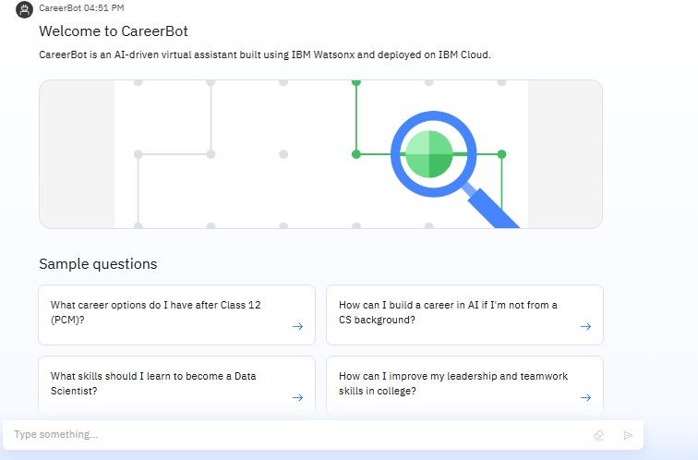
Results

Slide 9
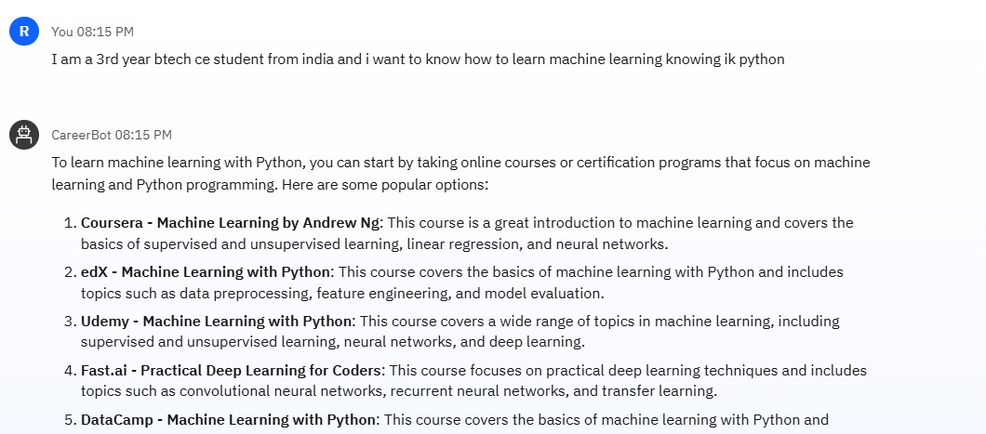
Results

Slide 10
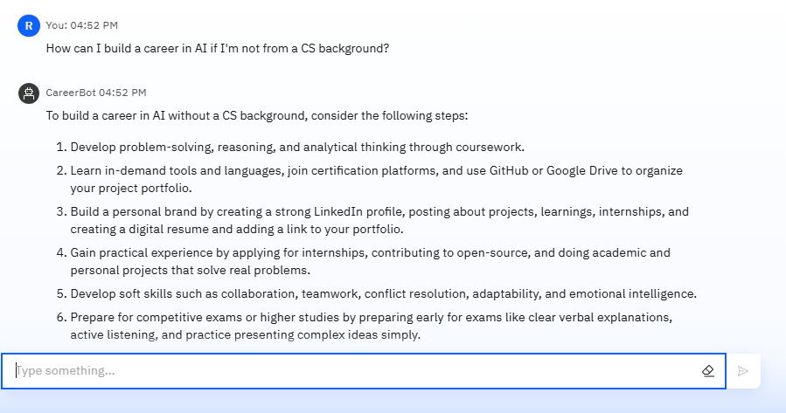
Results

Slide 11
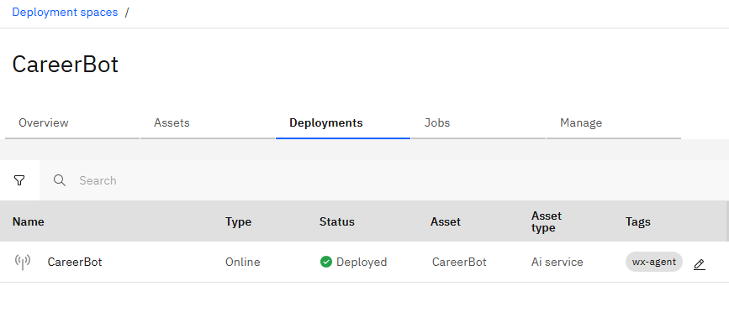
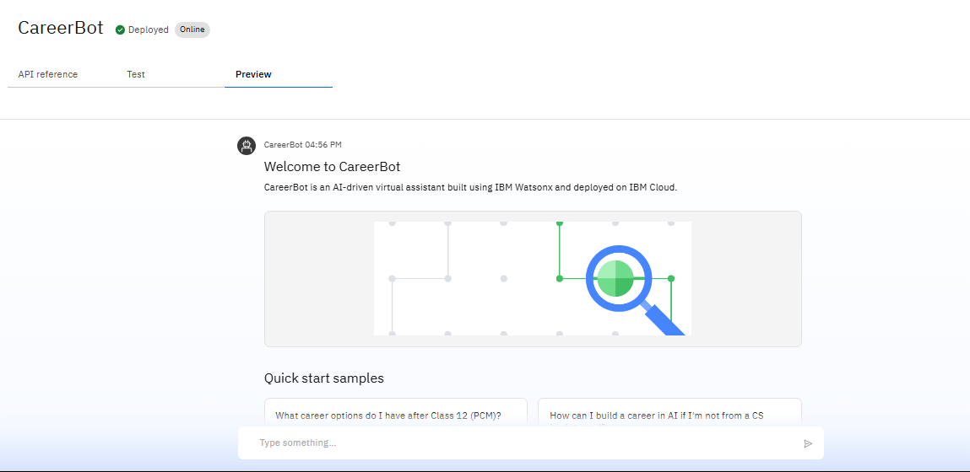
Results
Deployed AI Agent

Slide 12
Conclusion
The agent provides personalized career guidance, answers education-related queries, and recommends skills and certifications based on user input.
It saves time by automating career research, skill-matching, and roadmap generation.
CareerBot enhances clarity, confidence, and future-readiness for students, bridging the gap between aspiration and action.

Slide 13
Future scope
Multilingual support for Hindi and regional languages
Integration with resume builders and college portals
Add a "skill gap checker" and resume matcher
Export answers as PDFs for counselors
Add real-time job market trends via API integration

Slide 14
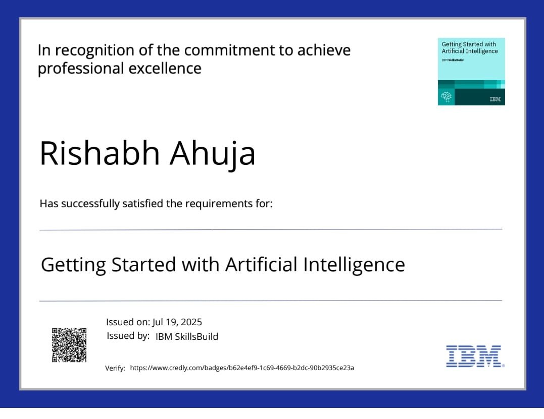
IBM Certifications

Slide 15
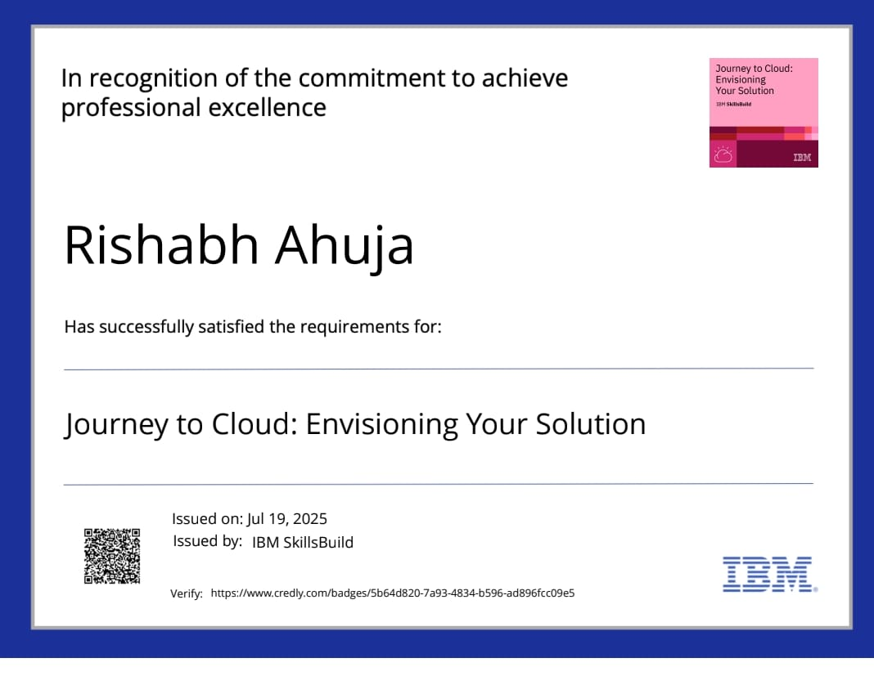
IBM Certifications

Slide 16
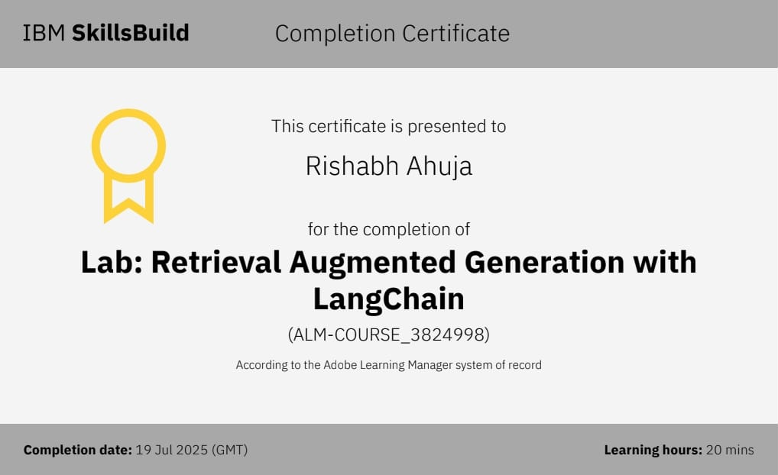

Slide 17
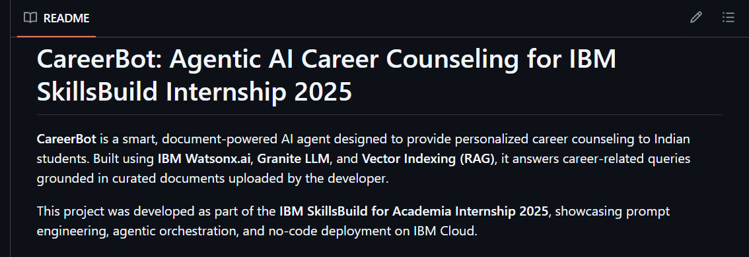
GitHub Link
https://github.com/rishabhahuja12/careerbot

Slide 18
THANK YOU

