Slide 1


SELF ORDERING SYSTEM
Notes:
First

Slide 2

Contents
ABSTRACT
INTRODUCTION
SYSTEM REQUIREMENTS
ADVANTAGES
FUNCTIONAL FLOW BLOCK DIAGRAM
E-R DIAGRAM
WORKING
LIMITATION
CONCLUSION

Slide 3
Abstract
Requirement Specification For An Online Ordering System.
Quickly And Easily Manage Online Menu
Easy To Navigate Graphical Interface
Describes Overall Model Of System
Presents An Account Of Evolution Of System With Maintenance.
Notes:
Second

Slide 4
Introduction
Earlier, restaurant systems offered rich dinning experience.
Recently, delivery orders were placed over phones – includes disadvantage.
Thus, our system simplifies ordering process.
Orders are automated.
As orders get placed, immediately entered in to database and retrieved by the admin.
Delivery details are finally displayed.
Notes:
Third

Slide 5
System Requirements
Functional Requirement
3-Logical components-
Web Ordering System
Menu Management System
Order Retrieval System
Notes:
Fifth

Slide 6
System Requirement (cont.)
Non- Functional Requirement
Written using Visual Studio 2012
Complied to ASP.NET
Backend language- C#
Supported by web server
Database used – MICROSOFT SQL SERVER

Slide 7
Advantages
User-Friendly User Interface.
Customer can Order as per His/her Choice.
System will Calculate and Display the Final Bill.
Less Probable to make Mistake.
Fast and Easy.
Available 24 hours for 365 Days.
Notes:
Eighth

Slide 8
Advantages (cont.)
Less Use Of Paper and Pen.
Multiple Orders at a Time.
Effortless– Order Can be Placed Easily.
Time Efficient.
Easy to Update and Maintain Database.

Slide 9
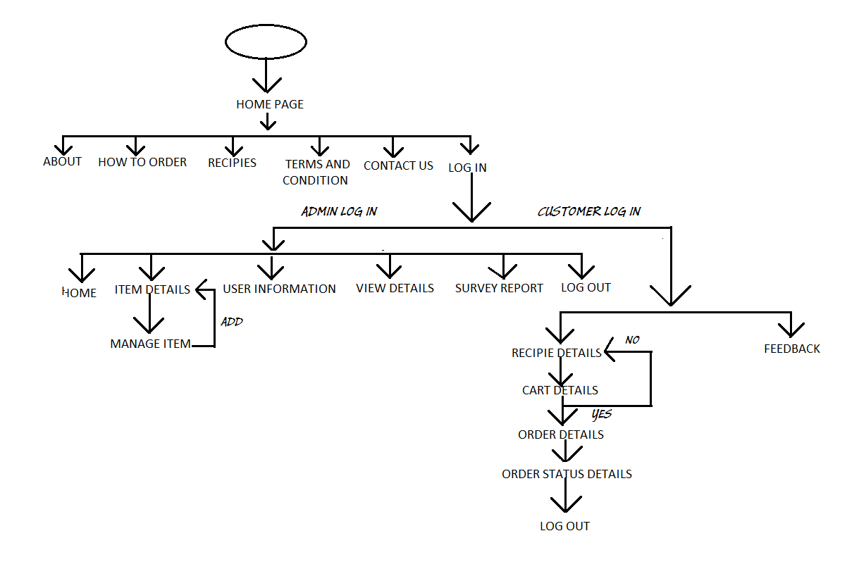
FFBD

Slide 10
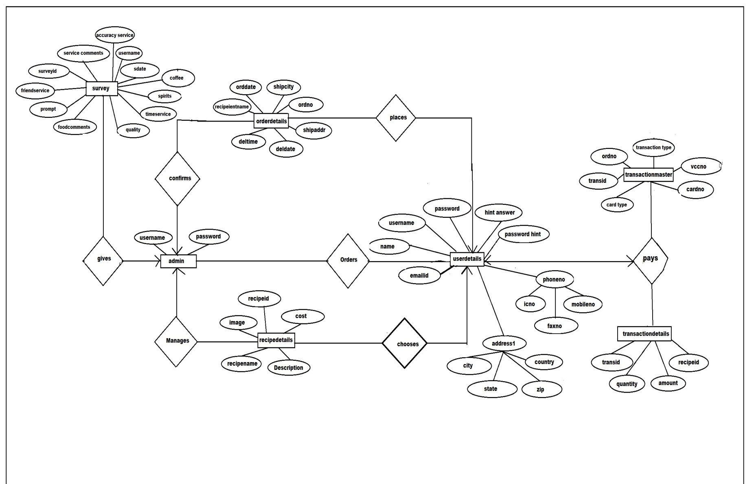
E-R DIAGRAM
Notes:
Seventh

Slide 11
Working
Customer opens Website Registers and Login.
1. PLACE ORDER:
User sees menu
User select from menu
User add the selected to cart
User confirms the order
User choose payment type.
Notes:
Sixth

Slide 12
Working (cont.)
Administrator opens Website and Login
2. UPDATE MENU:
For Admin
The admin enters the system with some password
The admin makes the required changes
The admin saves the changes and logs out.

Slide 13
Working (cont.)
3. READ ORDER:
For Admin
Internal order system reads the order
Communicates the order to the food preparation person

Slide 14
Limitation
Not for ILLITERATE People.
No Connection due to System Failure.
Server could be busy as number of Users Increases.
Notes:
Ninth

Slide 15
Conclusion
Heart of the ordering system is Database which is relatively constant.
If system goes in actual use , requests will arise for additional features which would be useful.
With booming popularity of mobile apps, this web interface can be further developed as phone apps.

Slide 16

Project by- Medha Anjali Sharma Rashi Raina Deepali Sharma Sweta Kumari Guided by- Miss. Jaya Paul

Slide 17
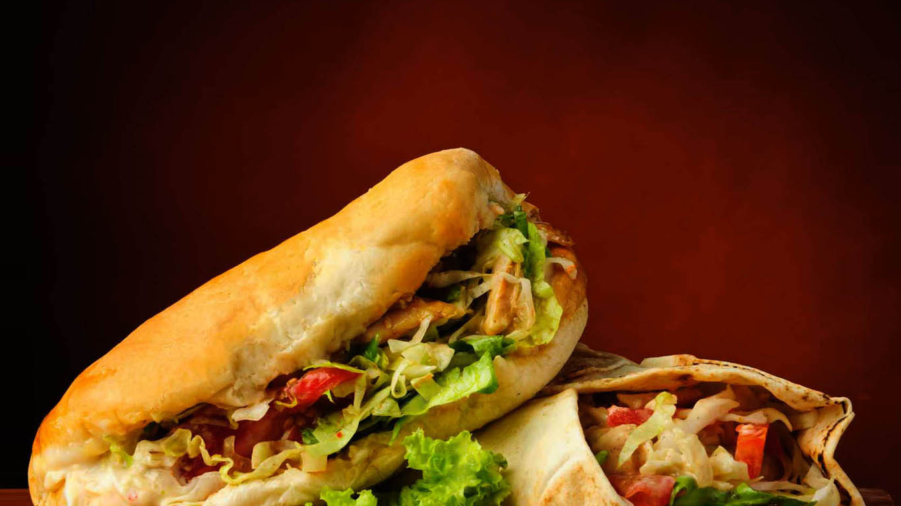
Thank You

