Slide 1

TEXT-TO-SPEECH
PLATFORM

Slide 2
TEXT-TO-SPEECH
PLATFORM
The most user-friendly platform I personally explored:
NATURAL READER
TTSREADER
GOOGLE CLOUD
PLAY HT
GENNY LOVO

Slide 3
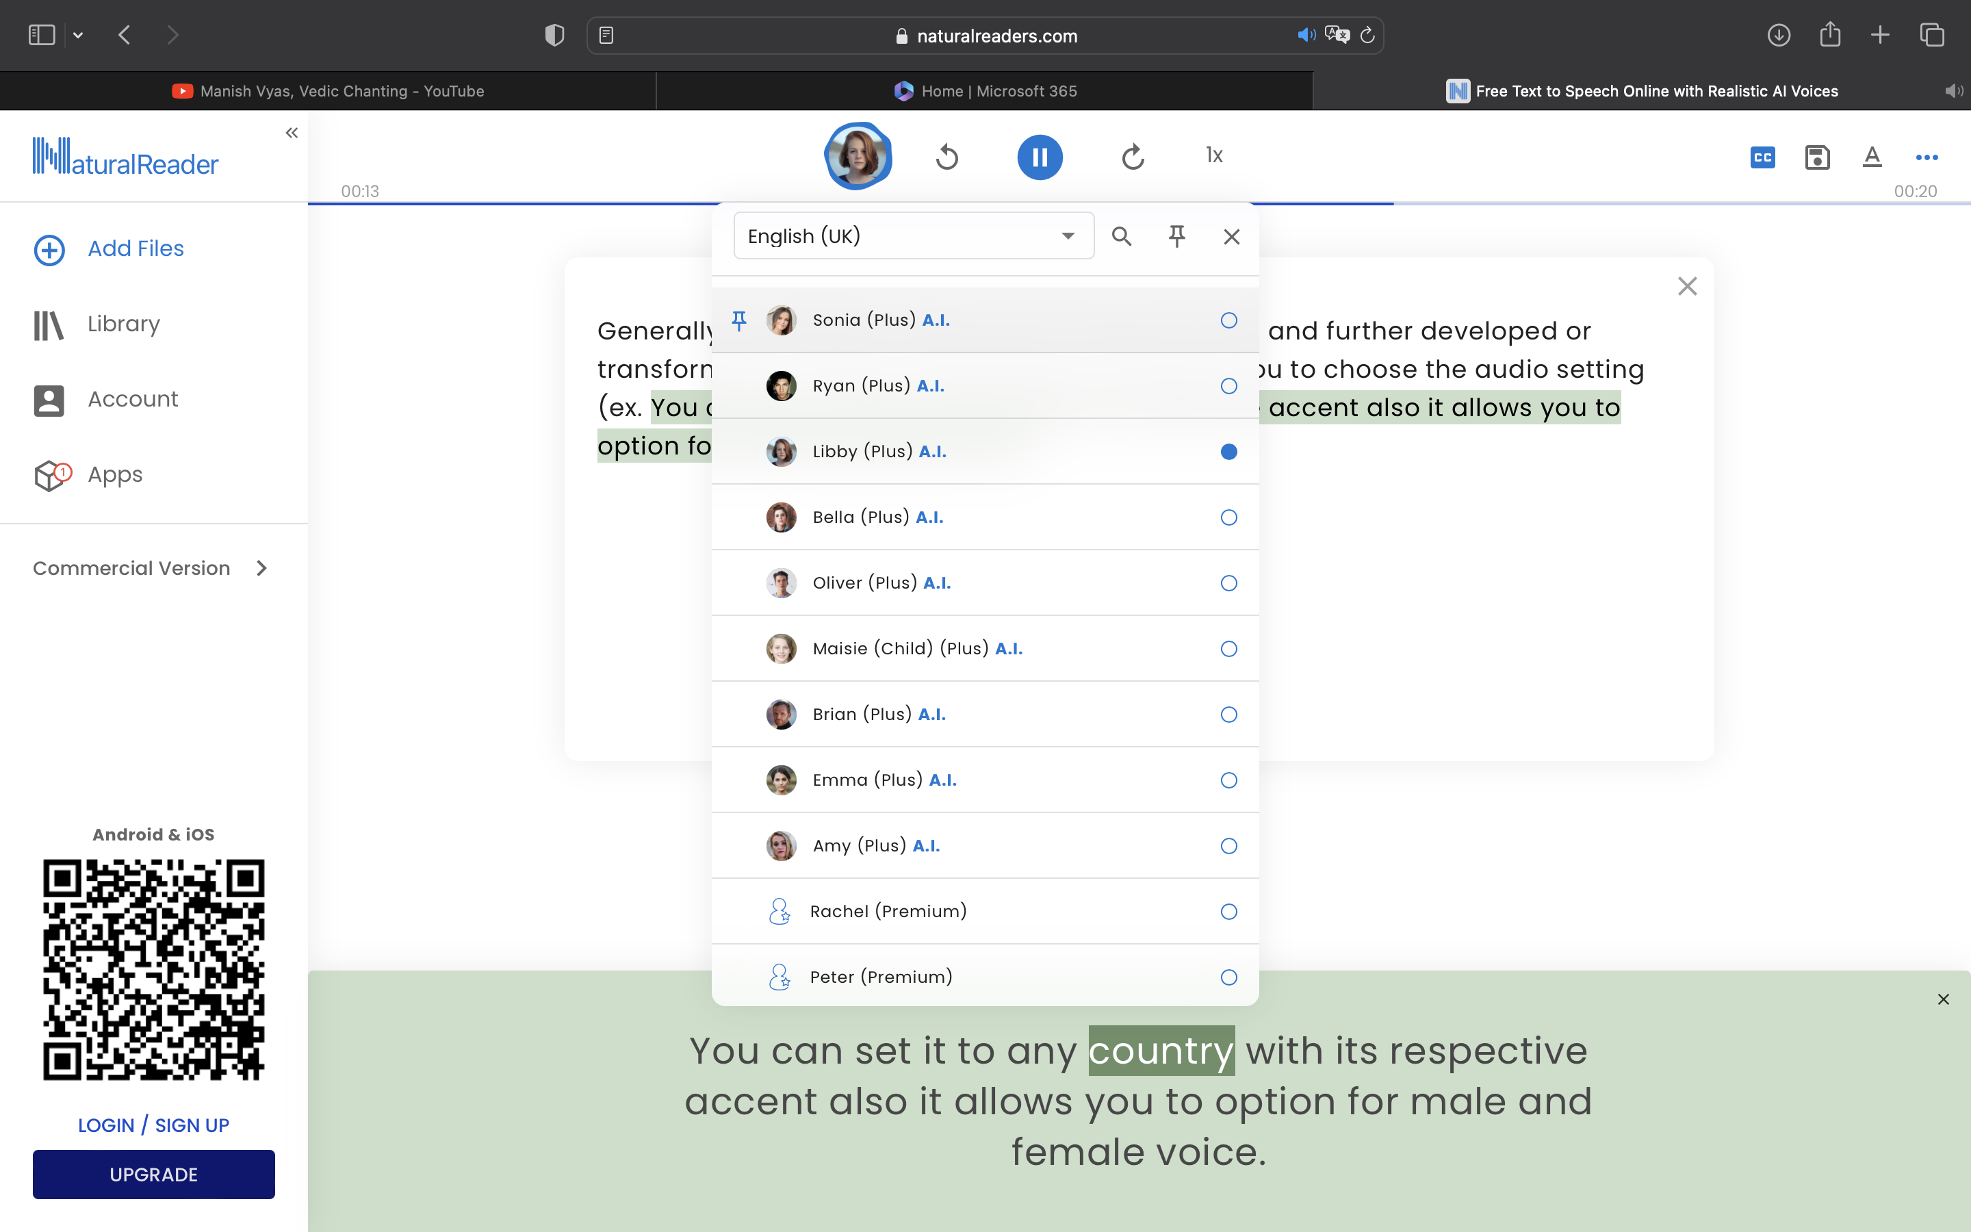
TEXT-TO-SPEECH
PLATFORM
NATURAL READER
Generally this platform allows you to write your text and further developed or transformed in a audio. Interestingly it also allow you to choose the audio setting (ex. You can set it to any country with its respective accent) also it allows you to option for male and female voice.

Slide 4
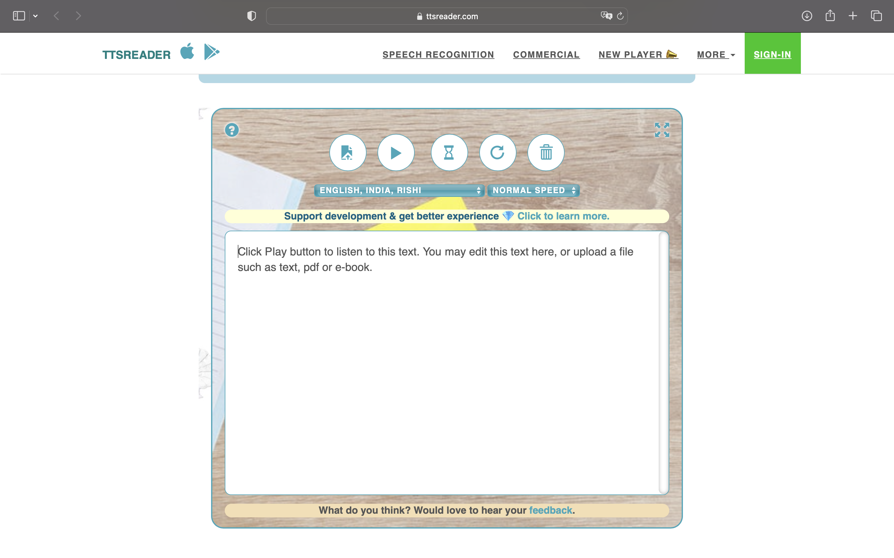
TEXT-TO-SPEECH
PLATFORM
TTSREADER
Somehow it is quite similar as the last platform. Additionally it has one advance feature than the last one which is to add pause.

Slide 5
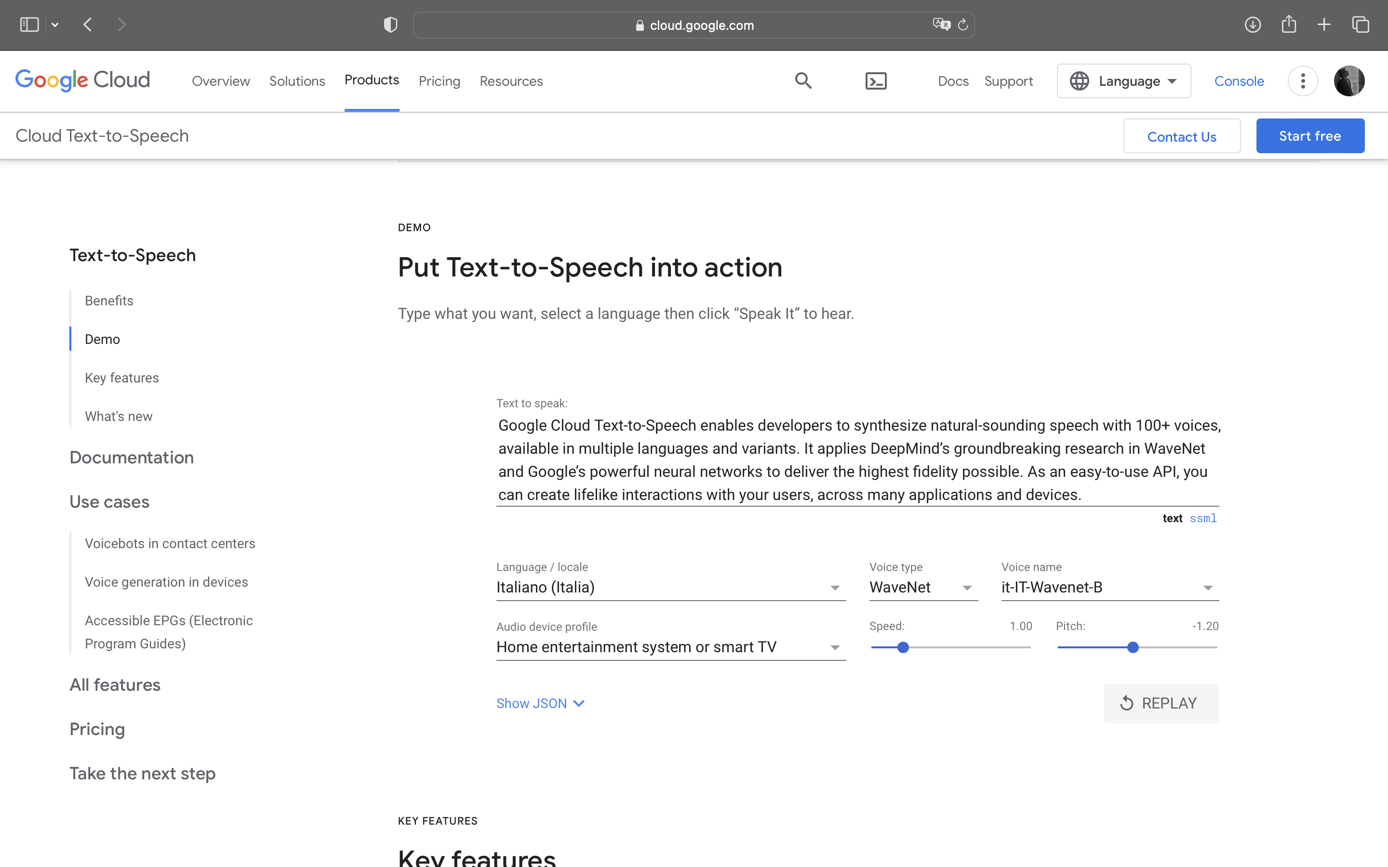
TEXT-TO-SPEECH
PLATFORM
GOOGLE CLOUD (text-to-speech)
It has many settings to play with eg. Voice type, voice name, also the output device and especially the pitch. It has a wide range of trained sound sample which are easy to user.

Slide 6
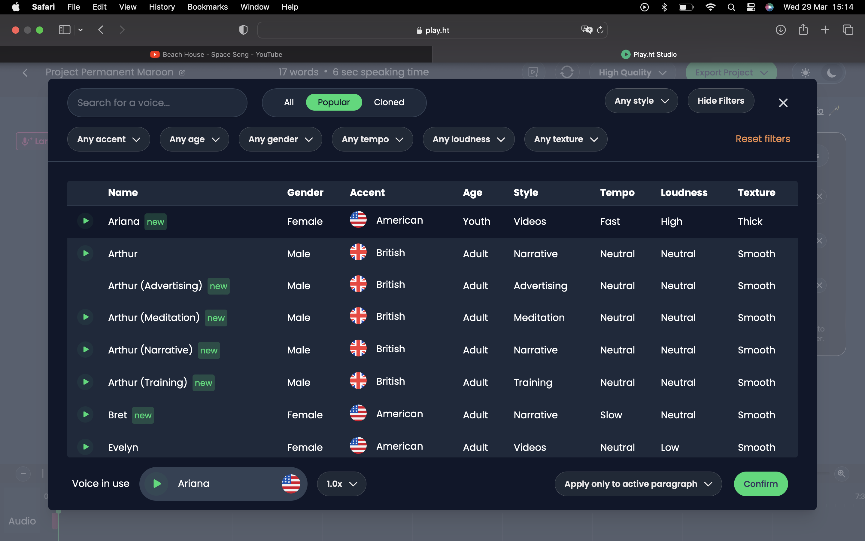
TEXT-TO-SPEECH
PLATFORM
PLAY HT
As you explore this platform, it has many setting like texture, loudness, tempo, accent and most clamant one is age, as I think it is the most amazing feature which make it most unique. Also it is being used by most of the big companies and organization.

Slide 7
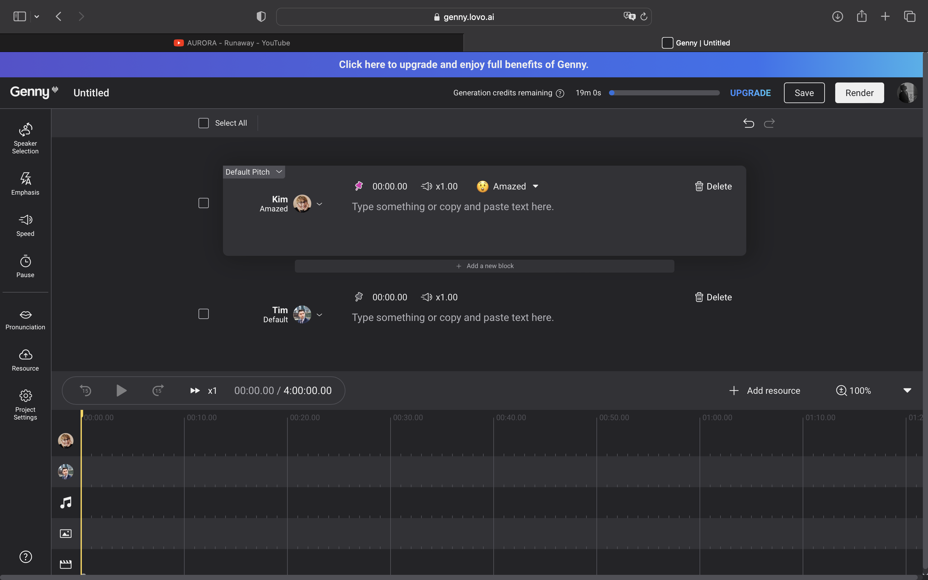
TEXT-TO-SPEECH
PLATFORM
GENNY AI
I personally go with this option. This platform has a lot features to offer, I can even set the generated voice emotions and emphasize the pronounciation of any certain word or sentence. It also has the recently covered features which was present in the last platforms.

Slide 8
TEXT-TO-SPEECH
PLATFORM
C
In a conclude manner, an ideal text-to-speech platform should have an input space to text also a lot of features that allow the user to select the gender of the generated voice that is common features in every platform, but it also should have an age factor to vary the tone of the voice which may improve the desired result. Analyzed personally many platform and concluded to put only few in my report as mentioned above. Many additional features that I personally praised was the emotion and accent of the voice.
ONCLUSION

