Slide 1

HEART DISEASE PREDICTION

Slide 2
PROBLEM STATEMENT
Health is real wealth in the pandemic time we all realized the brute effects of covid-19 on all irrespective of any status. You are required to analyse this health and medical data for better future preparation.

Slide 3
Attribute Information:
-> age -> sex -> chest pain type (4 values) -> resting blood pressure -> serum cholesterol in mg/dl -> fasting blood sugar > 120 mg/dl -> resting electrocardiographic results (values 0,1,2) -> maximum heart rate achieved -> exercise induced angina -> oldpeak = ST depression induced by exercise relative to rest the slope of the peak exercise ST segment -> number of major vessels (0-3) coloured by fluoroscopy -> thal: 0 = normal; 1 = fixed defect; 2 = reversable defect

Slide 4
Data Preprocessing
To understand the data:
1. How big is the data?
2. How does the data look like?
3. What is the data-type of columns?
4. Are there any missing values?
5. How does the data look like mathematically?
6. Are there duplicate values?
7. How is the correlation between the columns?

Slide 5
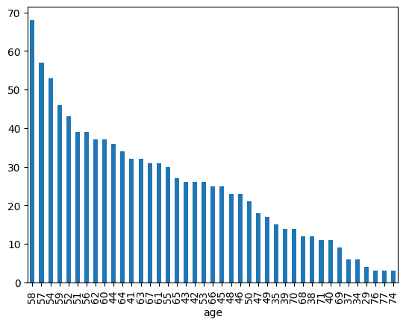
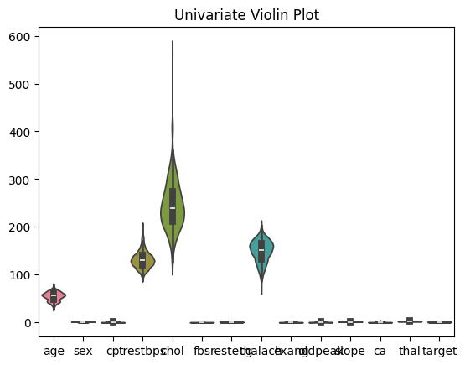
Exploratory Data Analysis

Slide 6
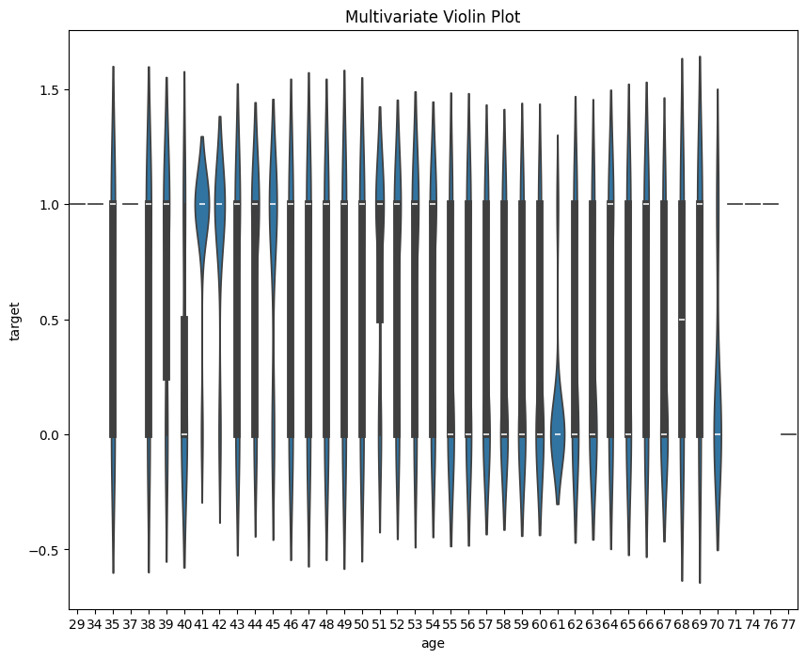
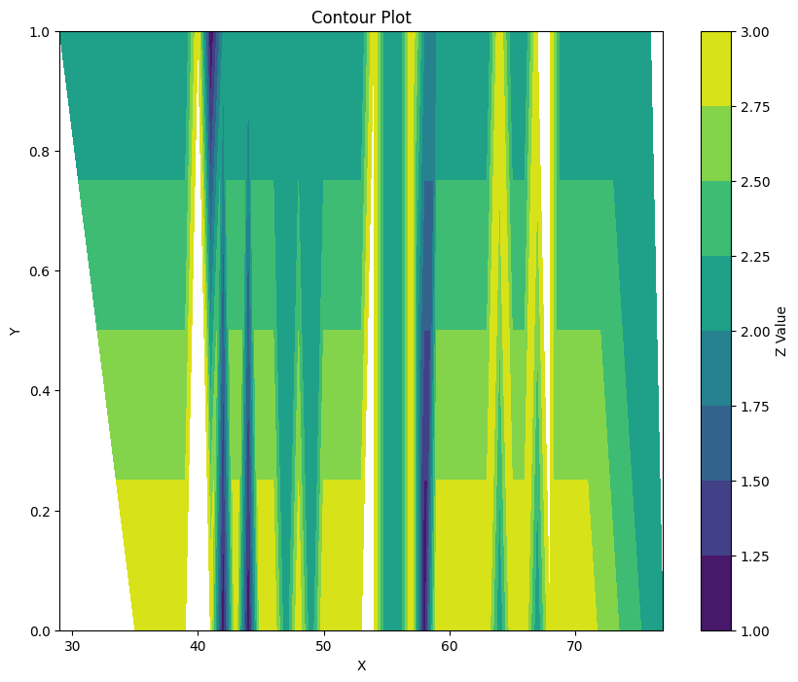

Slide 7
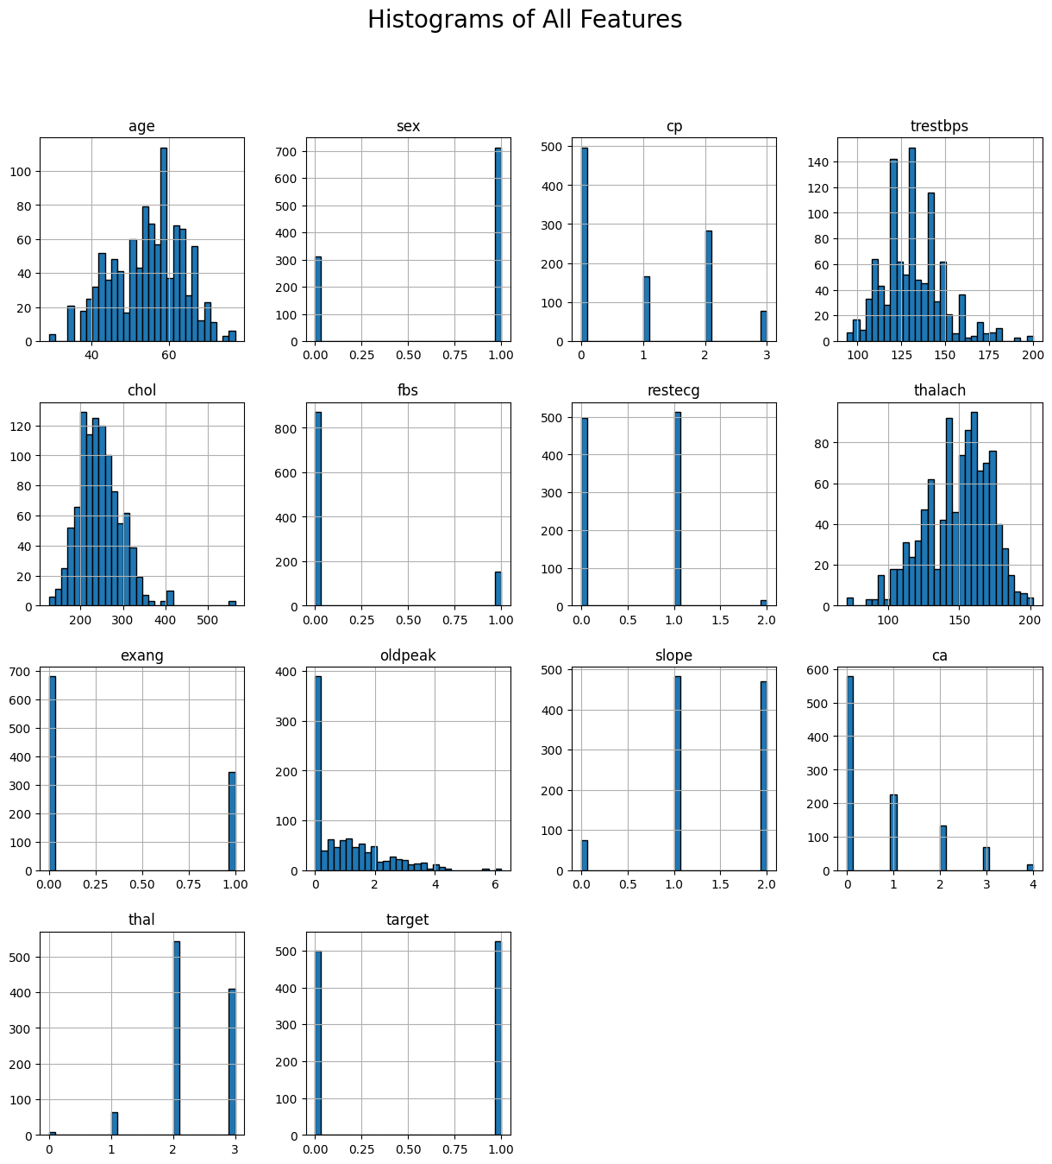

Slide 8
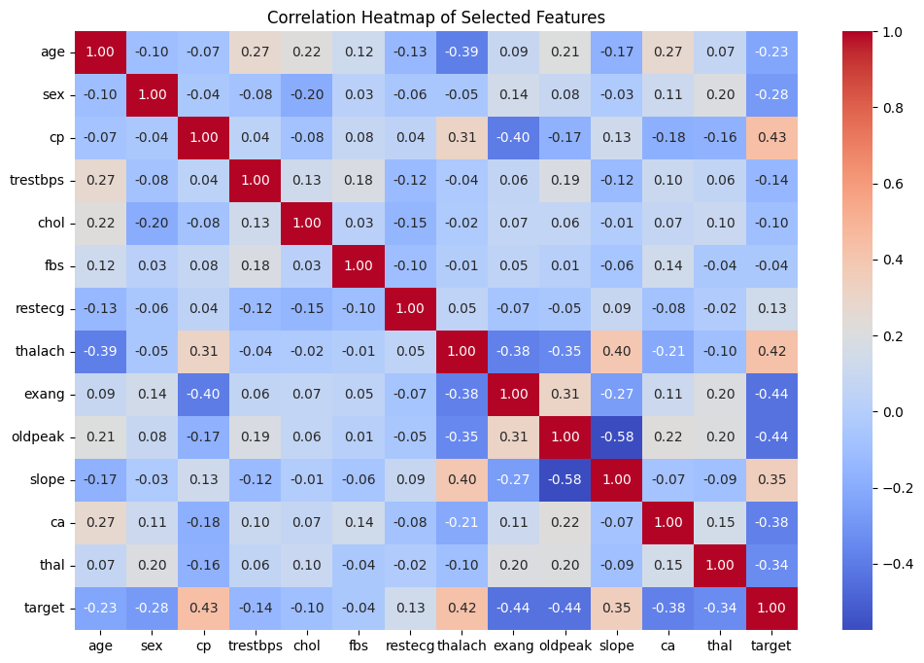

Slide 9
DATA SPLITTING AND MODEL TRAINING
#Split data into features and target
X = data.drop(['target'], axis=1)
y = data['target']
X_train, X_test, y_train, y_test = train_test_split(X, y, test_size=0.2, random_state=42)
log_reg = LogisticRegression(max_iter=1000)
log_reg.fit(X_train, y_train)
dec_tre = DecisionTreeClassifier()
dec_tre.fit(X_train, y_train)

Slide 10
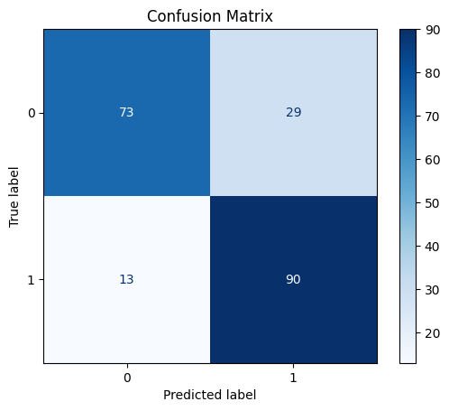
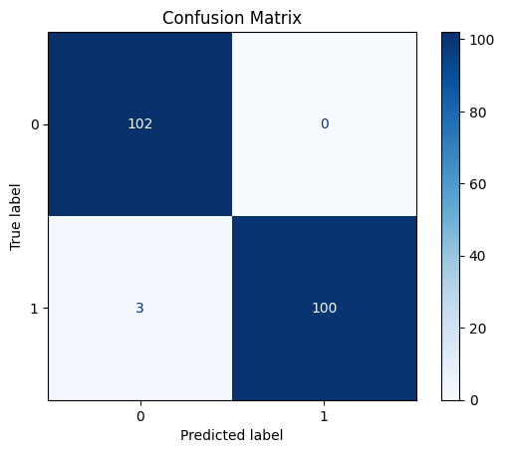
CONFUSION MATRIX
LINEAR REGRESSION
DECISION TREE

Slide 11
CONCLUSION
As you can see, Decision tree is performing better than linear regression. We used this model to predict the new result.
These insight serves as a call to action for healthcare professionals to leverage data-driven decision-making to enhance diagnosis, treatment, and ultimately patient care.
PYTHON CODE
https://github.com/rishabhbhartiya/Unified-Mentors/blob/URBANSOUND8K/Task-1/Heart_Disease.ipynb
THANKYOU

