Slide 1



AdventureWorks_project_report_RISHABH_CHHILLAR
View in Power BI
Last data refresh:
6/25/2022 2:48:46 AM UTC
Downloaded at:
9/17/2022 12:10:09 PM UTC

Slide 2
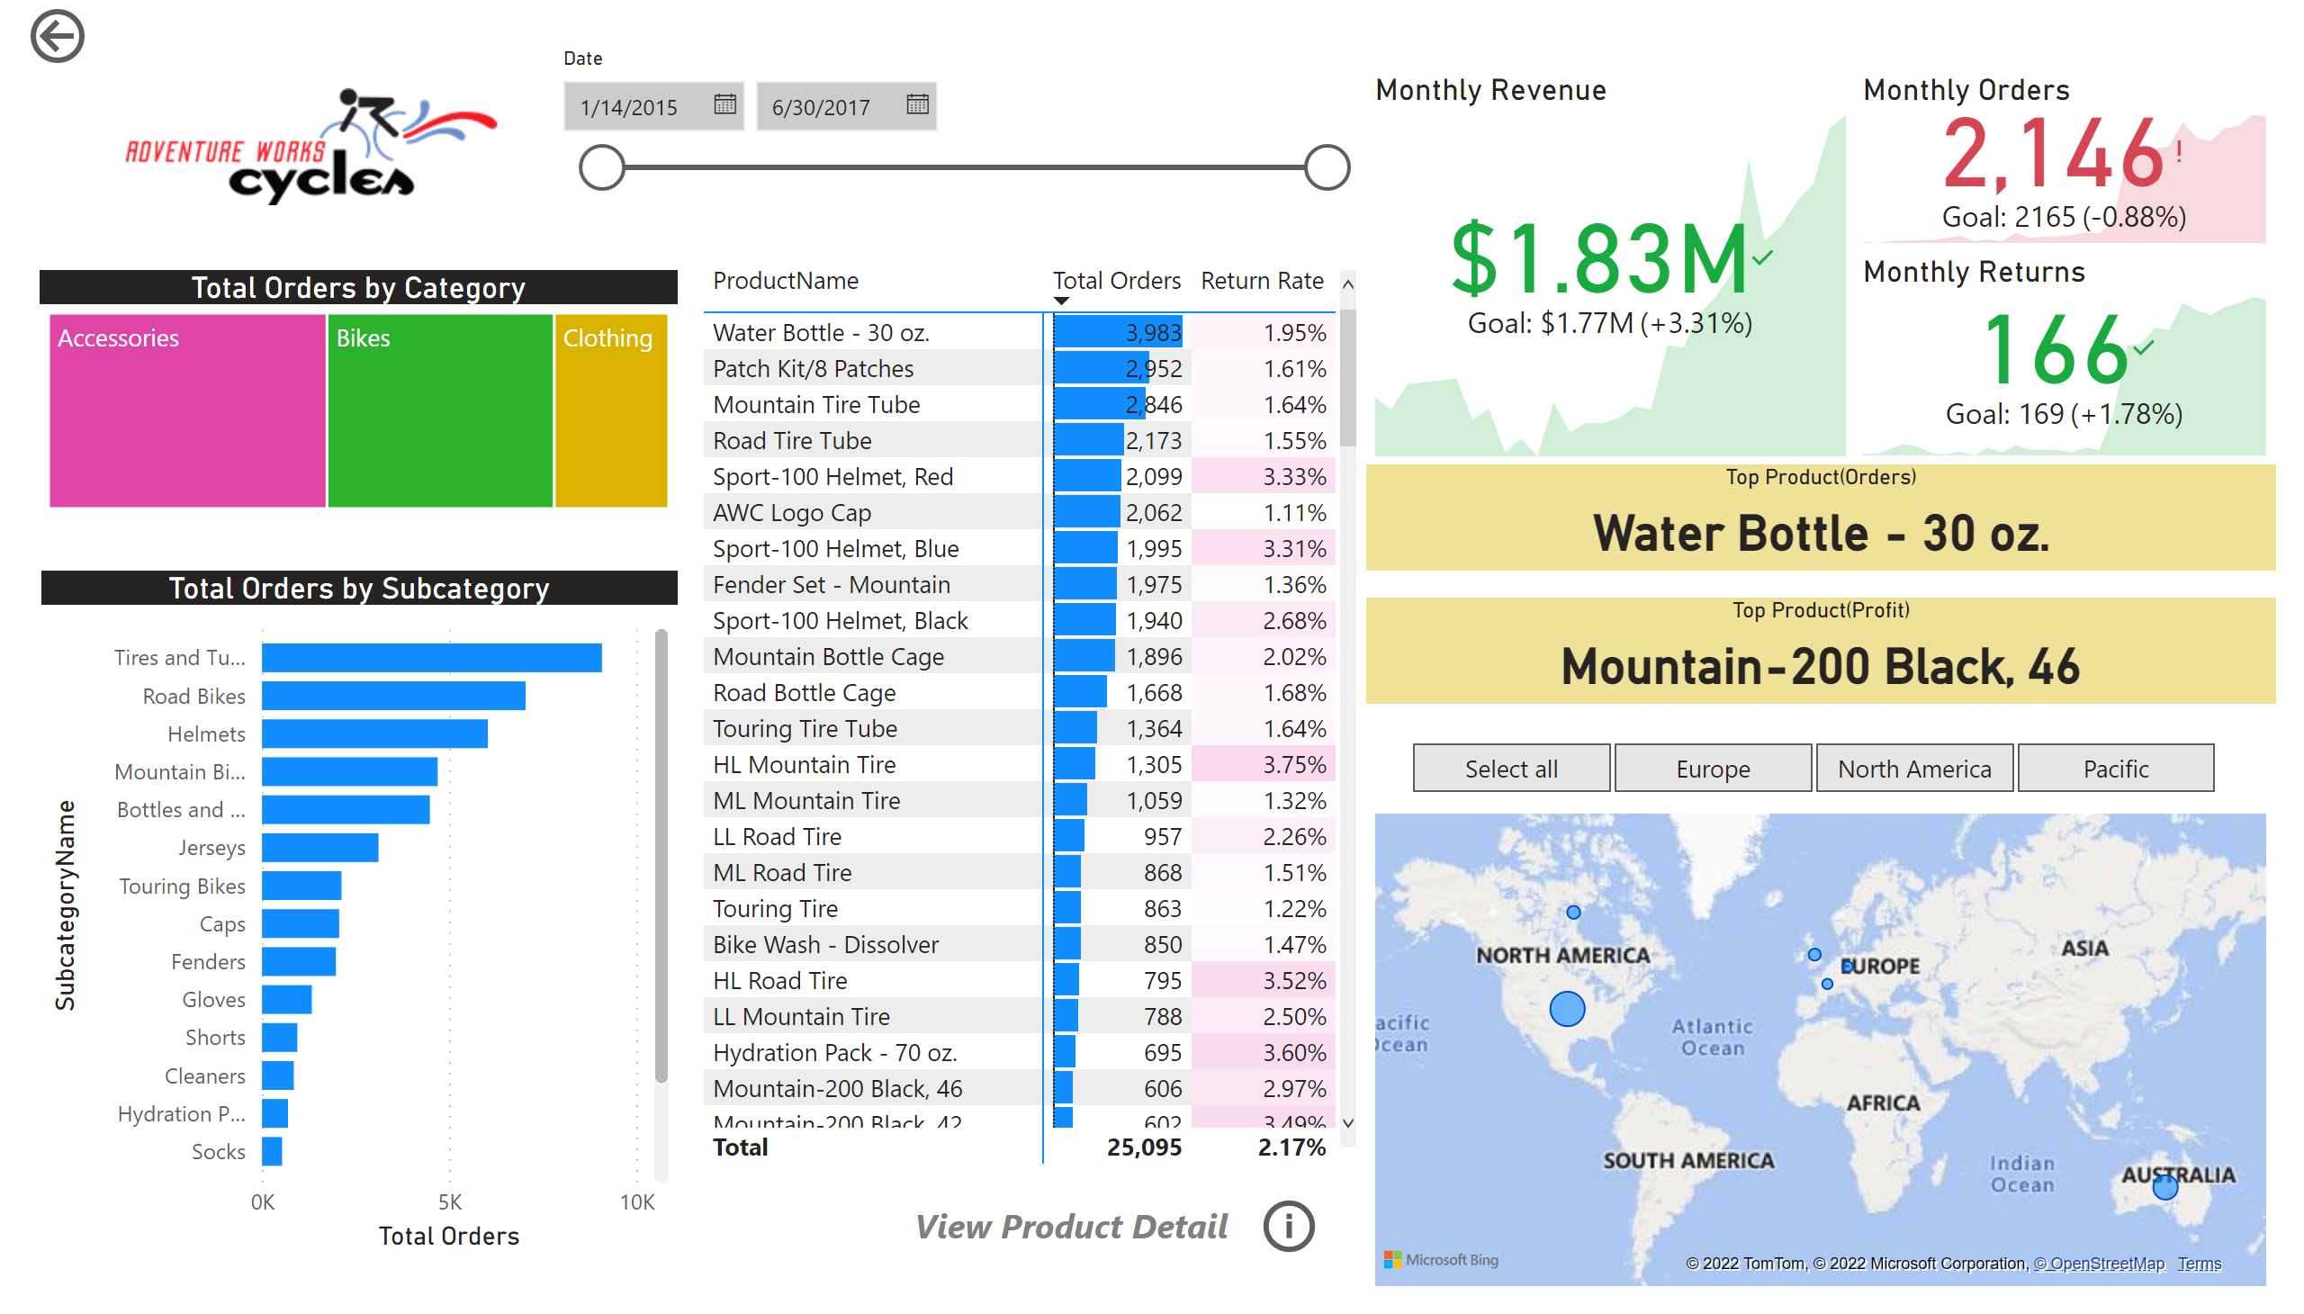
Exec Summary
Notes:
actionButton
No alt text provided
image
No alt text provided
slicer
No alt text provided
Total Orders by Subcategory
No alt text provided
Total Orders by Category
No alt text provided
pivotTable
No alt text provided
textbox
No alt text provided
Monthly Returns
No alt text provided
Top Product(Profit)
No alt text provided
Top Product(Orders)
No alt text provided
map
No alt text provided
slicer
No alt text provided
Monthly Revenue
No alt text provided
Monthly Orders
No alt text provided
actionButton
No alt text provided

Slide 3
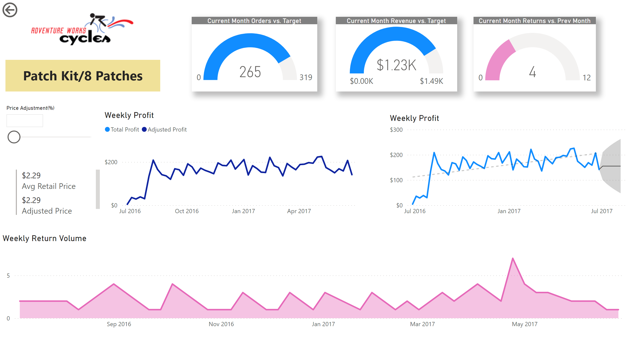
Product Detail
Notes:
image
No alt text provided
actionButton
No alt text provided
card
No alt text provided
slicer
No alt text provided
Weekly Return Volume
No alt text provided
Current Month Revenue vs. Target
No alt text provided
Current Month Returns vs. Prev Month
No alt text provided
Weekly Profit
No alt text provided
Weekly Profit
No alt text provided
Current Month Orders vs. Target
No alt text provided
multiRowCard
No alt text provided

Slide 4
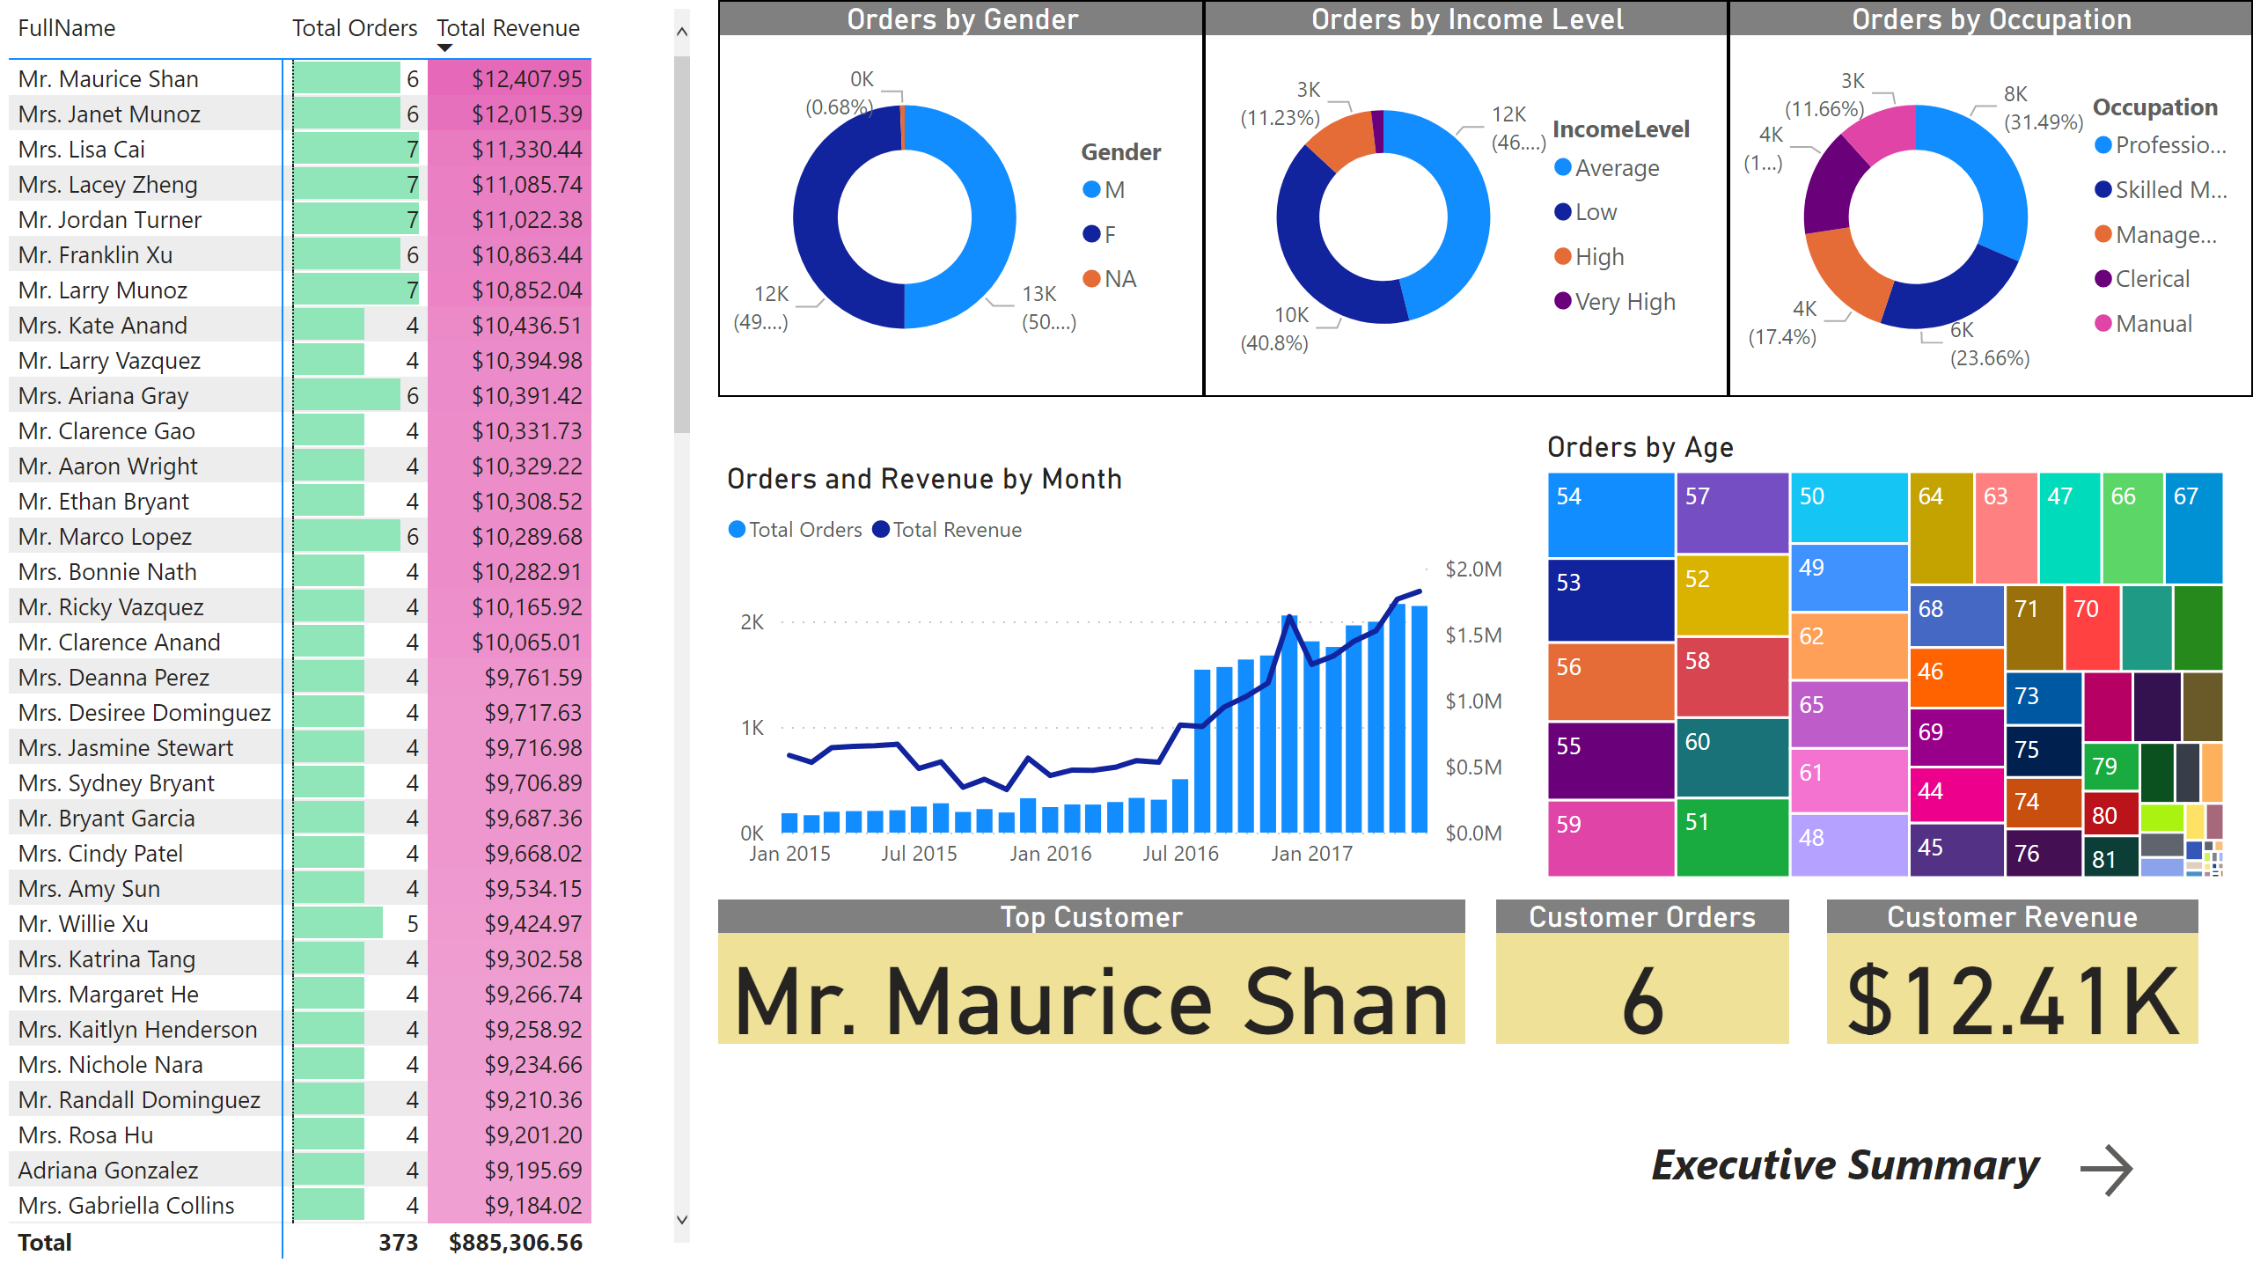
Customer Detail
Notes:
Orders by Gender
No alt text provided
Orders by Occupation
No alt text provided
pivotTable
No alt text provided
Orders by Income Level
No alt text provided
textbox
No alt text provided
actionButton
No alt text provided
Orders and Revenue by Month
No alt text provided
Customer Orders
No alt text provided
Customer Revenue
No alt text provided
Top Customer
No alt text provided
Orders by Age
No alt text provided

