Slide 1
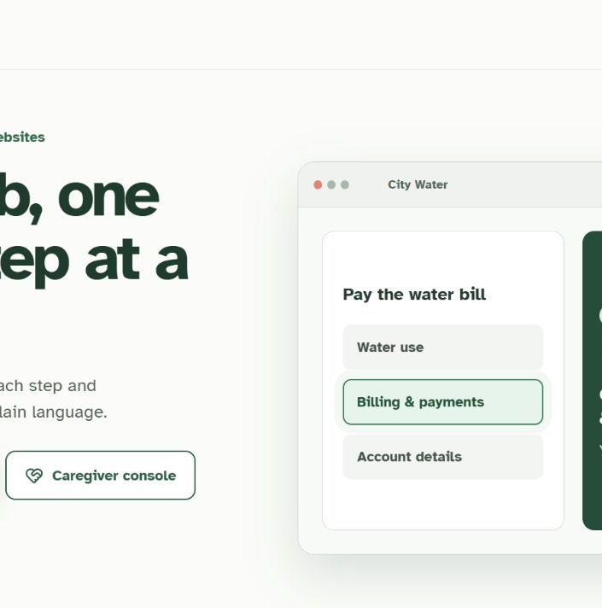
WEBACCESSIBLE
A browser that
does the errand
for you.
Plain-language autonomous browsing for older adults — with caregiver visibility and hard safety stops.
Application overview · 2026
01
Notes:
[Sources]
- README.md and AGENTS.md at repository revision 64fc387.
- Screenshot: locally built WebAccessible landing page, http://127.0.0.1:8000/.

Slide 2
WHY IT EXISTS
A DIFFERENT BROWSER
Older adults should not need perfect recall — or a distant relative — to finish an online errand.
Notes:
[Sources]
- README.md, opening problem statement and intended user.
- AGENTS.md, current autonomous execution model.

Slide 3
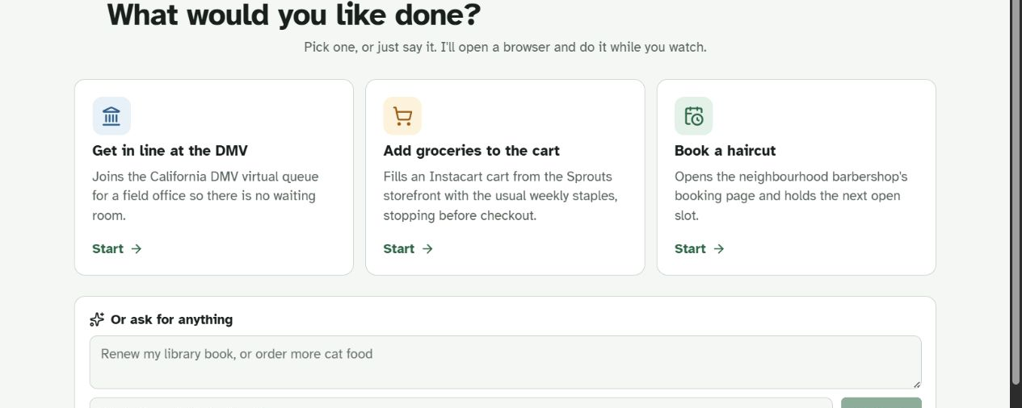
The participant starts with a goal — not setup.
Three ready errands, a free-form request, and grounded recall — all behind passwordless entry.
03
Notes:
[Sources]
- README.md, ‘What it looks like to use’ and passwordless entry.
- web/src/agent/TaskLauncher.tsx at repository revision 64fc387.
- Screenshot: locally built participant view, http://127.0.0.1:8000/participant.

Slide 4
One request becomes a visible, narrated browser run.
ASK
WATCH
DECIDE
Say the errand
Choose a ready task or describe it in your own words.
The agent works
It drives a real browser and narrates each action in plain language.
People keep control
Money, deletion, and passwords stop the run for a person.
04
Notes:
[Sources]
- README.md, participant workflow and visible action narration.
- AGENTS.md, execution and human-decision boundaries.
- web/src/agent/AgentDashboard.tsx and StepsPanel.tsx at repository revision 64fc387.

Slide 5
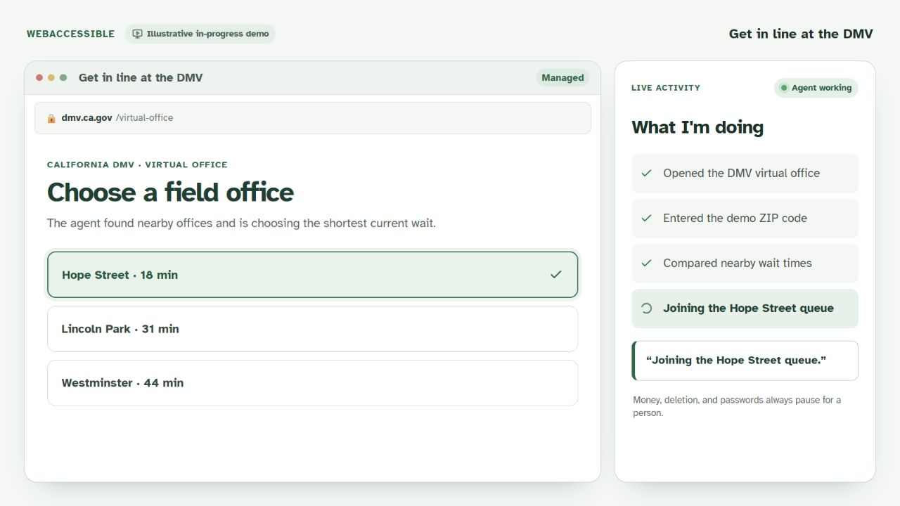
Demo: joining the shortest DMV queue.
The work stays visible: completed steps, current action, and the safety boundary share one screen.
05
Notes:
[Sources]
- web/src/slides/SlidesView.tsx at repository revision 64fc387 plus working-tree presentation additions.
- Screenshot: local illustrative in-progress view, http://127.0.0.1:8000/slides/demo/dmv.
- This is an illustrative UI state, not live Browserbase execution evidence; local Browserbase readiness was unavailable during capture.

Slide 6
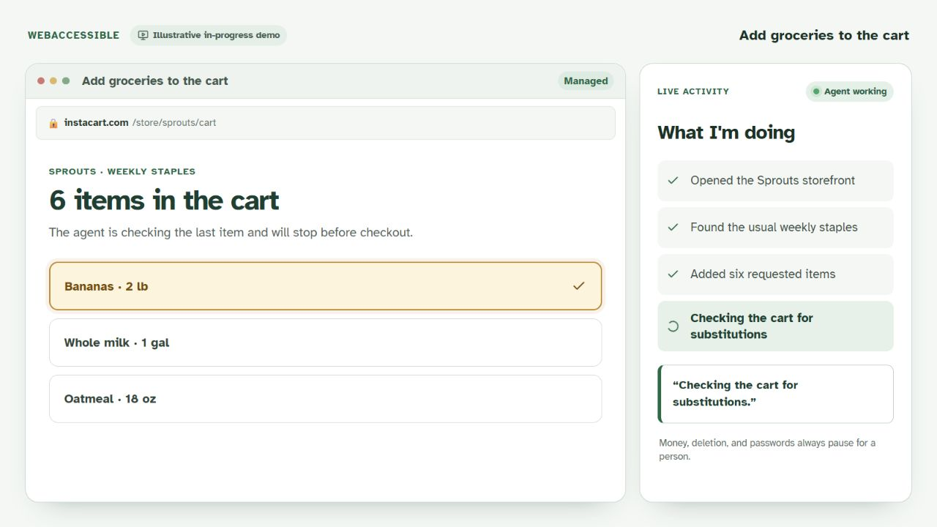
Demo: reviewing the cart before checkout.
The agent completes reversible work, then leaves the purchase decision to the person.
06
Notes:
[Sources]
- web/src/slides/SlidesView.tsx at repository revision 64fc387 plus working-tree presentation additions.
- Screenshot: local illustrative in-progress view, http://127.0.0.1:8000/slides/demo/groceries.
- This is an illustrative UI state, not live Browserbase execution evidence; local Browserbase readiness was unavailable during capture.

Slide 7
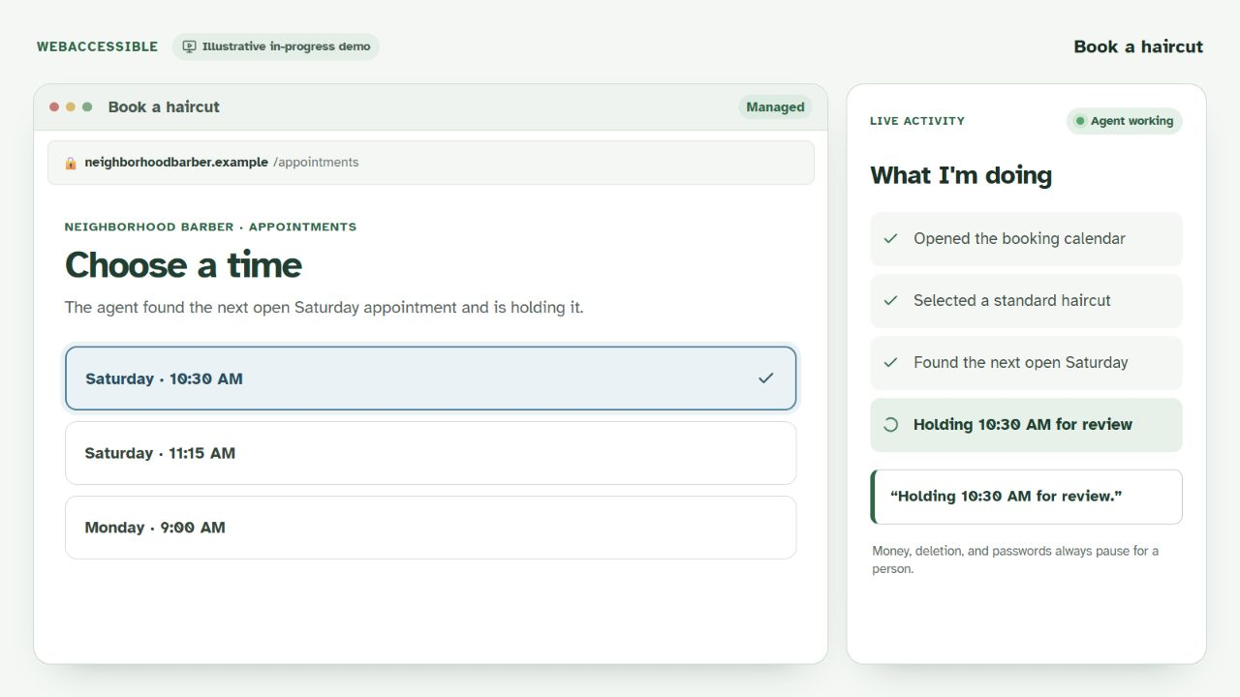
Demo: holding the next practical haircut time.
Plain-language narration makes the run understandable without exposing browser internals.
07
Notes:
[Sources]
- web/src/slides/SlidesView.tsx at repository revision 64fc387 plus working-tree presentation additions.
- Screenshot: local illustrative in-progress view, http://127.0.0.1:8000/slides/demo/haircut.
- This is an illustrative UI state, not live Browserbase execution evidence; local Browserbase readiness was unavailable during capture.

Slide 8
Autonomy stops exactly where consequences begin.
Reversible work continues without constant interruptions.
The agent may search, navigate, fill forms, add to a cart, join a queue, or hold an appointment.
It does not hide uncertainty: risky actions pause and failures remain visible.
Money pauses
Deletion pauses
Passwords stay private
Every action is visible
Scam signals escalate
08
Notes:
[Sources]
- README.md, ‘What it will not do’.
- AGENTS.md, autonomy boundaries, password handling, and scam escalation.

Slide 9
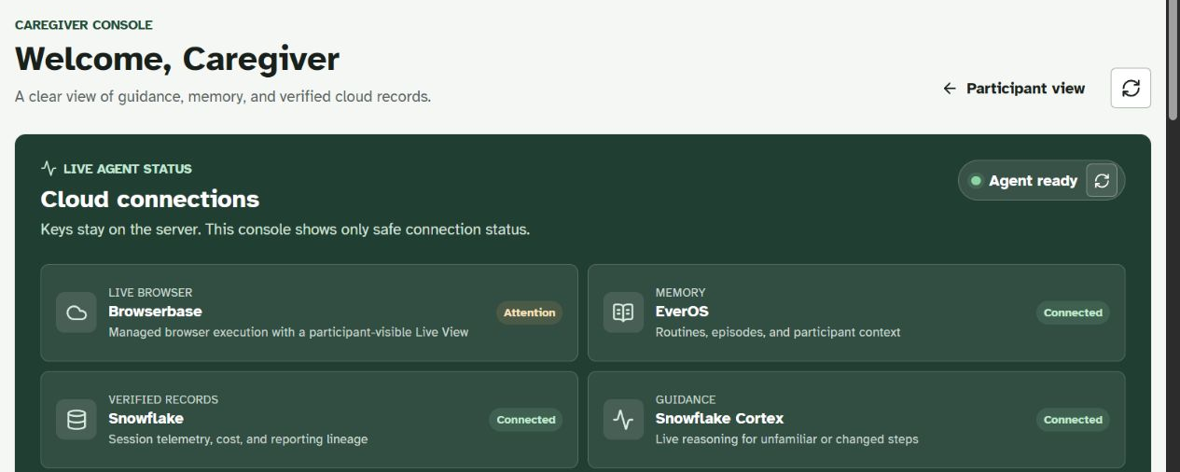
Caregivers see evidence — not remote controls.
Run history, cost, routines, notes, and cloud readiness — without exposing provider keys.
09
Notes:
[Sources]
- README.md, caregiver view and architecture sections.
- web/src/caregiver/CaregiverView.tsx at repository revision 64fc387.
- Screenshot: locally built caregiver console, http://127.0.0.1:8000/caregiver.
- The screenshot truthfully shows Browserbase requiring attention while EverOS, Snowflake, and Cortex are connected.

Slide 10
Memory turns completed errands into dependable context.
Grounded recall
Answers come from completed runs. If the record is missing, the app says so.
Routine timing
Repeated task starts can reveal daily, weekly, or monthly patterns.
Proactive, not pushy
Suggestions are dismissible, expire on their own, and avoid repeated nagging.
Permission first
Accepting a reminder is the boundary that permits a new run to begin.
10
Notes:
[Sources]
- README.md, ‘It remembers what you did’.
- AGENTS.md, reminder consent, delivery, dismissal, and lapse behavior.
- backend/app/services/recall.py and proactive.py at repository revision 64fc387.

Slide 11
The cloud stack separates execution, memory, and evidence.
Browserbase
Managed Chrome execution with a participant-visible Live View and server-side CDP control.
EverOS
Durable episodes, readable routines, and user-owned context for recall and suggestions.
Snowflake + Cortex
Planning for cold runs, synchronized telemetry, and cost evidence from actual usage.
11
Notes:
[Sources]
- README.md, architecture and provider responsibility map.
- AGENTS.md and docs/sponsors/BROWSERBASE.md, execution-provider constraints.
- SPONSORS.md at repository revision 64fc387.

Slide 12
THE IDEA
One request. A visible run. Human control.
No participant login
Caregiver sees the record
Safety pauses stay human
Notes:
[Sources]
- README.md and AGENTS.md at repository revision 64fc387.

