Slide 1
Project Presentation of Industry Oriented Hands on Experience (22CS422)
On
Chirp – A Real-Time Social Media Interaction Platform
Rakshit Kamboj 2210992134
Rhythm Goyal 2210992147
Rishabhdev 2210992156
Ayush 2210991418
Supervised By
Dr. Shikha Tuteja
Department of Computer Science and Engineering,
Chitkara University, Punjab

Slide 2
Introduction
Real-time chat application for flawless communication.
Supports instant messaging and media uploading.
Real-time notifications for receiving any new message.
Can be used for personal or professional communications.
Emphasizes on safety, speed, and usability.
Has a friendly user interface for ease of use.

Slide 3
Problem Statement
Delayed messaging: Slow message delivery can cause inefficiencies when there is an urgent need for communication.
Complexity in interfaces: Some applications are too complex, thus hindering efficient communication.
Cross-platform compatibility: Most chatting applications do not support cross-platform compatibility, which can make communication cumbersome across various devices and platforms (web and mobile).
Group management challenges: Most applications do not incorporate proper group management capabilities.

Slide 4
Technologies Used
Frontend:
HTML, CSS, JavaScript: Basic elements to build the framework of websites.
React.js: Framework used to develop dynamic and interactive frontends with the help of component-based approach.
Backend:
Node.js: Technology to handle backend operations and creating API.
Express.js: Backend technology used for managing requests and routes.
Database:
MongoDB: NoSQL Database to store user data.
Mongoose: It is used to simplify working with databases through data modeling and managing schemas.
Prisma: It is used to simplify database interactions via ORM with model definition, schema management, type-safe query, and migration facilities.
PostgreSQL : Open-source and robust relational database.

Slide 5
Purpose of the Project
Create an efficient platform for instant communications.
Make it possible for users to communicate using instant messages.
Allow users to share multimedia files (pictures, documents, videos).
Ensure data privacy and security with encryption technology.
Use a user-friendly design to make navigation easier.
Provide reliable means of communication with minimum latency.

Slide 6
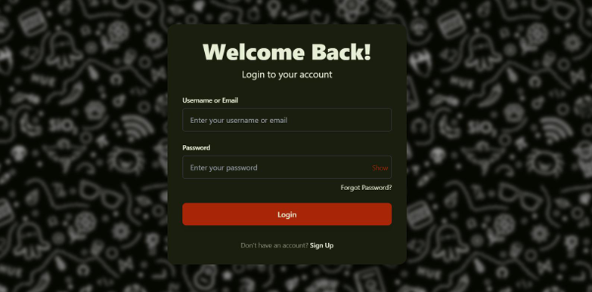
Screenshots

Slide 7
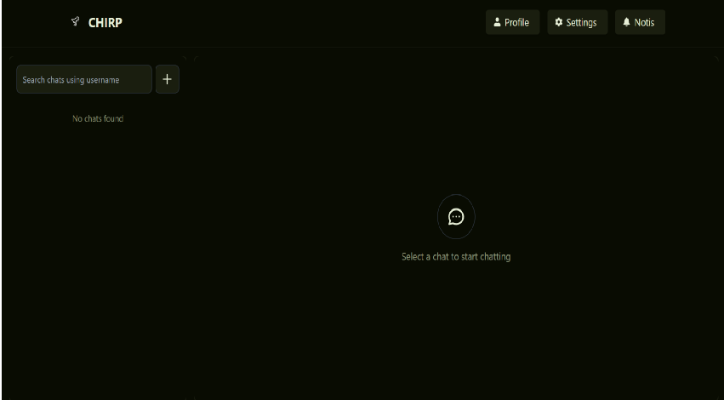

Slide 8
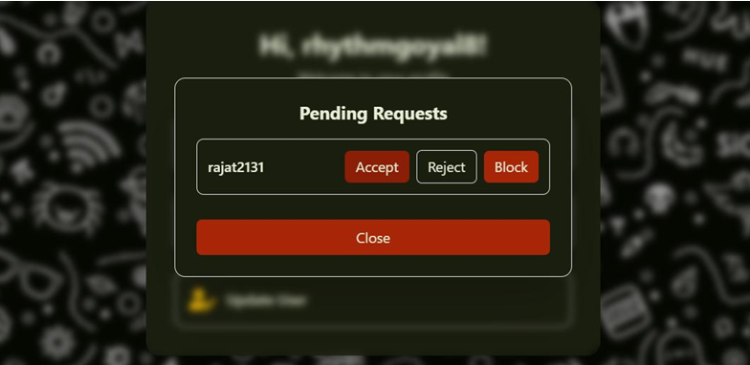

Slide 9
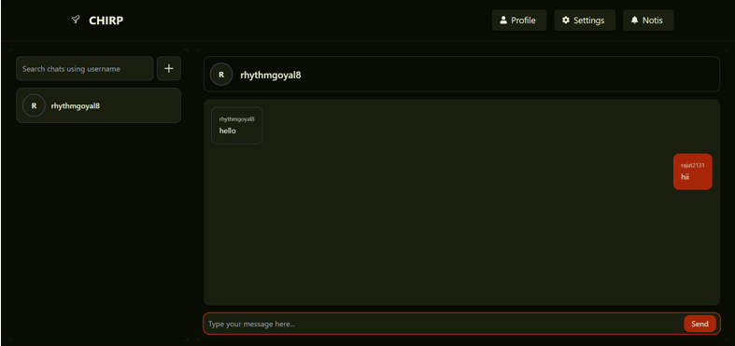

Slide 10
Future Improvements
Voice & Video Calling: Incorporate live voice and video calling functionalities.
End-to-End Encryption: Upgrade messaging security by integrating end-to-end encryption.
Group Chat Management: Introduce additional group chat functionalities such as roles and administrators.
Chatbots: Implement AI-enabled chatbots for automated support.
Cross-Platform Integration: Ensure cross-platform availability on both desktop and mobile devices (iOS and Android).
Message Search & Filtering: Upgrade the messaging search engine and include filtering options.
Presence Status Indicators: Include presence status indicators for users.
Themes & Customization: Introduce theme and customization settings.

Slide 11
Conclusion
The aim of creating the chat application project is to deliver a highly safe, reliable, and user-friendly application used for instant communication purposes. As far as performance and user-friendliness are concerned, the application project can be considered successful as it allows users to communicate in real time. It provides an opportunity to chat using text, share videos and photos, and interact with other people online. Thanks to the application's advanced security system, users enjoy complete privacy and confidence while using this software. At the same time, there is great potential for development in the future. There is a possibility to include additional functionality like making calls (voice and video), using AI chatbots, and better managing groups. All these future developments will contribute greatly to enhancing the application.

Slide 12
Thank You
12

