Slide 1



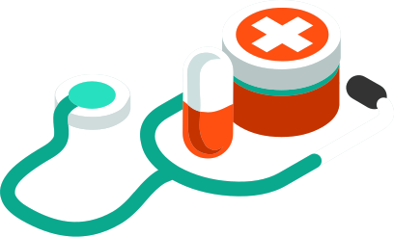

TeleDoc (http://teledoc.digital)
A PRESENTATION BY THE DOCASSISTANT

Slide 2

It is health that is real wealth and not pieces of gold and silver
Mahatma Ghandi

Slide 3

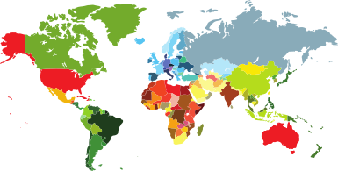
The Numbers
Current HealthCare market expenditure is of 8.7 Trillion USD.
With market having growth rate of 12%.
33% of the world health budget will be from emerging economies such as India, Brazil, China, Middle East Countries.

Slide 4
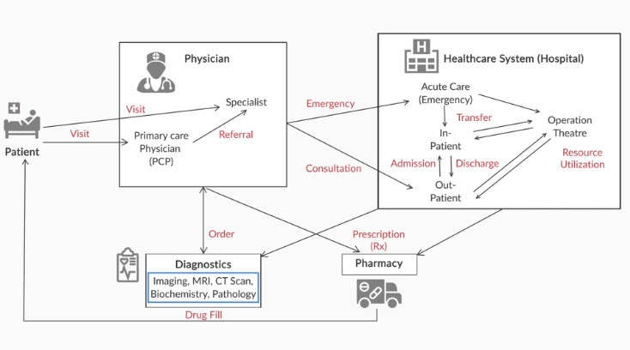
StakeHolders

Slide 5
StakeHolder's Market Share
Others
29%
Hospitals
37%
Outpatients care centre
7%
Physicians Offices
14%
Pharmaceuticals
13%

Slide 6
The Problems
01
02
03
Quality Care for the Patient.
Inaccurate diagnosis of the disease.
Unnecessary hospital stay and overpriced medication.

Slide 7

TeleDoc's Solution
An online single platform to link all the stakeholders which reduces the complications.
IoT enabled cloud solutions to collect live body data from patients.
AI and ML model to help doctors to predict disease accurately and provide medication solutions.
Data Collection and Analysis of Diagnosis reports for research work in medical field.

Slide 8
Platform
Our Website and App provide facility to patient to book an appointment with General Physicians and Specialists, to help the doctors in treatment patients can also share their medical history reports via chat. It also enables the video call facility to have conversation with the doctor.
After the clinical visit, patients can buy the prescribed medicines online through our Website and App at cheap rate compared to that of retail rates as we will have collaboration with the Pharmaceutical Companies, that will cut down the cost of wholesalers and retailers.

Slide 9
IoT Data collection
We will gives franchise of our IoT Diagnosis kit to various Primary Health Care centers, after booking the appointment the patients will have visit any of our franchise clinic for the diagnosis, their body data will be transferred to our server where the doctor can see the diagnosis report and based on report doctor can prescribe treatment or send the patient to pathology for test. The pathology test report will also be made available to the doctor, further doctor will prescribe medication.
If something found serious in reports then the doctor can refer the patient for hospitalization.

Slide 10
AI and ML based ChatBot & Data Analysis
Doctors can use our AI based ChatBot to prescribe medication and suggest diet plan based on symptoms and report of the patient.
We will maintain the Electronic Health Card of patients.
And their data will be used to improve our AI model.
Privacy of the patients will be maintained. Permission will be taken from patients before using their data, those will agree will be given cost benefits.

Slide 11

Thank You
rdhenkwat@gmail.com

