Slide 1
AI-Powered Financial Fraud Detector
Hackathon 2025
Team: CodeEats
Members : Rishabh Gupta
Uday Gautam

Slide 2
The Challenge
• Rising financial frauds impacting individuals and businesses
• Manual detection is slow and error-prone
• Need: Automated, real-time, and accurate fraud detection

Slide 3
Our Goal
• Detect fraudulent transactions automatically
• Reduce false positives and ensure real-time alerts
• Provide actionable insights for security teams

Slide 4
AI-Driven Fraud Detector
• Built using Aptos Move smart contracts for secure on-chain events
• ML-based anomaly detection on transaction patterns
• Event logging and reporting via blockchain

Slide 5
System Architecture
1. User initiates transaction
2. Transaction details captured on blockchain
3. ML model evaluates transaction in real-time
4. FraudAlert generated and stored in Move module
5. Security team notified

Slide 6
Key Features
• Real-time fraud detection
• Immutable transaction logging on Aptos blockchain
• Custom alert events using Move module
• Easy integration with existing systems

Slide 7
Our Demo Highlights
• Alerts detected during test run
• Accuracy / precision of ML detection
• Sample FraudAlert emitted on-chain

Slide 8
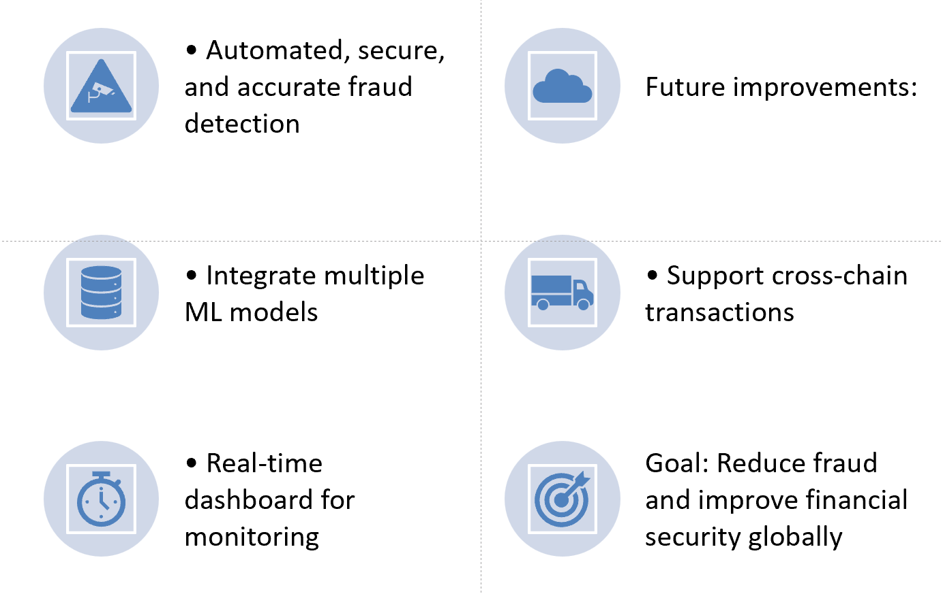
Conclusion & Next Steps

