Slide 1
Intelligent optimization of distribution of resources
Team 7: Throttling Error

Slide 2
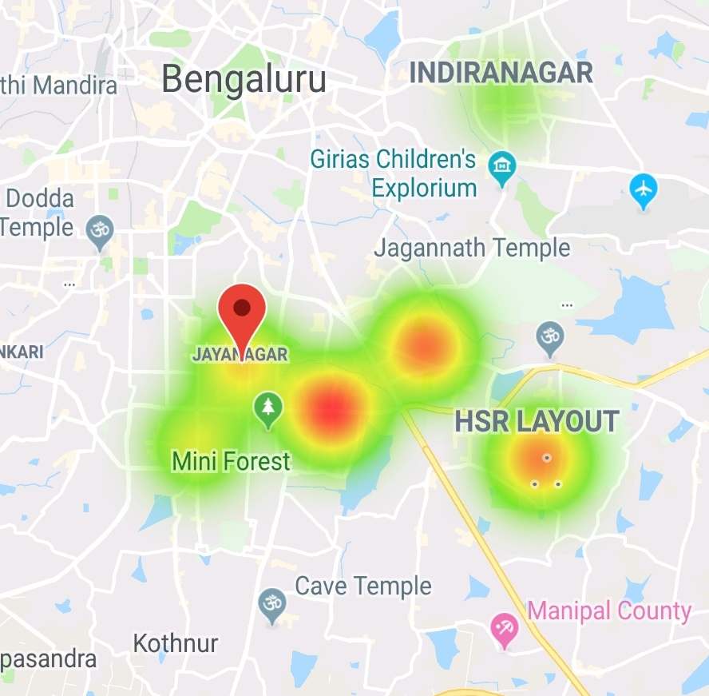
What?
Workforce Client
The resource client gets a heat map of the next
“# of predicted orders/ # of resources available”
in that area
Resource makes an informed decision, based on heat map (can still retain his/her location specifics)
Updating the heat map based on the decision taken

Slide 3
Why?
Improved customer satisfaction
Better experience for the workforce
Decrease latency by better distribution of workforce

Slide 4

How?

Slide 5
Trained
Model
Workforce
APIs
Database
Client
Server

Slide 6
Future Scope
We are currently reliant on the manual decisions of the resources for keeping their experience optimal. Once we grow more confident with the model, we can aim for better efficiency by providing active guidance.
Concurrently predicting possible drop in the intensity of the hotspots considering time taken to reach there.
Predicting drivers movement on the go to reduce sudden mass movement into higher intensity areas

Slide 7
Demo

