Slide 1








Parking Reservation Chatbot
SmartPark AI
RAG-Powered Conversational Parking Chatbot
An intelligent conversational system combining Large Language Models, semantic search, and a structured Reservation Agent to handle parking queries and bookings.
PRESENTER: RISHABH GUPTA

Slide 2
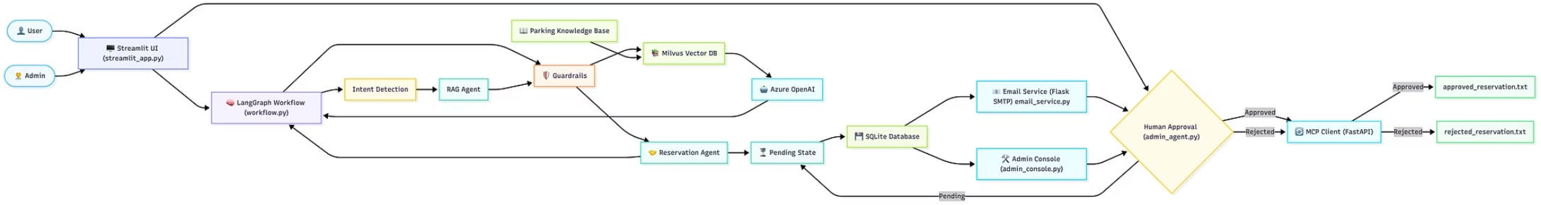
ARCHITECTURE
System Architecture
SmartPark AI follows a modular, agent-driven architecture. The LangGraph workflow orchestrates interactions between the chat orchestrator, reservation agent, RAG retriever, and admin agent — all backed by Azure OpenAI, Milvus, and SQLite.
LangGraph Workflow
Azure OpenAI
Milvus + SQLite
Orchestrates agent state transitions and decision logic
LLM and embedding models power all AI interactions
Vector store for RAG; relational DB for reservations

Slide 3
TECH STACK
Technologies Powering SmartPark AI
UI
Streamlit
Workflow
LangGraph
LLM
Azure OpenAI
Framework
LangChain
Vector DB
Milvus
Database
SQLite
API/Email
Flask/Flask
Backend
Python 3.12.7
Testing
Pytest
CI/CD
GitHub Actions
Container
Docker

Slide 4
CORE FEATURES
Key Capabilities at a Glance
Conversational Assistant
RAG Knowledge Retrieval
AI chatbot handles parking queries and reservations in natural language.
Milvus vector DB powers accurate answers on policies, pricing, and FAQs.
Reservation Workflow
Guardrails & Data Masking
Guides users through booking, validates details, and allocates available slots.
Protects sensitive data — phone numbers, vehicle details, and licenses are masked in logs.
Email Notifications
MCP Synchronization
Automated alerts for approvals, rejections, and admin notifications via Gmail SMTP.
Syncs reservation data with the MCP server after every status change.

Slide 5
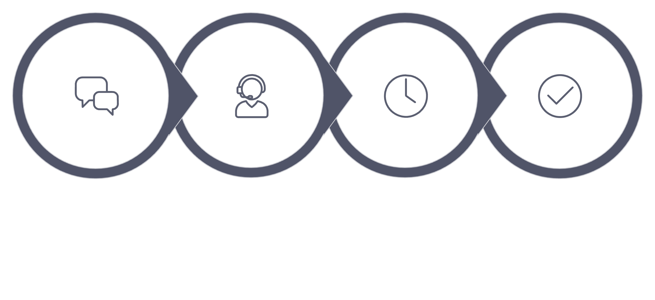
USER JOURNEY
How the Reservation Workflow Operates
MCP Synchronization
Open Chat
Chat Orchestrator
Admin Agent
Every reservation begins in a Pending state. When an administrator approves or rejects a request, the status is automatically synchronized to the FastAPI MCP server, which updates the approved_reservations.txt or rejected_reservations.txt files. This ensures external systems stay in sync with every status change through the MCP file synchronization mechanism.

Slide 6
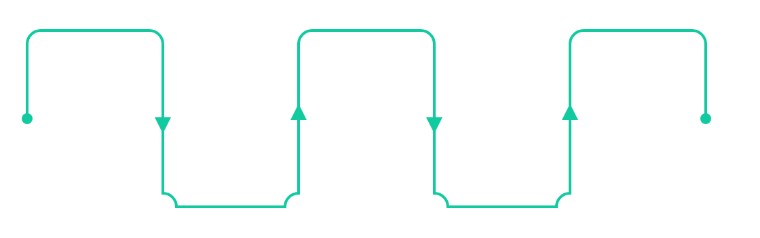





The RAG Pipeline
Document Loading
Embedding Generation
Semantic Retrieval
Load parking docs from data/documents
Embed query and search similar vectors
Use Azure OpenAI text-embedding-3-small
Text Splitting
Vector Storage
Chunk large documents into passages
Store embeddings in Milvus vector store
SmartPark AI
Slide 5 of 13

Slide 7




Twin-Filter Defense Layers
Security Guardrails
Sensitive Data Masking
To secure modern conversational pipelines, input_filter.py enforces robust barriers before executing prompt sequences:
Active regex rules continuously scrub incoming strings, masking confidential parameters inside chatbot logs.
Injection Dropouts: Instantly rejects attempts to leak SQL schema structures or override prompts.
Content Verification: Evaluates prompt sanity, returning safe default outputs for inappropriate phrases.
Raw Buffer
Masked Output
SmartPark AI
Slide 6 of 13

Slide 8
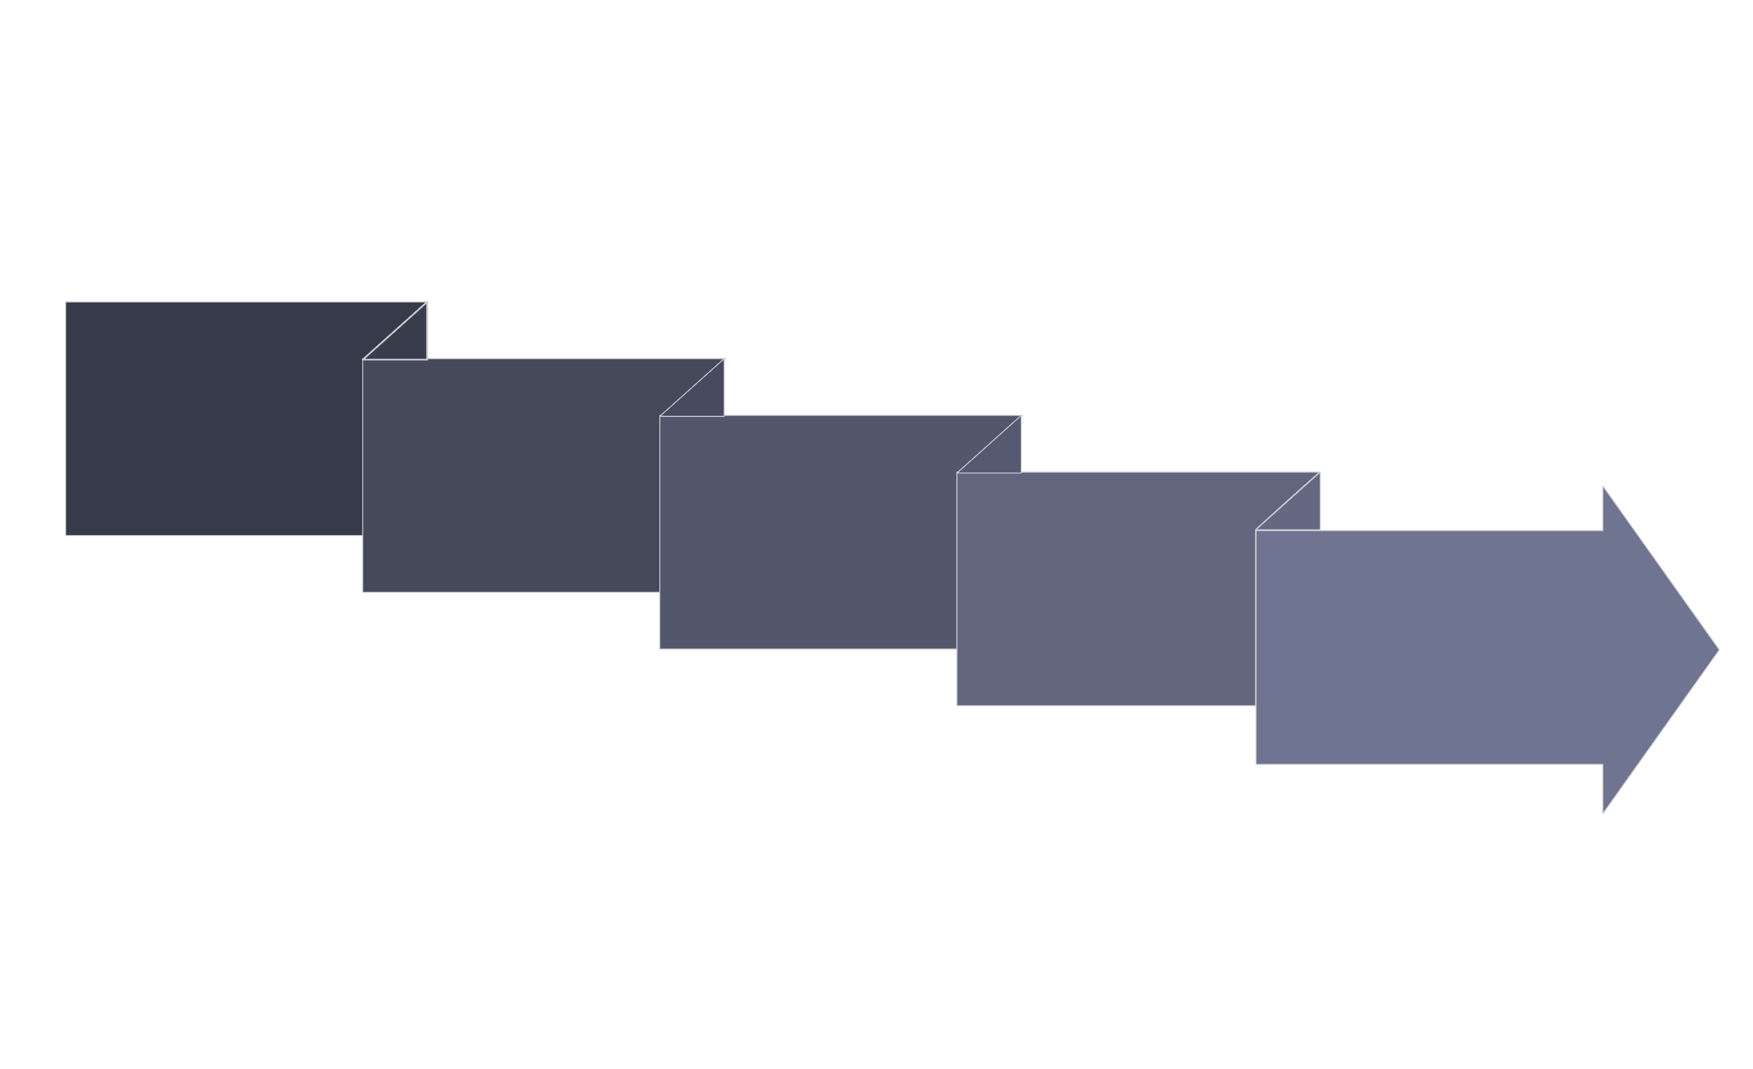
WORKFLOW
Human in the Loop
User Submits Reservation Request
Admin Notified
EmailAdmin Console TerminalStreamlit Admin Dashboard
MCP Synchronization
Updates approved_reservations.txt or rejected_reservations.txt
Status = PENDING
Admin Actions
ApproveRejectRevert to Pending
SmartPark AI uses a human-in-the-loop reservation flow where a user submits a request, the status remains PENDING, administrators are notified through multiple channels, and then approve, reject, or revert the request. The final decision is synchronized through MCP to update approved_reservations.txt or rejected_reservations.txt.

Slide 9
INSTALLATION & SETUP
Getting Started
Follow the setup below to install dependencies, start services, run tests, and troubleshoot common issues.
Start Services
Workflows and Tools
Clone Repository
Run Langraph Workflow
1
git clone https://github.com/rishabhjhs56/parking-reservation-chatbot.git
cd parking-reservation-chatbot
1
python -m run_graph.py
Or: python -m main.py (Chatbot)
Or: python -m misc_scripts.admin_console (Admin Console)
Start Milvus
2
cd docker/milvus
docker-compose up -d
Launch Streamlit
2
python -m streamlit run app/ui_app/streamlit_app.py
Initialize Database
RAG Evaluation
3
python -m app.database.init_db
python -m app.database.seed_slots
python -m app.evaluation.rag_evaluation
Report: docs/evaluation_reports/rag_evaluation_report.txt
CI/CD
Index Documents
GitHub Actions: Install dependencies, Run Pytest, Build validation
4
python -m app.rag.index_documents
🛠️ TROUBLESHOOTING
Start Server
Issue
Solution
5
Flask API: python -m app.api.admin_api
MCP Server: uvicorn app.mcp.server:app --reload
Docker not running
Start Docker Desktop
Milvus connection error
Verify Docker containers are running
Testing
SQLite locked
Close other database connections
python -m pytest -v
SMTP failure
Verify credentials in .env file.
Logs
Port already in use
Stop the existing process.
Kill -9 $(lsof –ti:8000)
logs/

