Slide 1
Managing Cloud Costs with Cloud Billing and Budgets
Focus: Cloud Billing, IAM, Monitoring, and BigQuery Export
By : Rishabh Johri (rjohri@deloitte.com)

Slide 2
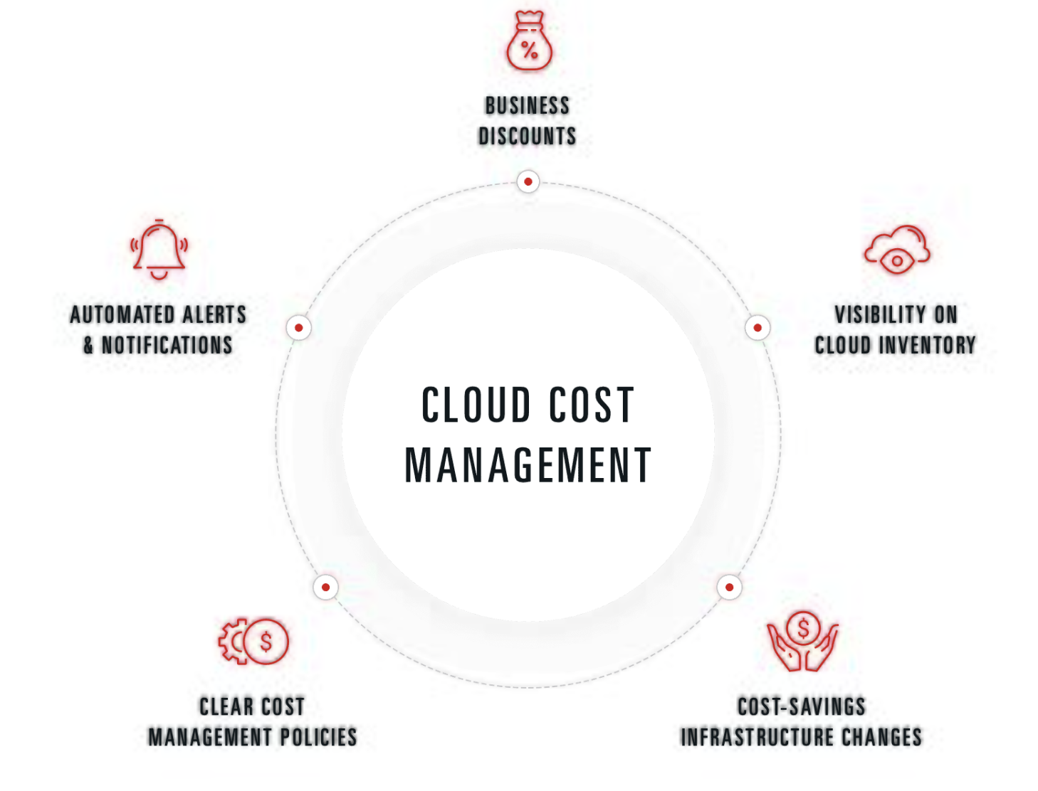
Why Cloud Cost Management Matters
Cloud costs can rise rapidly due to on-demand scalability.
Untracked idle resources and lack of visibility cause overruns.
Essential for financial control and cost optimization.

Slide 3
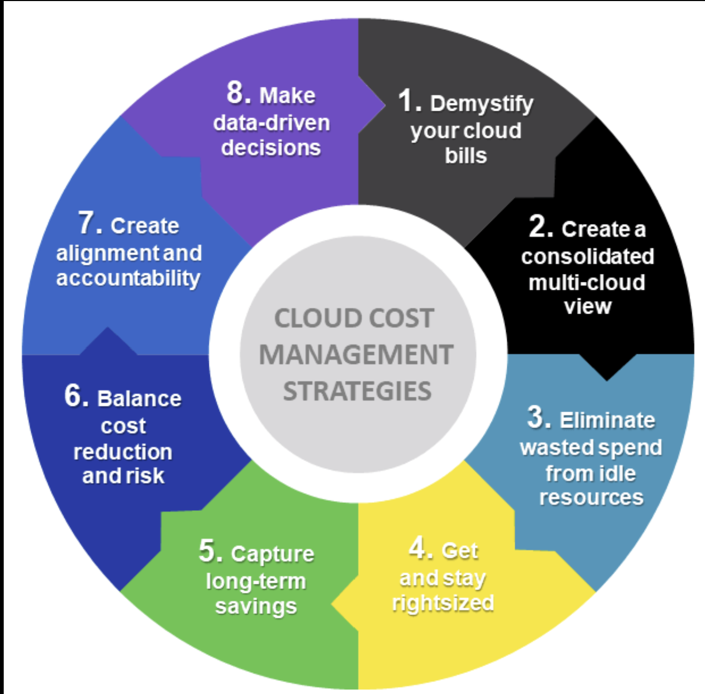
Cloud Billing & Cost Structure
Billing accounts link projects and track resource usage.
Costs include compute, storage, networking, and APIs.
Discounts: committed use, sustained use, and custom pricing.

Slide 4
IAM & Cost Governance
Assign least privilege roles like Billing Admin or Viewer.
Separate operational access from financial access.
Use labels/tags to map costs to departments or teams.

Slide 5
Monitoring, Metrics & Alerts
Set up cost metrics and usage dashboards.
Configure alerts for 50%, 80%, and 100% thresholds.
Integrate alerts with email, Slack, or Cloud Monitoring.

Slide 6
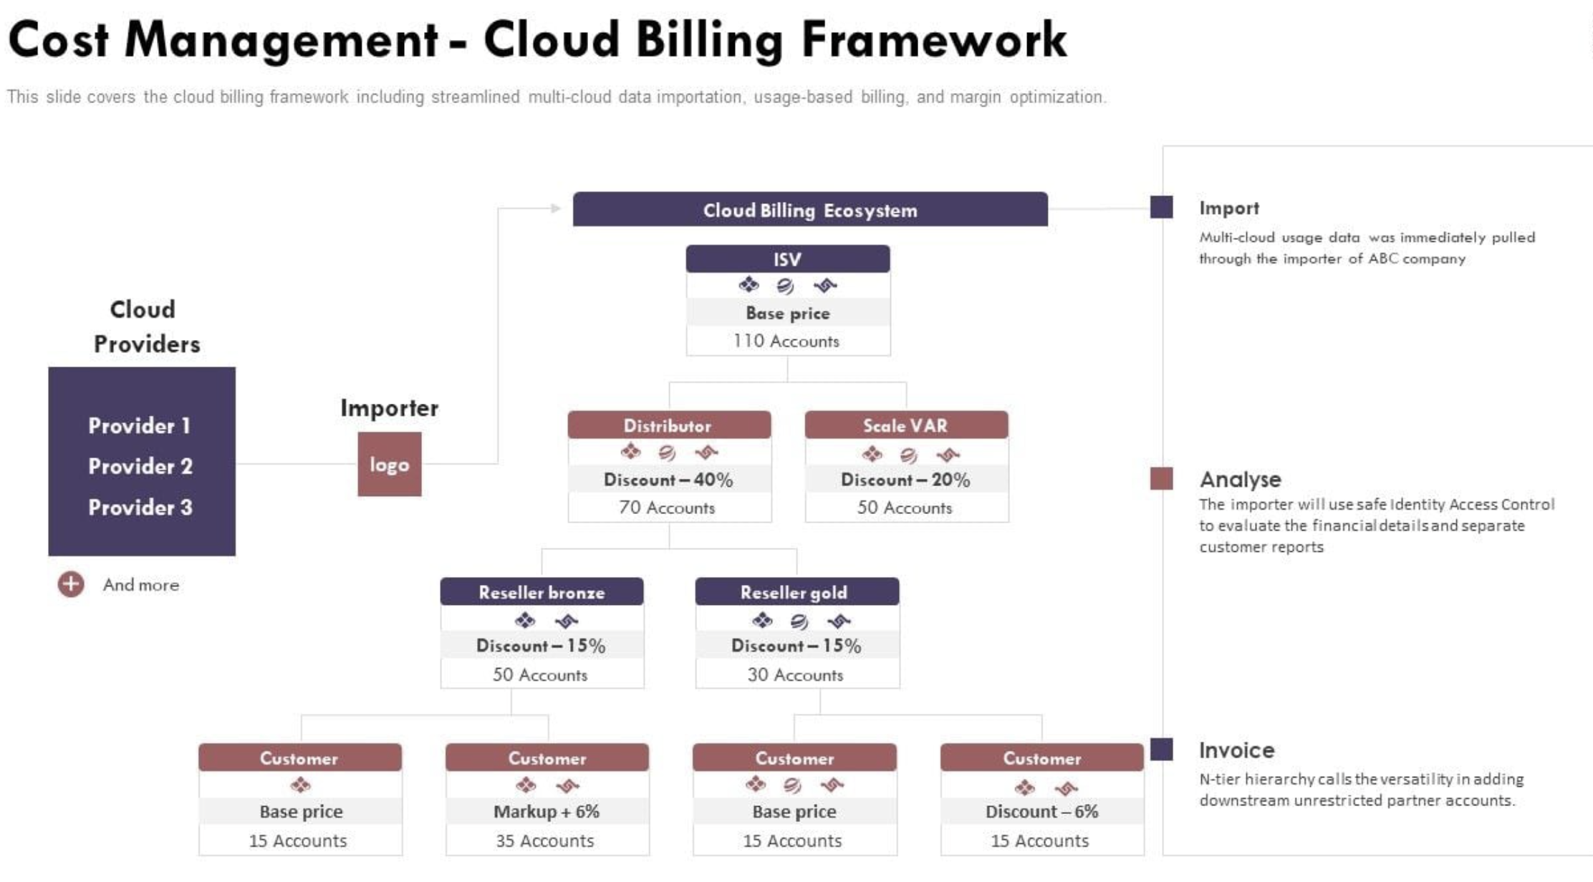
Creating Budgets and Alerts
Budgets track actual vs forecasted spend.
Threshold alerts notify when nearing limits.
Automate cost-control scripts based on alert triggers.

Slide 7
Exporting Billing Data to BigQuery
Enable export in Cloud Billing → BigQuery Dataset.
Detailed line-item cost data available for analysis.
Use BigQuery to run SQL queries on cost data.

Slide 8
Analyzing Billing Data in BigQuery
Example SQL: Aggregate cost by project or SKU.
Integrate with Looker Studio for visualization.
Automate reporting via scheduled queries.

Slide 9
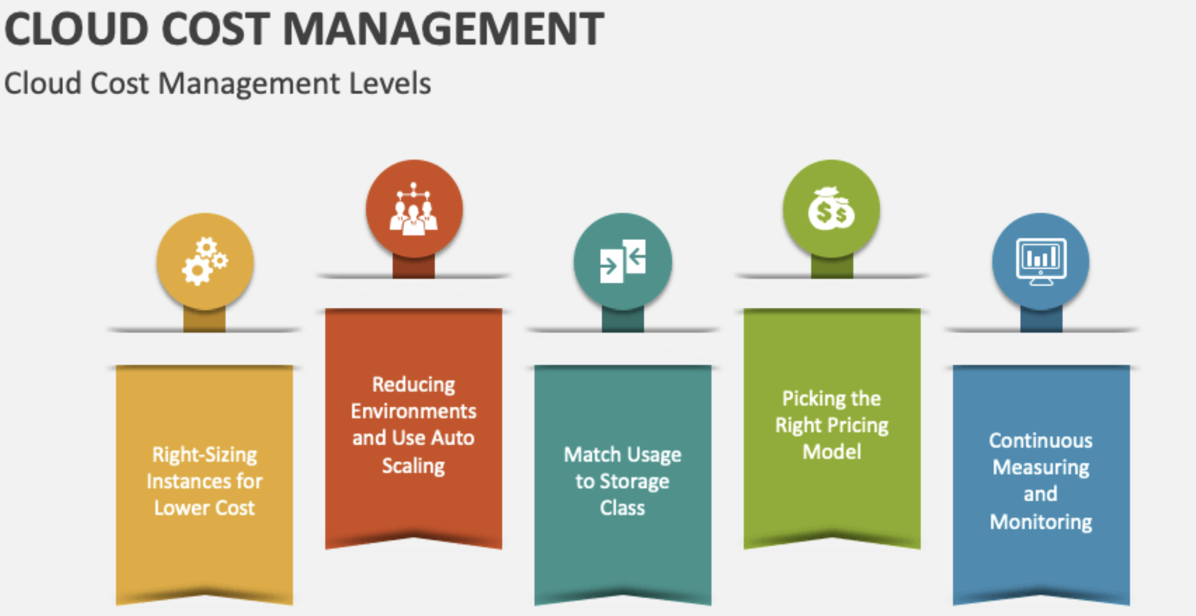
Cloud Cost Management Flow
Billing → Export → BigQuery → Visualization → Action Loop
Combines IAM, Monitoring, and Budgets for governance.

Slide 10
Best Practices & Recommendations
Enable detailed billing exports early.
Use labels for resource cost attribution.
Review idle resources and apply sustained use discounts.
Continuously monitor and adjust budgets.

