Slide 1
Capstone Project Strategy: Checkpoint 1 & Full Roadmap
Team Task Plan | Timeline | Deliverables | Tools
Team A1

Slide 2
Team Task Distribution – Checkpoint 1
Python Team (A & B):
- Data Cleaning, EDA, Class Imbalance
- Feature Importance & HTML Export
- Prepare half of the presentation
SQL Team (C & D):
- ER Diagram, Table Creation, SQL Queries
- Word Document with screenshots
- Prepare half of the presentation

Slide 3

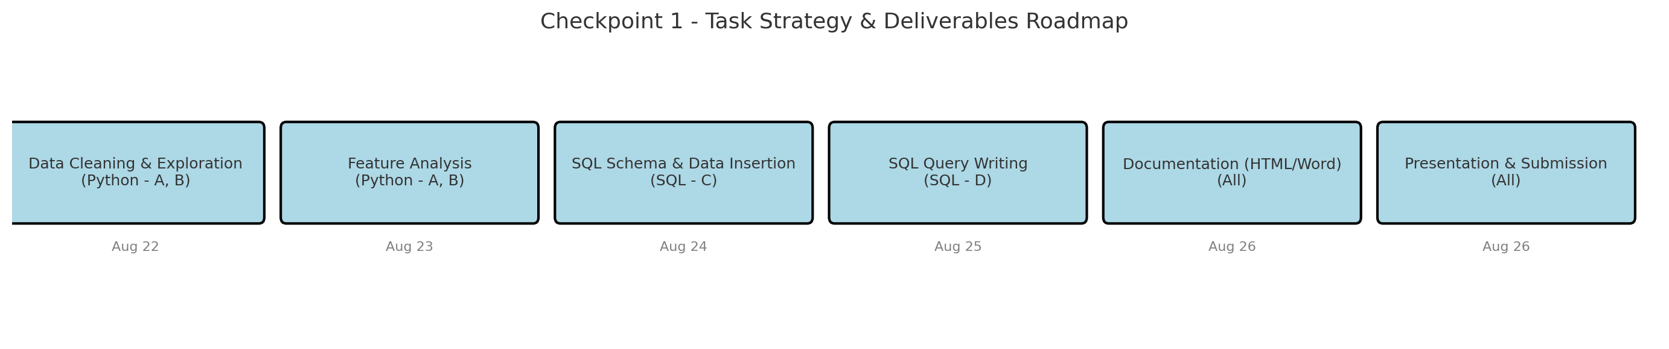
Roadmap – Checkpoint 1 Strategy & Deliverables

Slide 4
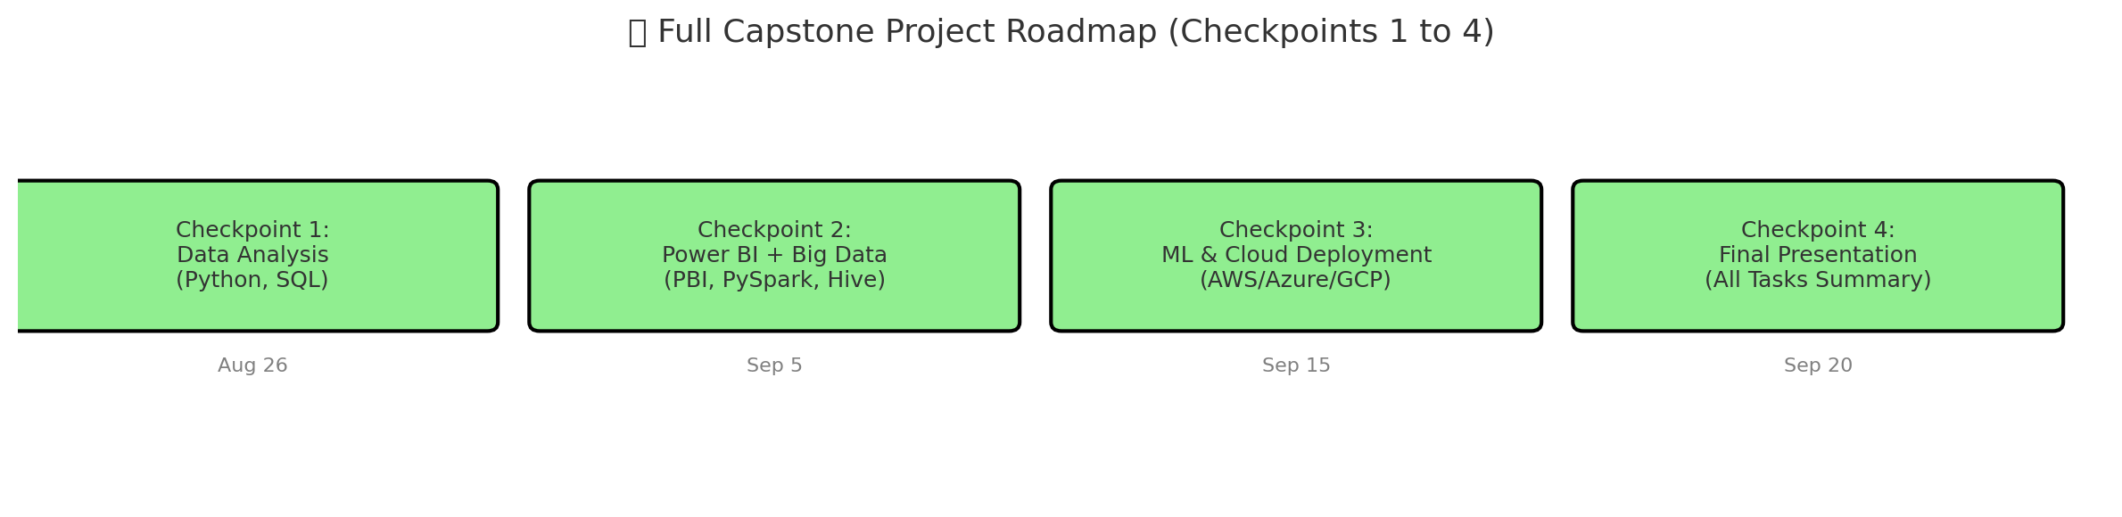
Capstone Full Roadmap (Checkpoints 1–4)

Slide 5
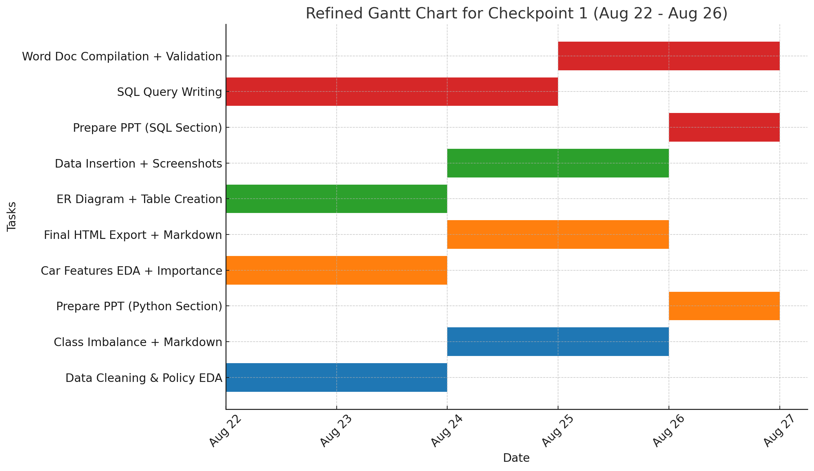
Gantt Chart – Checkpoint 1 Task Timeline

Slide 6
Summary & Next Steps
All tasks clearly divided among 4 members
Parallel work on Python and SQL
Deliverables: Code(sql,python),working model for demo, Word Doc, PPT
Final Submission for Checkpoint 1: August 26
Future Checkpoints: Power BI, Big Data, ML, Cloud

Slide 7
Problem Statement Summary
Business Context: XYZ is a fast-growing car insurance startup known for a high claim settlement ratio. The startup wants to optimize costs by identifying policyholders who are more likely to file a claim within the next 6 months. This enables proactive risk management and better pricing strategies.

Slide 8
Key Challenges:
Predicting Claims:
Identifying which policyholders are high-risk.
Data Understanding & Preparation:
Need to understand what features are available and how they influence claim likelihood.
Model Building:
Must create and compare ML models to predict claim probability.
Data Complexity:
Mix of numerical, categorical, and boolean features across two domains:
Policyholder details
Car features

Slide 9
Insights we aim to derive
From Policy Features:
Is age of the policyholder or age of the car influencing claim likelihood?
Does population density or policy tenure show any correlation with claim rates?
From Car Features:
Do safety features (like airbags, ESC, NCAP rating) reduce claim chances?
Are claims more common with certain makes, models, or segments?
Data Quality:
Is the dataset balanced in terms of the is_claim class?
Are there duplicate records?Are there missing values, or incorrect datatypes?

Slide 10
