Slide 1
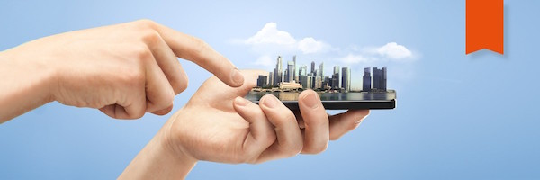
Smart Cities & Smart Homes
Rishabh Mulani | Arunprakash Nagarajan

Slide 2
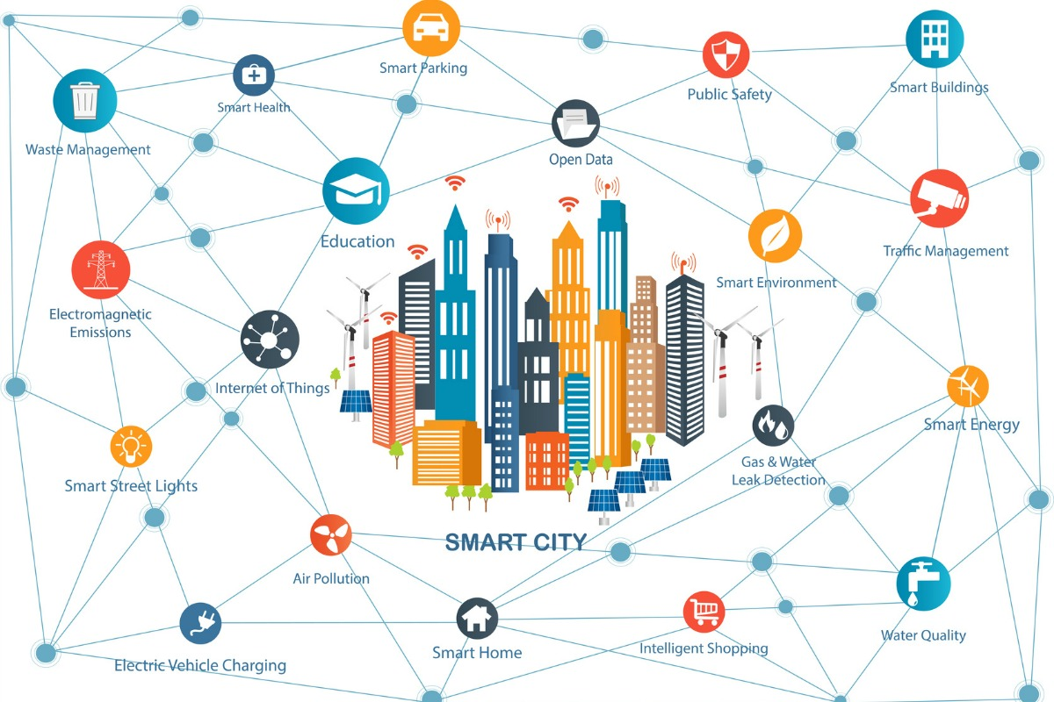
Smart Cities
Is an urban area that uses different types of electronic data collection sensors to supply information which is used to manage assets and resources efficiently
Some examples of Smart Cities are Singapore, London, New York, Barcelona

Slide 3

Predicting Weather Summary of London using the sensor data
We identified a dataset in Kaggle which is a collection of sensor data which has columns like temperature, humidity, pressure and few others
We built a Machine Learning model to predict if the conditions are sunny or cloudy or foggy or clear, etc
We used a Random Forest classifier to achieve it since we also wanted to consider the “feature_importance_” aspect of Random Forest
Reference : https://www.kaggle.com/jeanmidev/smart-meters-in-london#weather_hourly_darksky.csv

Slide 4
Data Privacy and Trust for a smart city
Transparency: The city administration should make sure they inform people what kind of data is collected. For example many motion sensors and cameras are used and it is essential to inform about the types of data being collected
Trust: Since the collected data is about the people and various aspects of the city, standards should be maintained to prevent any misuse of data. Security protocols should be updated and engineers working on the project should be educated to safeguard the information
Control: Although in a smart city it is difficult to give lots of controls to people, the city should provide latest uniform security to all. People should have common way to view the data that is collected from them
Value: With data being collected, the advantages that people obtain should be clearly defined. Be it the safety aspects of citizens, weather data the value obtained needs to be communicated in simple ways

Slide 5
Smart homes: IoT Architecture
Physical World
Switches
Remote controllers
Edge (Sense & Act)
This connection is what gives the user access to control her/his devices from anywhere in the world!
Cloud (Store and process)
Communication protocols
Applications
Monitor appliances and appliance use
Network (Connect)
All sorts of electric and electronic devices such as led lights, fans etc.
Sensors & actuators are present in this system as every event triggered through a device (for e.g. a smartphone) triggers an actual signal flowing to the device, and receives feedback on whether the event completed or not
The moment an event is triggered, it flows to the cloud and then to the device which takes care of maintaining the last ‘state’ of the device e.g. ‘On’, ‘Off’, ‘Speed-3’ etc.
AWS Cloud storage and IoT services for secure transmission
Remotely access electronic appliances: e.g. start the air conditioning 30 mins before reaching home, turn off the oven in 45 minutes
The ‘connected home’, implying the devices in the ‘smart home’ and the device(s) to control it are part of the internet
AI & ML
People
Smartphones/ Smart devices
Notes:
Talk about:
Network:
-Device aggregation, network abstraction (how the network layer is abstracted for the user)
-Fog computing: not storage or computation, but communication routed over the internet backbone
Cloud:
-Secure, monitor & maintain data & communication using communication protocols
-Store, route & orchestrate data
- Analyze all accumulated data using ML & AI: start giving suggestions like ‘It’s 5:00, want to start the air conditioner?’

Slide 6
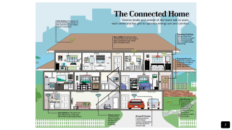
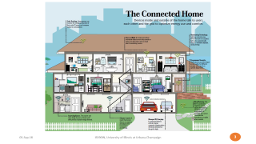
What do we mean by smart homes?
This idea simply refers to the concept of ‘The Connected Home’ where devices inside and outside the house talk to users
This ‘talking’ or communication refers to any kind of information interchange between the user and technology. This can range from sending a command from a phone to control an electronic appliance or even an appliance sending a text or an e-mail back to a user

Slide 7
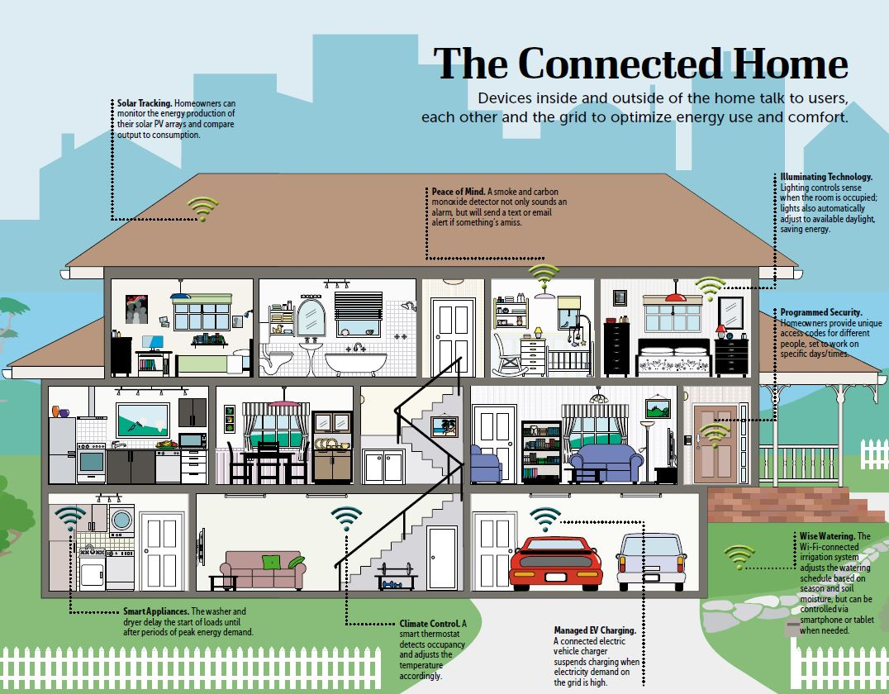

Slide 8
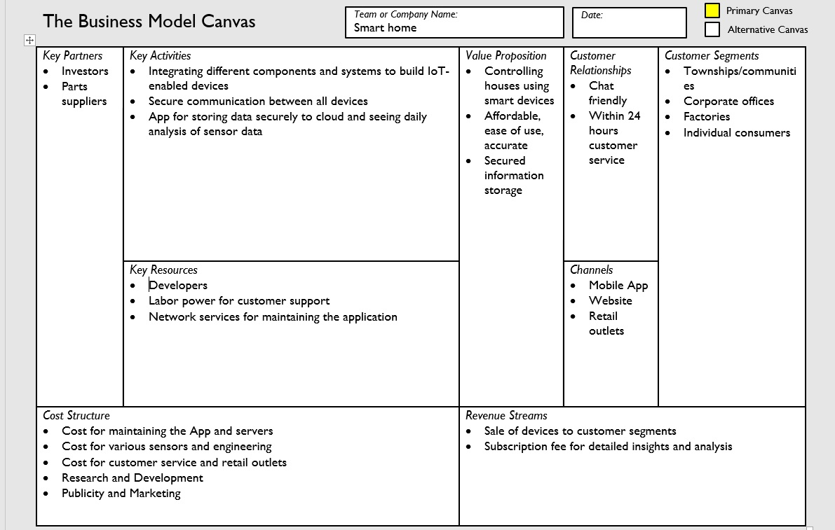
Smart Homes– Business Model

Slide 9

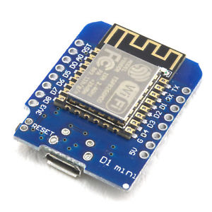


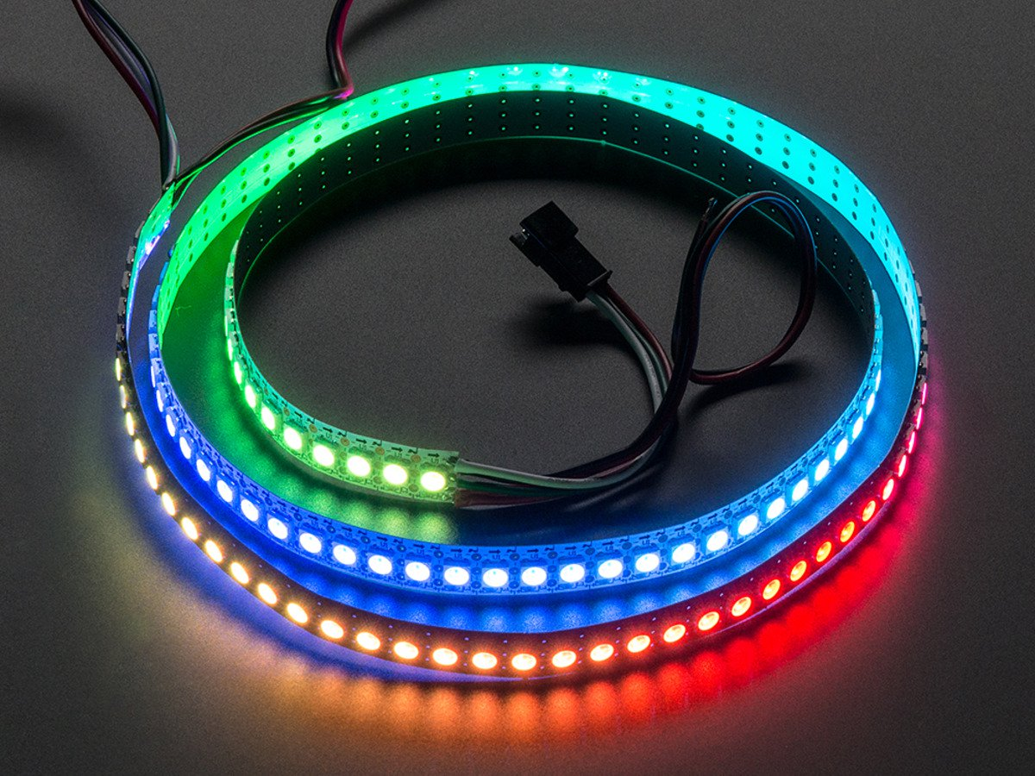

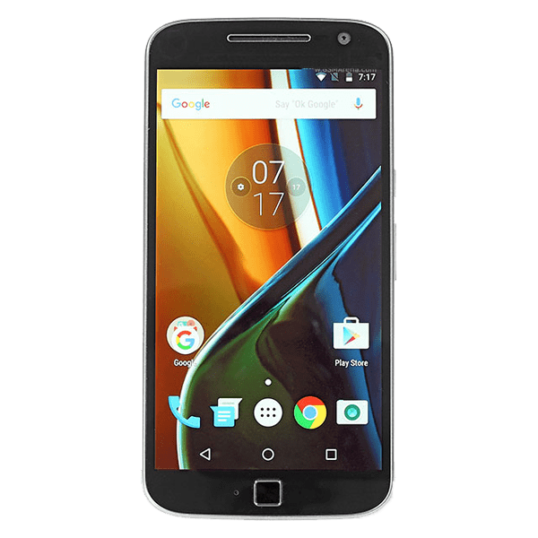
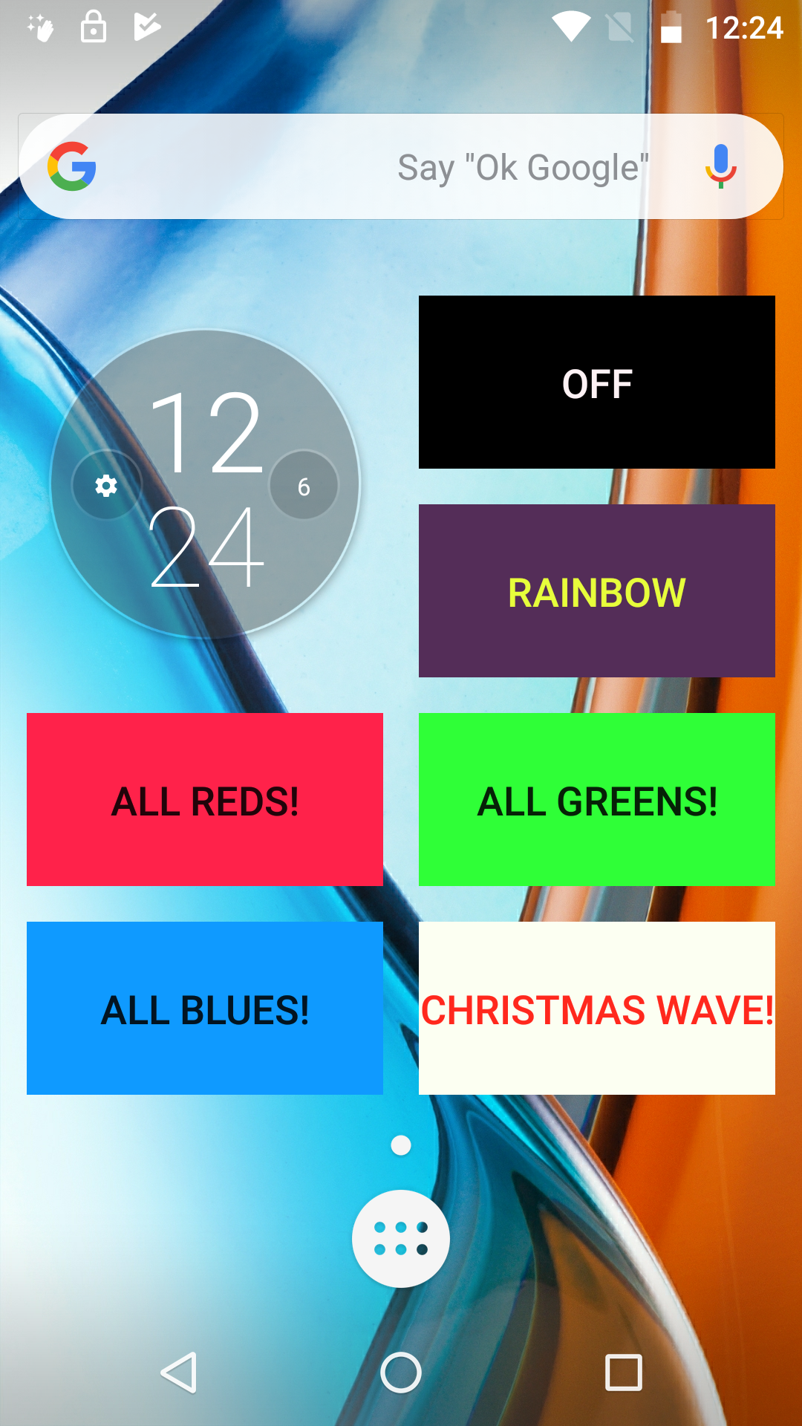
System Architecture
5V Power Supply
One more thing… would you like to see this live?

Slide 10
References & Special Mentions
CU Community Fab Lab: Brandon, Emily, Max, Amanda
Another big shoutout to Adhbuth Reddy for lending us his ESP8266MOD because of which the live demo was possible!
Bitlunis lab youtube channel: https://www.youtube.com/bitlunislab
Kaggle: for our dataset
Mark Moran’s PowerPoint slides and in-class lectures
Arduino libraries:
Neopixel
ESP8266 Community Edition

