Slide 1

CASE STUDY
Dining Philosopher, Drinking Philosopher,
Reader’s Writer’s Problem, Mobile Philosopher
Rishabh Murarka
Kaushik L V
Juhi Gupta
Krishna Dwypayan

Slide 2

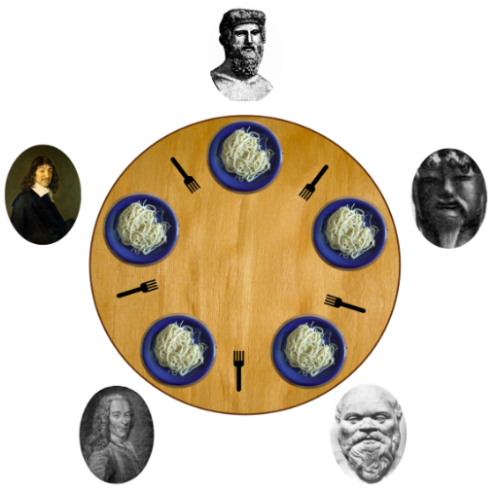

Dining Philosopher Problem
The problem of dining philosophers described by Dijkstra is as follows -
The problem is the Five Dining Philosophers The life of a philosopher consists of an alternation of thinking and eating
        Cycle begin
        Think
        Eat
        End
Their only problem besides those of philosophy is that the dish served is a very difficult kind of spaghetti that has to be eaten with two forks.
There are two forks next to each plate so that presents no difficulty as a consequence however no two neighbours may be eating simultaneously.

Slide 3
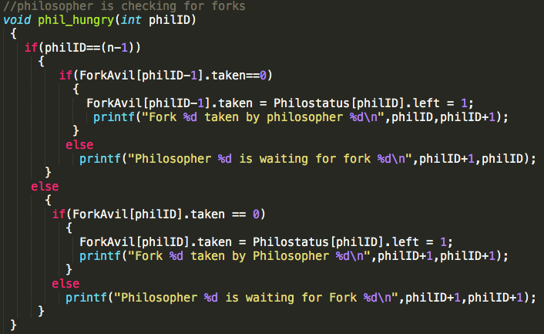

Solution
The first (n-1) philosophers can pick the left forks first and then the last philosopher picks the right fork first or vice versa.

Slide 4
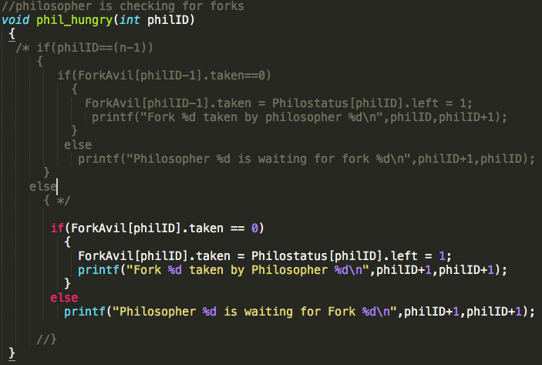
Deadlock Simulation
However, if all the philosophers pick either the left or the right fork first then this will lead to a Deadlock as shown in the below snippet.

Slide 5
Reader’s Writer’s Problem
There is a shared resource which should be accessed by multiple processes.
There are two types of processes in this context and they are reader and writer.
Any number of readers can read from the shared resource simultaneously, but only one writer can write to the shared resource.
When a writer is writing data to the resource, no other process can access the resource.
A writer cannot write to the resource if there are non zero number of readers accessing the resource.

Slide 6
Solution for Readers
Pseudo Code for Reader -
  Semaphore r, s;
  while(true) {
      wait(r)
      readCount++
      if (readCount >= 1)
        wait(s)
      signal(r)
      READ TEXT
      wait(r)
      readCount—
      if(readCount == 0)
        signal(s)
      signal(r)
  }
Explanation -
The code makes use of 2 semaphores.
The first semaphore(s) synchronises between reader-writer and writer-writer.
The second semaphore(r) synchronises between reader-reader which gives the security to readCount variable which keeps count of the number of readers in critical section

Slide 7
Solution for Writers
Pseudo Code for Writer:
    while(true) {
        wait(s)
        WRITE TEXT
        signal(s)
    }
Explanation:
The code makes use of the semaphore(s) which ensures that neither a reader nor a writer can be allowed while a writer is in critical section.

Slide 8
Mobile Philosophers’ Problem
Philosophers move between the cells.
Base-stations responsible for channel allocation within a cell.
Frequency reuse between the cells, at the same time, avoid channel interference.
Set of free-frequencies for a particular cell-agent not in use of the cell.
Solution should aim at allocating the resource, and at the same time maximising the number of satisfiable requests.

Slide 9
Solution
This problem can be viewed as the list colouring problem.
Every node of the graph has associated with it a list of colours(set of free-frequencies).
Need to find a proper vertex colouring of the graph such that the vertex is coloured with one of the colours in the list.
List chromatic number [XL(G)] is the list size assigned to every node of the graph
If XL(G) <= k, then G is said to be k-choosable. So, solution converges to find the list size to list colour G, as the size of the free spectrum sufficient to satisfy the pending requests.

Slide 10
Drinking Philosophers Problem
• The drinking philosophers problem, is a generalisation of the dining philosophers.
• Each philosopher has, as before, an arbitrary number of neighbours with each one of whom he shares one bottle; each time that it becomes thirsty, it requires a (pre-speci ed) subset (which may differ each time) of its incident bottles in order to drink.
• processors as philosophers are in one of three states – tranquil, thirsty, and drinking
• a tranquil P may become thirsty
• a thirsty P needs a nonempty set of bottles that he wishes to drink from
• a thirsty P may need different set of bottles for different drinking sessions
• on holding all needed bottles, a thirsty P starts drinking
• a thirsty P remains thirsty until he gets all bottles he needs to drink
• on entering the drinking state, a P remains in that state for a finite period, after which he becomes tranquil
• a P may be in the tranquil state for an arbitrary period of time
• It can be mapped to general paradigm for modeling conflicts like exclusive write to a common file.

Slide 11
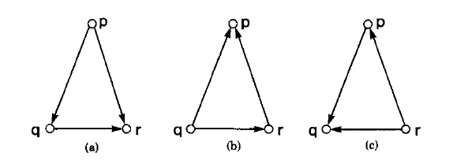
Proposed Solution
We represent the state of the system as a precedence Graph where the processes are the nodes and an edge in this graph represents a conflict.
Conflict is when two processes request for the same resource(bottle). The direction on the edge is given in accordance to precedence which is assigned by using Timestamps.
In this graph we check the indegree of the vertices and the vertex with the least indegree has the highest precedence.
We must always ensure that the graph is Acyclic to avoid deadlocks.
To ensure fairness, we make changes to the graph such that all the processes will get the highest precedence eventually.
This is achieved by changing the direction of edges as shown. Thus all the processes get a fair chance at all the resouces.

Slide 12
Thank You

