Slide 1
CS 771 Presentation
Classifying Heart Sounds Challenge
By: Group 12
Atulya Shivam Shree
Rajesh Shubhankar
Richa Sharma
Rishabh Nigam

Slide 2
Challenge
Heart beat data – using
Clinical Trial – dataset B
IPhone app – dataset A
Challenge1 – Segmentation of heart data to find S1 and S2 peaks.
Challenge2 – Classification of heart sound into normal, murmur, extra heart sound and Artifact for dataset A and normal, murmur, extrasystole for dataset B.

Slide 3
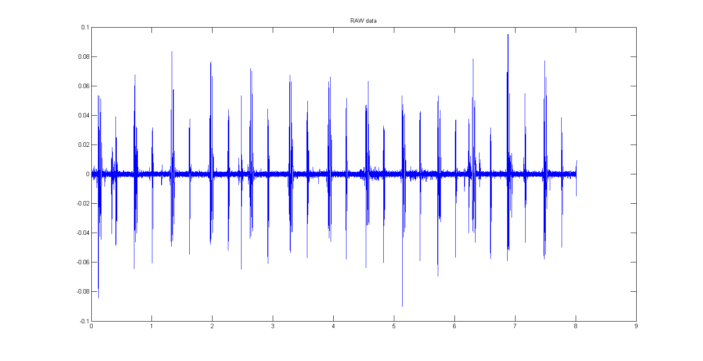
Dataset
Dataset available in .wav and .aif format. We use data from .wav format.
Dataset A contains data at 44100 frames per second, Dataset B at 4000 frames per second
Training File: segmentation data is provided in a csv for 21 and 90 files for dataset A and B respectively

Slide 4
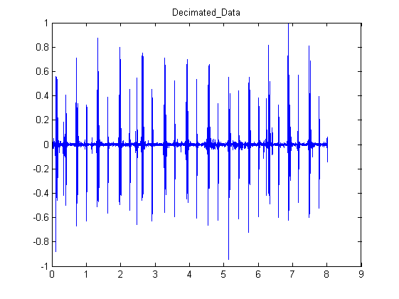
Challenge1 : Step1 decimation
Decimate the signal by a factor of 20 for dataset A and for 2 for dataset B. This brings down the frequency close to 2000 for both the datasets.
Normalize the signal to (-1,1)

Slide 5
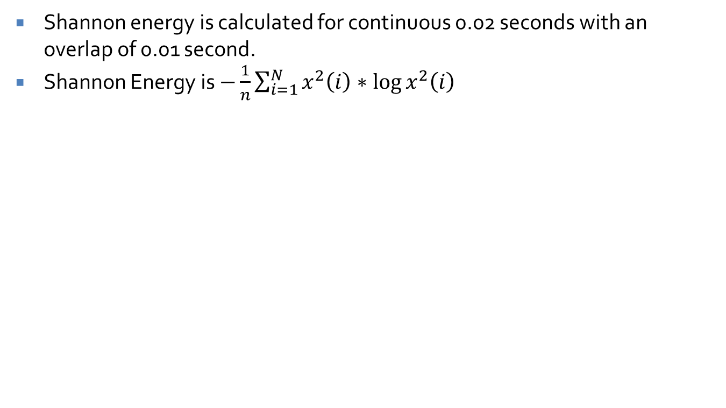
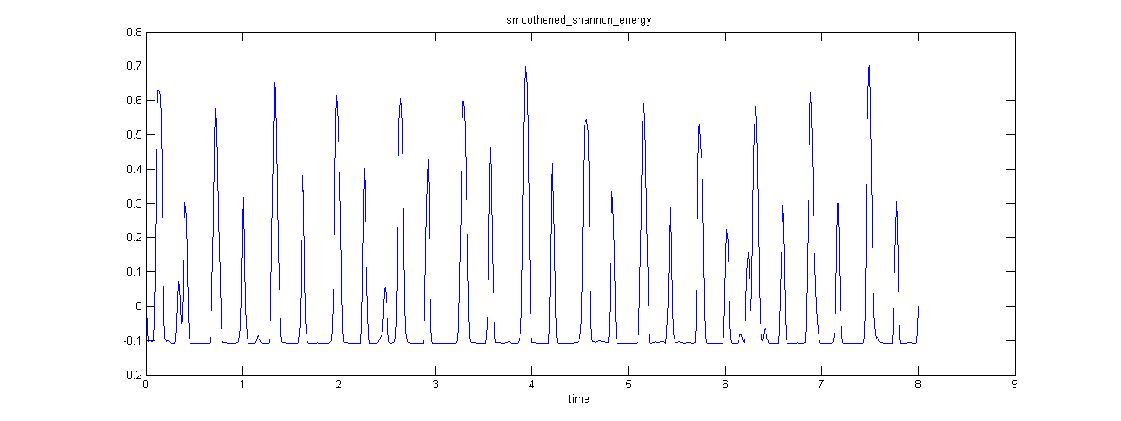
Challenge1: Step2 Shannon Energy
S

Slide 6
Challenge1: Step3 smoothening
We use “triangular smooth” to smoothen the signal

Slide 7
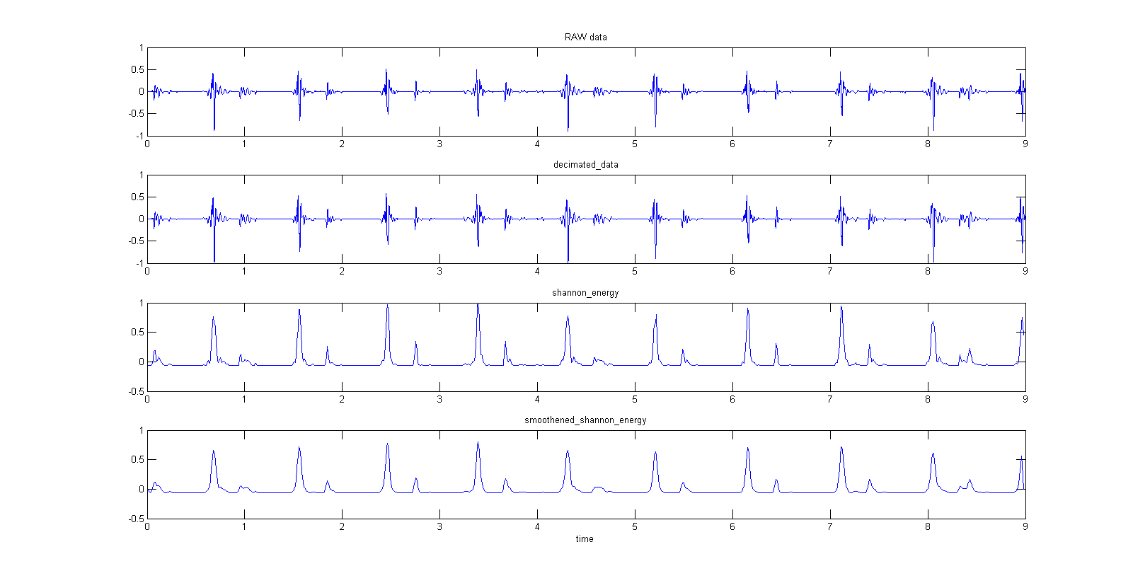
Complete preprocessing

Slide 8
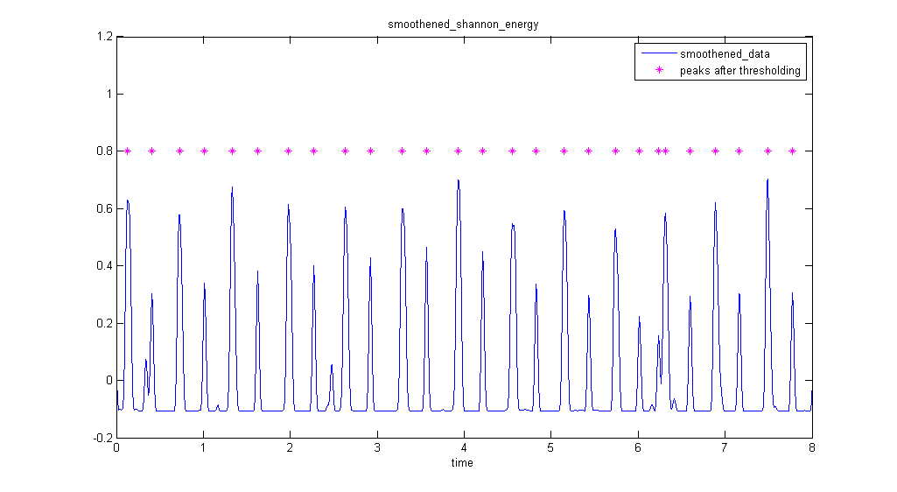
Challenge1: Step4a getPeaks
We use a threshold and extract all values above the threshold. Then we select the best peak among the neighbouring peaks within a range.

Slide 9
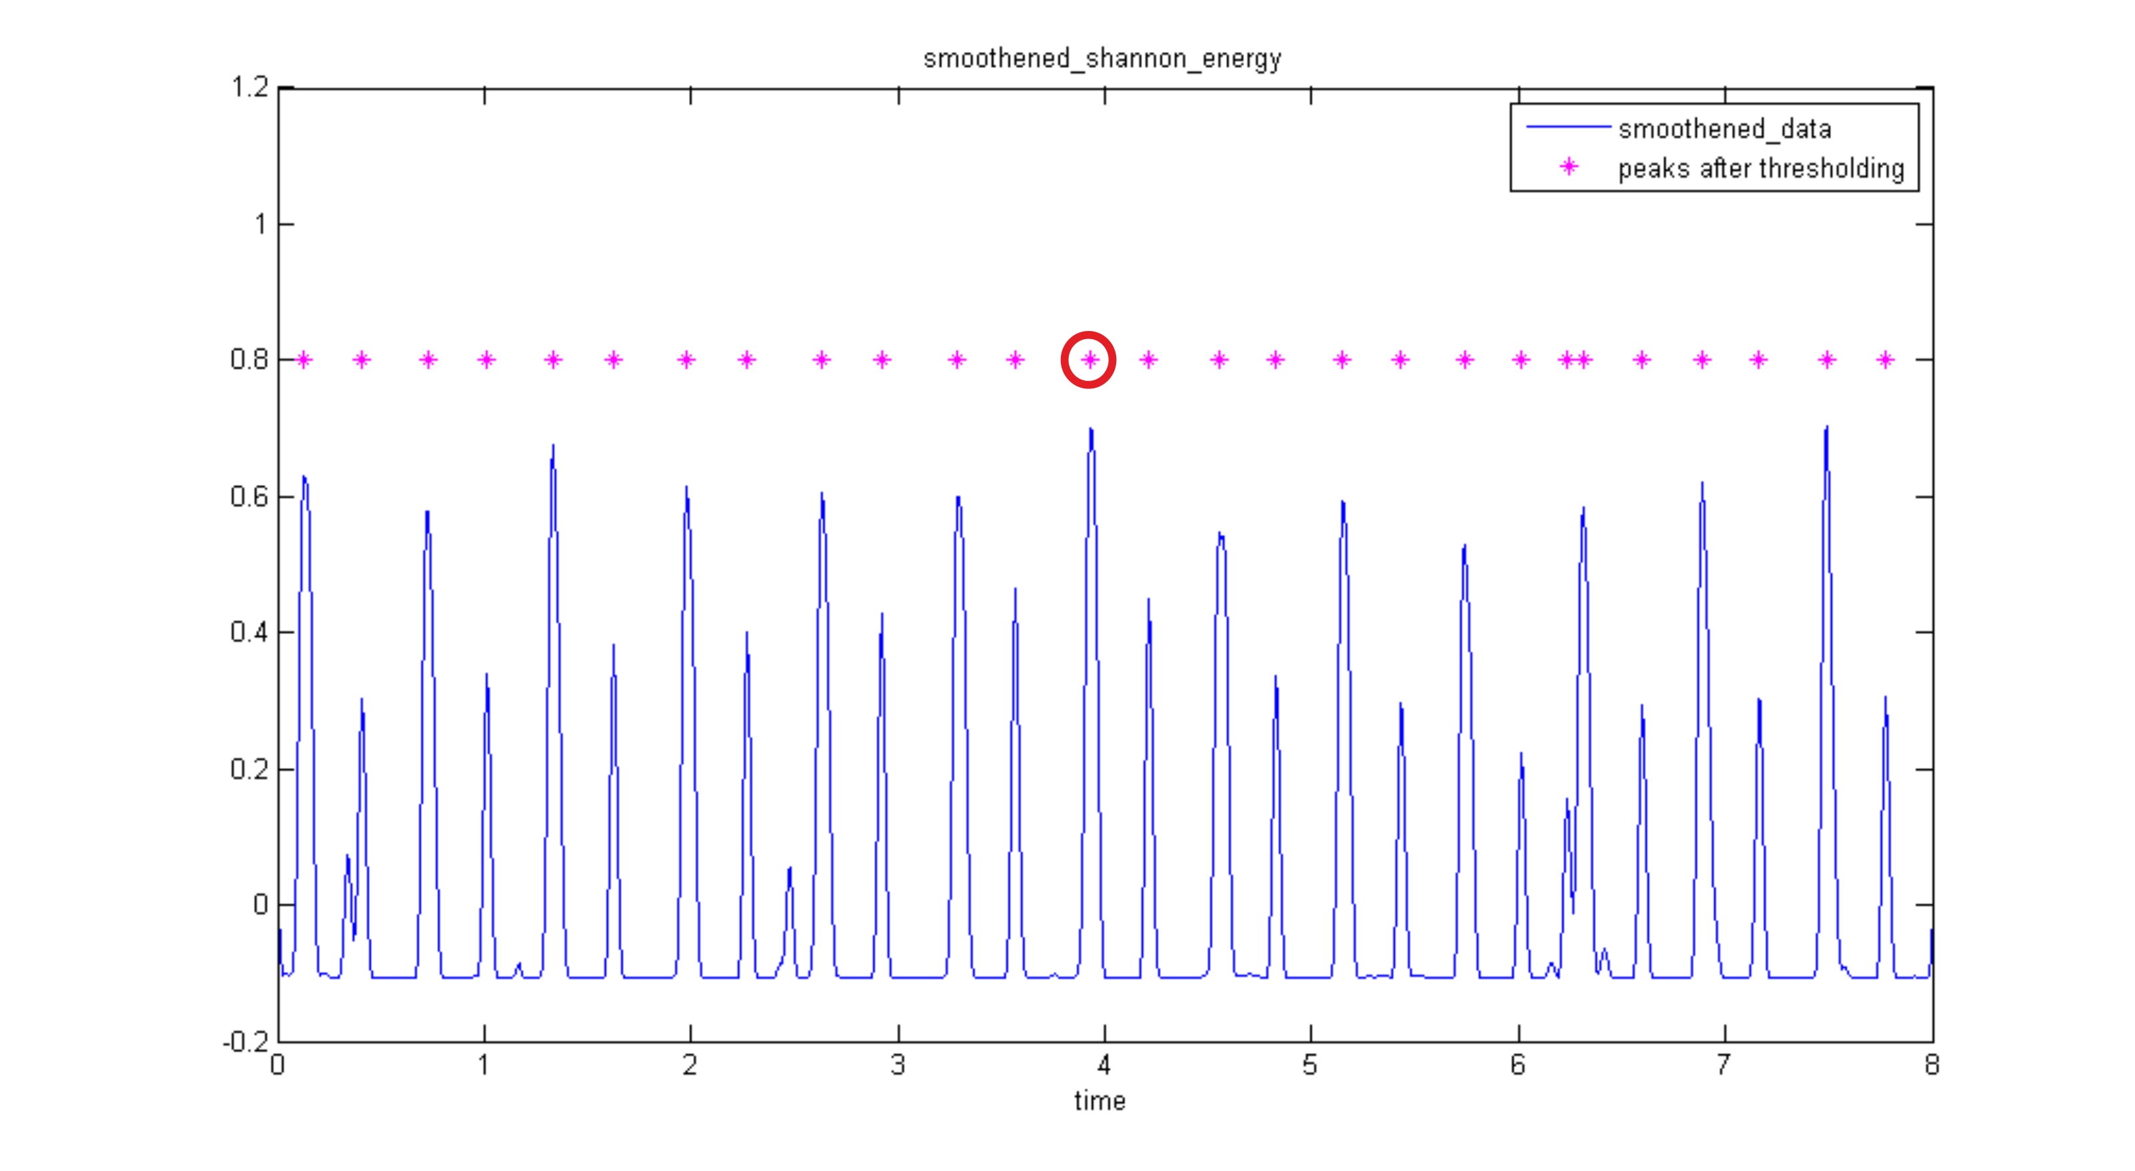
Algorithm: getS1Peaks

Slide 10
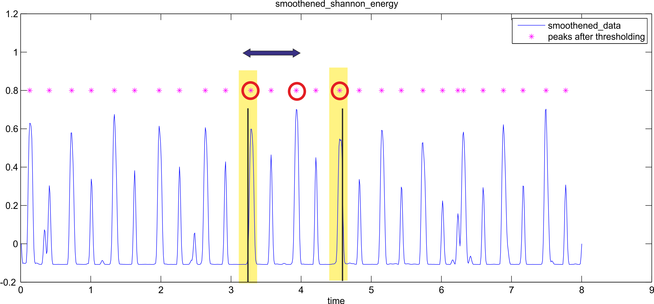
Algorithm: getS1Peaks

Slide 11
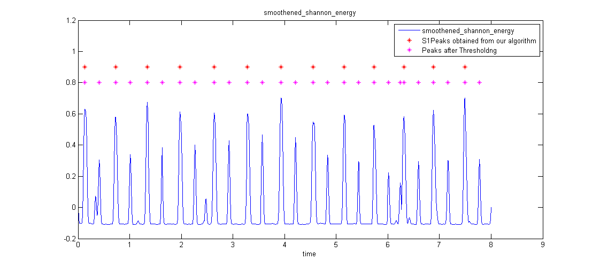
Challenge1: Step4b getS1Peaks
In this we start with the assumption the S1peaks have higher energy. We start by picking the peak with the maximum energy. Then we look at peaks within distance of one time period of it, and so on. We vary the time period and pick the best set of S1Peaks.

Slide 12
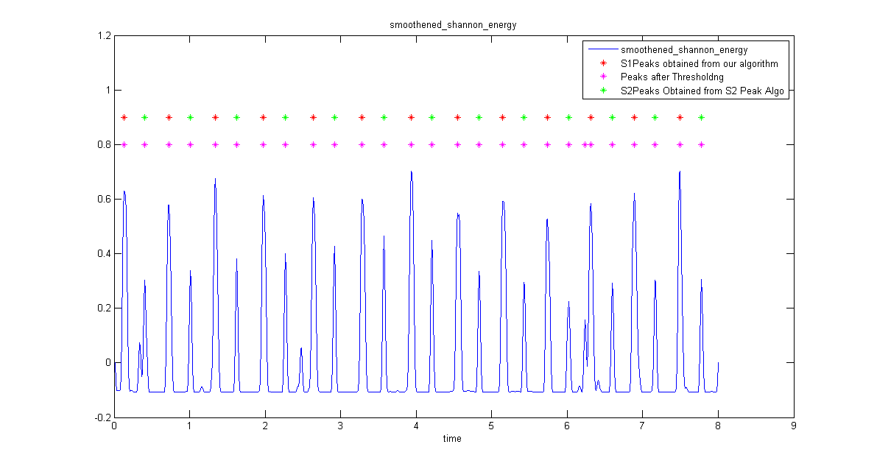
Challenge1: Step4c getS2Peaks
Look between 2 S1 peaks, and pick the best peak. If no peak is found we lower the threshold and look again.

Slide 13
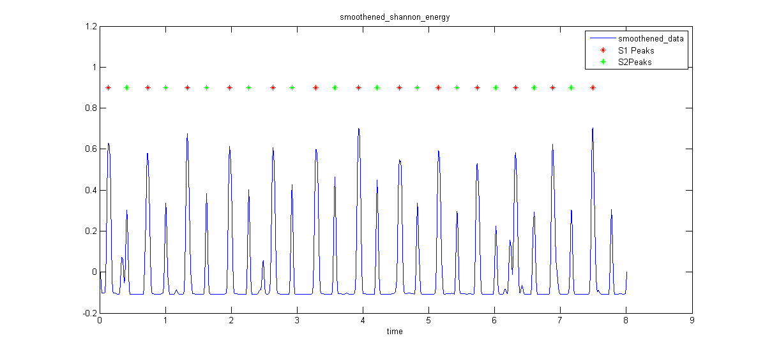
Challenge1: Step4d FixPeaks
Fix peaks uses the length of diastolic and systolic period to fix which is S1 and S2.

Slide 14
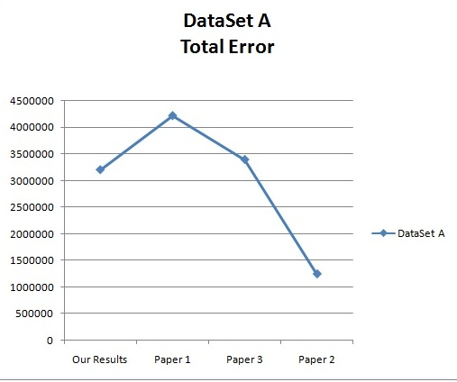
Result comparison

Slide 15
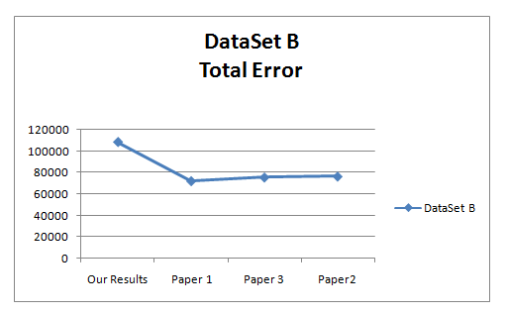
Result comparison

Slide 16
Challenge2: AttributeSet
We use 14 attributes to classify heart data.
best_frequency;
Systolic_period;
Diastolic_period;
Diastolic_period_variance;
Systolic_period_variance;
number_of_peaks_after_findmaxpeak;
number_of_peaks_finally;

Slide 17
Challenge2: AttributeSet
S1Peaks_Energy;
S2Peaks_Energy;
Extra_Peaks_Energy;
systolicPeriodEnergy
diastolicPeriodEnergy
time_period_variance
ratio_threshhold_peaks_to_final_peaks

Slide 18
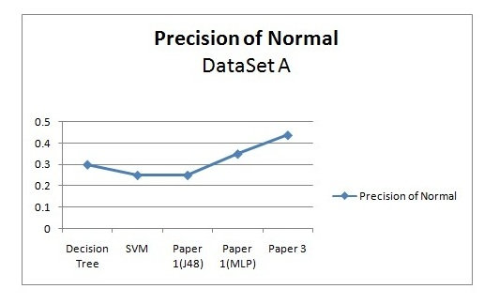
Challenge2: Results dataset1

Slide 19
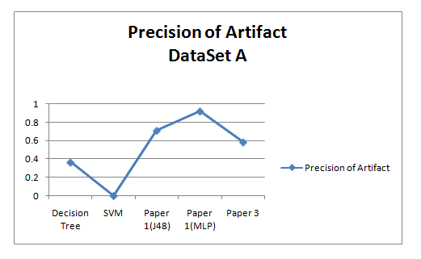
Challenge2: Results dataset1

Slide 20
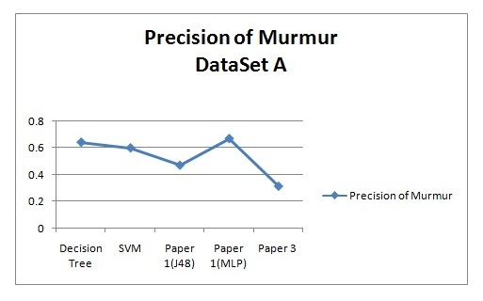
Challenge2: Results dataset1

Slide 21
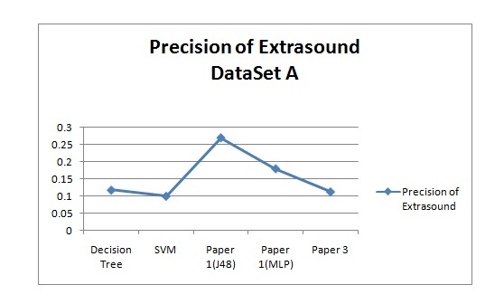
Challenge2: Results dataset1

Slide 22
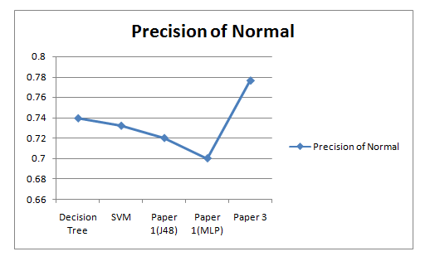
Challenge2: Results dataset2

Slide 23
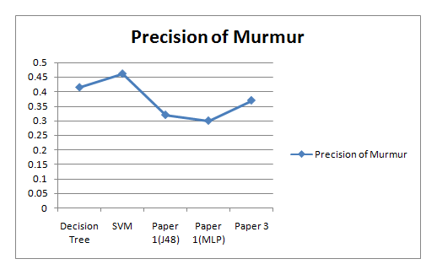
Challenge2: Results dataset2

Slide 24
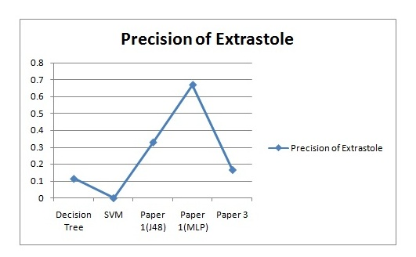
Challenge2: Results dataset2

Slide 25
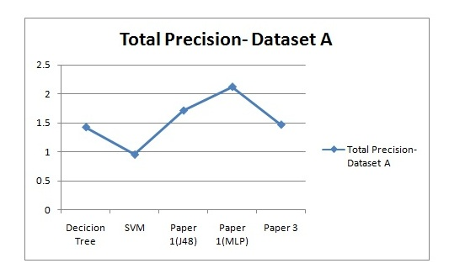
Challenge2: SummaryResults

Slide 26
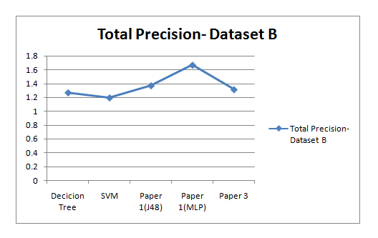
Challenge2: SummaryResults

Slide 27
Results using 5 fold validations: Support Vector Machine
Dataset B
Dataset A
Correctly Classified Instances 69.2308 %
Incorrectly Classified Instances 30.7692 %
Mean absolute error 0.3177
Root mean squared error 0.4117
Relative absolute error 90.8775 %
Root relative squared error 98.6397 %
Total Number of Instances 312
Correctly Classified Instances 54.8387 %
Incorrectly Classified Instances 45.1613 %
Mean absolute error 0.3051
Root mean squared error 0.3894
Relative absolute error 82.9609 %
Root relative squared error 90.8359 %
Total Number of Instances 124

Slide 28
Results using 5 fold validations: Neural Networks
Dataset B
Dataset A
Correctly Classified Instances 64.7436 %
Incorrectly Classified Instances 35.2564 %
Mean absolute error 0.2705
Root mean squared error 0.4267
Relative absolute error 77.3767 %
Root relative squared error 102.232 %
Total Number of Instances 312
Correctly Classified Instances 54.8387 %
Incorrectly Classified Instances 45.1613 %
Mean absolute error 0.2406
Root mean squared error 0.4187
Relative absolute error 65.4115 %
Root relative squared error 97.6673 %
Total Number of Instances 124

Slide 29
References
Heart Sound Segmentation Algorithm Based on Heart Sound Envelolgram .H Liang, S Lukkarinen, I Hartimo .Helsinki University of Technology, Espoo, Finland.
Sapire DW. Understanding and diagnosing paediatric heart disease: Heart sounds and murmurs. Norwalk, Connecticut, Applcton & Langc 1992: 27-43.
A Robust Heart Sound Segmentation and Classification Algorithm using Wavelet Decomposition and Spectrogram. Yiqi Deng , Peter J Bentley. Dept. of Computer Science, UCL Malet Place, London.
Classifying heart sounds using peak location for segmentation and feature construction. Emanuel Pereira,Elsa Ferreira Gomes. Institute of Engineering (ISEP/IPP) Porto,Portugal

Slide 30
Code
Will be available at http://github.com/rishabhnigam31/heartSegmentation.git
Thank You

