Slide 1
Python PROJECT
Made by :-
Rishabh Ostwal (247903)
Hardik Nigam (228389)
Rishabh Mondal (251101)

Slide 2

FEATURES OF PYTHON
Easy to learn and use
Expressive language
Interpreted language
Cross platform language
Free and open source language
Object oriented language
Extensible
Large standard library
GUI programming support
Integrated

Slide 3

Set
Tuple
Dictionary
List
File
Handling

Slide 4
List
Python lists are like arrays.
It is a collection of multiple values of same data type under a common variable name.
This not only helps to store large amounts of data but also performs different operations on all data at the same time.
Syntax : Var_name = [ Value1, Value2, …]

Slide 5
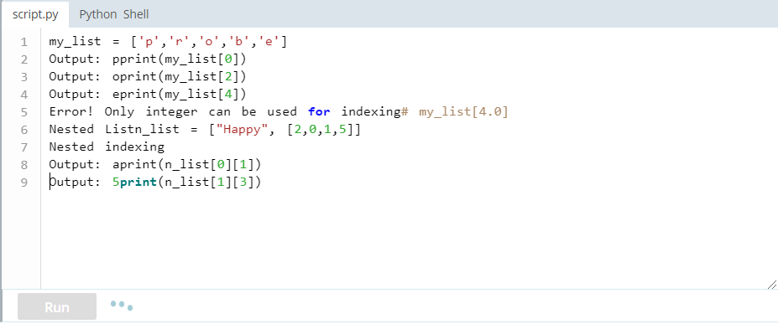
How to access elements
from a list?
Accessing
We can use the index operator [ ] to access an item in a list.
Index starts from 0.
So, a list having 5 elements will have index from 0 to 4.

Slide 6
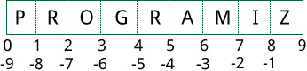
Double Indexing of lists
in python
Positive Index
We know that Index of a list starts from 0. So, a list having 5 elements will have index from 0 to 4.
This is called positive index
Negative Index
Python also allows negative indexing for its sequences. The index of -1 refers to the last item, -2 to the second last item and so on.

Slide 7
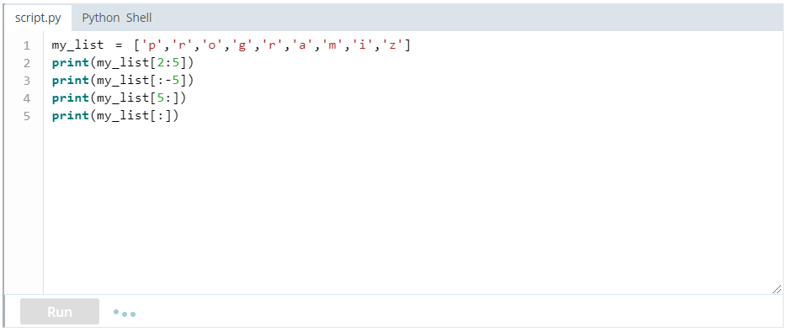
How to slice lists in Python?
Slicing
Slicing refers to accessing a range of items from a list by using ‘:’ operator.
Within the square brackets as shown below the left value shows the starting point and up to the right value excluding the value itself

Slide 8
Methods used to operate on lists
Python List Methods
append() | - Add an element to the end of the list
extend() | - Add all elements of a list to the another list
insert() | - Insert an item at the defined index
remove() | - Removes an item from the list
clear() | - Removes all items from the list
index() | - Returns the index of the first matched item
count() | - Returns the count of number of items passed as an argument
sort() | - Sort items in a list in ascending order
reverse() | - Reverse the order of items in the list

Slide 9
Tuples
A Tuple is different from a list based on the fact that once created it cannot be changed.
Tuples also serve the same purpose as the list.
Instead of ‘[ ]’ it uses ‘( )’
Syntax : Var_name = ( Value1, Value2, …)

Slide 10
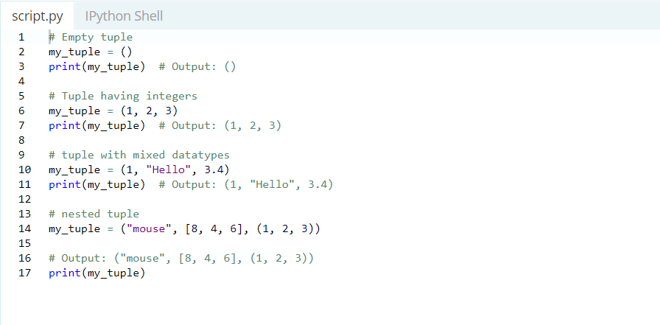
How to create a Tuple ?
A Tuple is created by placing all the items inside parenthesis () separated by commas. The parenthesis
are optional.
A tuple can have any number of items and they may be of different types (integer, float, list, string , etc.).

Slide 11
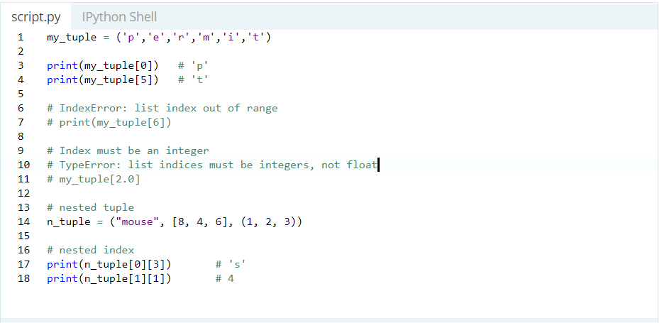
Access Tuple Elements
Indexing
We can use the index operator [ ] to access item in a tuple where the index starts form 0.
So a tuple having 6 elements will start from 0 to 5.
Trying to access an element outside of tuple (for example, 6, 7,...) will raise an Index Error

Slide 12
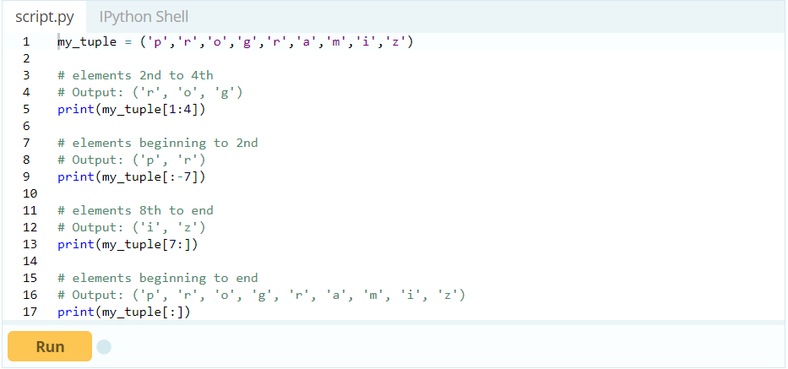
Slicing of Tuple
Elements
Slicing
Slicing in case of a tuple is the same as that of a list except for the ‘()’
Slicing can be best visualized by considering the index to be between the elements as shown below. So if we want to access a range, we need the index that will slice the portion from the tuple.

Slide 13
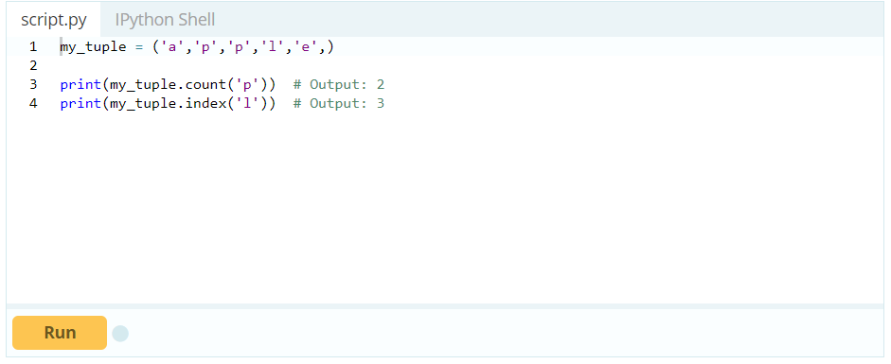
Methods used to operate on Tuples
Python List Methods
index() | - Returns the index of the first matched item
count() | - Returns the count of number of items passed as an argument

Slide 14
Dictionary
A Dictionary serves the same purpose as lists and tuples, however it’s structure and working is different.
Rather than using indexes it stores values in pairs where each pair contains two values
The first value is called a key and the second value holds the data
These keys are then used to access the data
Syntax : Var_name = { Key1 : Value1, Key2 : Value2, …}

Slide 15
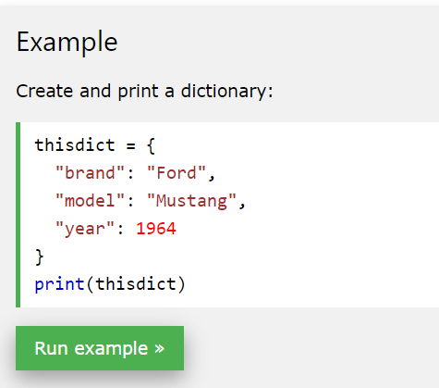
Creating a Dictionary
To create a dictionary first we need to assign a key value, keys are unique values and stored in unordered manner
If we try to create a duplicate key of the existing key, then the data will be overwritten instead of creating a new pair
Strings and Tuples are mostly used to create keys as they are immutable each pair
Is separated by commas and the statement is bound under ‘( )’ braces

Slide 16
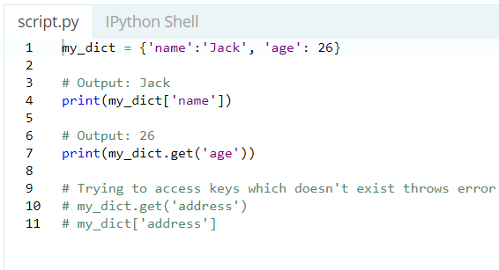
Accessing
The keys are used to access values or perform operations on the data of the list
We put the key we need in the index operator and the corresponding value is reached

Slide 17
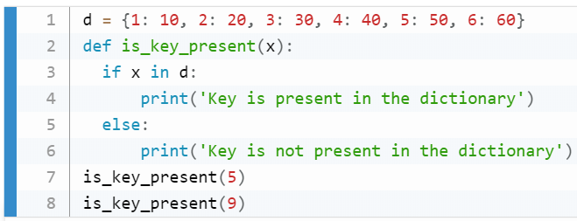
Check if a Key
exists ?
In order to determine if a specified key exists or not in a present dictionary we use keyword ‘in’
‘in’ keyword returns a Boolean value i.e. True or False corresponding to the presence of the key

Slide 18
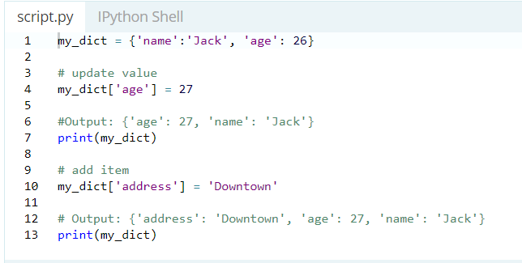
Adding Items
In case we need to add a new item to our current dictionary we need to assign a new key value for the new object
Syntax : Dict_Name[“Key”] = “Value”

Slide 19
Methods used to operate on dictionaries
Dictionary Methods
clear() | Removes all the elements from the dictionary
copy() | Returns a copy of the dictionary
fromkeys() | Returns a dictionary with the specified keys and values
get() | Returns the value of the specified key
items() | Returns a list containing the a tuple for each key value pair
keys() | Returns a list containing the dictionary's keys
pop() | Removes the element with the specified key
popitem() | Removes the last inserted key-value pair
values() | Returns a list of all the values in the dictionary

Slide 20
Dictionary-VS-List-VS-Tuple
DICTIONARY
TUPLE
LIST
Does not allow positional access
Uses Keys to access data stored
Data once can be changed only using keys
It is homogenous in nature
Allows positional access
Uses double indexing ‘positive and negative’ to access values
Data once entered cannot be changed
It is heterogenous in nature
Allows positional access
Uses double indexing to access values
Data once entered can be changed using positions
It is homogenous in nature

Slide 21
Sets
Set in Python is a data structure equivalent to sets in mathematics.
A set is an unordered collection of elements without duplicate entries.
When printed, iterated or converted into a sequence, its elements will appear in an arbitrary order.
Syntax : Var_name ={ value1, value2, …}

Slide 22
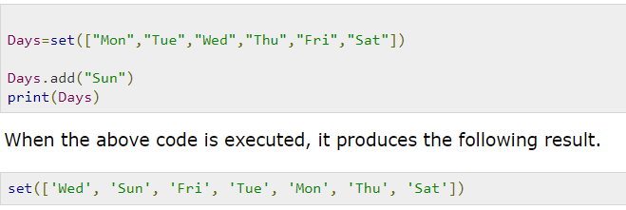
Adding Items to a set
We can add elements to a set by using add() method.
To add one item to a set use the add() method.
To add more than one item to a set use the update() method
OUTPUT :-

Slide 23
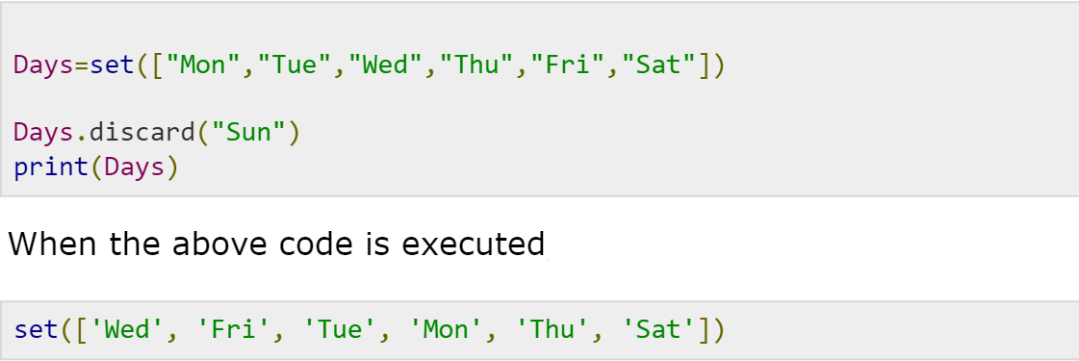
Removing Item from a set
We can remove elements from a set by using discard() method.
Remove() function can also be used to remove elements form a set
If an item to remove does not exist, discard() will NOT raise error

Slide 24
Methods used to operate on sets
Python List Methods
clear() | Removes all the elements from the set
copy() | Returns a copy of the set
discard() | Remove the specified item
pop() | Removes an element from the set
remove() | Removes the specified element
union() | Return a set containing the union of sets
update() | Update the set with the union of this set and others

Slide 25
File
Handling
It is an aspect of python programming that finds huge application in web app designs
This process has been made simpler in python as compared to other languages
Files are handled in text or binary format
Each line of the file ends with special character “\n” that works the end of the line
This concept works on applying different functions
Each file ends by eof() which denotes end of file function.

Slide 26
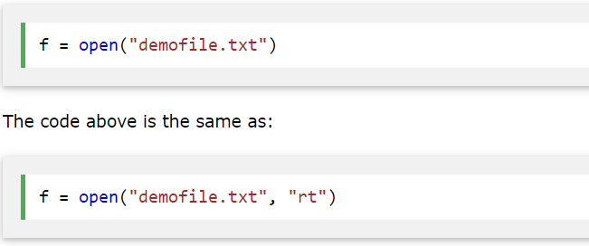
Open file function
A open() function is the most important function of the file handling operation.
It works with 2 parameters file name with extension and operation mode.
There are 4 operation modes for opening a file : -

Slide 27
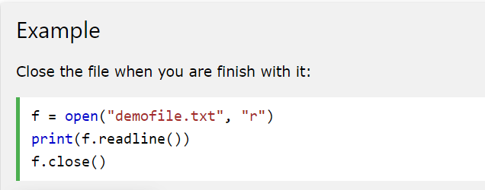
Close file function
A close() function is needed to close an opened file in the current Python Program.
This function resets the working mode of a file so next time we open the same file it opens in read/write mode

Slide 28

readline() function
The readline() function is used to access the contents of the file which is opened
Syntax : var_name = readline()
This statement accesses the first line of the file
Similarly, readlines() is used to read all the lines of a file at once

Slide 29

writelines() function
In python this function works in contrast with the readline() function and is used to add a line to the file that is opened
Syntax : file_name.writelines(“Statements”)

Slide 30
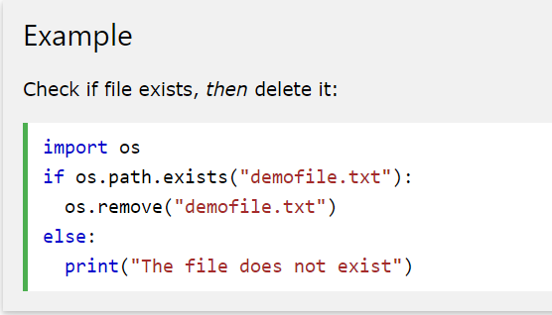
Deletion of a file
For this operation we need to import os library into the file
os.remove() is a method of the library used to delete a file from the system
os.path.exists() method is used to check if a file is present in the system

Slide 31
Thank You

