Slide 1

APRIL 2021
M1: Structural Pruning
EE 379K Final Project
Kenneth Mitra & Rishabh Parekh
Team 1

Slide 2
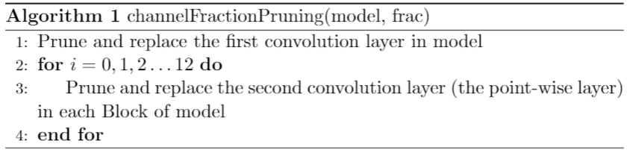
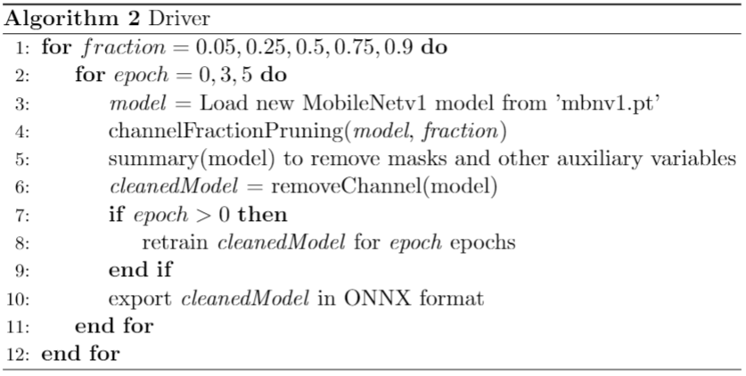
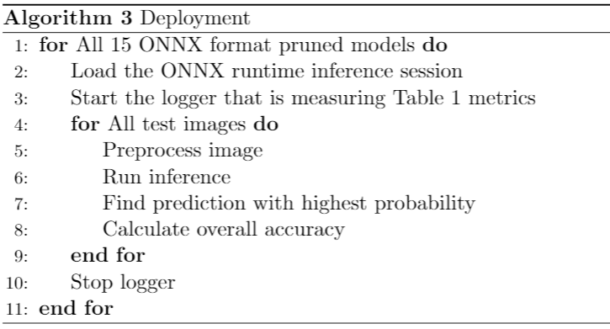
Approach
PyTorch + ONNX
torch.nn.utils.prune

Slide 3
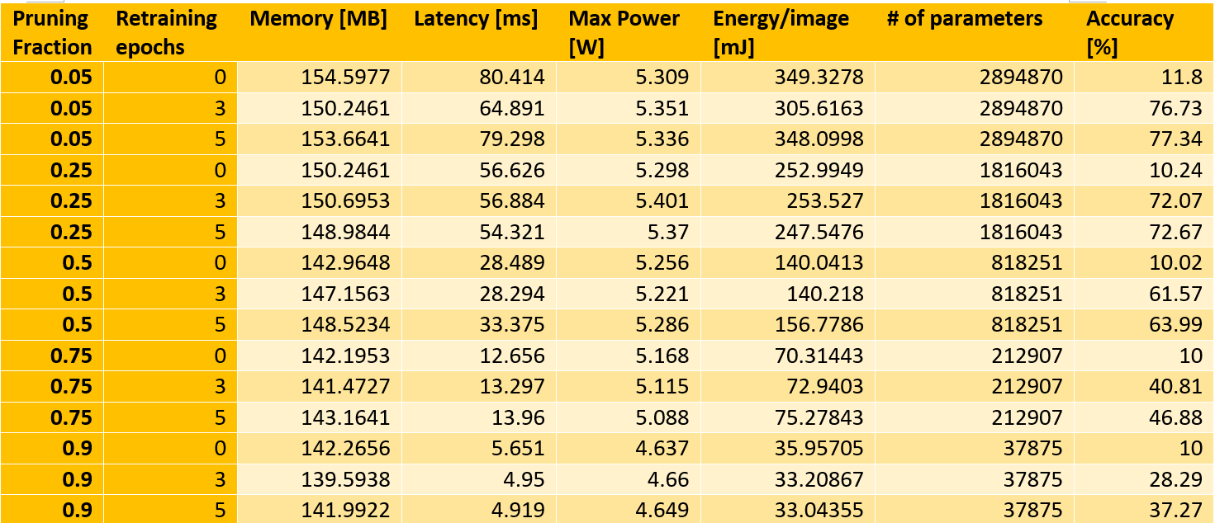
Experimental Results
Notes:
first click: Based on our experiments, retraining helped significantly (and was strictly better than no retraining)
second click: Also, latency and energy consumption reduced significantly when increasing the pruning fraction
however memory use and max power did not shift as much
Low latency is important for edge applications because speed of identification may be critical, low energy consumption may also be important with battery powered devices.
Depending on the application, we should choose the appropriate level of pruning. However, whenever possible we should retrain as much as possible, stopping just before the model begins to overfit

Slide 4
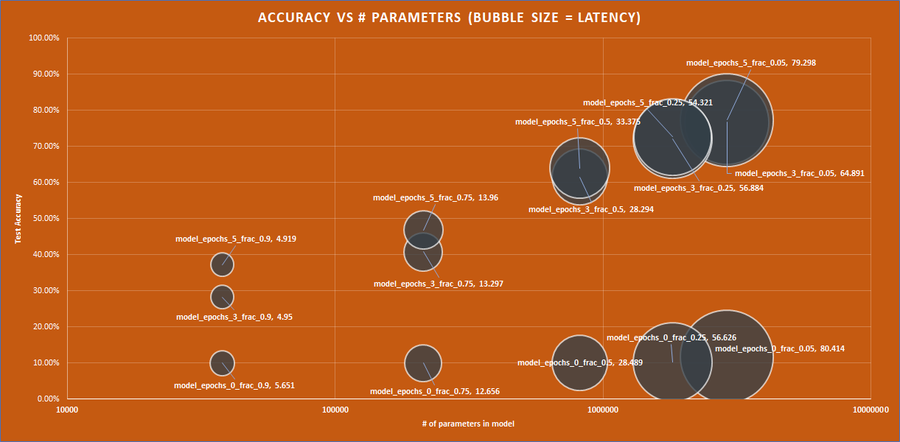
Experimental Results
???
Notes:
Here is a graph of the model accuracy (yaxis) vs the parameters (xaxis) after pruning and retraining. The bubble size corresponds to the latency of the model in milliseconds per image.
We can see that a higher pruning fraction corresponds to a lower test accuracy and lower latency. We can also see that models with more retraining epochs perform strictly better than models with less epochs.
The selection of the pruning fraction will depend on the application the model is used for.
However,
on click:
We think that if tried retraining the models for more epochs we might have been able to get more models in the top left region.

Slide 5
Conclusion
Increasing pruning fraction significantly reduces Latency and Energy Consumption, however more retraining needed
For M3:
Will try more combinations of fractions vs. epochs
Will try retraining after pruning a layer

