Slide 1
APRIL 2021
M2: Network Quantization
EE 379K Final Project
Kenneth Mitra & Rishabh Parekh
Team 1

Slide 2
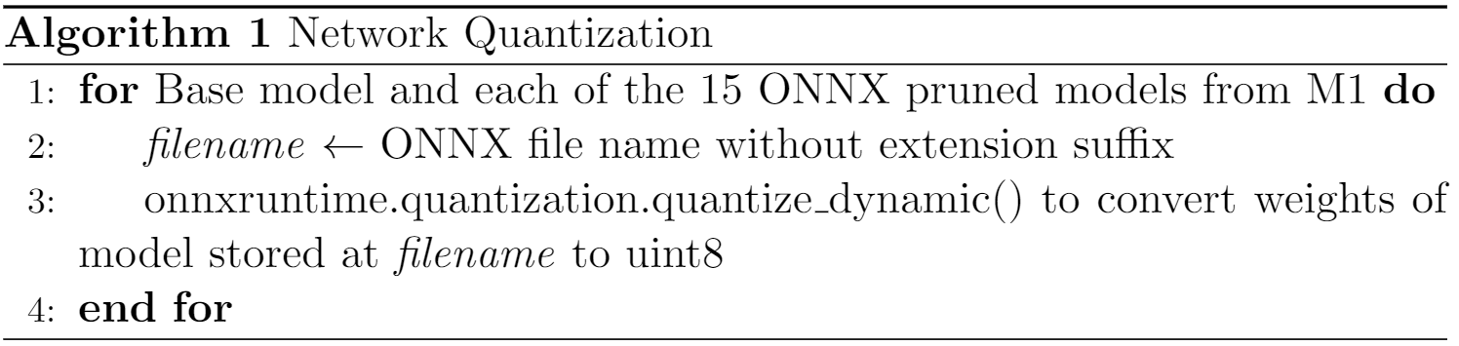
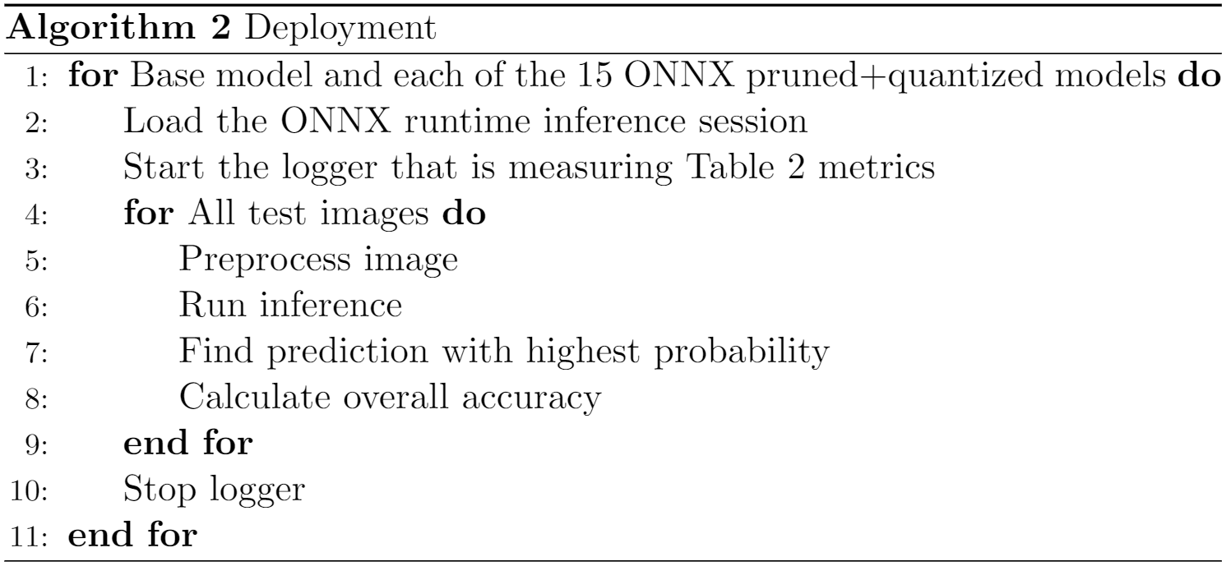
Approach
PyTorch + ONNX
onnxruntime.quantization.quantize_dynamic()
Notes:
Weights quantized, but activations in floating point during inference

Slide 3
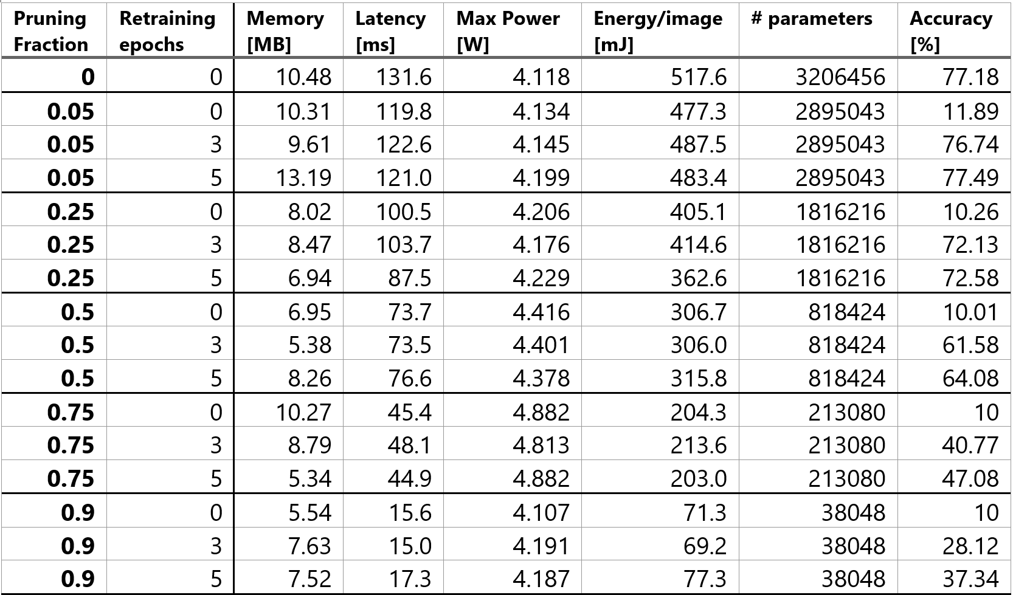
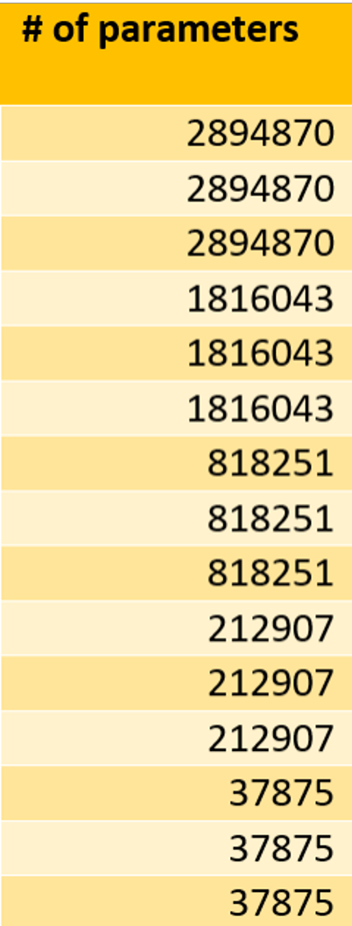
Experimental Results
Without quantization
Notes:
So based on our experiments, we found that all the categories (memory, latency, power usage, energy, # of parameters, and accuracy) followed the same trends as we increased the pruning fraction as in M1.
The memory usage and latency decreased as the pruning fraction increased due to the removal of convolution filters and the energy use per image also decreased due to the reduced number of computations
However (click), with quantization, the number of parameters in each model actually increased compared to the non quantized models since more parameters like the weight cluster centroids need to be stored.

Slide 4
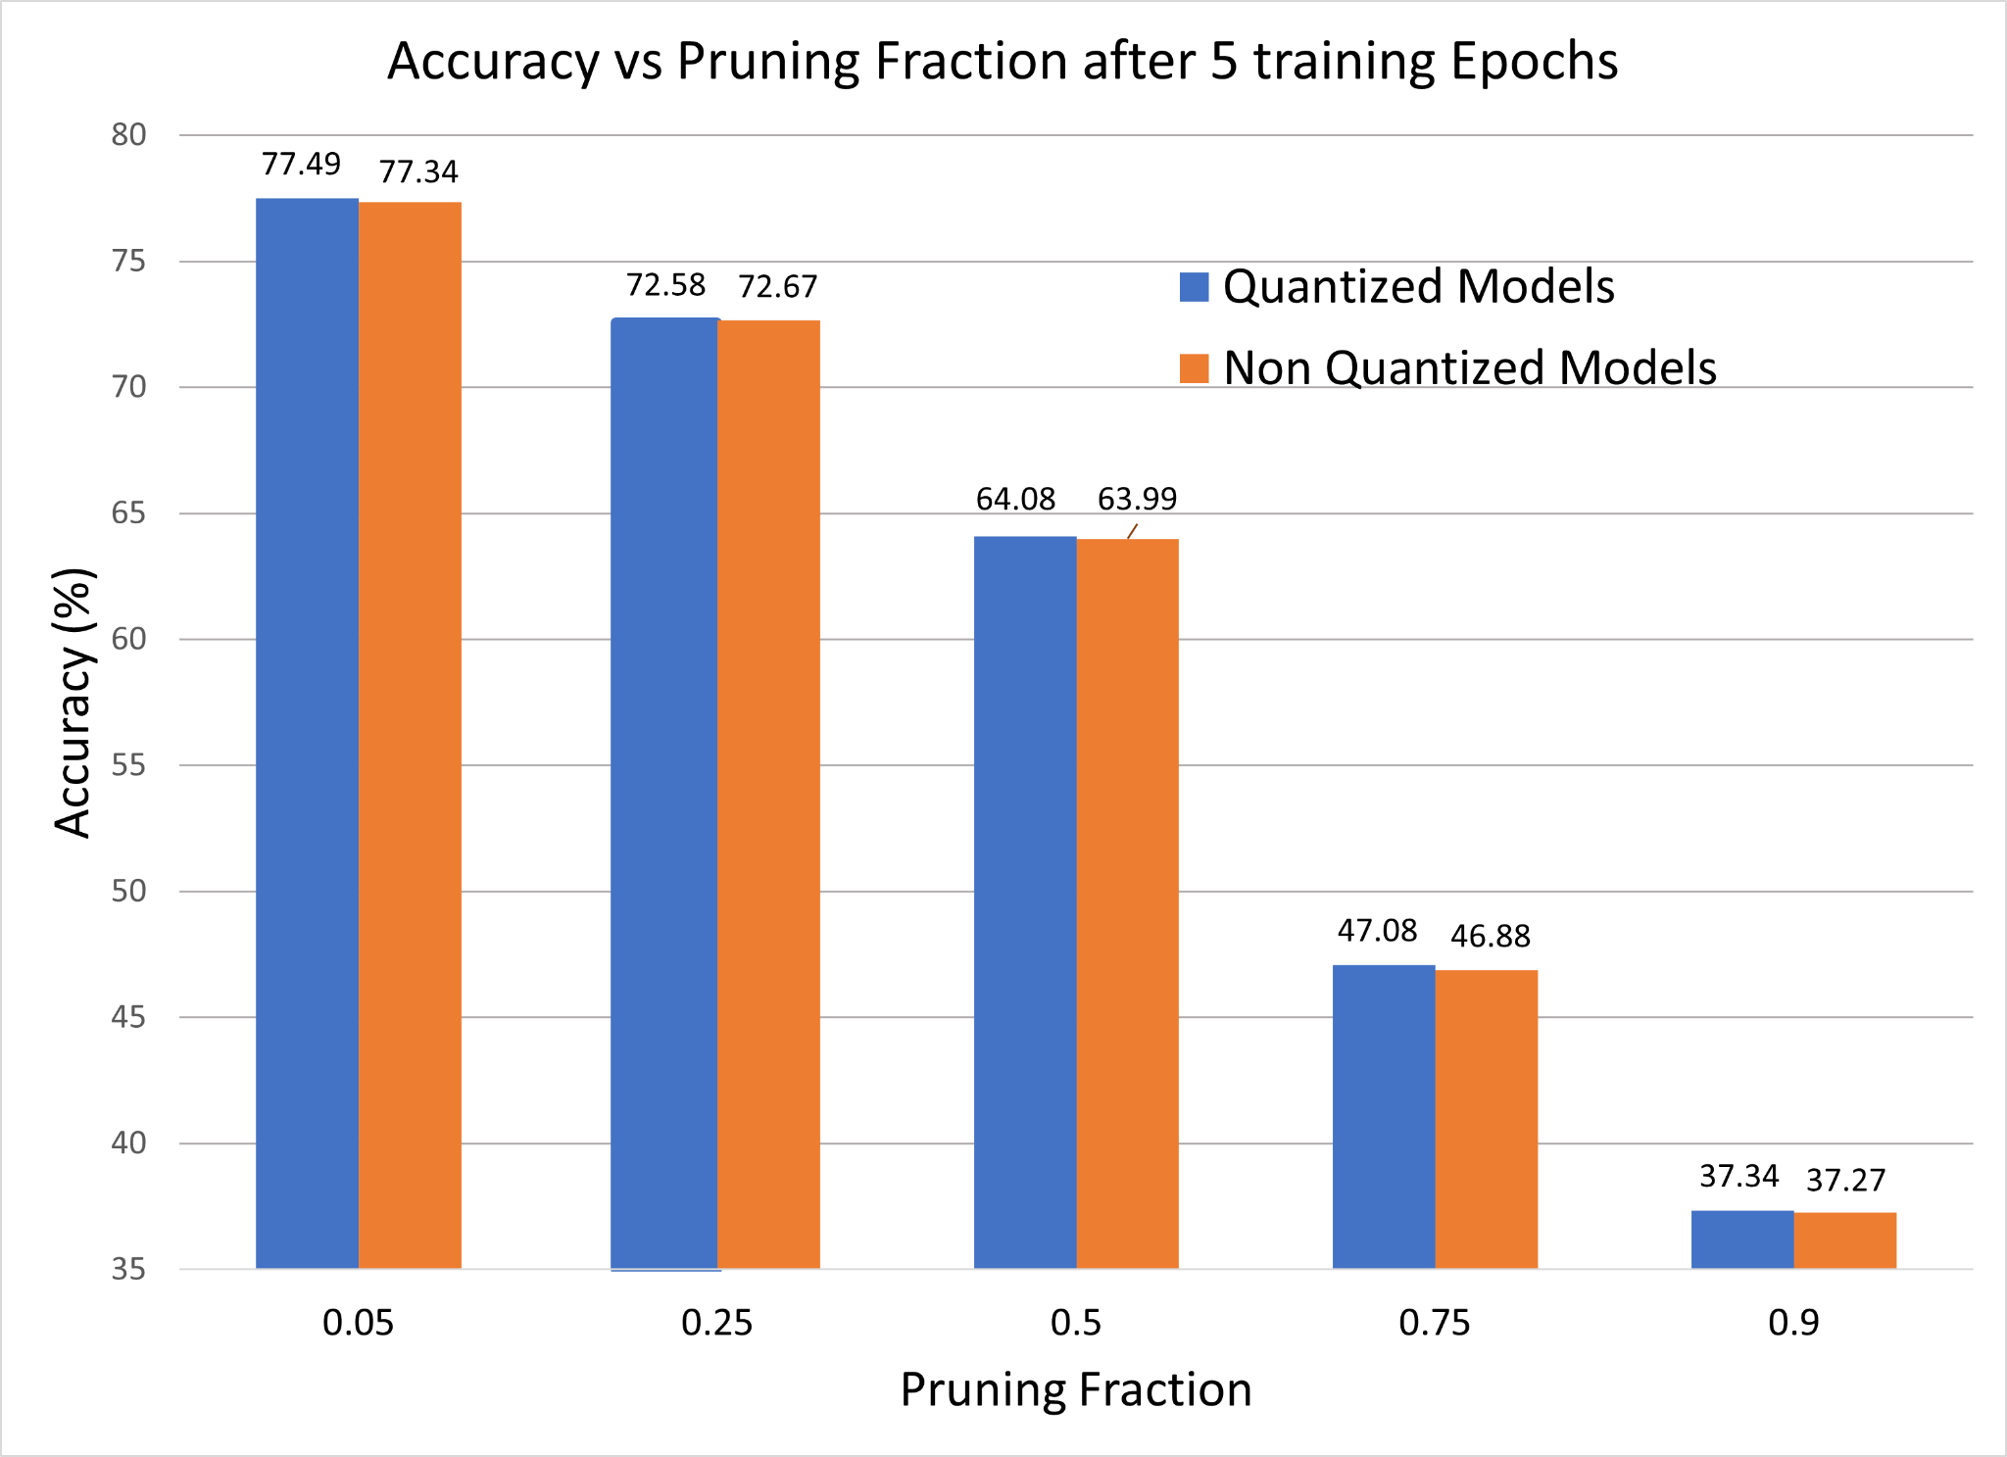
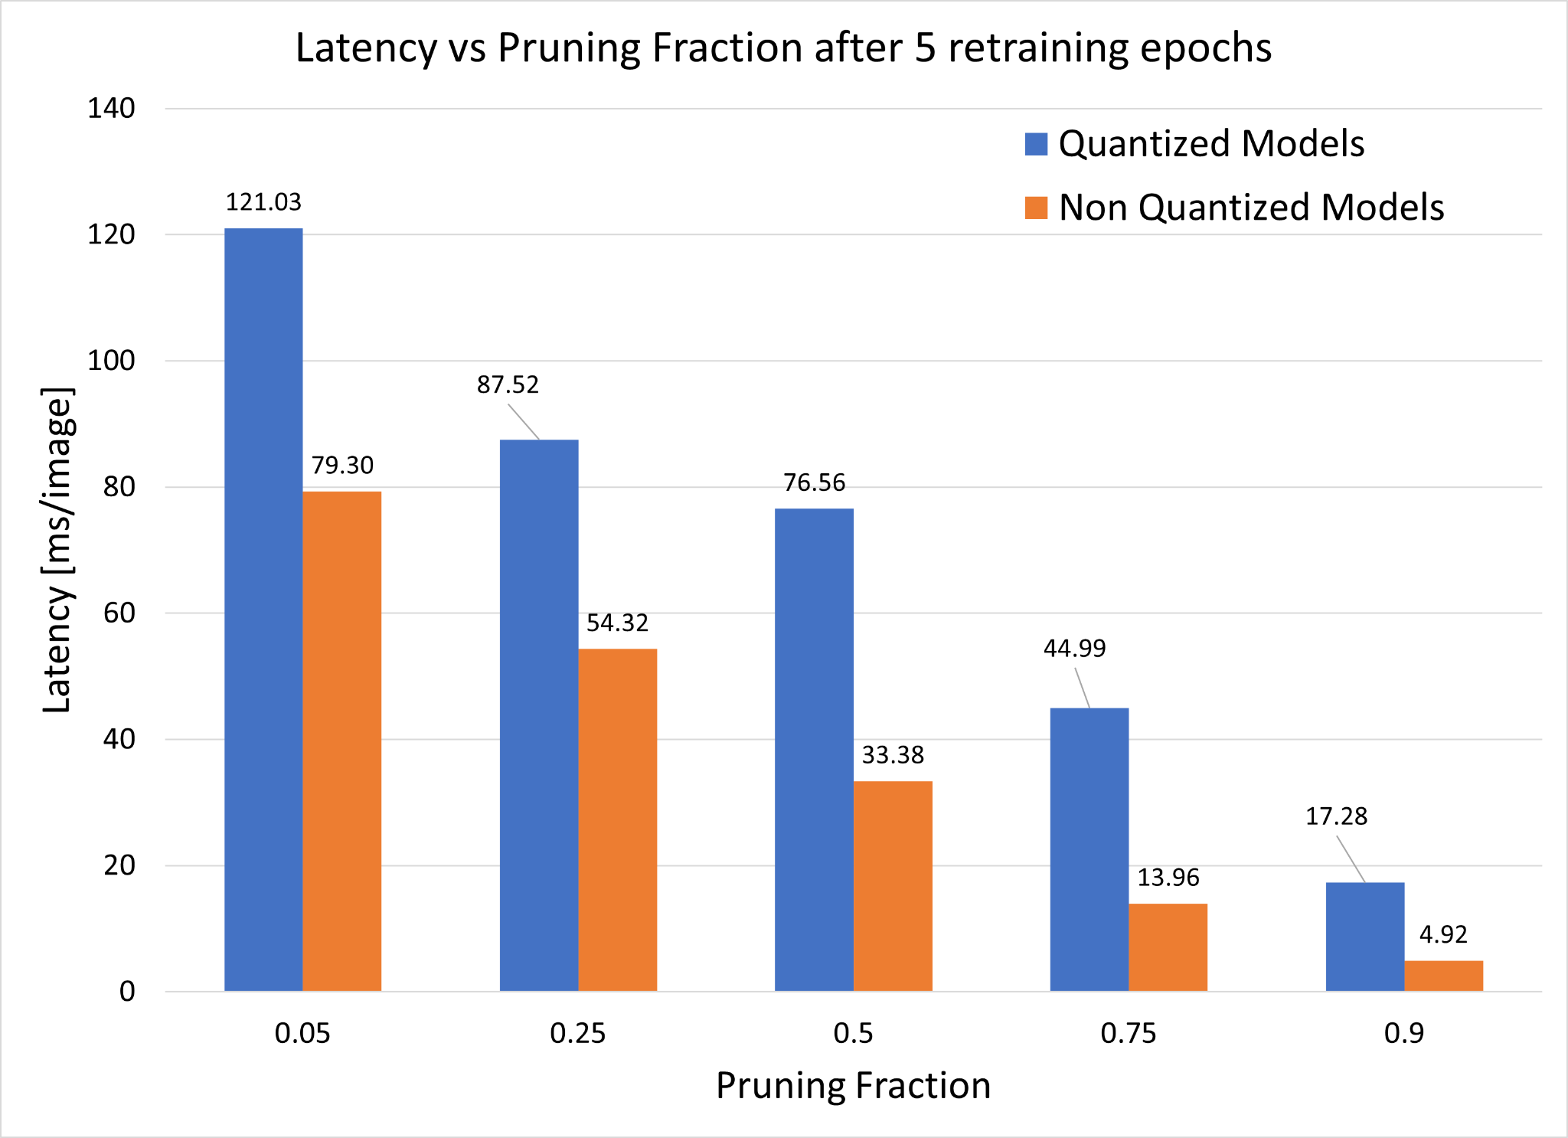
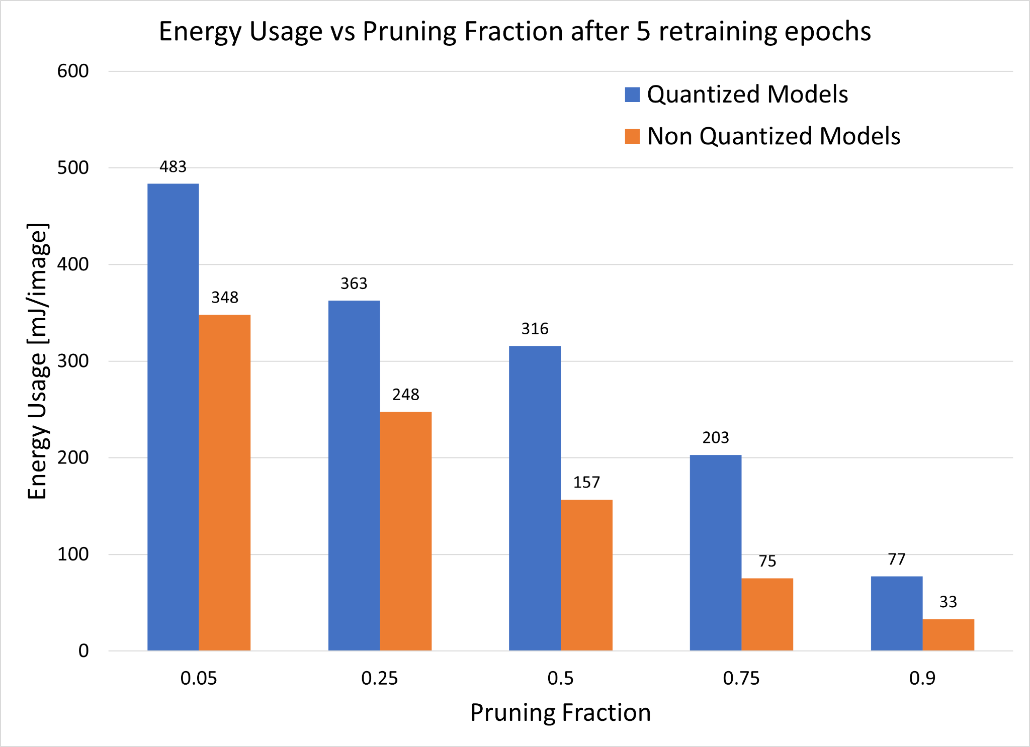
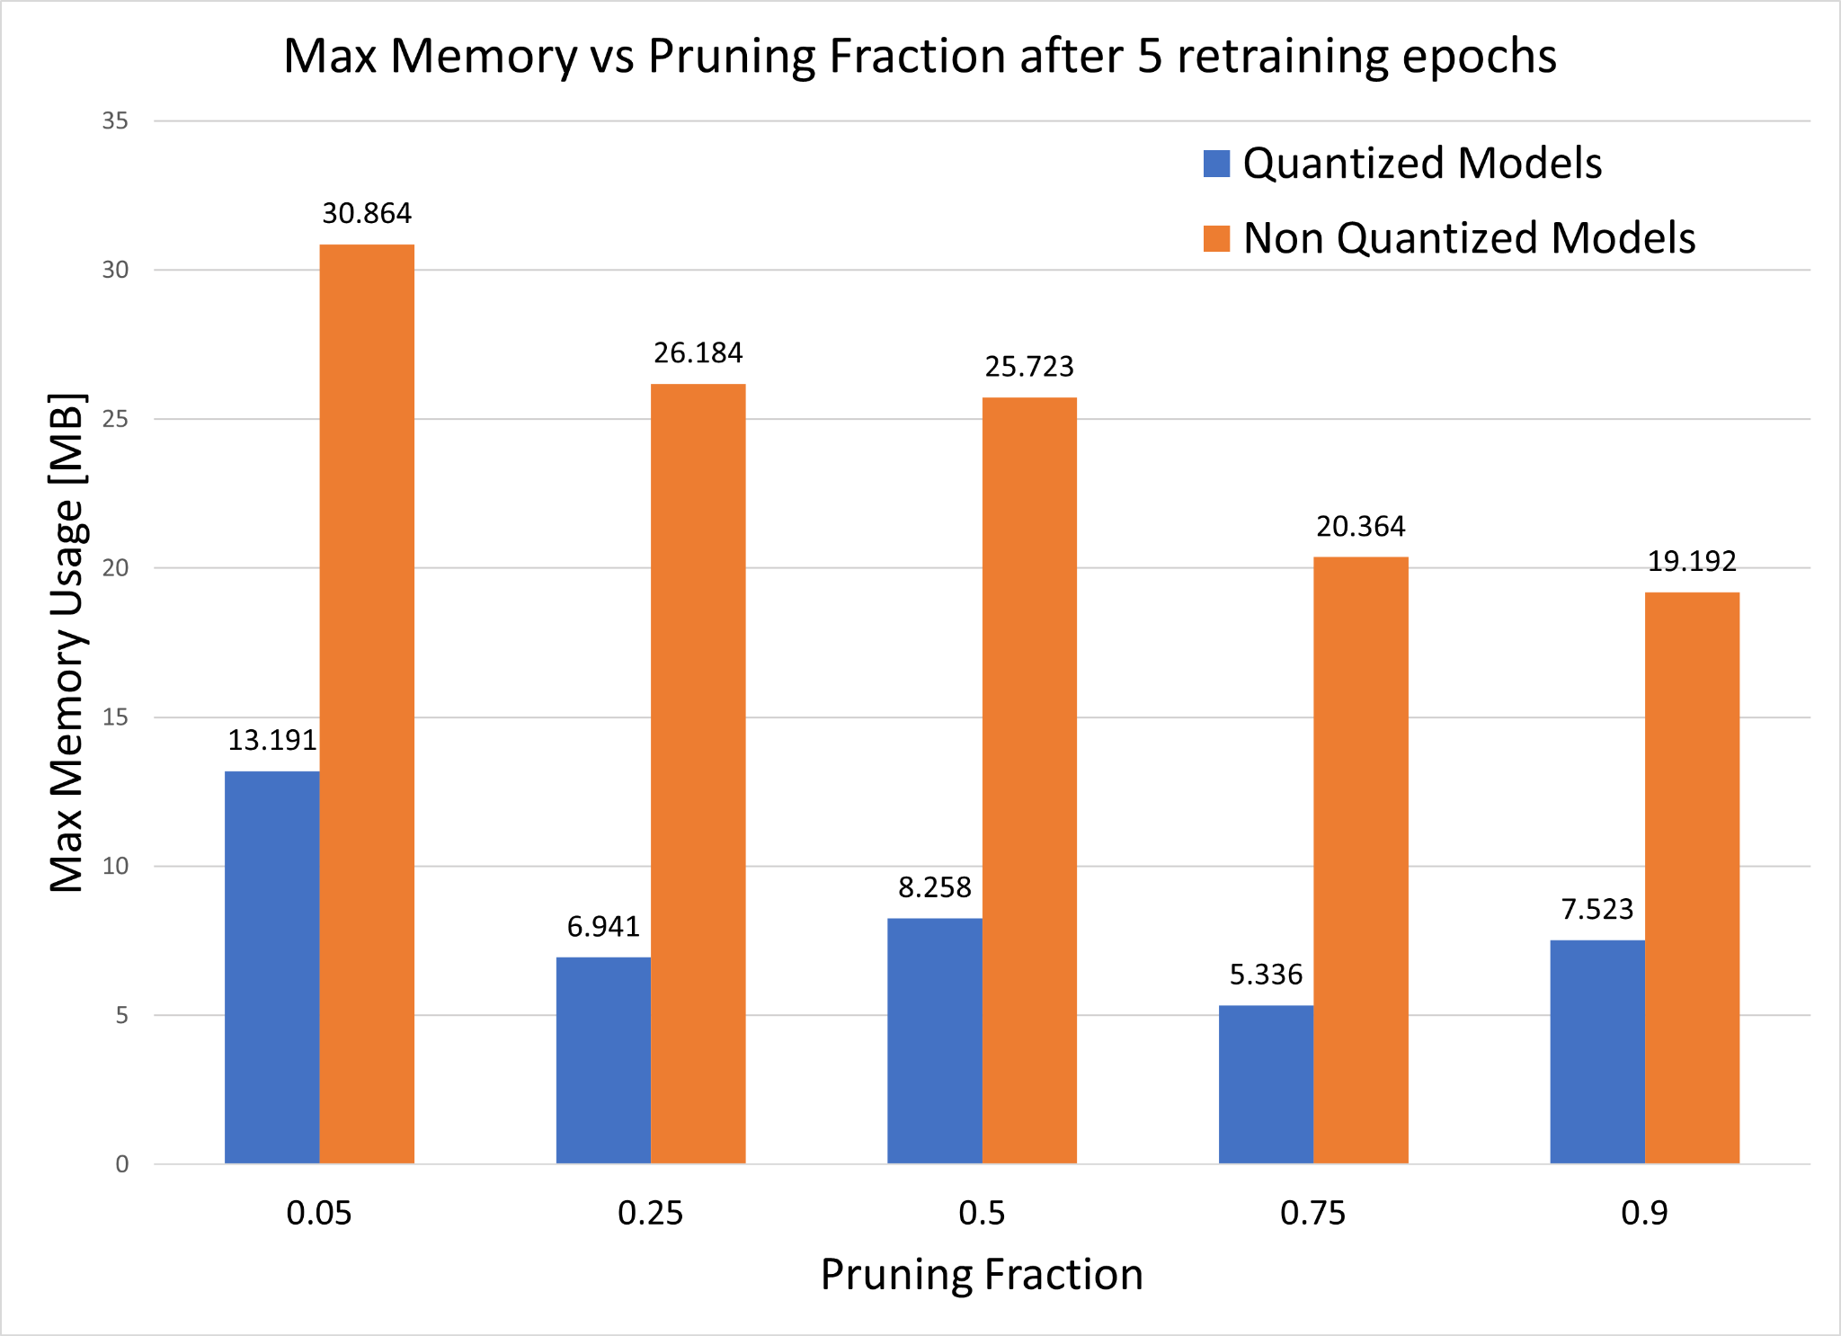
Experimental Results (continued)
Notes:
If we compare the results of the quantized models to the non quantized models, we can see that the accuracies were actually quite similar, and were even slightly higher in the quantized models
We can see that the latency and energy usage was actually higher in the quantized models, and we think this is because the models were dynamically quantized so while the weights are integers, the activations are computed in floating point
Because of this, there are multiple conversion between fp and integer and back which consume energy and introduce latency
However, we can see that the memory consumption was lower for the quantized models as expected because the weights are stored as 8-bit integers instead of 32 bit floating point numbers

Slide 5
Conclusion
Much smaller file size when we did pruning+quantization
Dynamic Quantization vs Static Quantization
Dynamic: Good if execution time dominated by loading weights, not computing GEMMs
✔ Reduce memory consumption
✔ Model accuracy maintained
✘ Energy use and latency overhead
Static: Experiments to be conducted in M3
Notes:
Dynamic: Weights quantized, but activations in floating point during inference →
Static: Weights + activations quantized → good if both memory bandwidth and compute savings are important.
Con is that it requires calibration.

