Slide 1
Large Scale
Classification
Prepared by: Rishabh Patel
(16IT088)
Guided by:
Purvi Prajapati
Hemant Yadav

Slide 2
Outline
Machine Learning
Large Scale Classification
Advantages
Applications
Algorithms and Convergence
Text Classification
Future Goals

Slide 3
Machine Learning
Unsupervised Learning
Supervised Learning
Clustering
Classification
Regression

Slide 4
Large Scale Classification ?
When the number of samples or input values turns out to be plethoric, one needs to incline towards Large Scale Classification.

Slide 5
Advantages
Understands non-linearity in the data and generates a function mapping input to output.
Improves speed and accuracy.
Ensures better profiling of customers to understand their needs.
Helps serve customers better and reduce attrition.

Slide 6
Large Scale
Machine Learning
Existing Algorithms

Slide 7
Large Scale
Machine Learning
Stochastic Gradient Descent

Slide 8
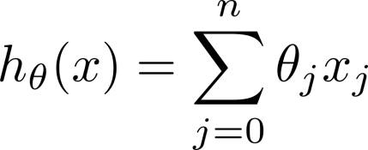
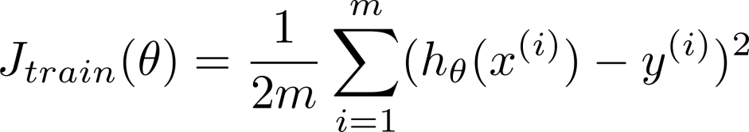
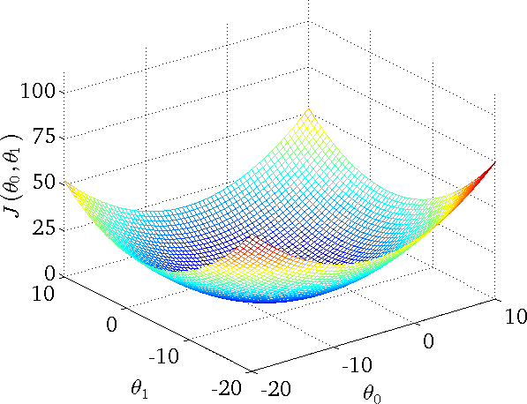
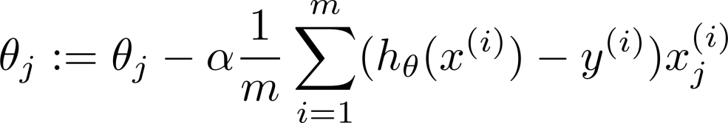

Linear regression with gradient descent
Repeat {
(for every
)
}

Slide 9
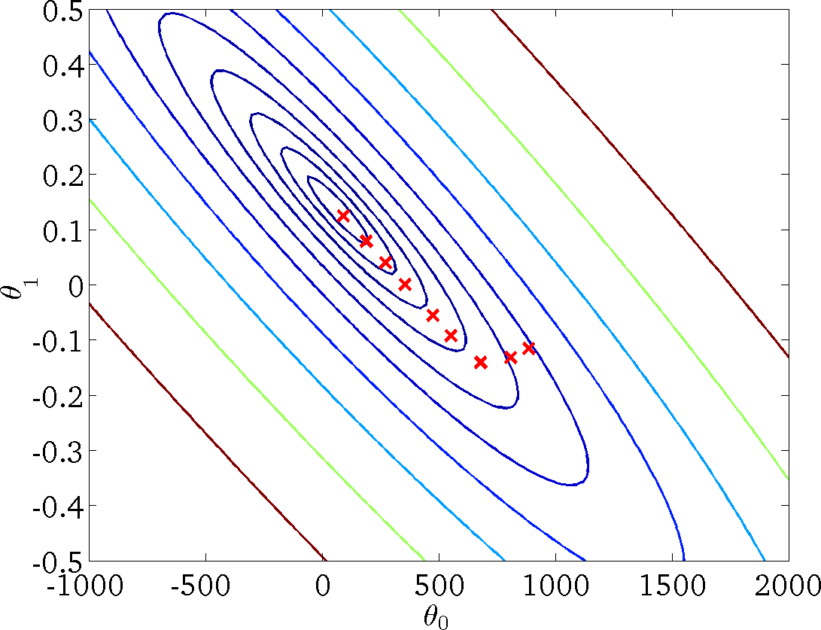

Linear regression with gradient descent
Repeat {
(for every
)
}

Slide 10
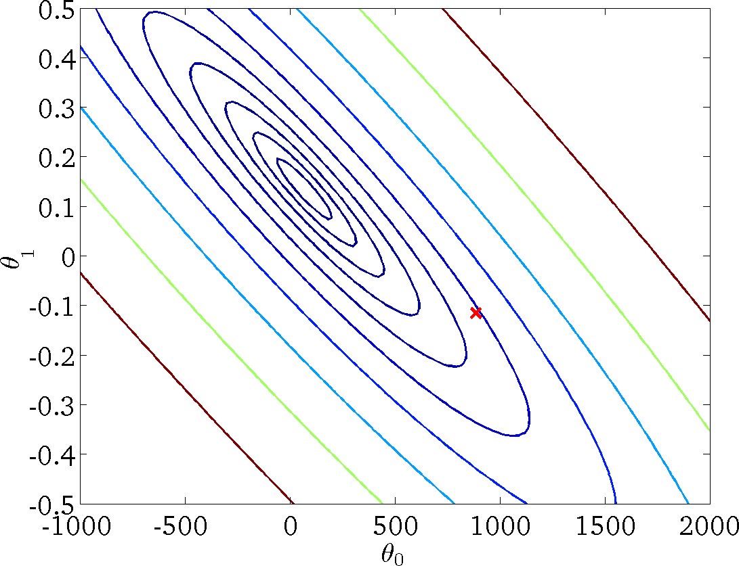
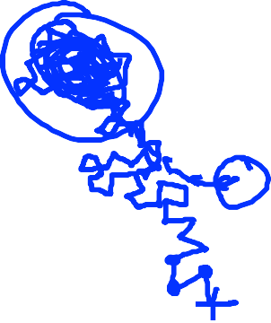


Stochastic Gradient Descent
1. Randomly shuﬄe (reorder) training examples
2. Repeat {
for
{
(for
every
)
}
}
SGD exploits the redundancy in the training data.

Slide 11
Stochastic Gradient Descent
SGD is applicable to many optimization problems including:
• K-means clustering
• Metric learning
• Learning to Rank
• Multiclass Learning
• Structured Learning

Slide 12
Large Scale
Machine Learning
Mini­Batch
Gradient Descent

Slide 13
Batch gradient descent: Use all examples in each iteration Stochastic gradient descent: Use 1 example in each iteration Mini-­‐batch gradient descent: Use examples in each iteration
Mini-Batch Gradient Descent

Slide 14
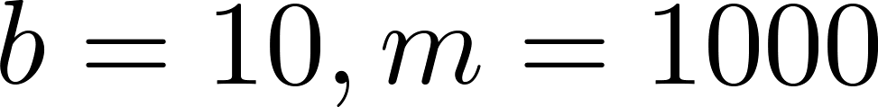
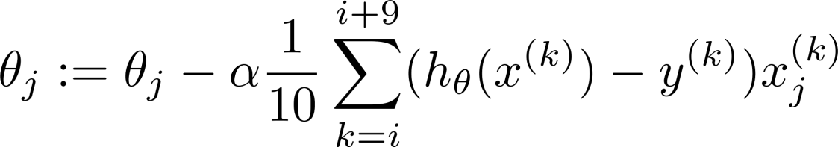

Mini-Batch Gradient Descent
Say Repeat {
for
.
{
(for every
)
}
}

Slide 15
Large Scale
Machine Learning
Stochastic
Gradient Descent
Convergence

Slide 16

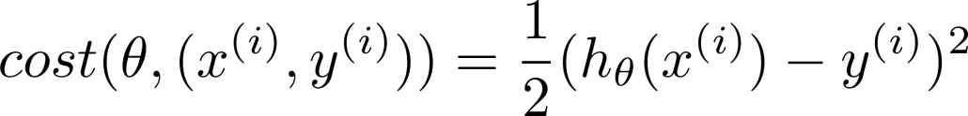


Checking for Convergence
Batch Gradient Descent:
Plot as a function of the number of iterations of gradient descent.
Stochastic Gradient Descent:
During learning, compute using .
before updating
Every 1000 iterations (say), plot averaged over the last 1000 examples processed by algorithm.

Slide 17
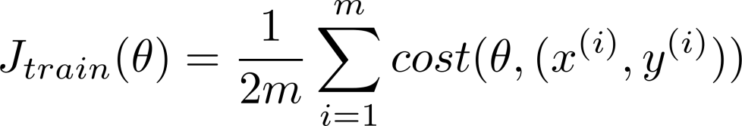
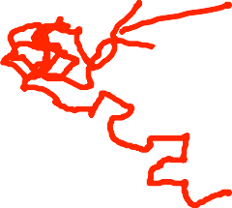



Stochastic Gradient Descent
Randomly shuﬄe dataset.
Repeat {
for {
(for )
}
}
Learning rate
is typically held constant. Can slowly decrease
over time if we want
to converge. (E.g.
const1
iterationNumber + const2
)

Slide 18

Stochastic Gradient Descent
Randomly shuﬄe dataset.
Repeat {
for {
(for )
}
}
Learnin rate
is typically held constant. Can slowly decrease
over time if we want
to converge. (E.g.
const1
iterationNumber + const2
)

Slide 19
BGD vs SGD
Imagine you have 100 training samples and that you copy them 10 times
10x100 = 1,000 training samples
If we do one pass over the data:
BGD: gradient with 100 samples = gradient with 1,000 samples
Computational cost x10 for the exact same result
SGD: better results with the 1,000 samples than with 100 samples
∗SGD exploits the redundancy in the training data

Slide 20
Large Scale
Machine Learning
Online learning

Slide 21



Online Learning
Shipping service website where user comes, speciﬁes origin and destination, you oﬀer to ship their package for some asking price, and users sometimes choose to use your shipping service ( ), sometimes not ( ).
Features capture properties of user, of origin/destination and asking price. We want to learn to optimize price.
`

Slide 22
Other Online Learning Example
Product search (learning to search)
User searches for “Android Phone 1080p camera” Have 100 phones in store. Will return 10 results.
features of phone, how many words in user query match
name of phone, how many words in query match description of phone, etc.
if user clicks on link. otherwise.
Learn .
Use to show user the 10 phones they’re most likely to click on.
Other examples: Choosing special oﬀers to show user; Customized selection of news articles; Product recommendation; etc.

Slide 23
Large Scale
Machine Learning
Map‐Reduce and Data Parallelism

Slide 24
Map - Reduce
Batch gradient descent:
Machine 1: Use
Machine 2: Use
Machine 3: Use
Machine 4: Use

Slide 25

Map-­ R educe
Computer 1
Training set
Computer 2
Combine results
Computer 3
Computer 4

Slide 26
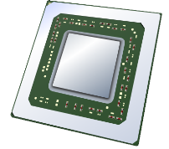
Multi ‐ Core Machines
Core 1
Training set
Core 2
Combine results
Core 3
Core 4

Slide 27
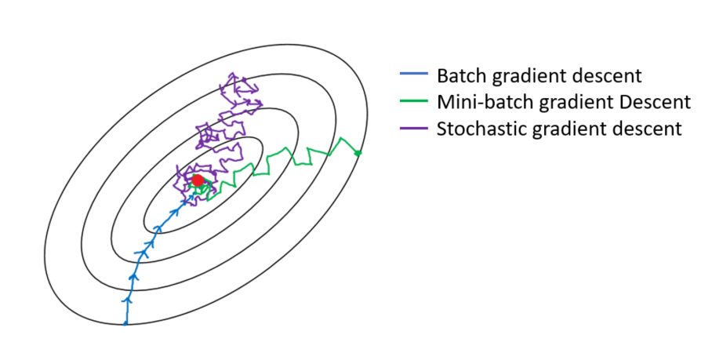
Relative Representation of Convergence

Slide 28
Future Goals
Plotting and Graphical comparison of Algorithms’ output over various datasets and analyse them.
Algorithm Improval that may rapidise convergence to global minimum for Stochastic and Mini-Batch Gradient Descent.
Research Paper after ample analysis.

Slide 29
THANK YOU !

