Slide 1

QWHO2502504
QUANTITATIVE ABILITY WORKSHOP HANDOUT
(Geometry and Mensuration, Data Interpretation)

Slide 2
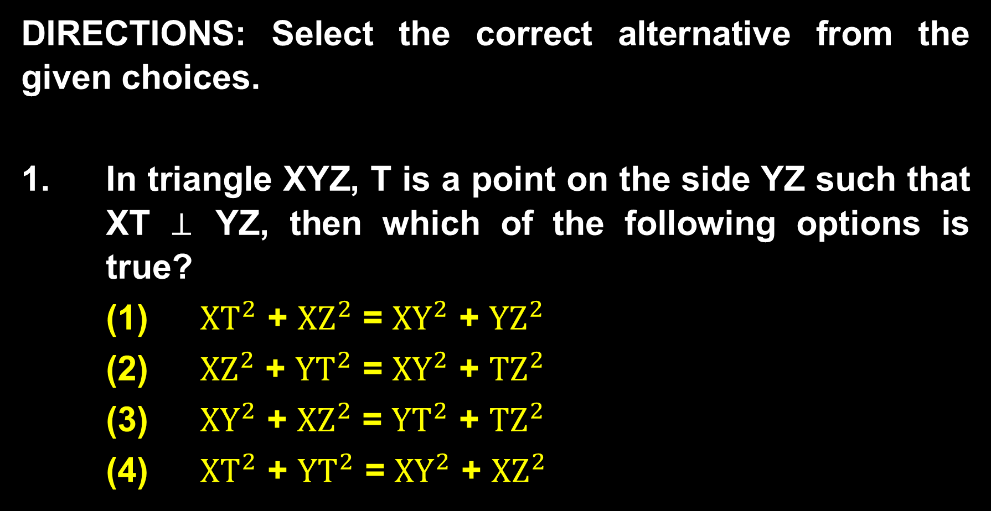

Slide 3
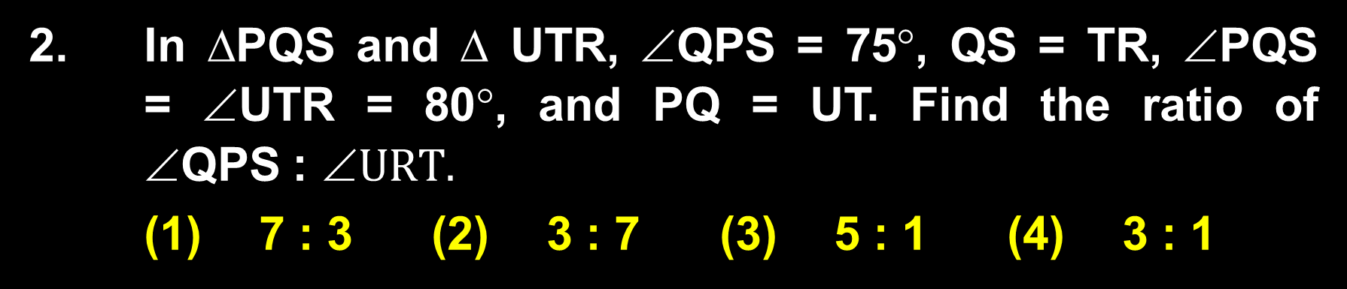

Slide 4
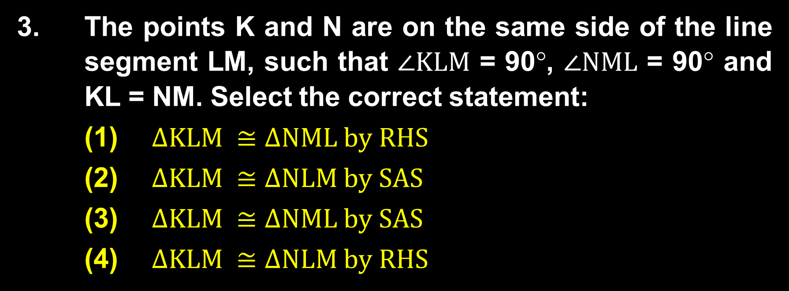

Slide 5


Slide 6
5. Line L cuts two concentric circles. The length of chords formed by this line on the circles is 8 cm and 20 cm. Find the difference in the squares of the radii of two circles.
(1) 84 cm (2) 78 cm (3) 72 cm (4) 64 cm

Slide 7
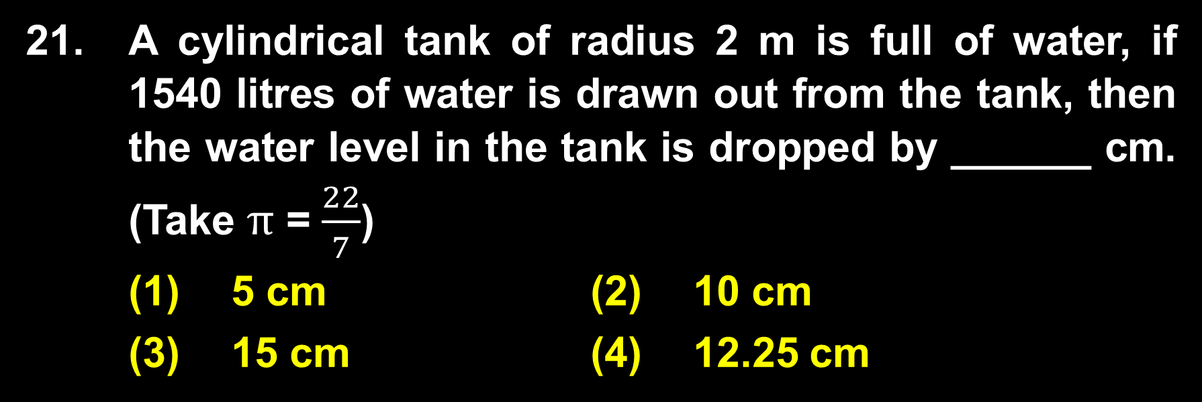

Slide 8
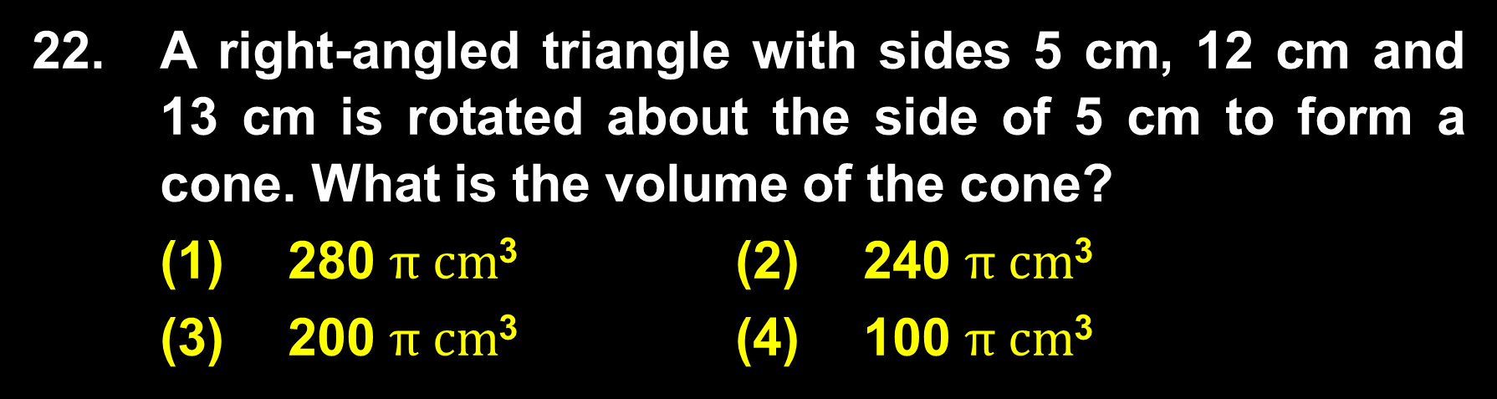

Slide 9
23. Study the table below carefully to answer the question that follows. The table shows the percentage of the population above the poverty line in four towns, along with the ratio of males and females.
Town | Percentage of the population above the poverty line | Ratio of males to females
 |  | Below poverty line | Above poverty line
 |  | M : F | M : F
A | 14% | 2 : 3 | 2 : 5
B | 20% | 4 : 7 | 5 : 7
C | 12% | 4 : 5 | 3 : 10
D | 16% | 2 : 7 | 8 : 5
Continued

Slide 10
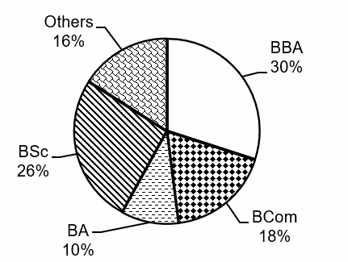
25. Study the pie chart and the table given below carefully to answer the question that follows. The pie chart shows the percentage-wise distribution of a total of 15000 students studying six different UG courses in a university. The table shows the ratio of male to female students in each of the UG courses.
Continued

Slide 11
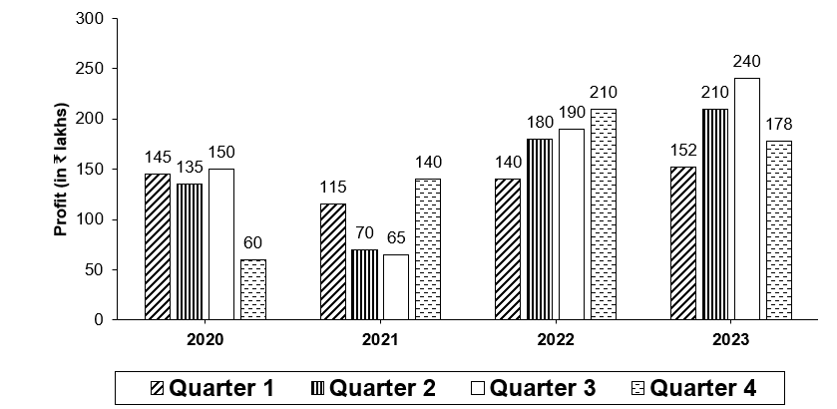
26. Study the bar graph below carefully to answer the question that follows. The bar graph shows the profit of Company ABC in the four quarters for each of the years from 2020 to 2023.
Continued

Slide 12


Take the next step towards your dream with

