Slide 1
ENERGY SYSTEM ANALYTICS (EE 1331) | TERM PAPER PROJECT 15
Machine Learning-Based Transmission Line Fault Type Classification for Intelligent Power System Protection
0.302 ms
Average inference latency per sample
618 × 24
High-Accuracy Multiclass SVM Classification & Sub-Cycle Digital Relay Prototype Module
Samples × voltage and current channels
Student Team: Rishabh Raturi (24EEB0A55) | Simhadri Yateesh Sai (24EEB0A59)
Faculty Guide: Prof. Debasmita Panda
Department: Electrical & Electronics Engineering, 5th Sem 2026–2027

Slide 2
Problem Context & Project Objectives
70–80%
15%
10%
5%
Single Line-to-Ground (LG)
Line-to-Line (LL)
Double Line-to-Ground (LLG)
Three-Phase (LLL)
1
Background & Limitations of Relaying
2
Project Goals & Proposed Approach
Transmission lines are vulnerable to weather, lightning, and insulation failure.
Conventional Distance Relays: Rely on fixed impedance reach zones (mho / quadrilateral) on the R-X plane.
Key Challenges: High fault resistance causes under-reach, power swings trigger false trips, and manual setting updates are required on topology changes.
Dataset Ingestion: 110 kV network simulated via DIgSILENT PowerFactory (IEC 60909 fault sweep & load flow).
Pattern Recognition: SVMs classify disturbances directly from 24 voltage and current channels.
Selective Tripping: Single-pole tripping for LG faults preserves transient stability; 3-pole tripping for multiphase faults.
Prototype Module: Standalone Python module with verified sub-cycle latency (< 20 ms) for real-time relay deployment.

Slide 3
System Architecture & Algorithmic Workflow
1
2
3
4
5
6
Raw Dataset
Cleaning
Scaling
Split
SVM Tuning
Evaluation
01
02
03
04
Data Ingestion & Audit
Deduplication & Prep
Scaling & Split
SVM Tuning & Relay Trip
618 samples × 24 sensors (9 voltages in kV, 15 currents in kA). 0 nulls in measurements.
Pruned 73 static load-flow duplicates. Kept high current spikes as physical fault signatures.
StandardScaler (mean 0, var 1) fit on train only. Stratified 70/15/15 train/val/test split.
5-fold Stratified CV for kernel, C, and gamma. Sub-cycle inference triggers selective tripping.

Slide 4
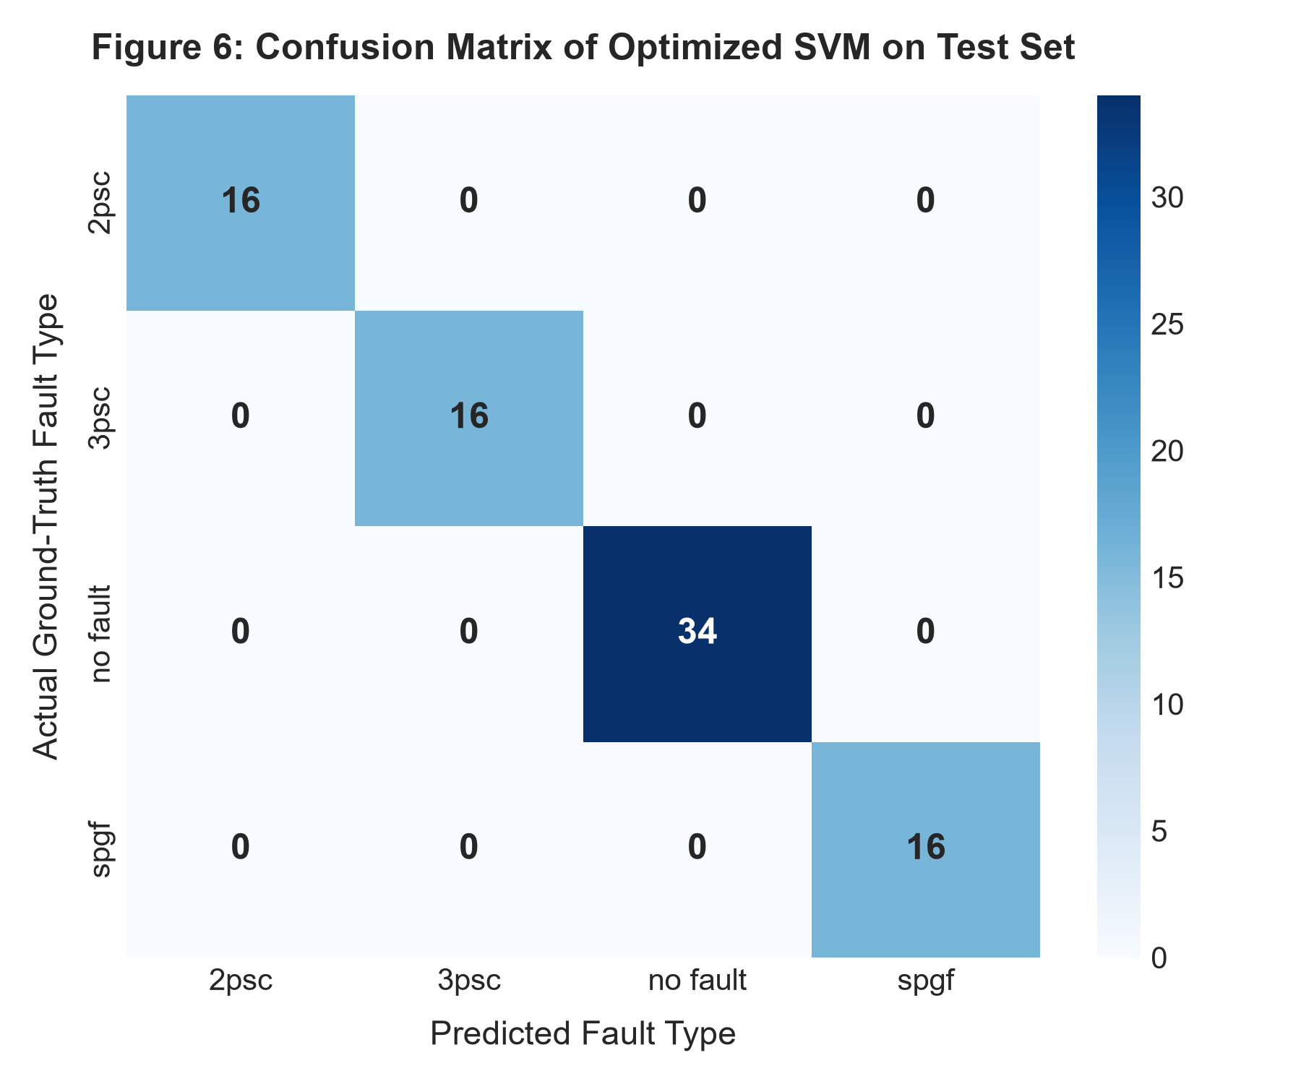
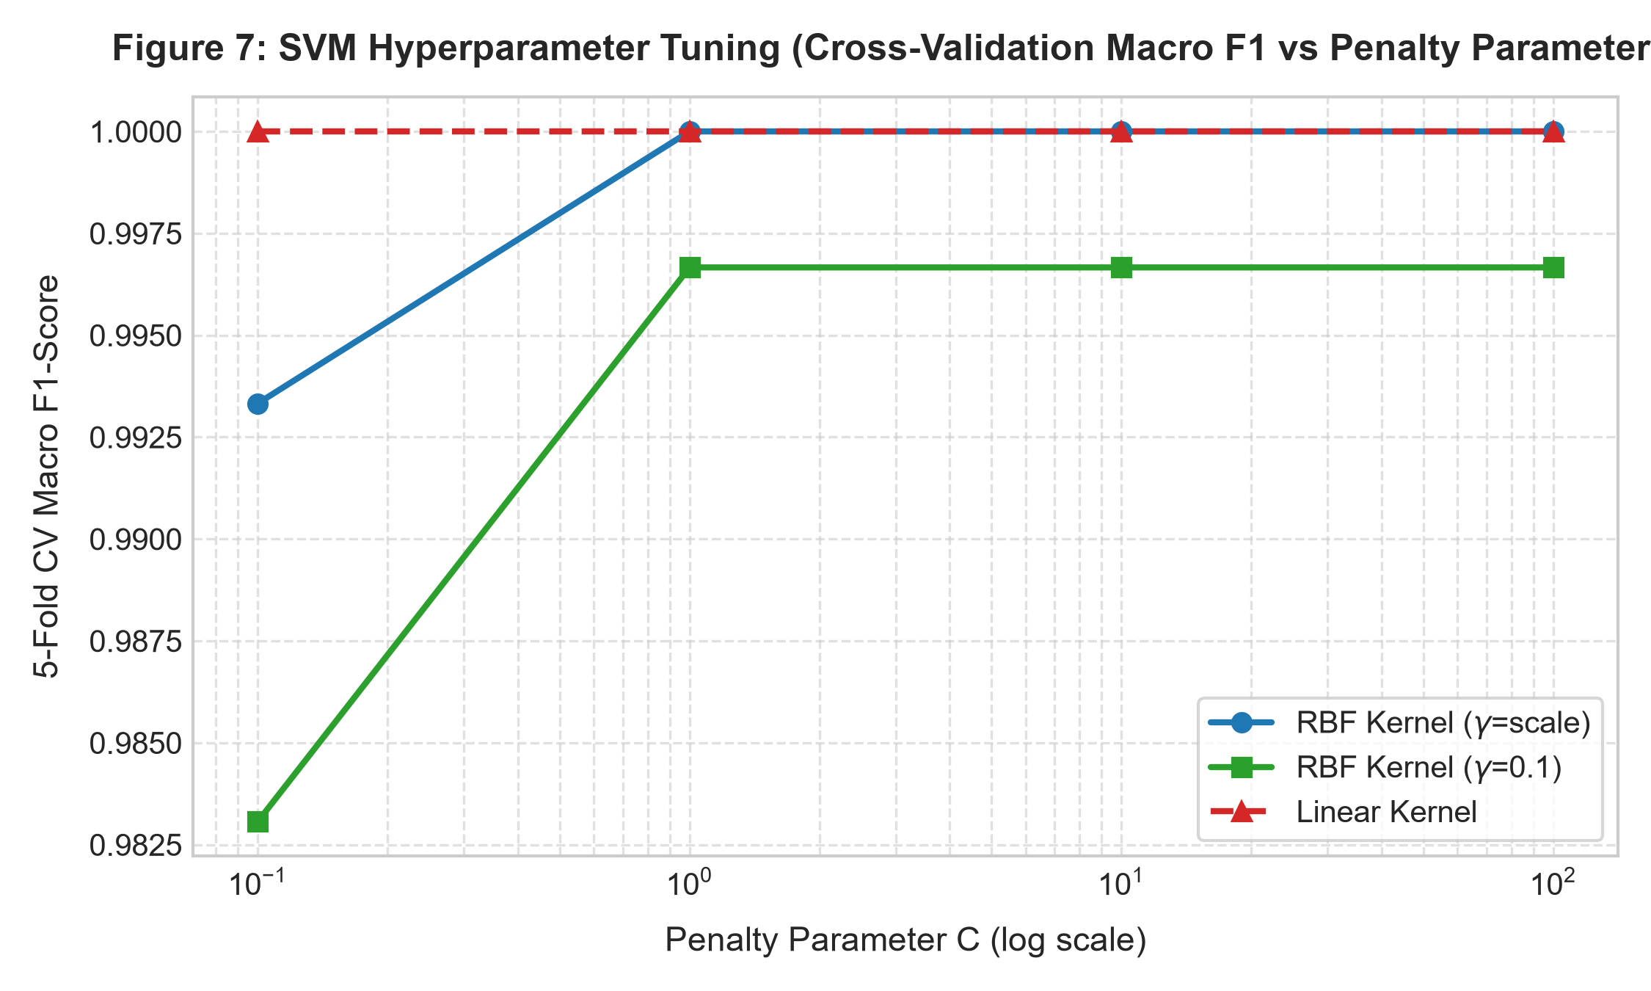
Experimental Results & Model Evaluation
Confusion Matrix (Optimized SVM, Test Set)
SVM Hyperparameter Tuning (CV Macro F1 vs C)
100.00%
100% / 100%
Convex
Test accuracy on all 82 held-out samples (16 2PSC, 16 3PSC, 34 no fault, 16 SPGF), zero errors
Random Forest and K-Nearest Neighbors baselines confirm strong class separability
SVM advantage: lowest computational overhead, low overfitting risk, global optimum guarantee

Slide 5

MODEL INFERENCE ENGINE & RELAY LOGIC
How the Protection Model Works, Step by Step
1
Input & normalization
2
SVM decision engine
3
Relay action logic
Sensor vector: 24 measurements (9 PT voltages Ua1–Uc3 in kV, 15 CT currents Ia1–Ic5 in kA).
Z-score: zⱼ = (xⱼ − μⱼ) / σⱼ using saved training parameters.
Why: Stops high voltages (~63.5 kV) from overpowering small currents (~0.2 kA).
Hyperplane: f(z) = sign(wᵀz + b).
OvO voting: 6 pairwise classifiers across 4 classes (2psc, 3psc, no fault, spgf).
Calibration: Platt scaling gives 98.3%–99.9% confidence.
Boundary: Separates zero-sequence (spgf), negative-sequence (2psc) and symmetric sag (3psc).
no fault: Keep breakers CLOSED; power transfer continues.
spgf: SINGLE-POLE TRIP on faulted phase only; auto-reclose keeps the 2 healthy phases in synchronism.
2psc / 3psc: THREE-POLE TRIP & LOCKOUT immediately to isolate high-energy short circuits.
0.302 ms
per prediction · 1,000 runs
At 50 Hz, over 98% of the cycle remains for DFT phasor calculation and physical breaker travel.
1.51% of one 20 ms cycle
ESA Term Paper | Project 15 | Fault Classification
6

