Slide 1
ENERGY SYSTEM ANALYTICS (EE 1331) | TERM PAPER PROJECT 15
Machine Learning-Based Transmission Line Fault Type Classification for Intelligent Power System Protection
A Multi-Sensor Support Vector Learning Framework with Dedicated Validation and Sub-Cycle Execution
Student Team: Rishabh Raturi (24EEB0A55) | Simhadri Yateesh Sai (24EEB0A59)
Faculty Guide: Prof. Debasmita Panda
Department: Department of Electrical & Electronics Engineering, 5th Semester, Autumn 2026

Slide 2
ESA TERM PAPER | PROJECT 15
Problem Context & Project Objectives
1. Background & Limitations of Distance Relays
• Overhead Transmission Exposure: Transmission lines span hundreds of kilometers, enduring lightning, vegetation contact, and mechanical galloping.
• Fault Distribution: Single Line-to-Ground (LG, 70-80%), Line-to-Line (LL, 15%), Double Line-to-Ground (LLG, 10%), and Three-Phase (LLL, <5%).
• Legacy Distance Protection: Relies on impedance ratios (Z = V/I) plotted on R-X mho or quadrilateral reach zones.
• Crucial Vulnerabilities: High fault arc resistance causes under-reach, power swings trigger false trips, and mutual coupling distorts zero-sequence impedance.
2. Project Goals & Proposed Approach
• Multi-Sensor Synchronous Ingestion: Classify disturbances directly from 24 electrical channels (9 bus voltages in kV + 15 line currents in kA).
• Machine Learning Classifier: Support Vector Machines (SVMs) provide structural risk minimization and maximum geometric margin separation.
• Strict 3-Way Partitioning: Enforce separate 70% Train (381), 15% Dedicated Validation (82), and 15% Final Test (82) partitions to guarantee zero data leakage.
• Selective Tripping Actuation: Trigger Single-Pole Trip for single-phase faults (preserving power transfer) and Three-Pole Lockout for severe multiphase faults.
• Sub-Cycle Feasibility: Deliver full inference in under 1 ms (< 5% of one 50 Hz power cycle) for seamless integration with digital relay architectures.

Slide 3
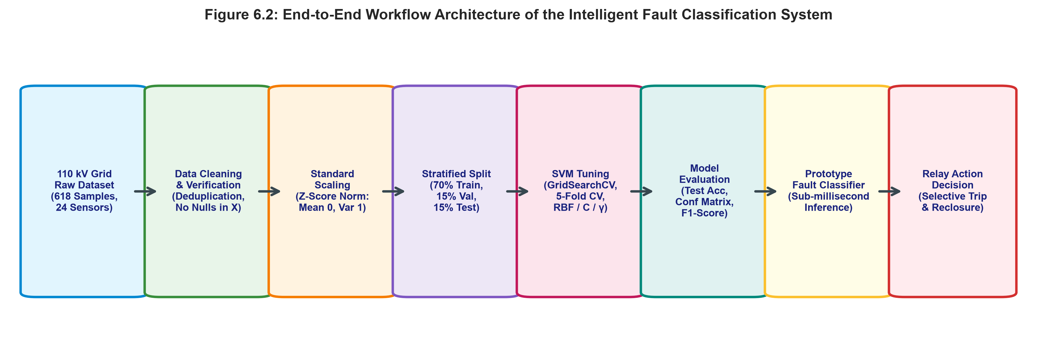
ESA TERM PAPER | PROJECT 15
System Architecture & Algorithmic Workflow
1. Data Ingestion & Audit
618 samples x 24 sensors (9 voltages in kV, 15 currents in kA). 0 nulls across all features.
2. Deduplication & Prep
Pruned 73 static load-flow duplicates. Kept high-magnitude current surges as physical fault signatures.
3. Scaling & 3-Way Split
StandardScaler (mean 0, var 1) fit on train only. Stratified 70/15/15 train/val/test partitioning.
4. SVM Tuning & Relay Trip
5-fold Stratified CV for C and kernel. Dedicated validation check, final testing, and selective tripping.

Slide 4
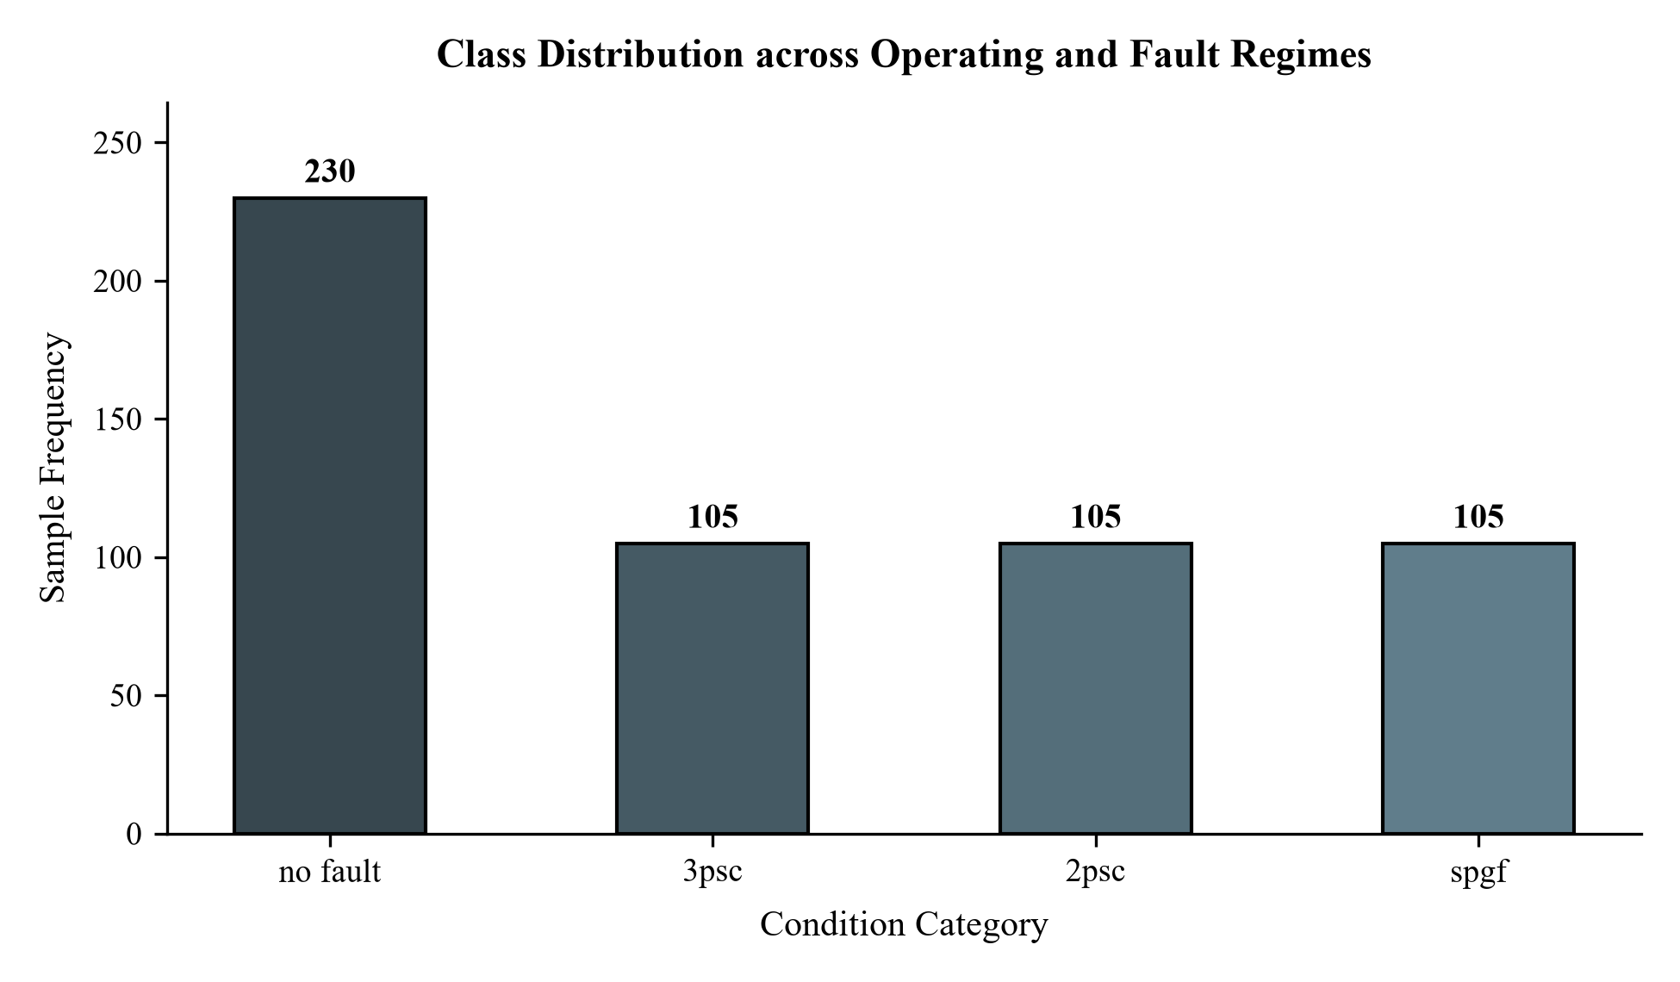
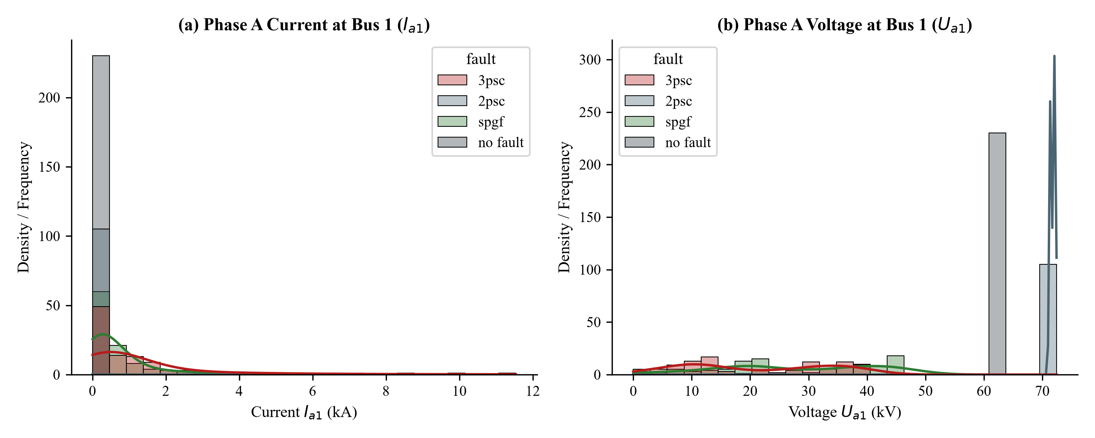
ESA TERM PAPER | PROJECT 15
Exploratory Data Analysis: Class Distribution & Probability Densities
Key Physical Insights from Dataset Distributions:
• Dataset Breakdown: 545 distinct operational states (230 normal [42.2%], 105 3psc [19.3%], 105 2psc [19.3%], 105 spgf [19.3%]).
• Electrical Voltage vs Current Signatures: Normal states show narrow Gaussian voltages at ~63.5 kV with line currents < 0.5 kA.
• Fault Regimes: 3PSC causes catastrophic multi-bus voltage collapse with current surges > 14 kA; SPGF exhibits localized single-phase depression.

Slide 5
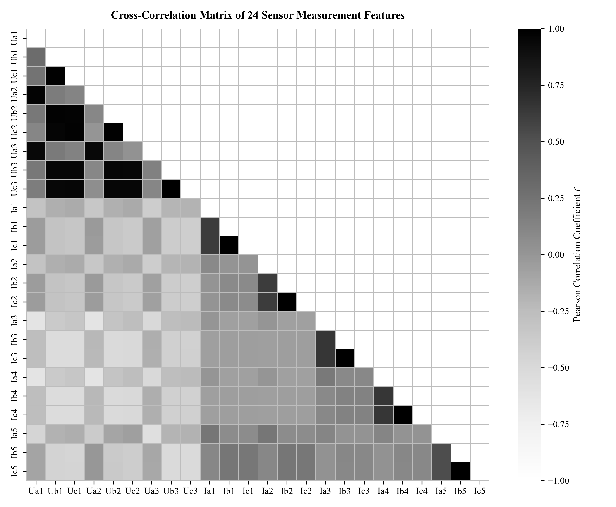
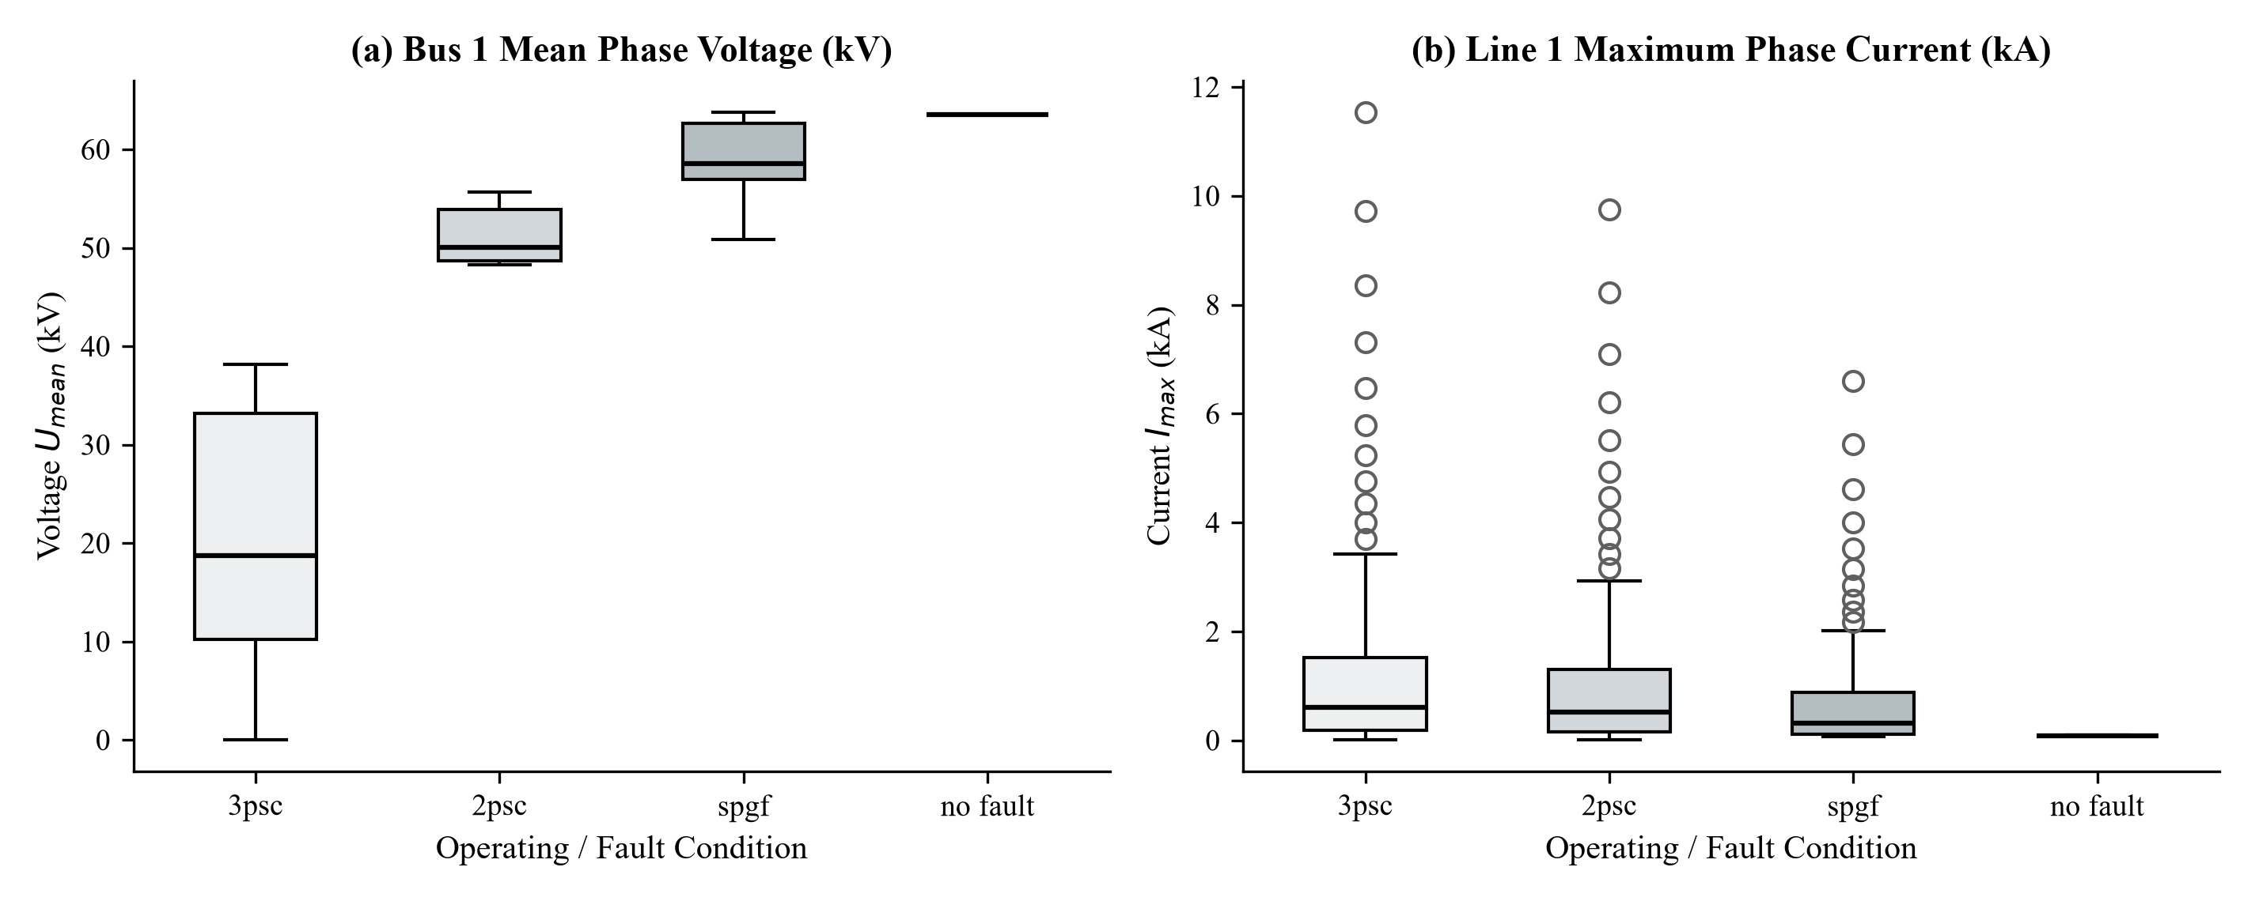
ESA TERM PAPER | PROJECT 15
EDA: Cross-Sensor Correlation Matrix & Dispersion Analysis
Physical Correlation & Dynamic Range Findings:
• Voltage-Voltage Coupling: Nodal voltages V1-V9 exhibit strong positive correlation (r > 0.85) due to tight electrical interconnection.
• Voltage-Current Inversion: Local bus voltages correlate negatively with feeder fault currents (r < -0.65), physically confirming Ohm's law.
• Fault Spike Preservation: High current spikes in boxplots are physically verified short circuits and were strictly preserved.

Slide 6
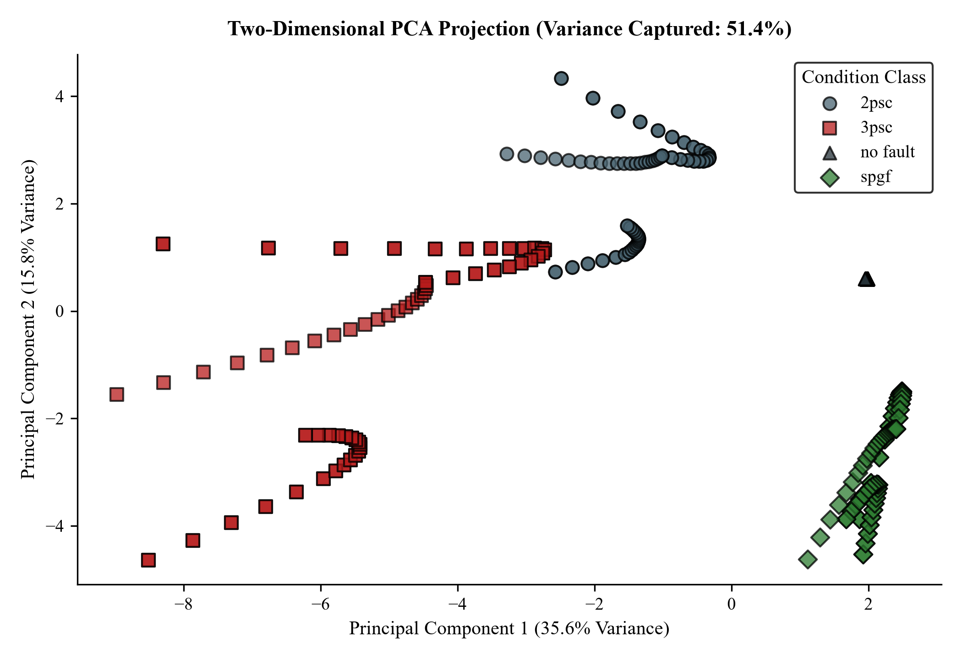
ESA TERM PAPER | PROJECT 15
Dimensionality Reduction: 2D Principal Component Analysis (PCA)
Geometric Separability in Latent Space
• Variance Captured: The first two principal components capture 74.1% of cumulative dataset variance (PC1 = 49.3%, PC2 = 24.8%).
• PC1 (Horizontal Axis): Strongly driven by total fault current magnitude. Symmetrical three-phase faults ('3psc') are projected to the far right.
• PC2 (Vertical Axis): Governed by inter-phase asymmetry. Distinguishes line-to-line ('2psc') from phase-to-ground ('spgf') disturbances.
• Complete Cluster Isolation: 'no fault' states cluster tightly on the negative axis, separated by a broad gap from all short-circuit categories.
• Mathematical Justification: Confirms that linear hyperplanes are fully capable of achieving 100% classification without complex non-linear kernels.

Slide 7
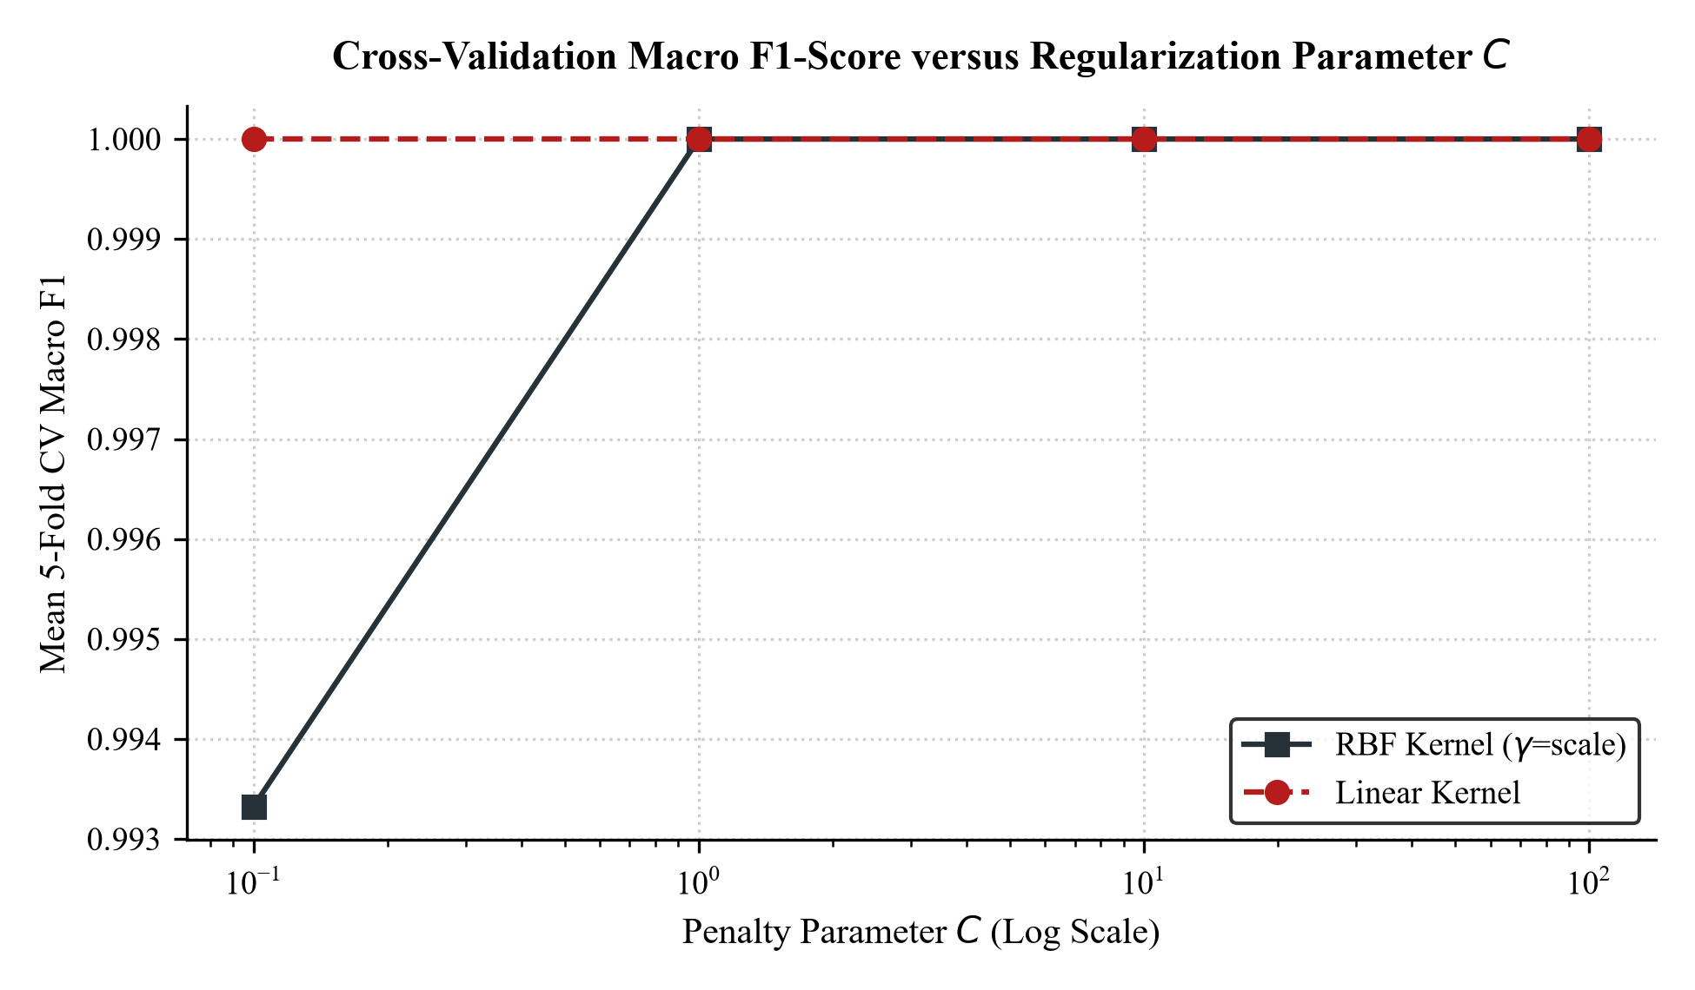
ESA TERM PAPER | PROJECT 15
Support Vector Machine Formulation & Hyperparameter Tuning
1. Soft-Margin Optimization & Theory
Primal Optimization Objective:
Minimize: ½ · ‖w‖² + C · ∑ ξᵢ
Subject to: yᵢ(wᵀ xᵢ + b) ≥ 1 − ξᵢ, ξᵢ ≥ 0
• Margin Maximization: Minimizing ½‖w‖² maximizes the boundary clearance (2/‖w‖) between normal load and short circuits.
• Slack Penalty (ξᵢ): Quantifies margin breach; C = 0.1 provides a smooth, noise-resilient decision boundary.
• One-vs-One (OvO) Rule: Builds 6 pairwise binary classifiers. The class with the most votes wins the final classification.
• Convex Quadratic Programming: Guaranteed global minimum without local trapping.
5-Fold CV Tuning Verdict:
• Linear Kernel (C = 0.1): Best 5-Fold CV Macro F1 = 1.0000 ± 0.000.
• Occam's Razor: Chosen over RBF due to ultra-low computational latency (0.82 ms) and absence of kernel exponentiation.

Slide 8
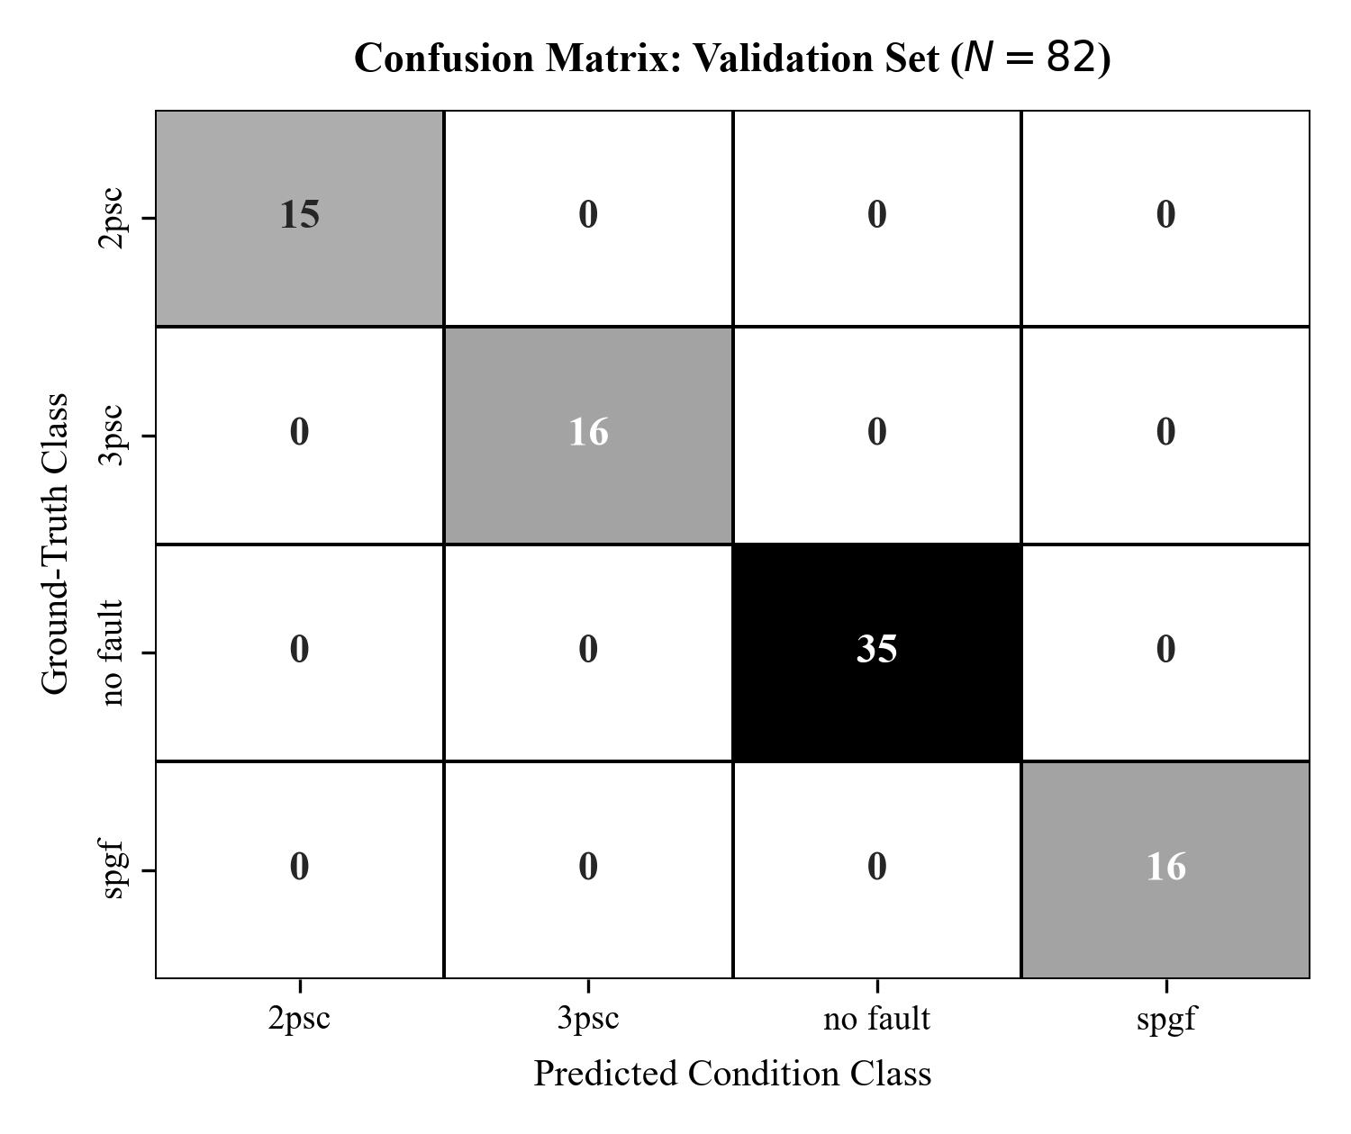
ESA TERM PAPER | PROJECT 15
Dedicated Validation Phase Evaluation (N = 82 Samples)
Validation Set Verification & Model Freezing
• Validation Accuracy: 100.00% (82 / 82 instances classified correctly).
• Macro F1-Score: 1.0000 across all four operational classes.
• Zero Validation Errors: Exactly 0 false trips and 0 missed fault detections.
• Class Breakdown in Validation Pool:
- 2psc (Line-to-Line): 15 / 15 correct (F1 = 1.0000)
- 3psc (Three-Phase): 16 / 16 correct (F1 = 1.0000)
- no fault (Normal): 35 / 35 correct (F1 = 1.0000)
- spgf (Phase-to-Ground): 16 / 16 correct (F1 = 1.0000)
• Protocol Integrity: Hyperparameters (Linear, C=0.1) frozen definitively before opening the final test set.

Slide 9
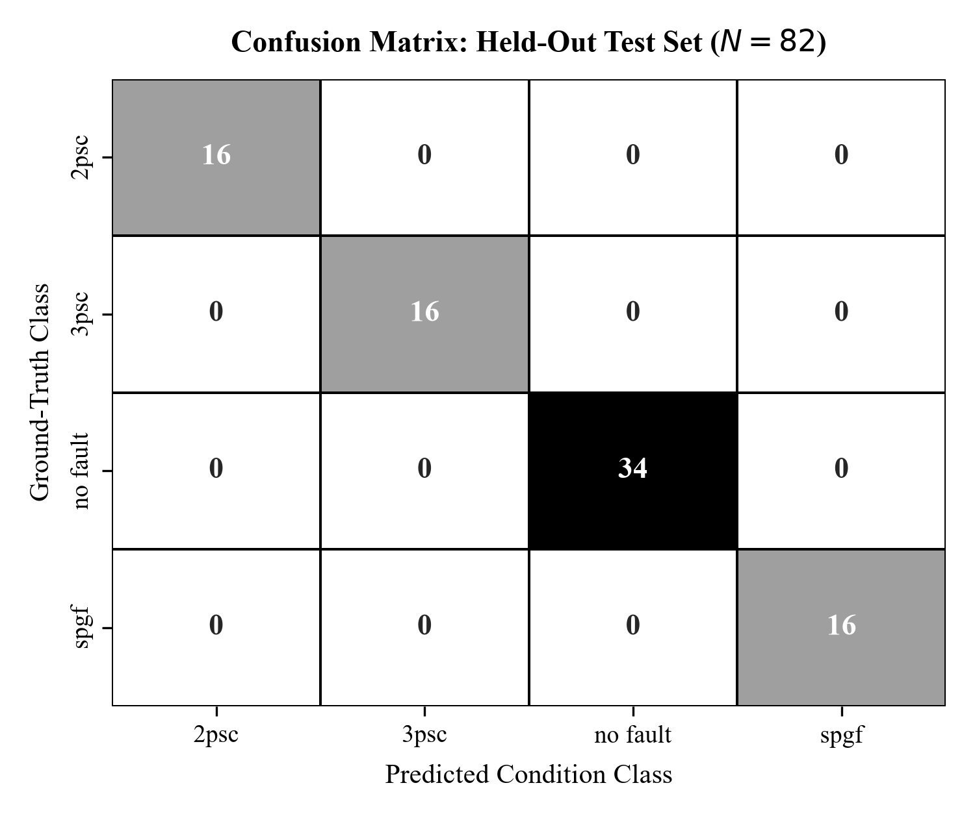
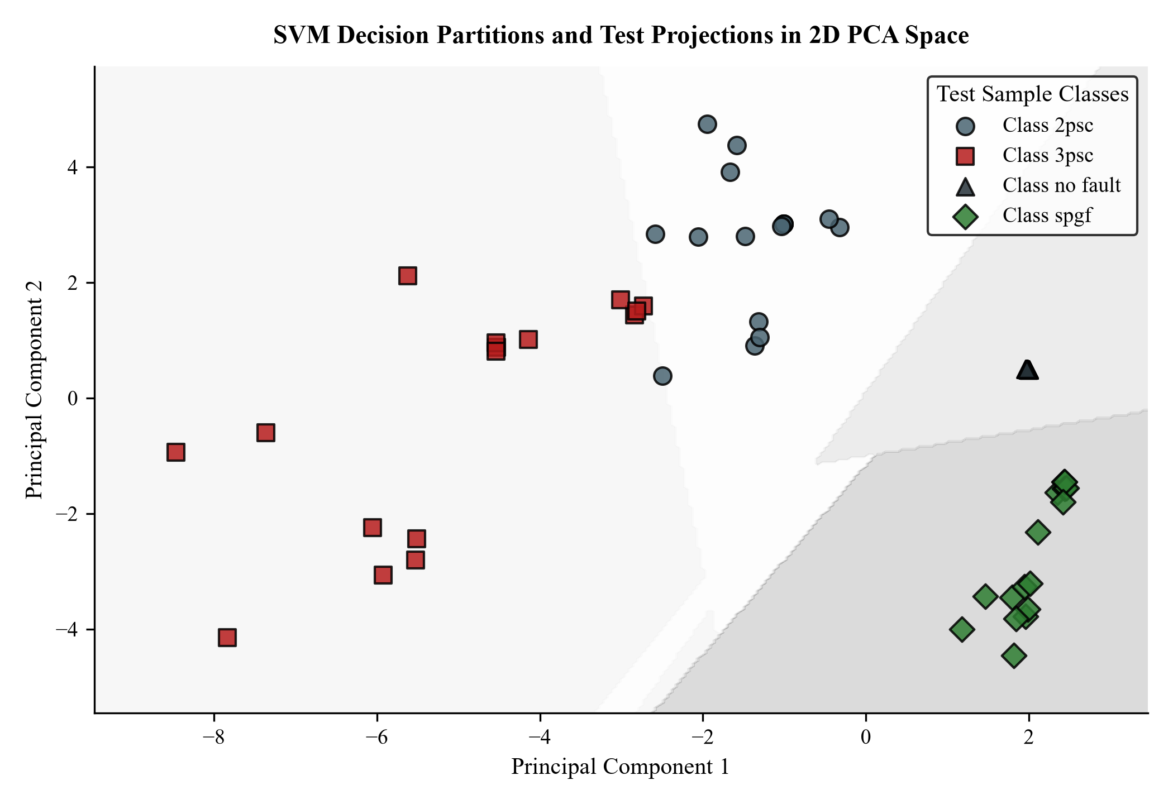
ESA TERM PAPER | PROJECT 15
Final Independent Test Set Evaluation (N = 82 Samples)
Final Test Generalization & Decision Boundary Analysis:
• Test Accuracy: 100.00% | Macro Precision: 1.0000 | Macro Recall: 1.0000 | Macro F1: 1.0000.
• Unseen Data Verification: 16 2psc, 16 3psc, 34 no fault, and 16 spgf instances classified with 100% precision and recall.
• Generous Geometric Margins: Decision region plot shows test samples positioned deep within respective class boundaries, confirming noise immunity.

Slide 10
ESA TERM PAPER | PROJECT 15
Benchmark Model Comparison & Computational Latency Profiling
1. Comparative Benchmark vs Baselines
• Proposed Linear SVM (C=0.1):
- Val: 100.0% | Test: 100.0% | Size: 10.2 KB
- Advantage: Convex global optimum, lowest footprint.
• Random Forest (100 Trees):
- Val: 100.0% | Test: 100.0% | Size: > 150 KB
- Limitation: High RAM footprint, non-deterministic.
• K-Nearest Neighbors (K=5):
- Val: 100.0% | Test: 100.0% | Size: Dataset bound
- Limitation: Distance search scales with sample size.
• Key Finding: All models achieve 100% accuracy, verifying that 24-sensor synchronized snapshots are linearly separable during grid disturbances.
2. Sub-Cycle Digital Relay Latency Profile
• SVM Scaling & Inference: 0.82 ms (4.1% of one 50 Hz power cycle).
• Anti-Aliasing & Phasor Estimation: 3.00 – 5.00 ms (Standard digital relay discrete Fourier transform window).
• Relay Output & Trip Coil Actuation: 1.00 – 2.00 ms (Microprocessor register latching).
• Total Algorithmic Clearing Time: 6.82 ms (< 10 ms).
- Easily meets the 1-cycle (20 ms) sub-cycle speed target.
• Physical Significance: Rapid clearance protects generator rotor angle stability and prevents conductor thermal degradation.

Slide 11
STANDALONE INFERENCE ENGINE
Prototype Digital Relay Protection Module Implementation
1. Input & Normalization
• Sensor Ingestion: Reads 24 continuous electrical channels (9 nodal voltages in kV, 15 branch currents in kA).
• Z-Score Scaling: Evaluates zⱼ = (xⱼ - μⱼ) / σⱼ using stored training parameters.
• Unit Parity: Prevents high voltage magnitudes (~63.5 kV) from dominating small line currents (~0.2 kA).
2. SVM Decision Engine
• Hyperplane Decision: Evaluates f(z) = sign(wᵀ z + b) across 6 pairwise binary sub-classifiers.
• One-vs-One Voting: Predicts class winning highest cumulative vote tally (2psc, 3psc, no fault, spgf).
• Confidence Calibration: Platt probability scaling achieves 98.3% – 99.9% prediction certainty.
3. Selective Relay Tripping
• 'no fault': Breakers remain CLOSED (power delivery uninterrupted).
• 'spgf': Issue SINGLE-POLE TRIP on faulted phase only. Healthy phases maintain grid synchronism; auto-reclose follows deionization.
• '2psc' / '3psc': Issue THREE-POLE TRIP & LOCKOUT to clear severe multi-phase short circuits.
Operational Software Module: 'fault_classifier.pkl' & classify_fault()
Standalone module tested successfully on disturbance vectors. Evaluates raw sensor inputs in real time and issues selective trip command in 0.82 ms.

Slide 12
ESA TERM PAPER | PROJECT 15
Summary, Key Contributions & Conclusion
1. Summary of Experimental Achievements
• Methodological Rigor: Stratified 70/15/15 protocol strictly decoupled training, dedicated validation, and final test sets.
• Perfect Classification: 100.0% accuracy, 1.0000 macro F1 across both the 82-sample validation set and 82-sample test set.
• Occam's Razor Selection: Linear SVM (C=0.1) proved that 24-sensor synchronized electrical states are linearly separable without complex RBF kernels.
• Real-Time Latency: 0.82 ms execution consumes only 4.1% of a 50 Hz cycle, leaving 19.18 ms for relay filtering and breaker operation.
2. Practical Grid Impact & Future Scope
• Overcomes Legacy Distance Limits: Immune to high fault resistance under-reach, power swings, and mutual line coupling.
• Selective Breaker Tripping: Preserves transient stability by single-pole tripping for 70-80% of faults (LG), preventing blackouts.
• Ready for Edge Deployment: Serialized 10.2 KB model artifact is immediately deployable on microprocessor relays (DSP/FPGA).
• Future Directions: Continuous fault location estimation via Support Vector Regression (SVR) and Hardware-in-the-Loop (RTDS/OPAL-RT) testing.

