Slide 1
Computer Vision Project Video Description
By Rishabh Sahlot

Slide 2
Who am I?
Rishabh Manish Sahlot
I completed my Bachelors in Computer Engineering in Dwarkadas J. Sanghvi College of Engineering, Mumbai, in the year 2019.
I have come here for Masters as soon as I finished my undergraduate studies.
During my undergraduate years, I did 2 short internships.
I am a newbie to computer vision, which is why this course has been a major learning experience for me.

Slide 3
Image Query Database
By Rishabh Sahlot

Slide 4
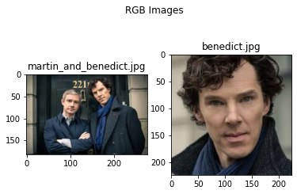
THE IDEA
How many of you all have heard about querying for images from an image database?
I guess a lot of you all ,since querying using tagged data or meta-data of the images is quite mainstream.
What about querying for images using images? Any database that comes to mind?
For example, let says I say retrieve something like this given the database has this in it. More formally,
Select * from Image_database
which looks path(‘benedict.jpg’) // where benedict.jpg has in it. What if I wanted to retrieve based on multiple images?

Slide 5
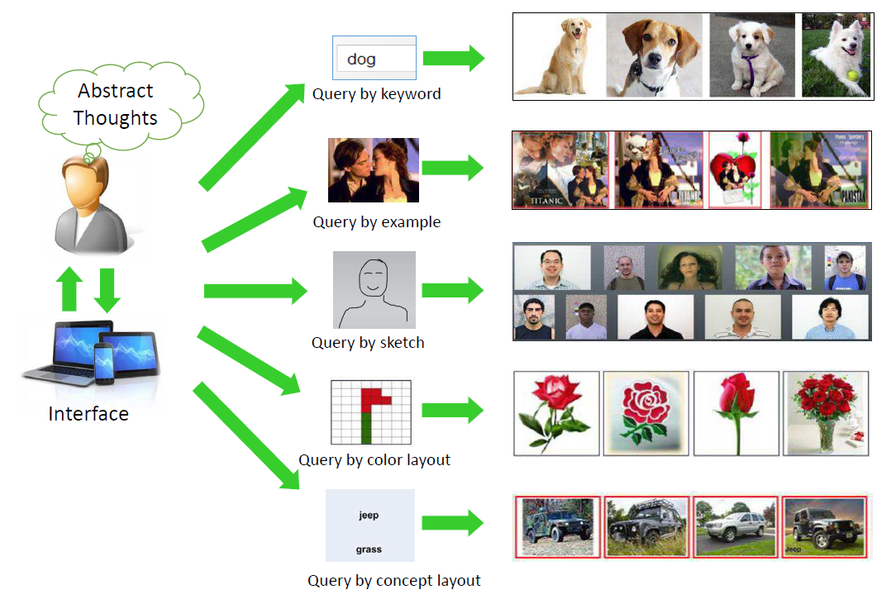
THE IDEA (..CONTD)
If you guessed Google’s Reverse Image search, or some other reverse image search engine- you are correct. Brownie points for you.
This type of system that retrieves images from a database when you provide a matching image/text description etc. is called Content Based Image Retrieval(CBIR).
And there has been a lot of research & successes in this field.
Different ways of CBIR Source- Recent Advance in Content-based Image Retrieval: A Literature Survey

Slide 6
Motivation
But I wonder why I have never heard about an image database, that allows to query & process multiple images – just like we do in any other database query and manipulation language.
It’s probably because though CBIR has seen some massive success, the issue of efficient querying and processing still remain.
With the way data is becoming BIGGER and VARIED, there is constantly a need for Data Scientists and Analysts to be equipped for more powerful tools to process and query massive amounts of image data and to find unexpected insights in it.

Slide 7
My Approach
My current approach is quite simpler than the grandiose ambition laid down in the previous slide. I am current only dealing with insertion & simple querying.
Algorithm for Building
Create SIFT(Scale Invariant Feature Transform) descriptors for all images.
Create Visual Learning Codebook(VLC)- for the entire image set using K-means++ for all descriptors.
Using the previous VLC and the sift descriptor quantize all SIFT descriptors in each image to VLAD (Vector of Locally Aggregated Descriptors) descriptors for the respective image.
Create a Ball or a Cover Tree using the VLADs.

Slide 8
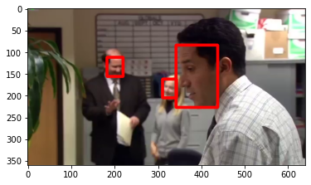
My Approach
Algorithm for Querying
Create VLAD vectors for the query image.
Query it from the inverted Index Tree.
Additionally, I am making use of pretrained face-detection algorithms so as to separate out features detected within face boundaries and those outside. Thus we get two paths for the work. And two databases:- One for face and second one not for faces.

Slide 9

Where did SIFT, VLAD & Ball Index Tree come from!!?

Slide 10
Scale Invariant Feature Transform(SIFT)
SIFT is an old but robust feature detection algorithm that identifies strong key-points in an image that identify their neighborhood using descriptors / vectors.
The specialty of SIFT is that it is location(position of the object made by the neighboring pixels), scale(size of object neighborhood in pixels) and orientation(rotation of the object) invariant. This means that even if the position, location or orientation of the object changes it will still be detected as the same object for all the images.

Slide 11
SIFT Algorithm
The SIFT algorithm can be divided in to 4 steps
Scale Space Extrema Detection
Keypoint Localization
Orientation Alignment
Keypoint descriptor extraction

Slide 12
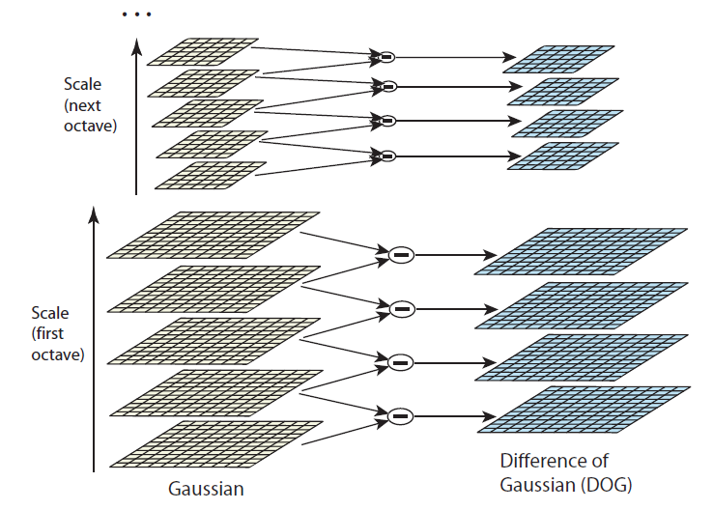
Scale Space Extrema Detection
Stack more blurred(Gaussian Averaged) images one above another.
Original idea was to perform Laplacian of gaussian (2nd Derivative) to find local maxima and minima directly for each pixel location
Instead they took difference of the Gaussian of successive image to estimate Laplacian, to find local minima and maxima pixel locations
Local maxima/minima refer to the maximum/minimum points in the 27-pixel neighborhood.
An extrema is required since these key points need to have a high contrast,(just like how high contrast edges helps us visualize the objects better)
Scale-Space Source- Original SIFT Paper

Slide 13
KEYPOINT LOCALIZATION
Key-points detected in the previous step are further refined (combined, removed, improved) to find exact pixel location and scale for the maxima/minima.
The authors express the scale space functions using Taylor example until powers of 2, take its derivative and derive and equation of extrema. They approximate it by replacing it by difference of neighboring pixels instead of derivative. This removes unstable extrema.
The ratio of Jacobian(Matrix of 1st derivatives ) & Hessian(Matrix of 2nd derivatives) is used later- against a user given threshold to remove points unstable to noise.

Slide 14
Orientation Assignment
In this step we assign orientation to the key-points.
We take a small neighborhood region around a key-point and using the points in it construct an orientation histogram of 36 bins (10 degree for each bin), which give a magnitude for a particular orientation.
At each of the points chosen in the small neighborhood its gradient magnitude as well as the gaussian average of gradient magnitude of a 3d window (size = 1.5 times sigma of key-point) around it are added to the corresponding gradient angle of that point.
The highest peak is that of the key-point, and another peak which is at-least 80% of the highest peak is used to create a key-point on the same original key point pixel but in another direction.

Slide 15
KEYPOINT DESCRIPTOR
We take a 16x16 window around the key-points & then split them up into 16 4x4 subregions.
Then just like in the previous, we create orientation histogram for each subregion, but here we take 8 bins (due to 8 pixels around the key-point in x-y plane). Then those 16 histograms are concatenated to give a vector 4*4*8 =128 numbers.
This vector is normalized, thresholded & again normalized to invariance/resistance to changes in exposure.

Slide 16
Visual Codebook Learning
This is just an intermediary step to convert from high number of feature/key-point descriptors (SIFT, SURF, ORB etc.) for each image to compact high dimensional vector (Bag of Visual Words, VLAD, Fisher Vector etc.) to represent that image.
In our step we make use of the K-means algorithm on all the descriptors in the data. More specifically, we use the k-means++ algorithms, which ensure the random seed used for picking initial cluster centers is not too bad.
Here we successively generate centroid and for each point check if the new centroid is its closest centroid. The next centroid is chosen from the data points the probability of selection of the next centroid increases with increasing distance from its closest centroid.

Slide 17
VECTOR OF LOCALLY AGGREGATED DESCRIPTOR (VLAD)
These aggregate the key point descriptors to form one single descriptor for each image. This reduces the processing and size of the index tree.
To get the feature aggregation for an image we use the K-means clusters created before. For each centroid for each descriptor column we find the sum of errors/distance between itself and the key-points in that image that are predicted to be in its cluster. This gives a 2d vector.
We flatten the vector, & then for each value in that vector, we multiply the sign of that vector by the square root of its absolute value.
Lastly, we do L2 normalization i.e. divide each element of the vector by the root of the sum of the squares of the values in the vector.

Slide 18
Ball Index tree insertion and querying
They are trees are use for representing a set of high dimension objects, as a tree to ensure faster nearest neighbor search queries.
Constructing a Ball tree
Find the dimension with the most spread/variance.
Consider the median of that dimension to the center.
Maintain the radius of the ball/area this center considers.
Recurse for the left and right points
Stop when only one instance in the data.

Slide 19
Ball Index tree insertion and querying
Tree Querying – we make use of a priority queue(max heap) to maintain the k-nearest neighbors. Let q be the query point:-
Start with the first center/root of the tree.
If the distance of q from the current center is more than the first child (maximum distance) of the current center return a priority queue as it is.
If current node is a leaf, iterate across each of its successors, and add all successors to the priority queue that are closer than the worst/first point in the priority queue. Also remove, points whenever the priority queue goes over k.
Else recurse for the closest child, followed by recursing for the furthest child

Slide 20
Implementation
This projected was implemented in python on Jupyter notebook.
Credits goes to https://docs.opencv.org/4.3.0/dc/dc3/tutorial_py_matcher.html
https://github.com/jorjasso/VLAD

Slide 21
Conclusions
SIFT IS NOT EXPOSURE INVARIANT!
As we take a higher k values for kmeans- (i.e. a larger number of vectors) our accuracy improves but the size of the tree and construction time also increases.

