Slide 1
Connected Vehicles
Created By - Rishabh Sharma

Slide 2
Idea
Vehicle has third party loT device which will send the telemetry data (in JSON format) over the AWS cloud.
We need to move data from third party AWS to General Motors Azure cloud.
You need to validate the JSON sometime it could be incomplete or wrong JSON which need to be rejected.
Once JSON got validated this data would be stored in the SQL database which will be further utilized by data science team.

Slide 3
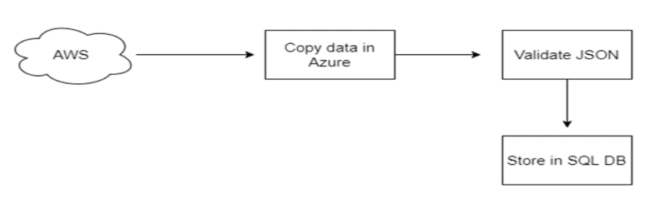
Idea

Slide 4
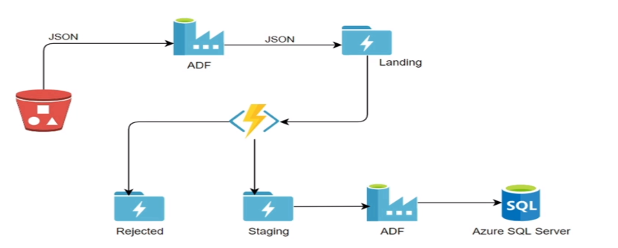
Architecture Design

Slide 5
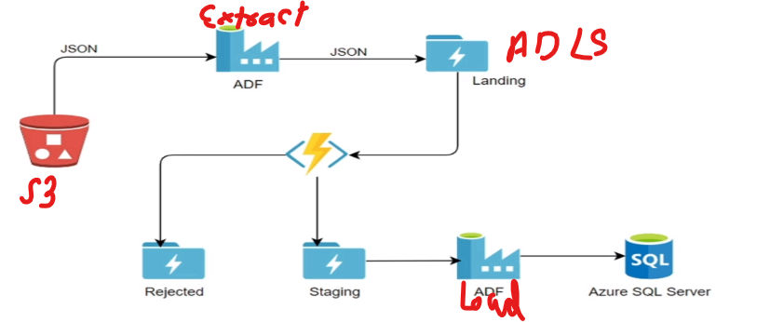
Architecture Design

Slide 6
Idea
Azure Secret for storing Access key Vault for S3 Bucket
ADLS for Staging
Azure DF for ETL
Azure Function for Filter valid/Invalid data
Azure SQL Server for end data

Slide 7
EOS

