Slide 1
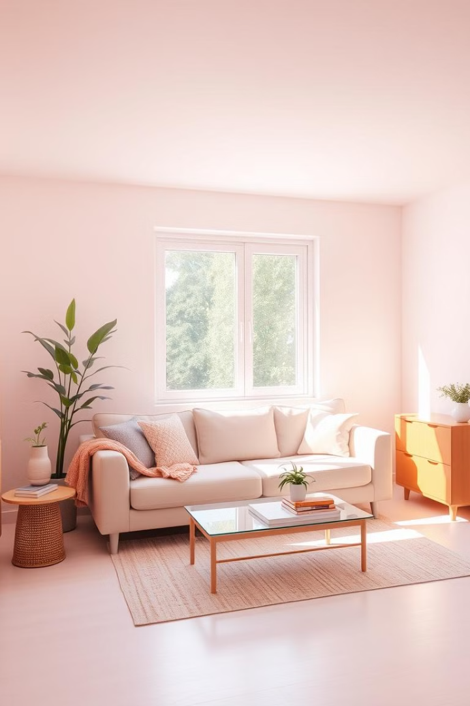
Clean Room vs Messy Room: Automated Image Classification
This project aims to develop a machine learning model that can accurately classify images of rooms as either "Clean" or "Messy" based on their visual features.
Prashik Lanje – BT22CSE103
Sudhanshu Mandhare – BT22CSE089
Rishabh Shikhare – BT22CSE112

Slide 2
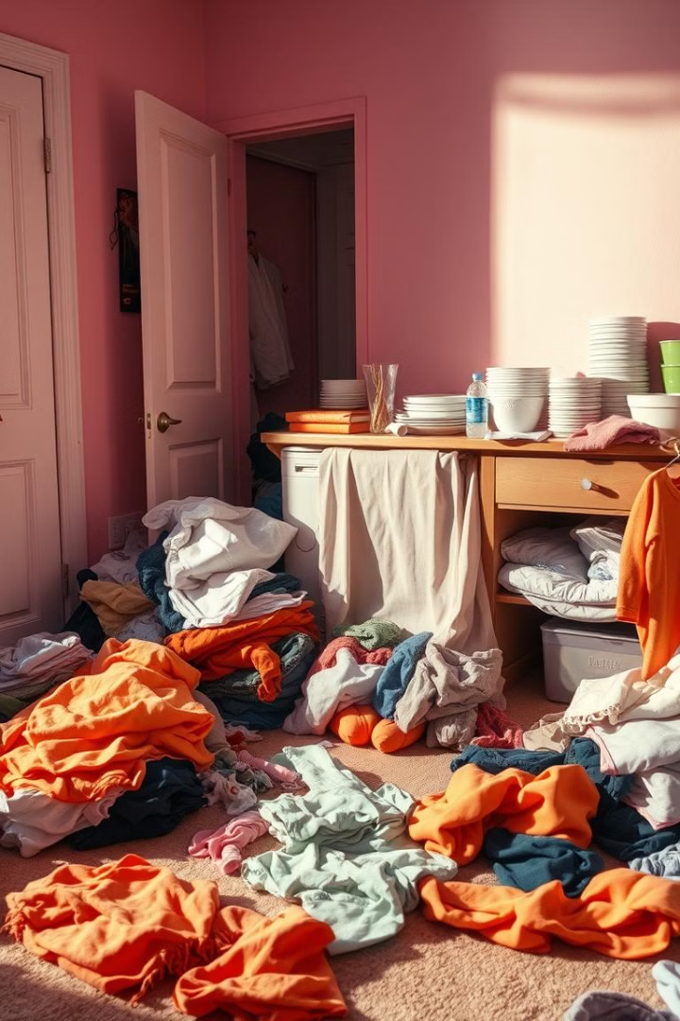
Problem Statement
Home Automation
Image Classification
The need for systems that can assess and classify room conditions based on visual data is growing.
This project focuses on developing an automated system to classify images of rooms into two categories: "Clean" and "Messy."
Objective
To create a machine learning model capable of accurately classifying room images as either "Clean" or "Messy" based on their visual features.

Slide 3
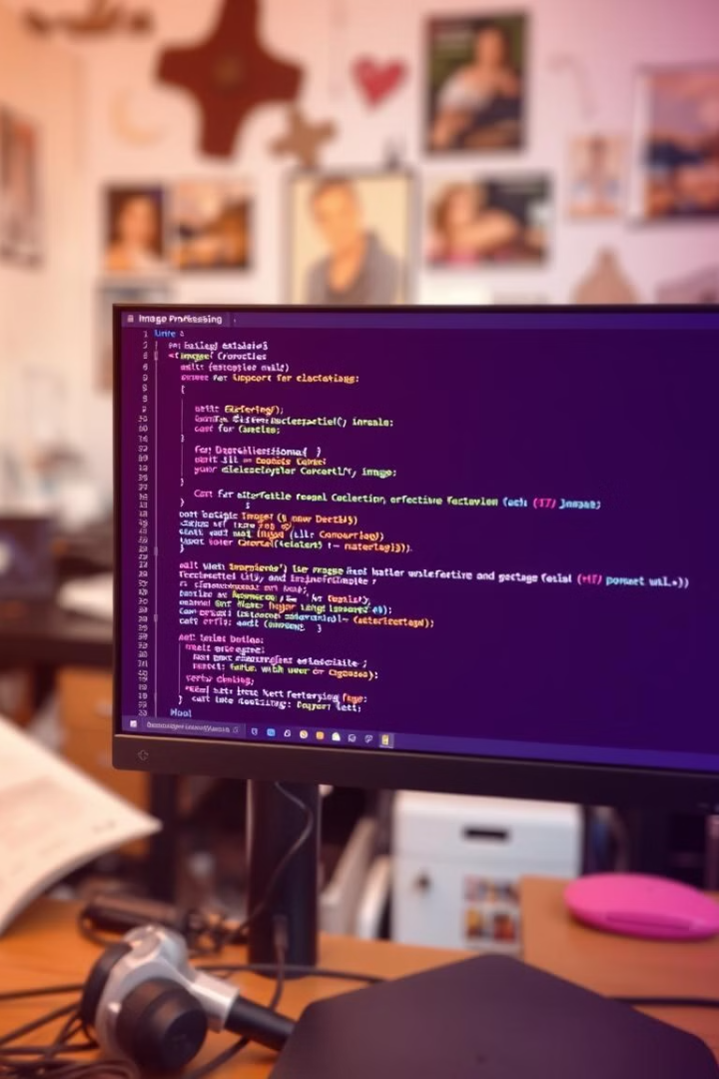
Data Preparation
1
Resizing Images
Images are resized to a consistent size for efficient processing.
2
Normalizing Pixel Values
Pixel values are normalized to a range between 0 and 1 for consistent scaling.

Slide 4
Model Development
Linear Regression Algorithm
Flatten Image Data
A linear regression algorithm is used to establish a relationship between the image features and the target variable (Clean or Messy).
Image data is flattened into a one-dimensional vector to be processed by the linear regression model.

Slide 5
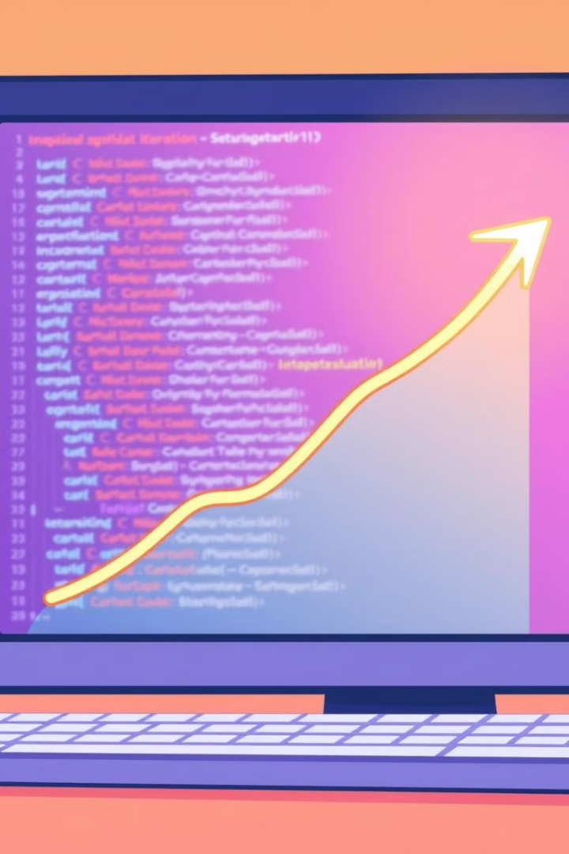
Evaluation
1
Accuracy Measurement
2
Visual Validation
The model's predictions on sample images are visually inspected to interpret its performance.
The model's accuracy is measured on the dataset to assess its performance.

Slide 6
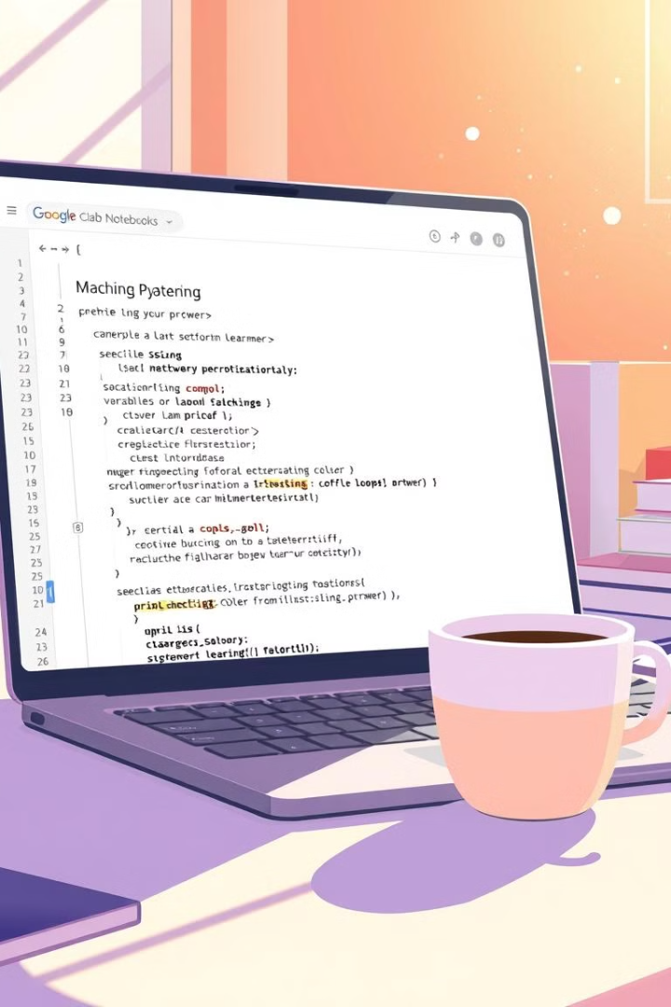

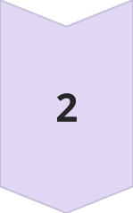
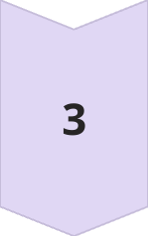
What We Have Done So Far
Importing Google Drive
Google Drive is imported into Google Colab for accessing the image dataset.
Importing Libraries
All necessary libraries for image processing and machine learning are imported.
Creating a Folder
A new folder is created to save the normalized images.

Slide 7
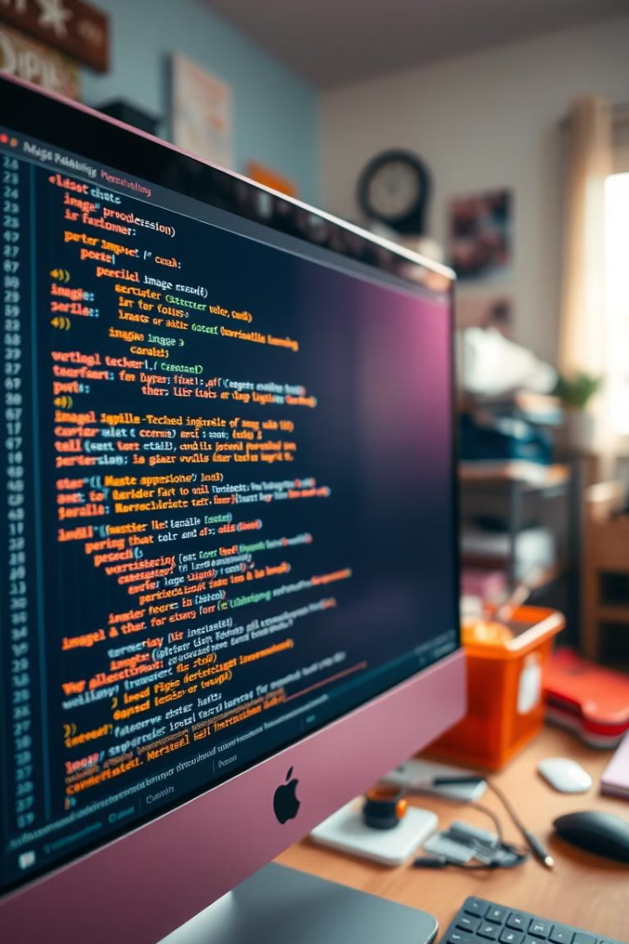
Image Processing
1
Converting to Grayscale
Images are converted to grayscale for simplifying the analysis.
2
Normalizing Images
Images are normalized to a range between 0 and 1 for consistent scaling.
3
Saving Images
Normalized images are saved into a designated folder.

Slide 8

Model Training
Train Data
Clean Images
Messy Images
Model
Logistic Regression
Logistic Regression
Output
Model Trained on Clean Images
Model Trained on Messy Images

Slide 9




Next Steps
Model Evaluation
Code Optimization
Parameter Tuning
Evaluate the model's performance using metrics like accuracy and precision.
Optimize the code for efficiency and improve the model's performance.
Fine-tune the model’s parameters to achieve optimal results.

Slide 10
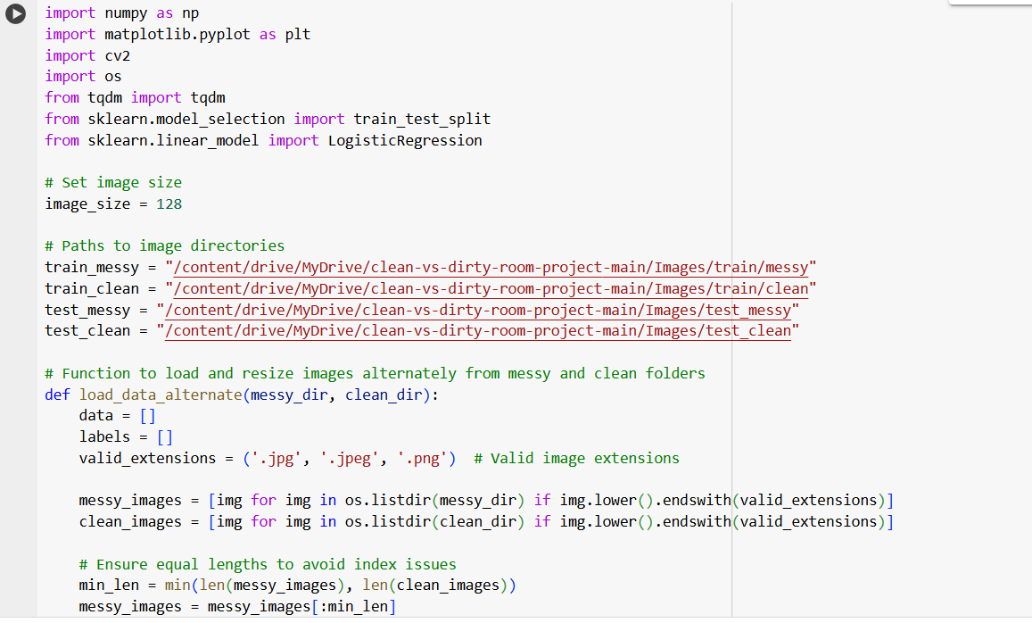
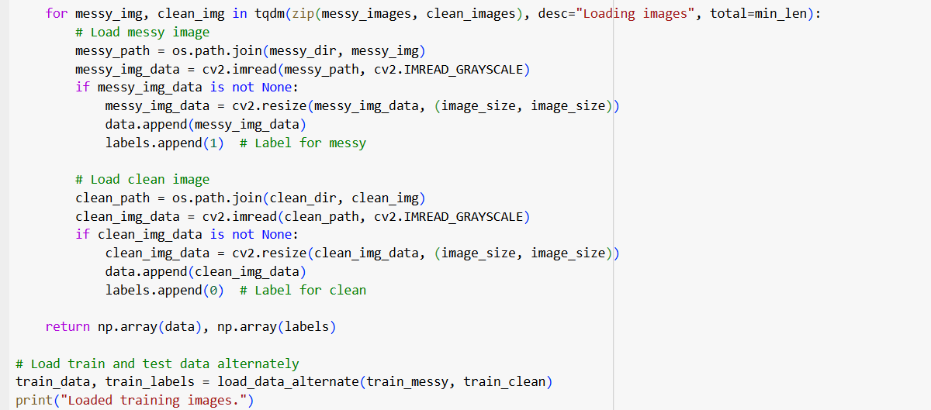
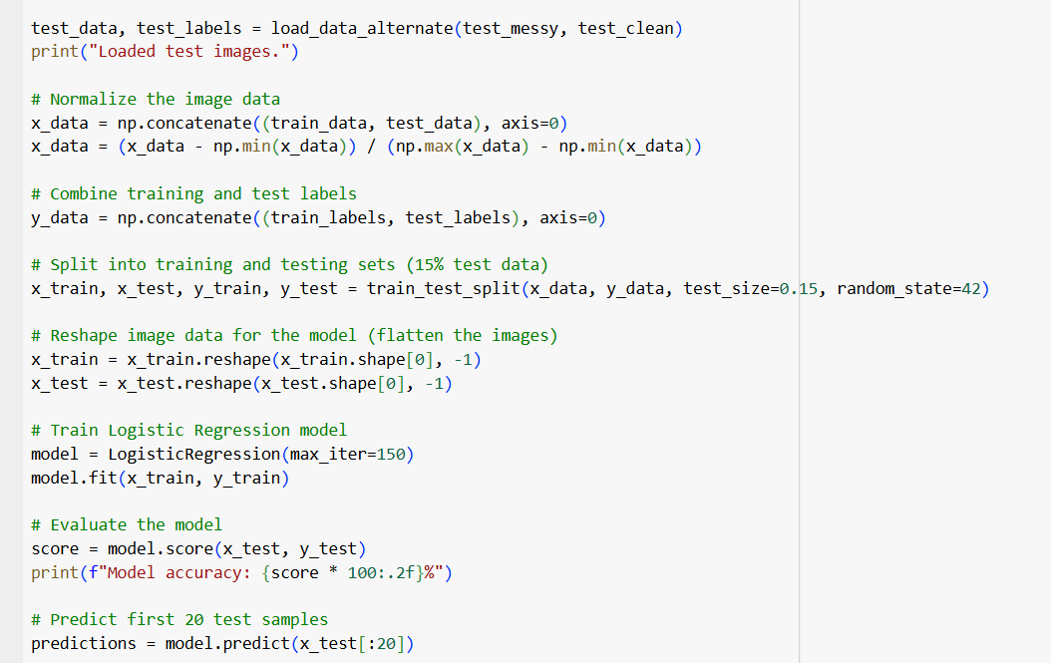
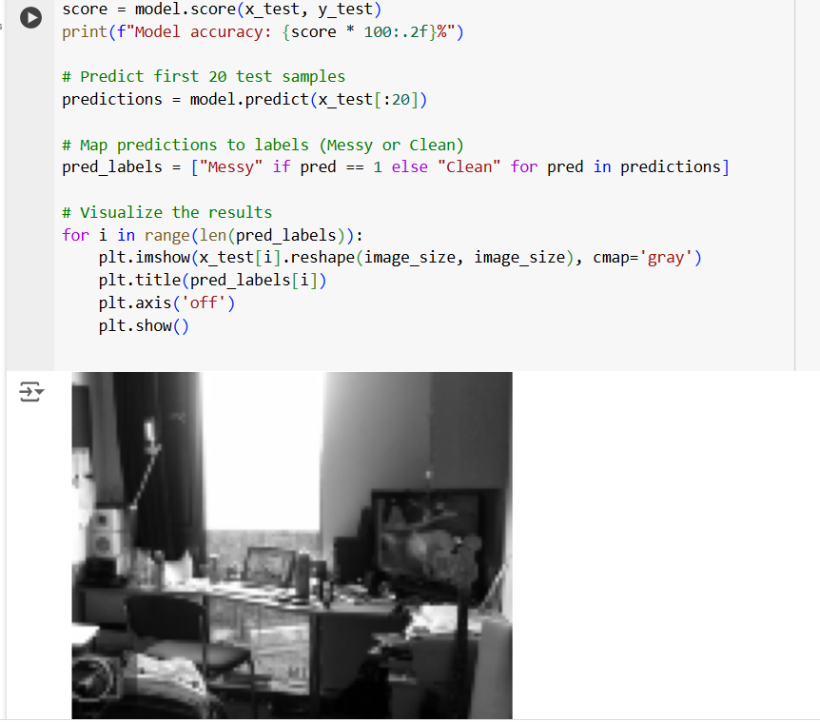
OUR MODEL’S CODE

Slide 11
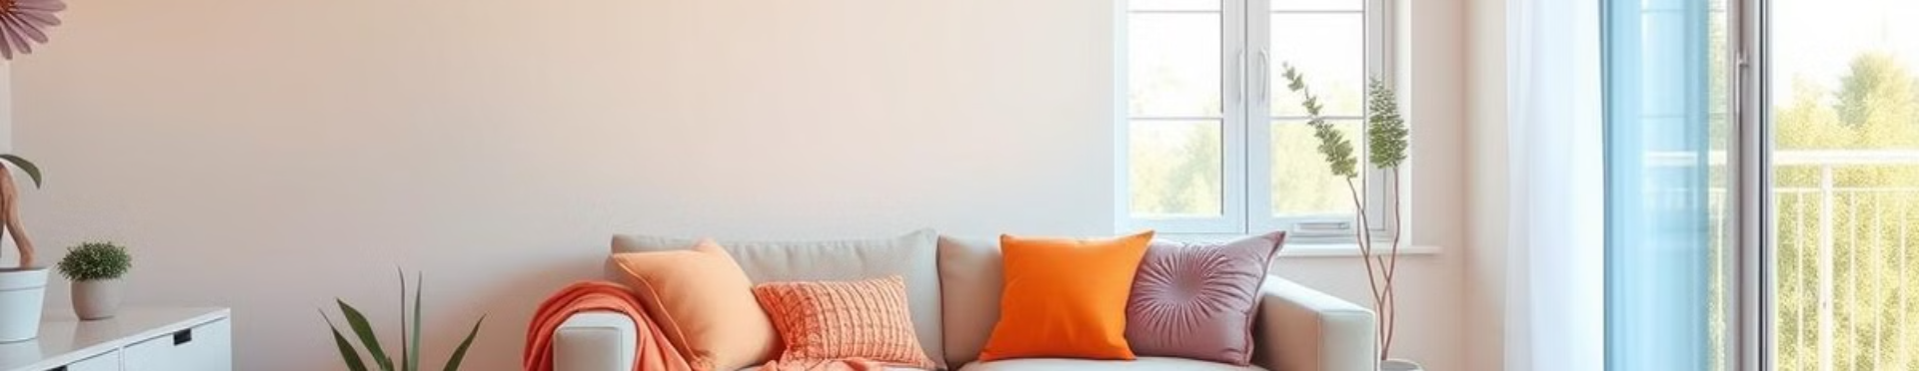
THANK YOU

