Slide 1
Ames, Iowa: Alternative to the Boston Housing Data as an End of Semester Regression Project
Dean De Cock Truman State University Journal of Statistics Education Volume 19, Number 3(2011)
-Rishabh Mehta (801257231)

Slide 2
Problem Statement:
Every day, thousands of residences are sold. Every buyer has various queries, such as: What is the genuine price that this home deserves? Is the price I'm paying reasonable? A machine learning approach is developed in this work to forecast a house price based on data about the house (its size, the year it was built in, etc.).

Slide 3
Data:
https://www.kaggle.com/code/ammar111/house-price-prediction-an-end-to-end-ml-project/data

Slide 4
Summary of the Method:
This study develops many regression models to forecast a house's price given a few of its characteristics. The models are evaluated and compared to identify the one that performs best. The steps in this paper's data science workflow are as follows: collecting the data, cleaning and preparing it, exploring it and creating models, assessing the findings, and conveying them visually.

Slide 5
Exploratory Data Analysis
Target variable distribution:
Distribution
Dataset contains a lot of variables, but the most important one for us to explore is the target
variable. We need to understand its distribution. First, we start by plotting the violin plot for the
target variable. The width of the violin represents the frequency. This means that if a violin is the
widest between 300 and 400, then the area between 300 and 400 contains more data points than
other
We can see from the plot that most house prices fall between 100,000 and 250,000. The dashed
lines represent the locations of the three quartiles Q1, Q2 (the median), and Q3

Slide 6
Exploratory Data Analysis
This shows us the minimum and maximum values of SalePrice. It shows us also the three
quartiles represented by the box and the vertical line inside of it. Lastly, we plot

Slide 7
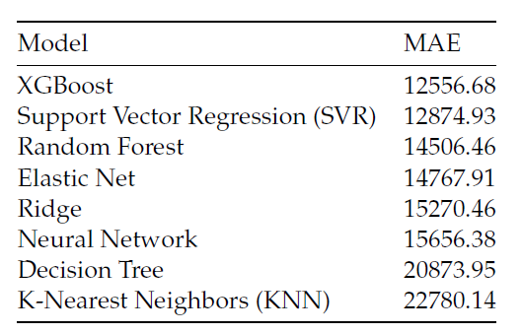
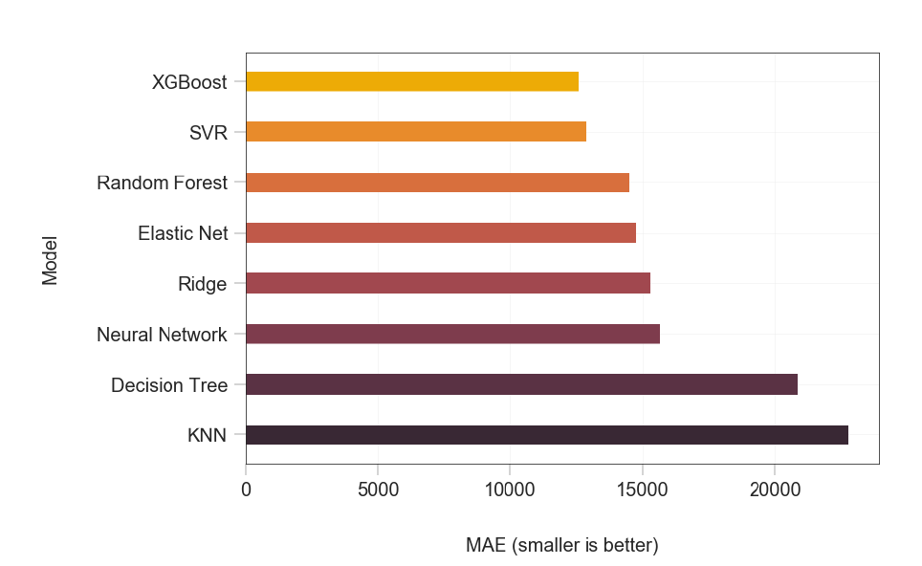
Summary
The best model is XGBoost and the worst model is K-Nearest Neighbors. We can see that the difference in MAE between the best model and the worst model is significant; the best model has almost half of the error of the worst model.

