Slide 1
Manipal University
Jaipur
End-Semester
Project Presentation on
“Corona Raiders”
B.Tech/CSE 2017-2021
– 6th semester
By:
Submitted to:
Mr. Nitesh Pradhan
Poojan Soni
Reg. no: 179301143
&
Rishabh Saxena
Reg. no: 179301163

Slide 2
Corona Raiders
Motto:
Graphical interfaces such as games
leave a great impact on child’s mind.
Through this game, we are trying to spread
the awareness among the young generation’s
mind like how to avoid spread of diseases and
how precaution might save your life

Slide 3
Main Functions Of the game
Player can Stay
inside the home
and be safe.
Player can
#fight corona by
going out and
killing it with
sanitizer
Player can get
infected if he
is not active
to dodge
the corona
1
2
3

Slide 4
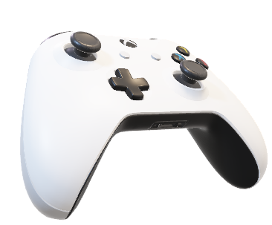
Development of the game
LANGUAGE AND LIBRARIES:
PYTHON3
Libraries used:
Turtle (graphics library)
OS
Math
Platform
Random
Time

Slide 5
Development of the game
FUNCTIONS CREATED:
Creating screen/canvas
Creating Main player and weapon
Keys definition to
moveLeft()
moveRight()
fireBullet() (Space key)
playSound(soundFile)
isCollided(turtle1, turtle2)
Creating ENEMY (corona)
Corona Move()
Score
Player infected

Slide 6


Development of the game
Move left(): key-> a
Move Right(): key-> d
Vice-versa of left movement
Stay Home, Stay safe
Red=> when player crosses Wall A
Green=> When Player crosses Wall B
Main game area
Wall A
Wall B
Home

Slide 7

Development of the game
Collision Handling
Along all the sides of the boundaries the distance of corona is checked and is reversed at a certain value
Speed = +x
Distance from wall <15 pixels

Slide 8
Development of the game
Collision Handling
Along all the sides of the boundaries the distance of corona is checked and is reversed at a certain value
Speed = -x

Slide 9
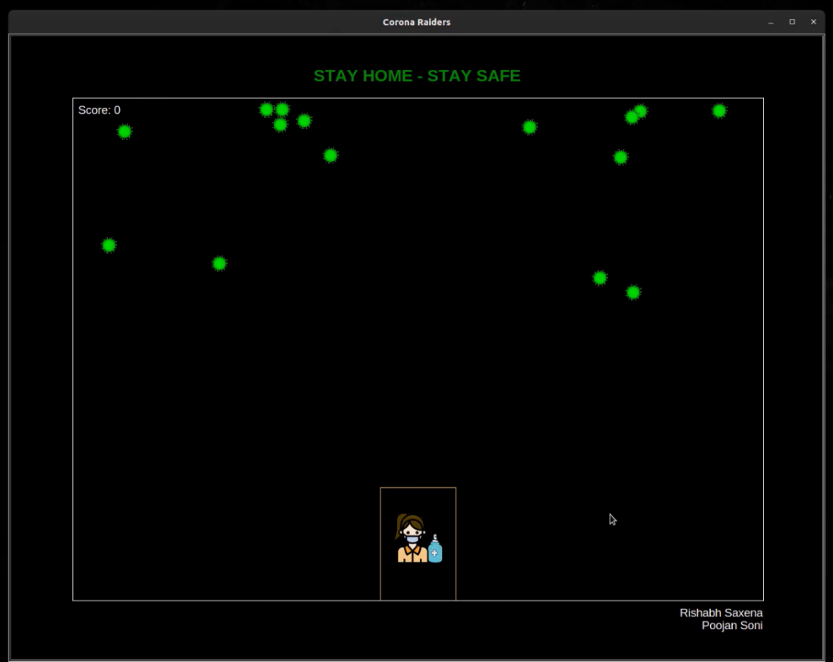
Output Screens
Initial screen with player inside house

Slide 10
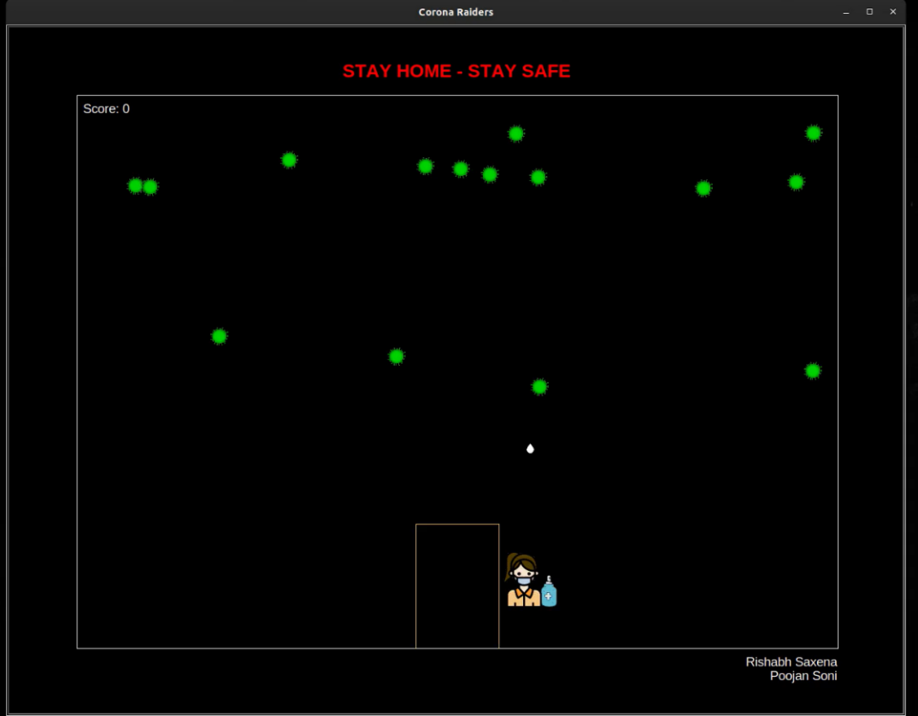
Output Screens
In the middle of the game using sanitizer drop
as bullet to kill corona

Slide 11
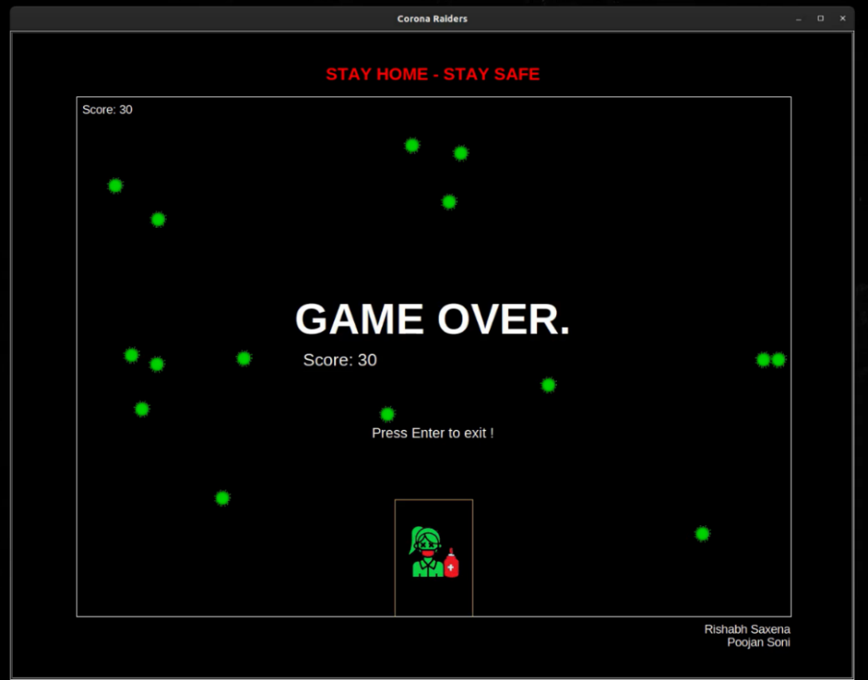
Output Screens
Ending screen / when player gets infected:

Slide 12
Conclusion
COMPLEXITY:
Although this game is fun to play.
Complexity of the main code running is O(n²).
FUTURE WORK AND CONCLUSION:
improve the performance. Also, we need to add
More animations
Graphic improvements
To conclude, using technology in more expressive way to
influence good to the society
is the best way for an Engineer to give back to the society.

