Slide 1

Department of computer science & Engineering AKS UNIVERSITY SATNA(M.P)
Mobile Application Development
(Android Programming)

Slide 2
Menus in Android
Menus are a common user interface component in many types of applications. To provide a familiar and consistent user experience, you should use the Menu APIs to present user actions and other options in your activities.
Beginning with Android 3.0 (API level 11), Android-powered devices are no longer required to provide a dedicated Menu button. With this change, Android apps should migrate away from a dependence on the traditional 6-item menu panel and instead provide an app bar to present common user actions.

Slide 3
Options menu and app bar
The options menu is the primary collection of menu items for an activity. It's where you should place actions that have a global impact on the app, such as "Search," "Compose email," and "Settings."

Slide 4
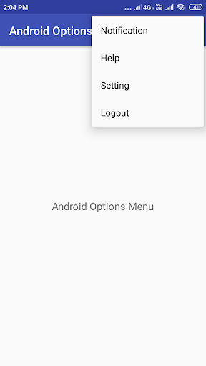

Slide 5
Context menu and contextual action mode
A context menu is a floating menu that appears when the user performs a long-click on an element. It provides actions that affect the selected content or context frame. The contextual action mode displays action items that affect the selected content in a bar at the top of the screen and allows the user to select multiple items.

Slide 6
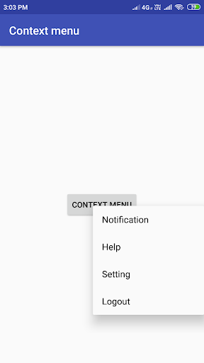

Slide 7
Popup menu
A popup menu displays a list of items in a vertical list that's anchored to the view that invoked the menu. It's good for providing an overflow of actions that relate to specific content or to provide options for a second part of a command. Actions in a popup menu should not directly affect the corresponding content.

Slide 8
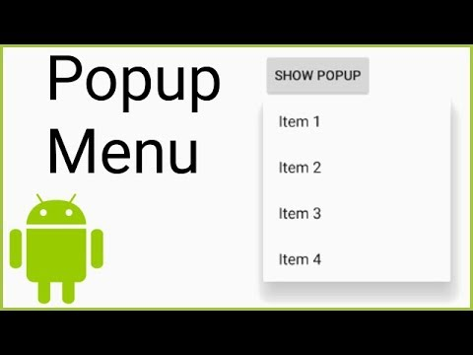

Slide 9
Defining a Menu in XML
Using a menu resource is a good practice for a few reasons:
It's easier to visualize the menu structure in XML.
It separates the content for the menu from your application's behavioral code.
It allows you to create alternative menu configurations for different platform versions, screen sizes, and other configurations by leveraging the app resources framework.

Slide 10
To define the menu, create an XML file inside your project's res/menu/ directory and build the menu with the following elements:
<menu>
Defines a Menu, which is a container for menu items. A <menu> element must be the root node for the file and can hold one or more <item> and <group> elements.
<item>
Creates a MenuItem, which represents a single item in a menu. This element may contain a nested <menu> element in order to create a submenu.
<group>
An optional, invisible container for <item> elements. It allows you to categorize menu items so they share properties such as active state and visibility. For more information, see the section about Creating Menu Groups.

Slide 11
The <item> element supports several attributes you can use to define an item's appearance and behavior. The items in the above menu include the following attributes:
android:id
A resource ID that's unique to the item, which allows the application to recognize the item when the user selects it.
android:icon
A reference to a drawable to use as the item's icon.
android:title
A reference to a string to use as the item's title.
android:showAsAction
Specifies when and how this item should appear as an action item in the app bar.

Slide 12
To specify the options menu for an activity, override onCreateOptionsMenu() (fragments provide their own onCreateOptionsMenu() callback). In this method, you can inflate your menu resource (defined in XML) into the Menu provided in the callback.
@Override
public boolean onCreateOptionsMenu(Menu menu) {
MenuInflater inflater = getMenuInflater();
inflater.inflate(R.menu.game_menu, menu);
return true;
}

Slide 13
Handling click event
When the user selects an item from the options menu (including action items in the app bar), the system calls your activity's onOptionsItemSelected() method. This method passes the MenuItem selected. You can identify the item by calling getItemId(), which returns the unique ID for the menu item (defined by the android:id attribute in the menu resource or with an integer given to the add() method). You can match this ID against known menu items to perform the appropriate action.

Slide 14
@Override
public boolean onOptionsItemSelected(MenuItem item) {
// Handle item selection
switch (item.getItemId()) {
case R.id.new_game:
newGame();
return true;
case R.id.help:
showHelp();
return true;
default:
return super.onOptionsItemSelected(item);
}
}

