Slide 1



K. J. Somaiya Information Technology(KJSIT), Mumbai
Department of Electronics and Telecommunication Engineering
Academic Year 2023-24
PBL I
Presentation
Topic- Obstacle Avoiding Robot
Project Guide –Prof. Amit Kukreja
Project Members: Dhruv Rathod (B45 )
Soham Sahastrabuddhe (B47)
Rishabh Tiwari (B58 )

Slide 2
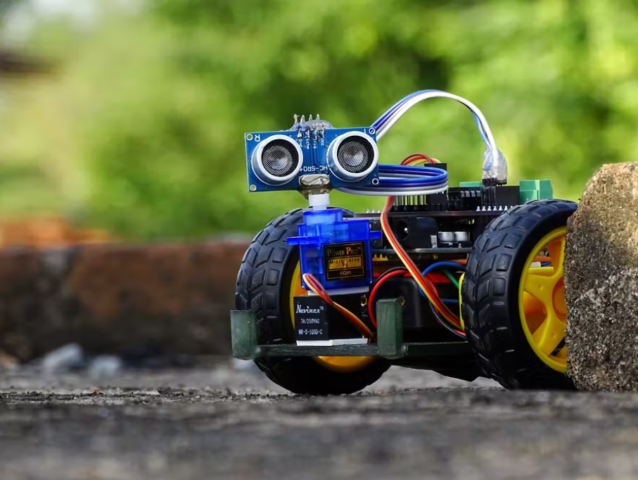
Introduction
In our journey through automation and robotics, one of the quintessential projects is the obstacle-avoiding bot.
This project epitomizes the intersection of fundamental robotics and practical application, demonstrating how sensors, microcontrollers, and programming come together to create an autonomous system capable of navigating its environment.

Slide 3
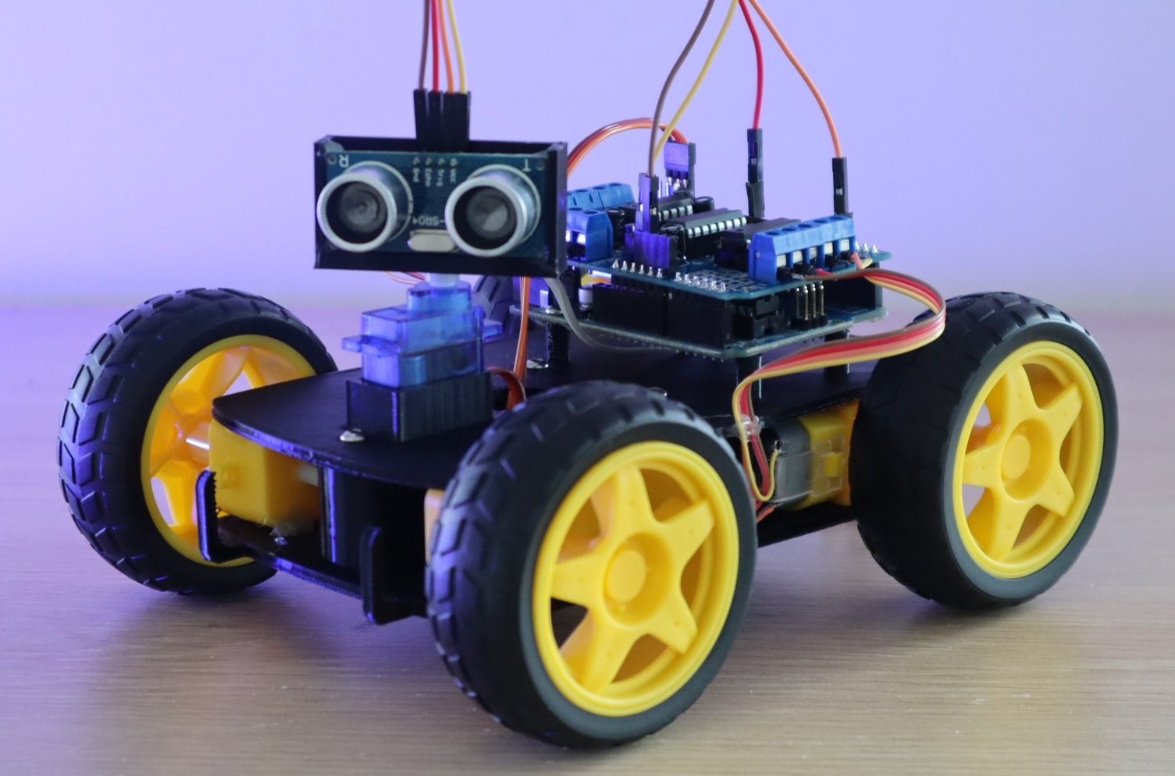
COMPONENTS
STM32(Black pill)
Ultrasonic sensor
DC motor
Motor driver
Battery
Breadboard and Jumper Wires

Slide 4
COST
Sr No. | Components | Price in INR
1 | STM32(Black pill) | 1000
2 | Ultrasonic sensor | 200
3 | DC motor | 150
4 | Motor driver | 200
5 | Battery | 30
6 | Breadboard and Wires | 300

Slide 5
WORKING
The battery powers the entire bot, including the STM32 microcontroller, motor driver, and ultrasonic sensor.
It measures the time it takes for the waves to bounce back after hitting an obstacle.
This time measurement is used to calculate the distance to the obstacle.
If the distance is less than a predefined threshold (indicating an obstacle is close), the microcontroller decides on the appropriate action to avoid the obstacle.
Based on the distance data, the microcontroller sends signals to the motor driver.
The motor driver then controls the DC motors to change the bot’s direction or stop it.
If no obstacle is detected, the bot continues moving forward.

Slide 6

THANK YOU!

