Slide 1

MARINO RECREATION DATABASE
A COMPREHENSIVE DATABASE FOR MANAGING GYM OPERATIONS, ATTENDANCE, STAFF, AND SESSIONS.
PRESENTED BY,
RISHAB SHUKLA - 002825936
01

Slide 2


Objective:
To design a database system to manage gym operations effectively, ensuring accurate data entry, user management, and operational efficiency.
Technology Used:
Database: MySQL
Devlopment Tools: MySQLWorkbench
Concepts Applied: Normalization, ACID Compliance, RBAC(Role-Based Access Control)

Slide 3
PROBLEM STATEMENT
Attendance tracking was prone to errors, with no automated validation for access.
Session bookings were unorganized, leading to overbooking issues.
Gym staff payroll calculations were manual and inefficient.
No centralized system for tracking equipment maintenance and service records.
PROPOSED SOLUTION
A relational database to handle all gym operations with automated validation, access control, and centralized data management

Slide 4
KEY FEATURES
Tracks gym member attendance with automated validation for gym access. Logs timestamps and provides a live count of members present within the last 2 hours.
Tracks gym equipment status and maintenance history. Updates service dates automatically after each maintenance log.
01
04
Allows booking of gym sessions like Yoga, Zumba, and Personal Training. Automatically manages seat availability and updates session details
Ensures secure and role-specific access. Admins manage all data, managers handle sessions, staff manage their timesheets, and members book sessions.
02
05
Automates biweekly payroll calculations for gym staff using logged working hours. Includes triggers to enforce a 20-hour weekly limit
Enforces consistency with triggers for seat availability, staff roles, and attendance logging
03
06

Slide 5
USER ROLES
Admin
Permissions: Full database access.
Responsibilities:
Manage users, staff, and gym policies.
Members
Permissions: Book gym sessions.
Responsibilities:
Use the booking system and attend sessions.
01
04
Manager
Permissions: Update sessions and monitor activity.
Responsibilities:
Track attendance and session summaries.
Maintenance Staff
Permissions: Log maintenance activities.
Responsibilities:
Update service logs and ensure equipment is operational.
02
05
Gym Staff
Permissions: View and update their timesheets.
Responsibilities:
Log working hours and assist members.
03

Slide 6





UNNORMALIZED FORM
1NF
2NF

Slide 7
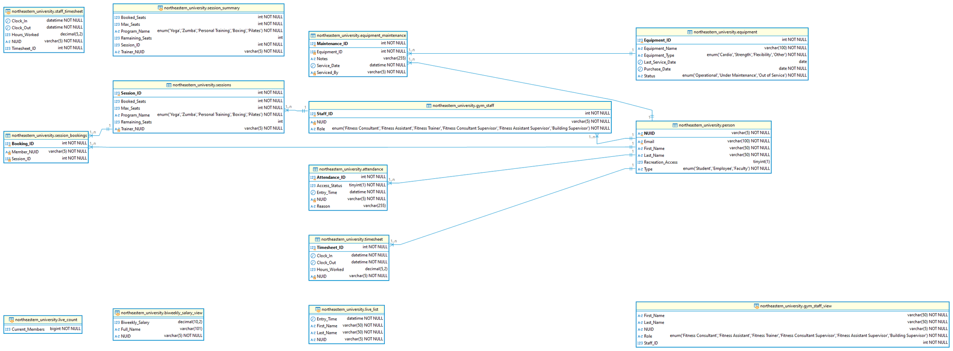
ER - DIAGRAM

Slide 8
VIEW
Gym_Staff_View: Displays staff details.
Live_Count: Counts current members in the gym.
Session_Summary: Summarizes session details.
TRIGGERS
Check_Student_Only: Ensures only students are added to Gym_Staff.
Check_Seat_Availability: Validates seat availability before bookings.
Update_Booked_Seats_After_Deletion: Adjusts seats when a booking is canceled.
STORED PROCEDURES
CheckAndLogAttendance: Validates access and logs attendance.
BookSession: Manages bookings and seat counts

Slide 9
FUTURE ENHANCEMENTS
Advanced Role-Based Access Control: Introduce granular roles like Senior Trainers and Front Desk Staff for better management.
Session Ratings and Feedback: Allow members to rate sessions and provide feedback for trainers and programs.
Equipment Usage Tracking: Log and analyze equipment usage by members to optimize gym operations.
Analytics and Reporting: Generate reports for attendance trends, session popularity, and maintenance schedules.
Integrated Payment System: Manage payments for personal training sessions and class subscriptions.
Emergency Incident Logging: Track and notify staff about gym-related emergencies like injuries or equipment failures.
Waitlist System: Allow members to join a waitlist for full sessions and auto-allocate seats upon cancellations.

Slide 10
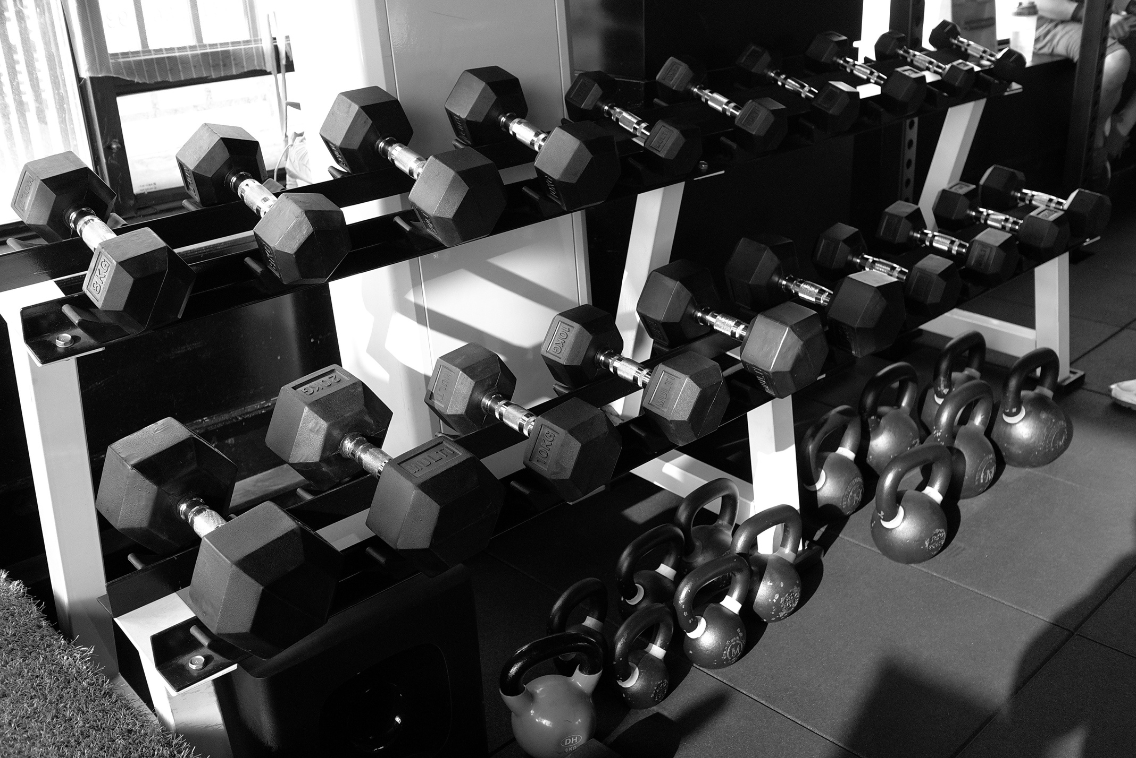
THANK YOU

