Slide 1
Collab.
A platform that helps to create collaborations between professors and students

Slide 2
Use-case Diagram & Narrative
Name:
Shafayet - Ul -Islam Shahriar Hasan Chowdhury Rishadul Islam Khan
ID:
170104029 170104030 170104047

Slide 3
Subsystems
Login
Profile
Newsfeed
Message

Slide 4
Let us look into use-case diagram and brief description on each subsystem

Slide 5
Login Subsystem
Use-case Name | Actors
Register | User (Student/Teacher)
Login | User (Student/Teacher)

Slide 6
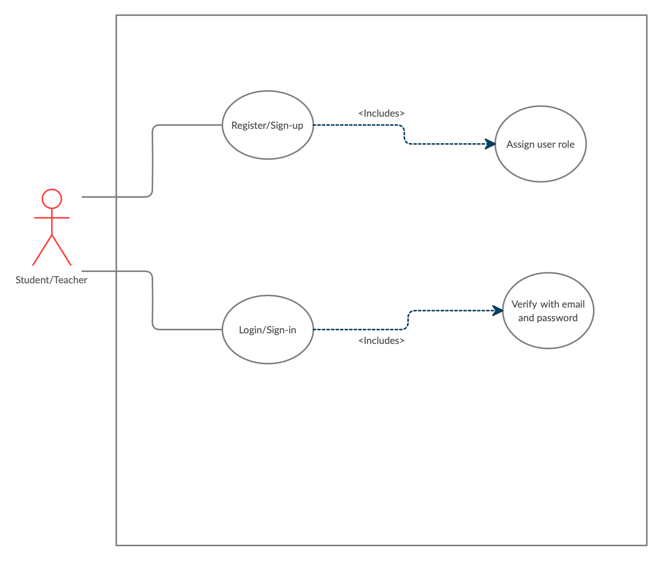
Login Subsystem(Cont...)

Slide 7
Login Subsystem(Cont...)
Use-case narrative of “Login” subsystem
Name: Registration
Priority: High
Primary Actor: User
Precondition: User must register before
Description: User can access all the feature after login

Slide 8
Typical Course of Event
Alternate Course of Event:
System detects wrong user input and password
User | System Response
User provide user email and password | System verifies information
 | Permits user to browse news feed, message and profile

Slide 9
Newsfeed Subsystem
Use-case Name | Actors
Browse news feed | User
Post status or Image | User

Slide 10
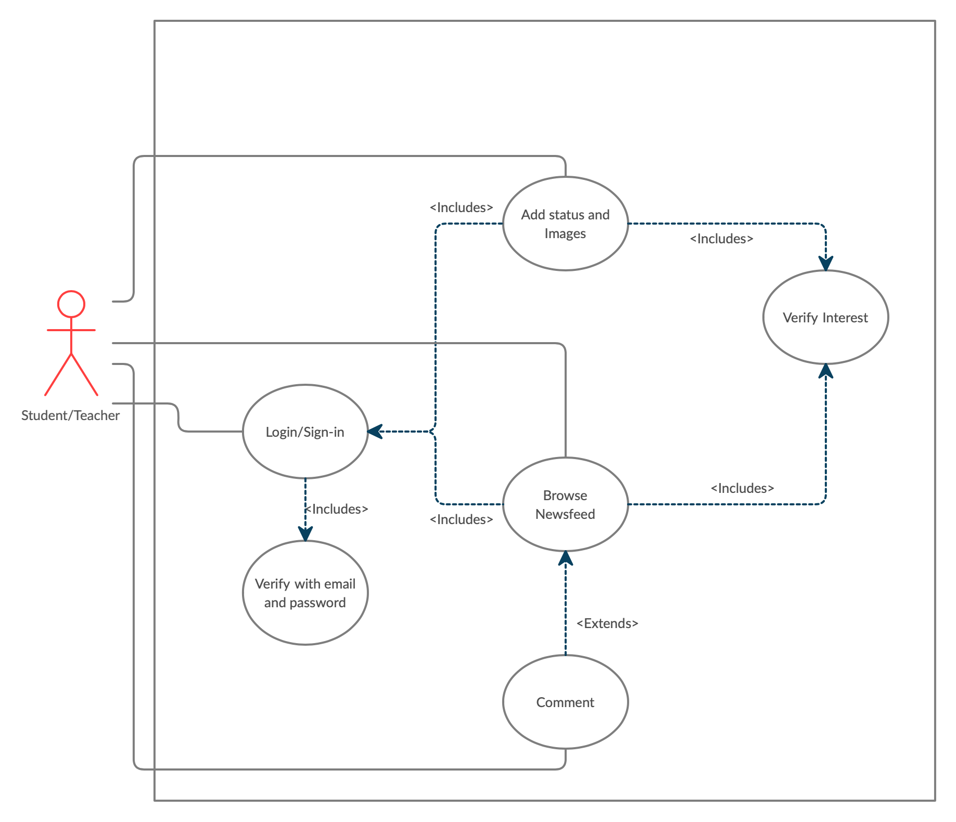
Newsfeed Subsystem(Cont...)

Slide 11
Newsfeed Subsystem(Cont...)
Use-case narrative of “Newsfeed” subsystem
Name: Newsfeed
Priority: High
Primary Actor: User
Precondition: User must login before
Description: User can browse posts of other user based on their own interest. They can also post status and images.

Slide 12
Typical Course of Event
User | System Response
User can post status and images | System will store status on database and show it on news feed.
User can browse other user’s post | Fetch and show posts on the basis of interest.
User can comment on various post | System will update the post on database and show it on news feed.

Slide 13
Profile Subsystem(Cont...)
Use-case Name | Actors
View Profile | User
Manage Profile (Research, About, Info etc.) | User

Slide 14
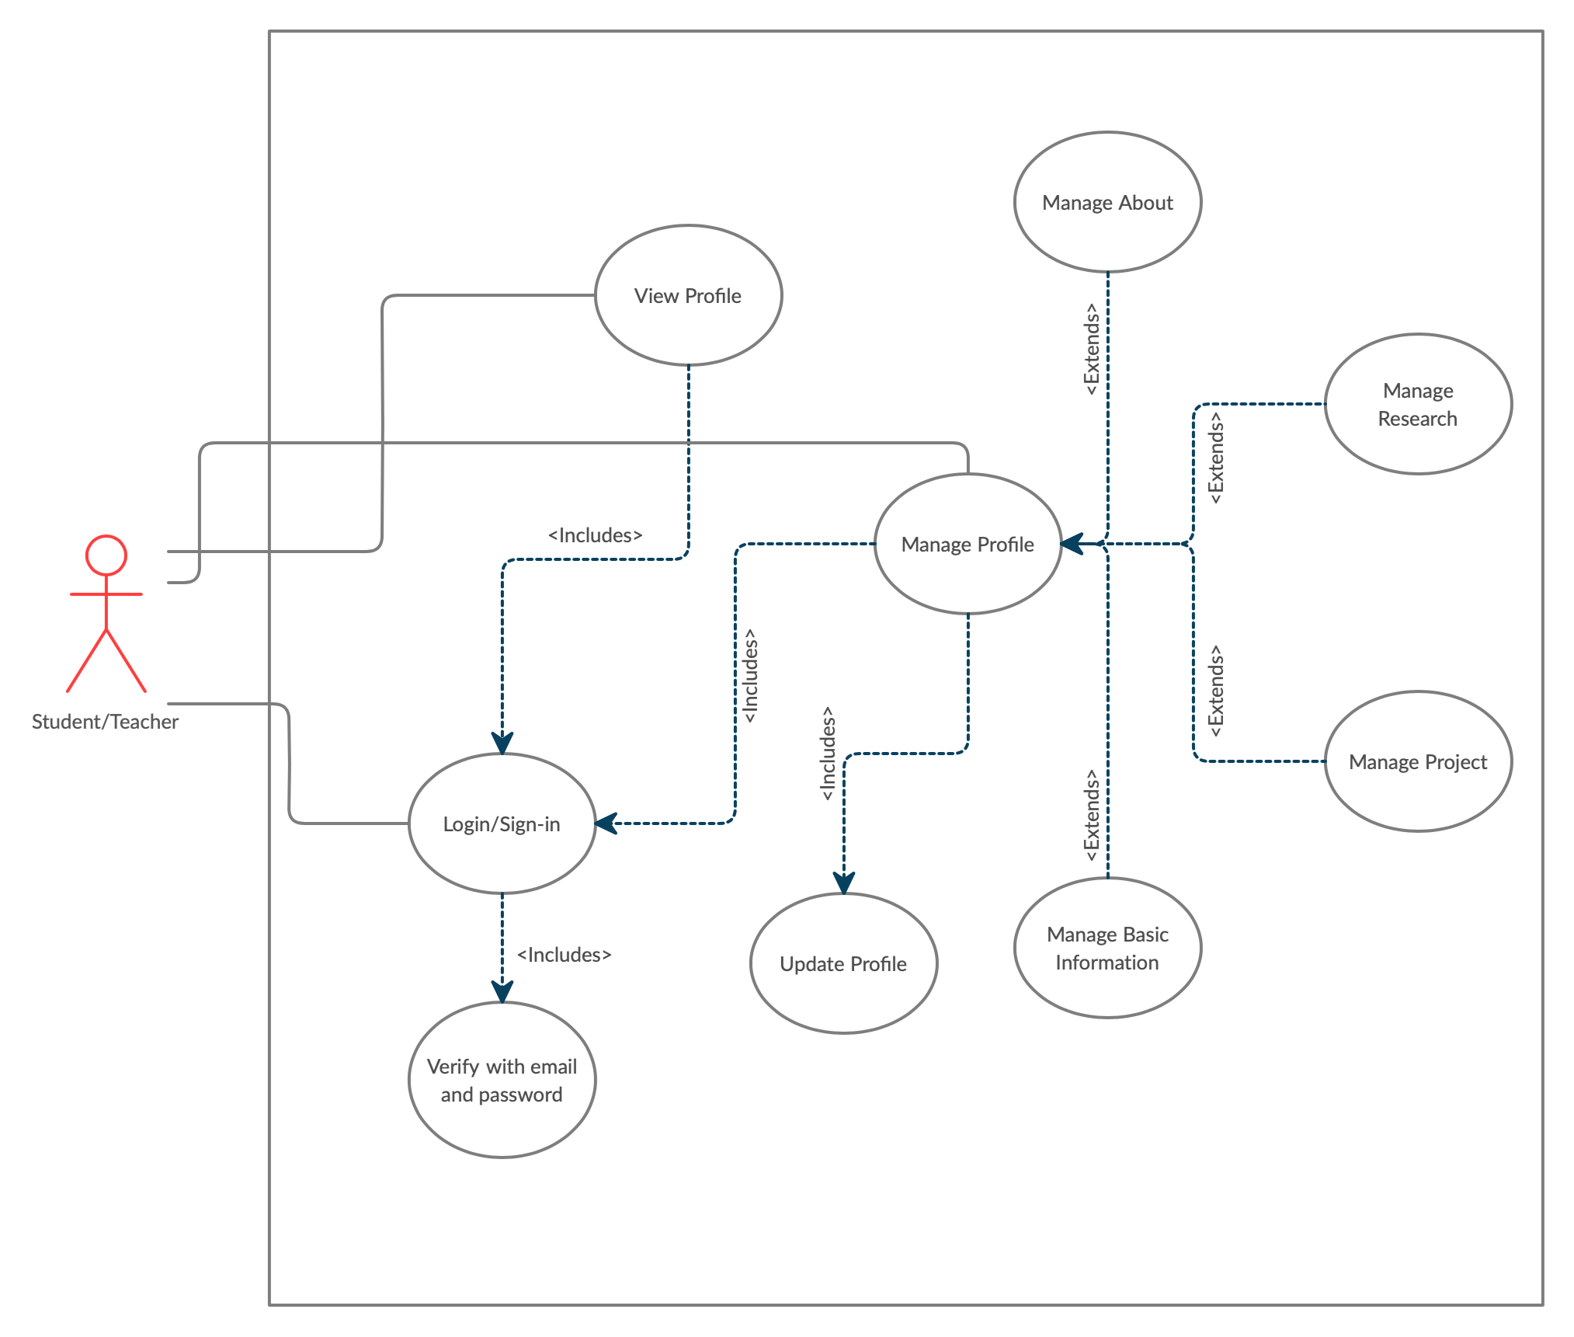
Profile Subsystem(Cont...)

Slide 15
Profile Subsystem(Cont...)
Use-case narrative of “Profile” subsystem
Name: Profile
Priority: High
Primary Actor: User
Precondition: User must login before.
Description: User can showcase their own profile by managing and updating his research, projects, basic informations etc.

Slide 16
Typical Course of Event
User | System Response
User can view profile | Fetch existing data from database and display it on profile page.
User can update his own profile | Update and store new data on database.
User can browse other’s profile | Fetch other’s profile data from database and display it to user.

Slide 17
Alternate Course of Event:
System will display a blank profile if user doesn’t provide information about themselves

Slide 18
Messaging Subsystem
Use-case Name | Actors
View inbox/spam | User
Message content | User

Slide 19
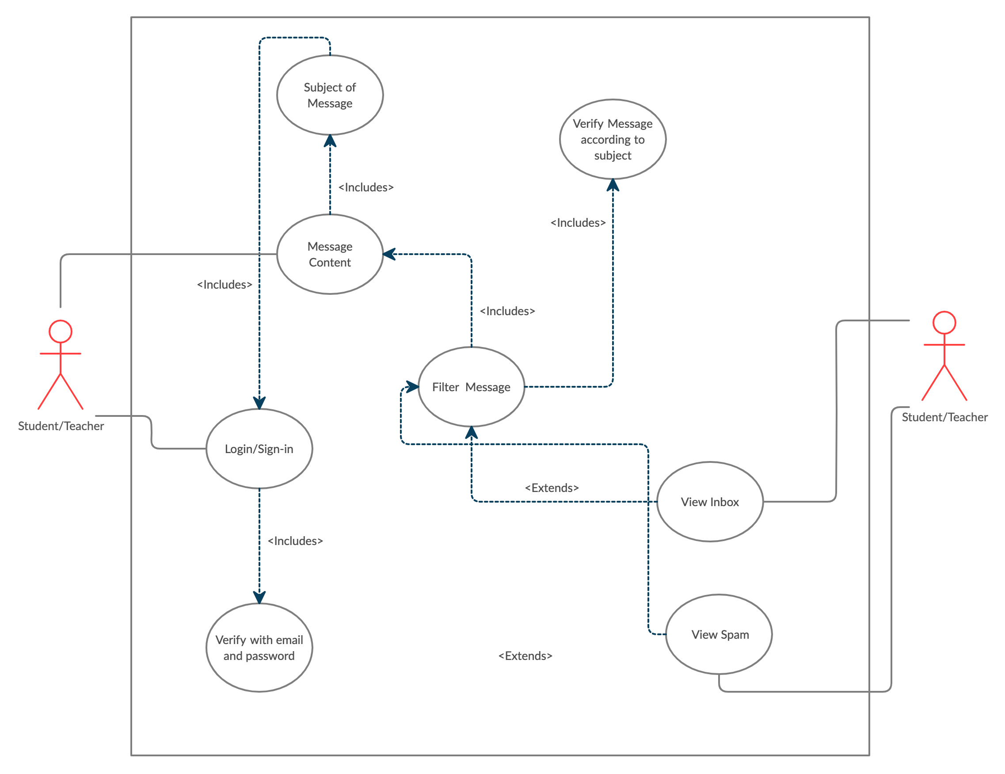
Messaging Subsystem(Cont...)

Slide 20
Messaging Subsystem(Cont...)
Use-case narrative of “Messaging” subsystem
Name: Messaging
Priority: High
Primary Actor: User
Precondition: User must login before.
Description: One user can communicate with another user through messaging

Slide 21
Typical Course of Event
User | System Response
User can set message subject | Received message will be filtered according to this subject.
User can send message | Store in database, broadcast the message and update UI in both user end.
User can pick message from inbox or spam | System will display previous messages.

Slide 22
Alternate Course of Event:
While sending a message an alert will be provided to user if subject placeholder is empty.

Slide 23
Thank you

